Slide 1
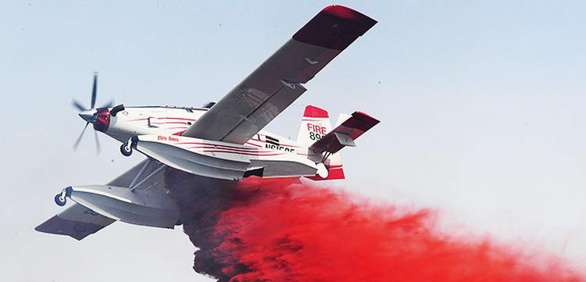
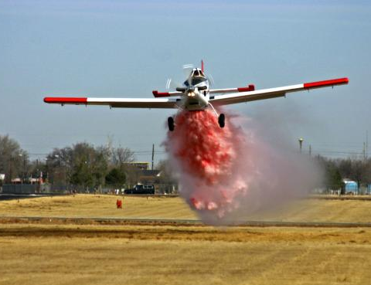
MNDNR FIXED WING TANKER INBRIEF
3/1/17

Slide 2
Of Interest
New DNR Pilot – Steve Day
New Fixed Wing – Dan Olds
New FireCenter Aviation Dispatcher – Anna Hines
Two ATGS (t)
Lee Schaar is back
Hibbing Ramp still bad
Frequency card changes
Area direct helicopter dispatch option
Arctic oscillation is in a positive trend
Its not 2019 anymore

Slide 3
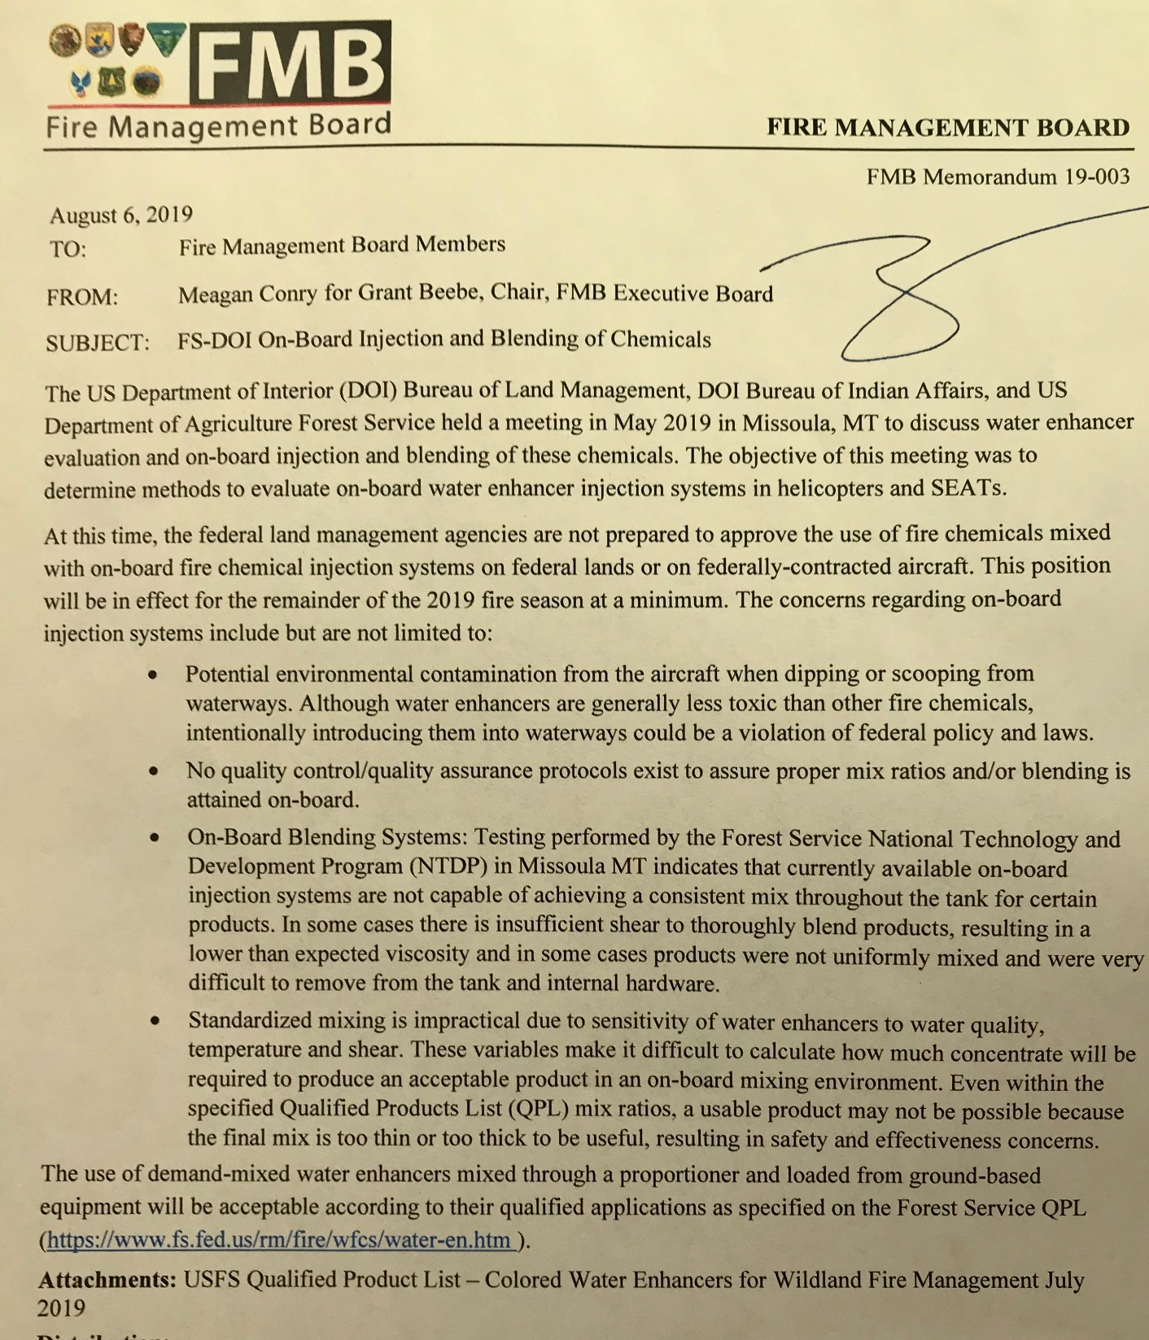
To deal with:
On-board injection is a no-go on fires not under state protection.
Can still ground load.

Slide 4
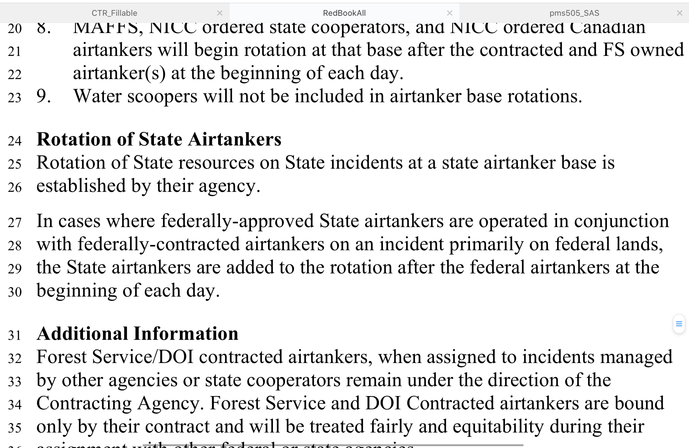
To deal with:
Red Book Language. Cooperator Aircraft.
MNICS Task Force has written a letter requesting a waiver.

Slide 5
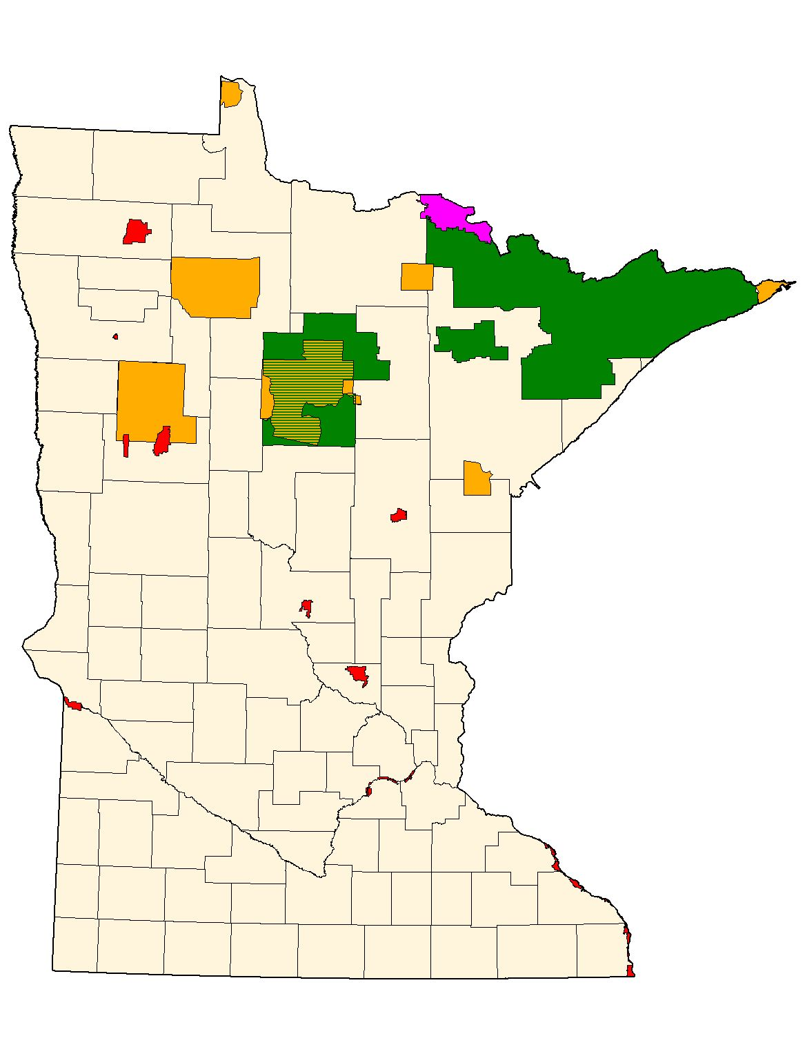
Warroad
USFS
BIA
NPS
FWS
Ely
Grand
Marais
Thief River Falls
Bemidji
Hibbing
Grand
Rapids
Brainerd
Princeton
Anoka
DNR

Slide 6
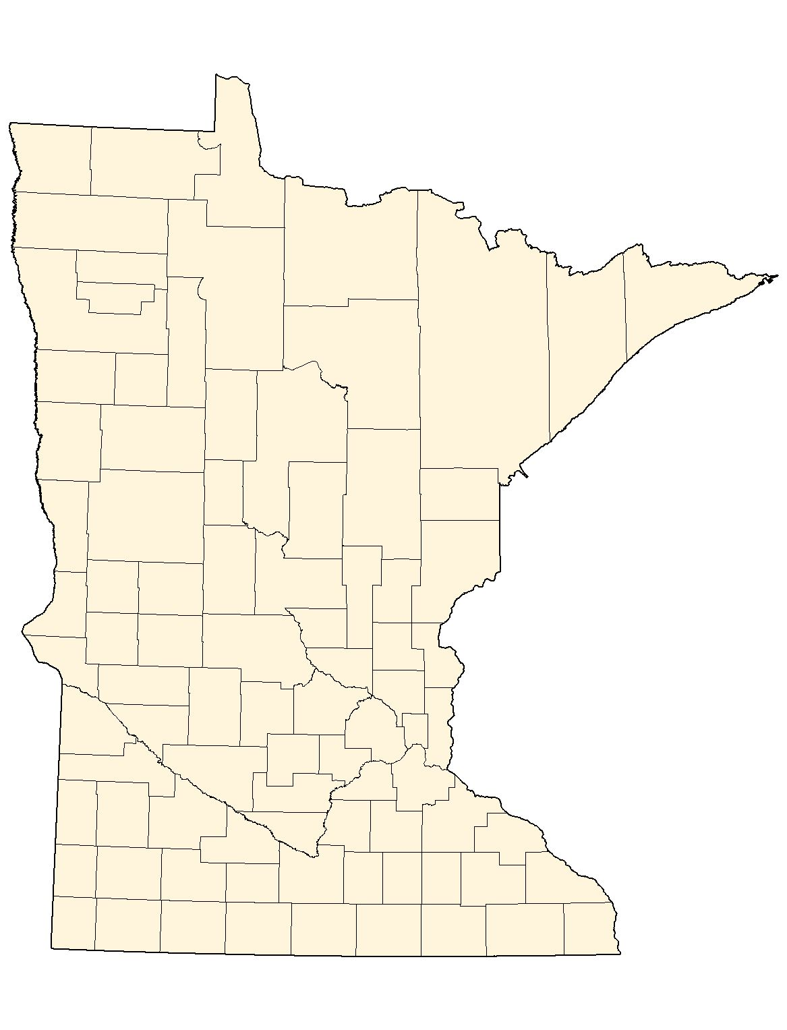
Helibases
Roseau
Ely
Bemidji
Hibbing
Hill City
Cloquet
Brainerd
Sandstone
Princeton

Slide 7
MN DNR Forestry Air Operations
Wildfire Aviation Supervisor
Darren Neuman
Division Aviation Safety Advisor
Darren Neuman
Assistant Wildfire Aviation Supervisor
Matt Woodwick
Helicopter Program Coordinator
Rob Johnson
Fixed Wing Program Coordinator
Dan Olds
Aviation Desk
Anna Hines
Pilots & ATGS
Administrative & Logistical Support
Tanker Base Personnel, NR Technician (Fire)
NR Technicians (Fire)

Slide 8
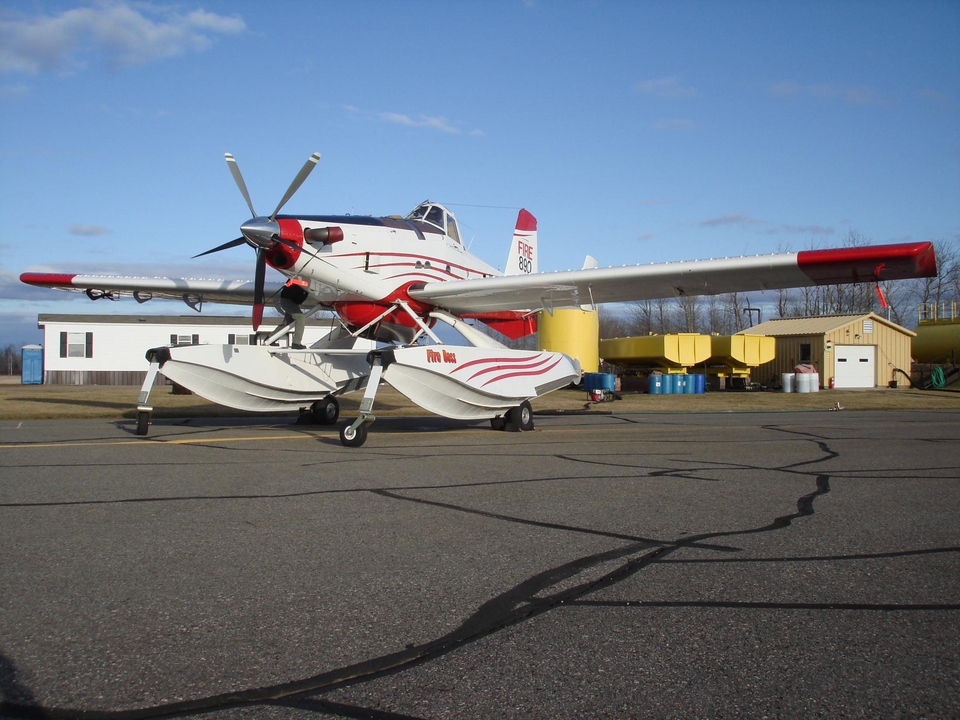
BASE EXPECTATIONS

Slide 9
Behaviors
Harassment, sexual harassment or physical violence of any kind will NOT be tolerated.

Slide 10
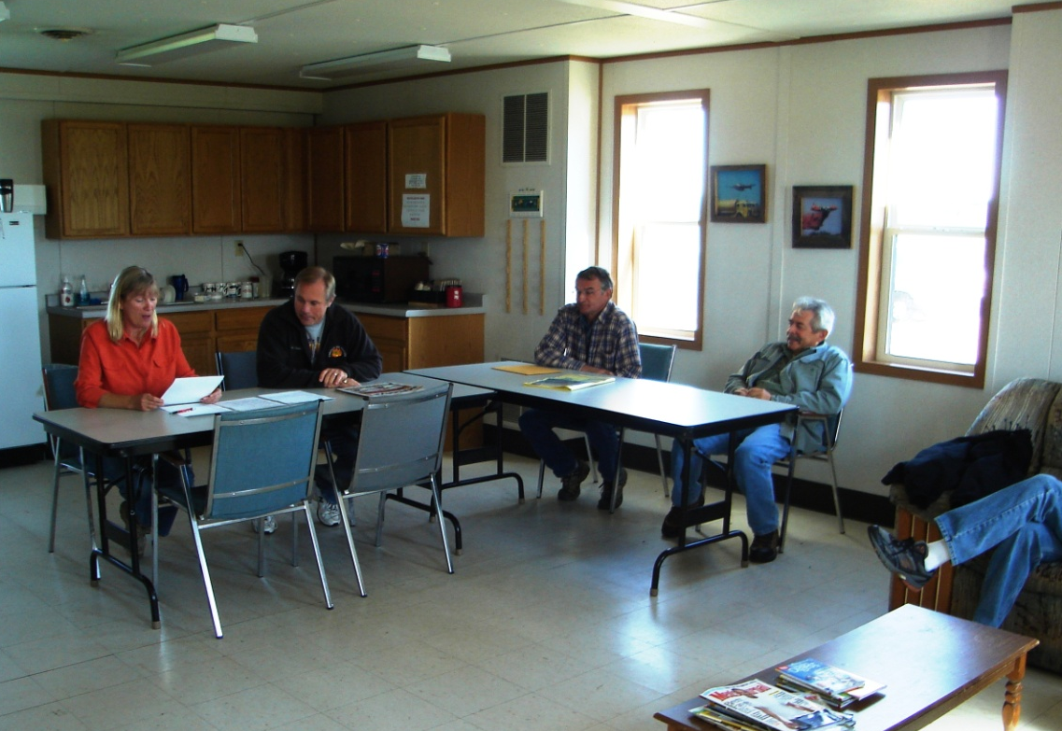
Briefings
Daily morning briefing: Normally at 10:00 am-State bases
Normally at 10:30 am-Bemidji T.B.
Expected to attend
Encourage pilot inputs

Slide 11
State Contract Duty Day
Could be anytime from ½ hour prior to sunrise to ½ hour after sunset-14 hour maximum.
Determined by Fire Center according to staffing guidelines.
Pre-flight (duty day starts) normally at 09:30, flight ready at 10:00 am.
-No Extended Standby in MN.

Slide 12
BIA-Bemidji Contract Duty Day **does not apply to State contracted aircraft based at BJI
BIA will set the duty day for BIA aircraft
-Pre-flight inspection will be done at start of duty day (normally 10:00am).
-Morning briefing starts after pre-flight approximately half hour into the duty day-normally 10:30am
-Extended standby after 9 hours
-Off base lunch determined by BIA
staff according to contract

Slide 13
Alert Status
Off base lunch:
State contract - To be assessed and approved at the discretion of the ATBM or SEMG and the ATGS. Inform the ATBM/SEMG and ATGS when leaving.
BIA aircraft - per contract and determined by BIA staff.
Off base lunch on the State contract will not be common during spring fire season when one hour fuels are cured. Plan to have lunch on base most days.

Slide 14
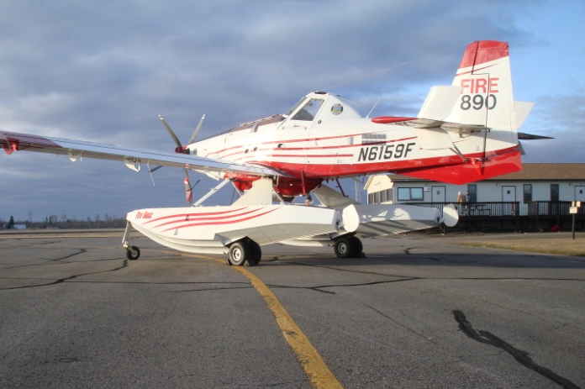
Flight and Duty Limitations
14 hour duty day / 10 hours rest
8 hours max daily flight time
(track individual fire times separate)
42 hours max on 6 day period – day off (36/6)
2 days off in every 14 (minimum)

Slide 15
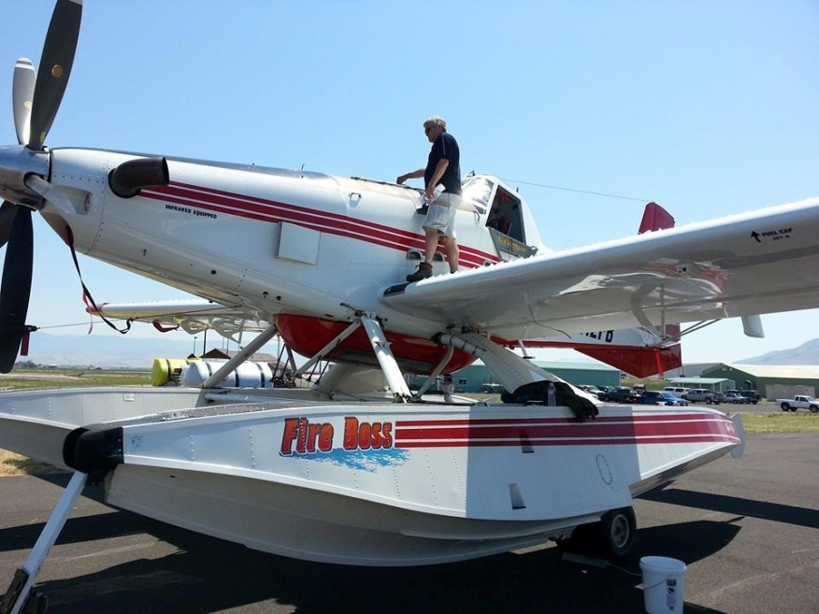
Dispatch Procedures
All dispatch requests will be forwarded to the Tanker Bases by email from the Fire Center.
Tactical Aircraft Request form printed and distributed by Tanker Base Dispatch
Option to forward via email instead of paper
Expected to be launched no more than 15 min. after receipt of dispatch

Slide 16
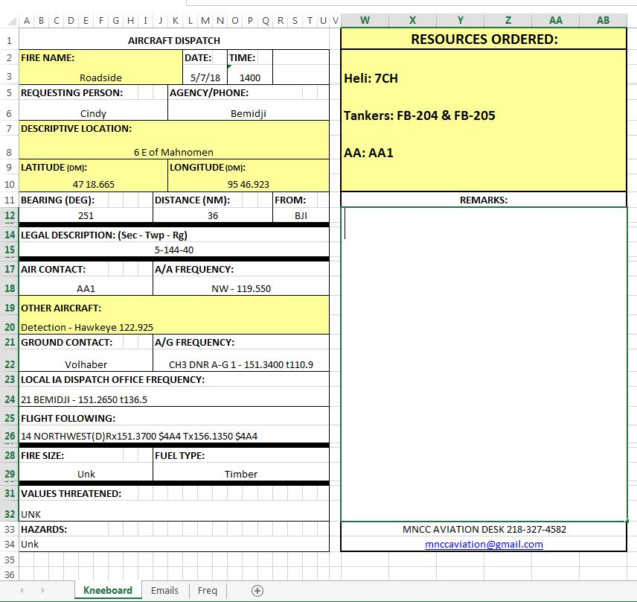
DISPATCH FORM

Slide 17
Call Signs
Fire Center (MNCC Air Desk)
Tanker Base (BRD, BJI, HIB, ELO)
SEAT Base (PNM, RRT)
Red Lake 50 (five-oh)
Air Attack 1 (2,5,6,7,9)
MNDNR Administrative Areas (by name- Bemidji Area)

Slide 18
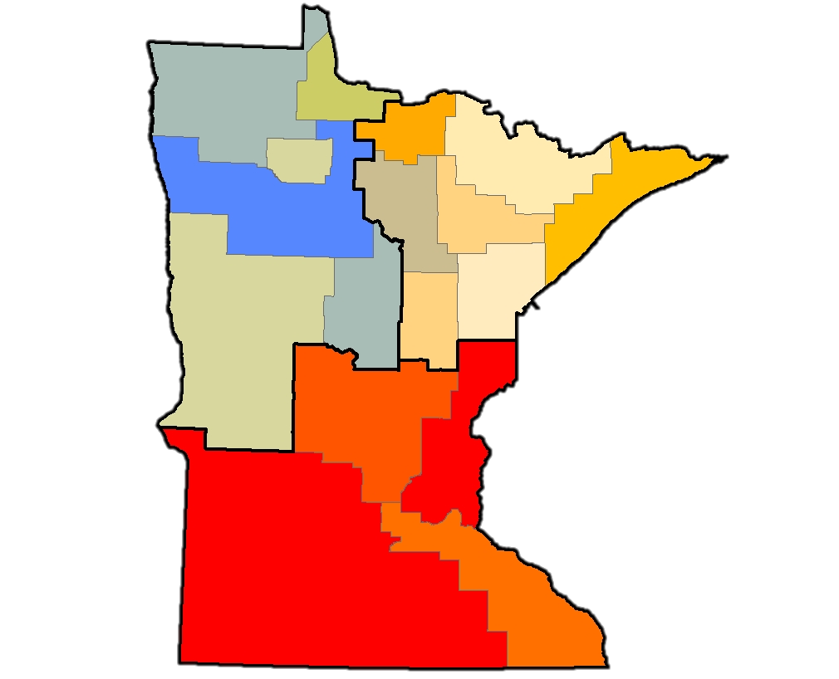
MN DNR Forestry Areas
Warroad
Baudette
Littlefork
Tower
Deer
River
Bemidji
Hibbing
Two
Harbors
Park
Rapids
Cloquet
Backus
Aitkin
Little Falls
Sandstone
Lewiston

Slide 19
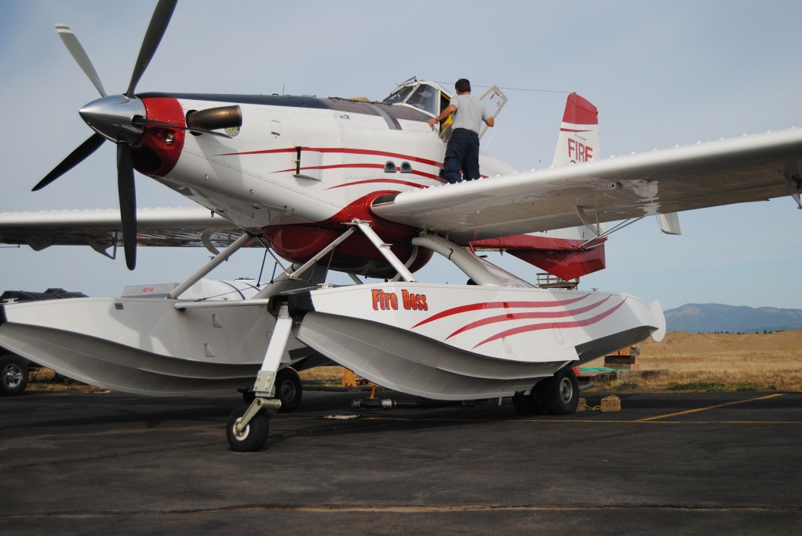
Ramp Procedures
All aircraft movement, operations, maintenance and parking on the ramp to be coordinated with the Ramp Manager.
Vehicle and foot traffic on the ramp to be approved and coordinated through the ramp or base manager.
Ramp frequency: 120.125

Slide 20
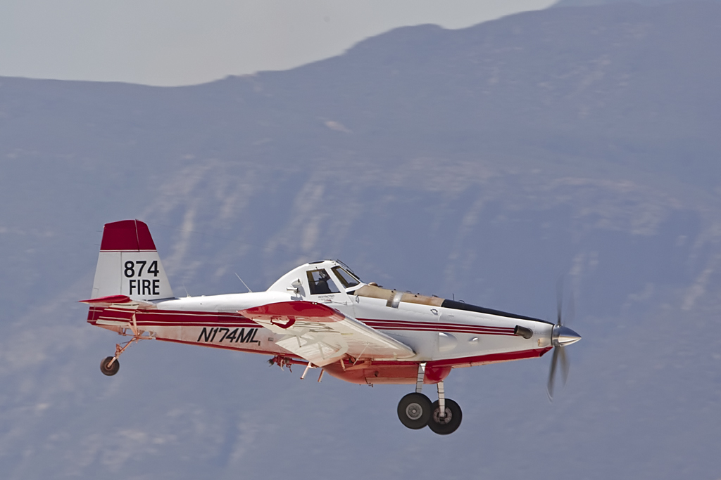
Fuel / Fueling
Contact the Tanker Base (BJI, BRD, HIB, ELO) to request fuel delivery if not self sufficient.
PNM-100LL self service only
RRT-self serve 100LL and JetA

Slide 21
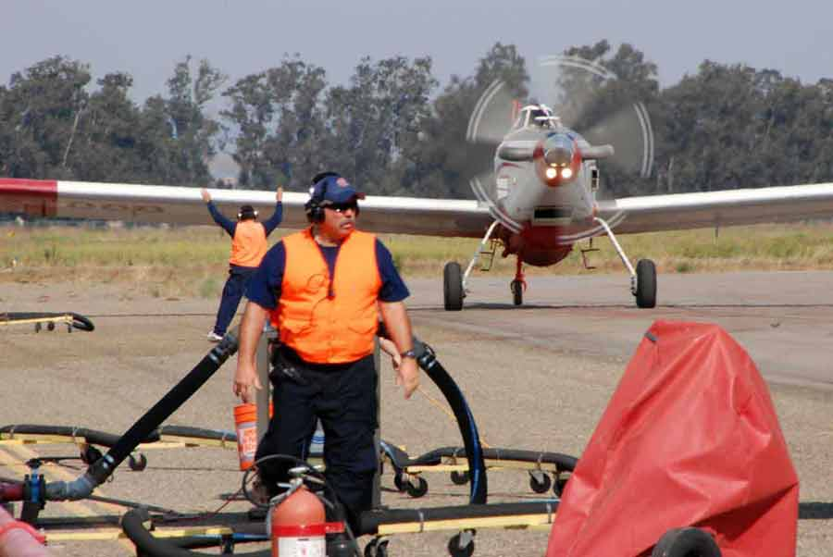
Retardant
Loading
SEATS/FIREBOSS
As per standard SEAT ops . Hot loading permitted. Hot fueling permitted if properly equipped.
Simultaneous loading and fueling NOT permitted.

Slide 22
JETTISON AREAS
WARROAD JETTISON AREA
Describe the jettison area establish for the base: Lat: 48:56.140 Long: 95: 20.716
Descriptive area: NE of Hangar’s along the tree line in the grass.
THEIF RIVER FALLS JETTISON AREA
Describe the jettison area establish for the base: Lat: 48: 03.9’ Long: 96: 11.1
Descriptive area: Jettison area is located west of the runways inside the perimeter of the fence.
PRINCETON JETTISON AREA
Describe the jettison area establish for the base: Lat: 45:25.980 Long: 93: 43.020
Descriptive area: Off airport on state land.
MORA JETTISON AREA
Describe the jettison area establish for the base: Lat: 46: 09.886 Long: 93: 11.862
Descriptive area: Off airport on state land.
HINKLEY JETTISON AREA
Describe the jettison area establish for the base: Lat: 45:56.259 Long: 92: 48.121
Descriptive area: Off airport on state land.
DETROIT LAKES JETTISON AREA
Describe the jettison area establish for the base: Lat: 46: 43.218 Long: 95: 48.344
Descriptive area: Section 36 of Lakeview Twp. TWP 138 Rng 41 Sec 36. Note: Adhere to the 300' buffer for lakes, wetlands, creeks & rivers.
ANOKA JETTISON AREA
Describe the jettison area establish for the base: Lat: 45: 19.97” Long: 93: 07.08”
Descriptive area:Upland grass field Carlos Avery Wildlife Refuge. Note: Adhere to the 300' buffer for lakes, wetlands, and rivers creeks & rivers.
BEMIDJI JETTISON AREA
Describe the jettison area establish for the base: Lat: 47 :22.583 Long:95 : 07.783
Descriptive area: 16-145-35
HIBBING JETTISON AREA
Describe the jettison area establish for the base: Lat: 47 : 13.850 Long: 92 : 51.950
BRAINERD JETTISON AREA
Describe the jettison area establish for the base: Lat: 46 : 36.360 Long: 94 : 02.500
List of 10 approved jettison areas included in pilot briefing pkt.
Each has a Lat/Long.
Some have a descriptive advisory.
Some have aerial photos
Recommend entering as waypoints-GPS or iPad

Slide 23
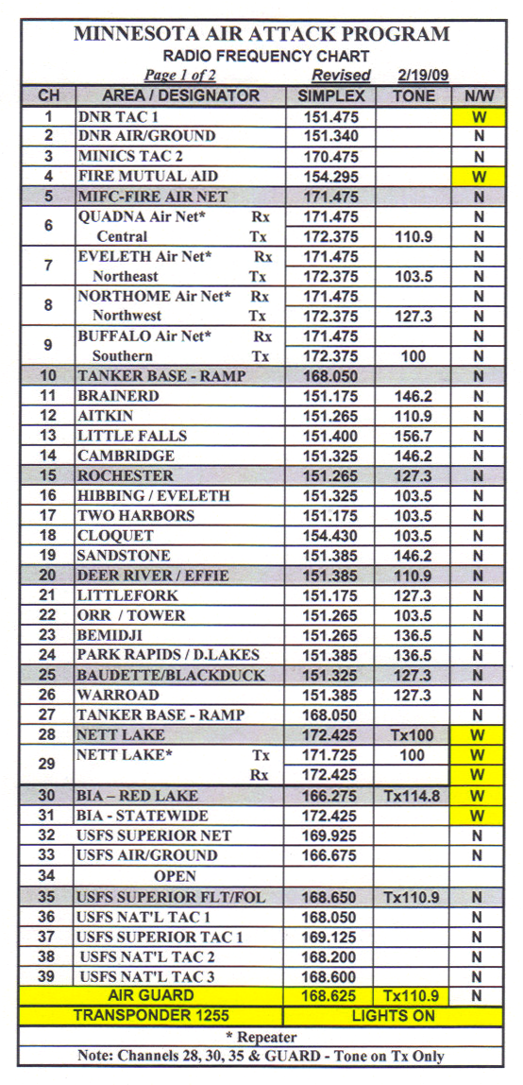
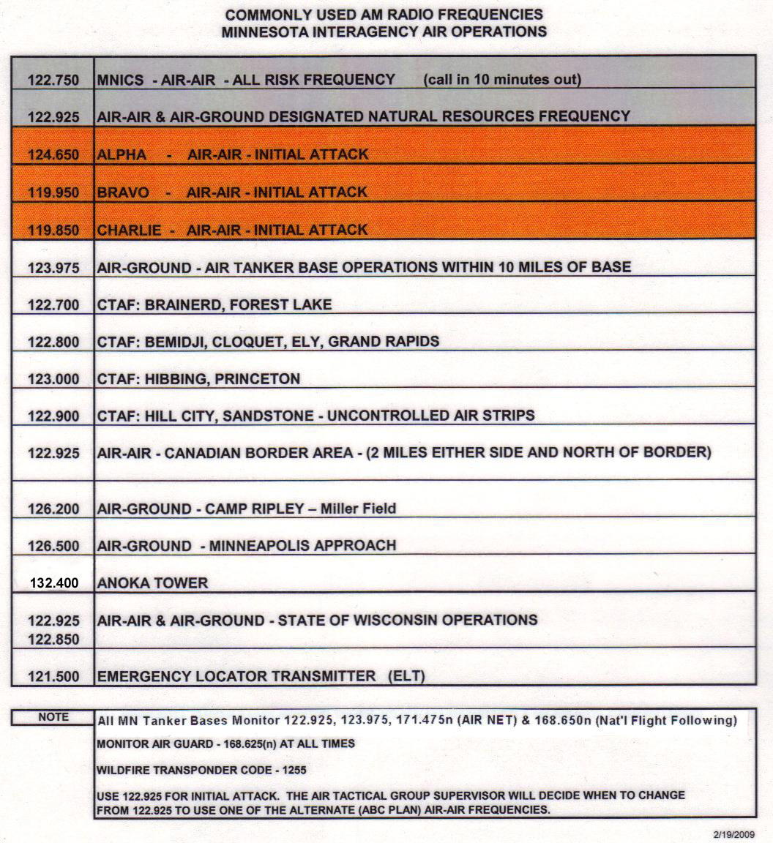
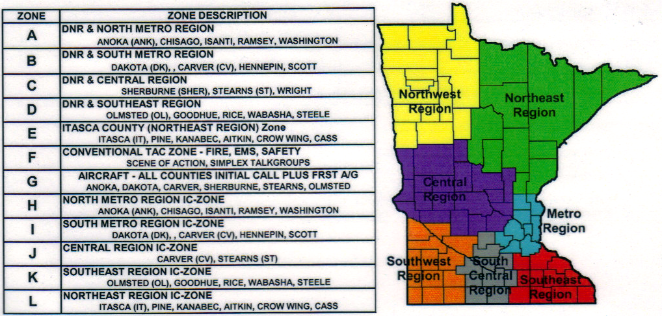
COMMUNICATIONS PLANS

Slide 24
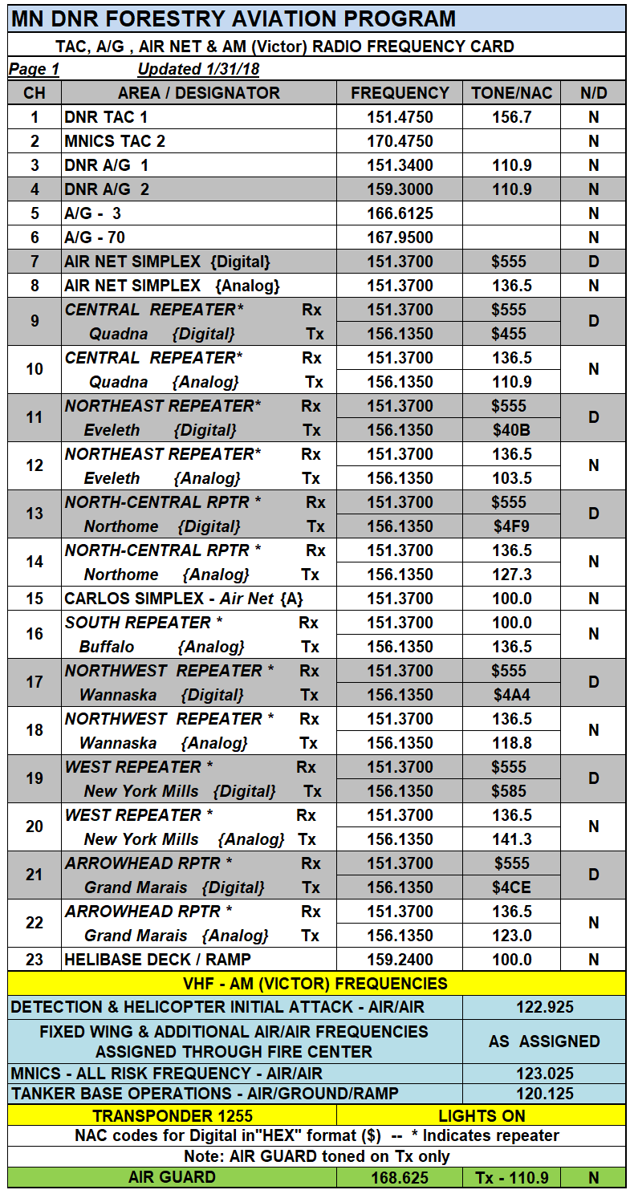
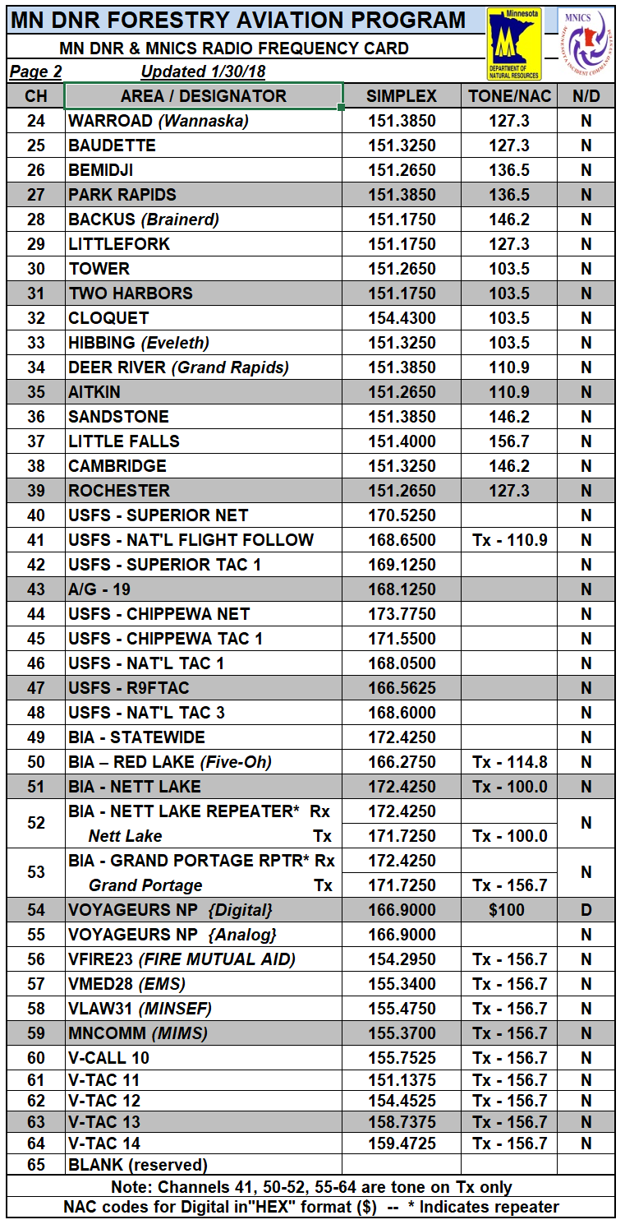
Air Attack Plan (FM/AM)
Air-to-Ground
Communications
VHF-FM
VHF-AM
Detection and
IA Helicopters
122.925
________________
**Fire Incidents
Air/Air
to be assigned at time of dispatch

Slide 25
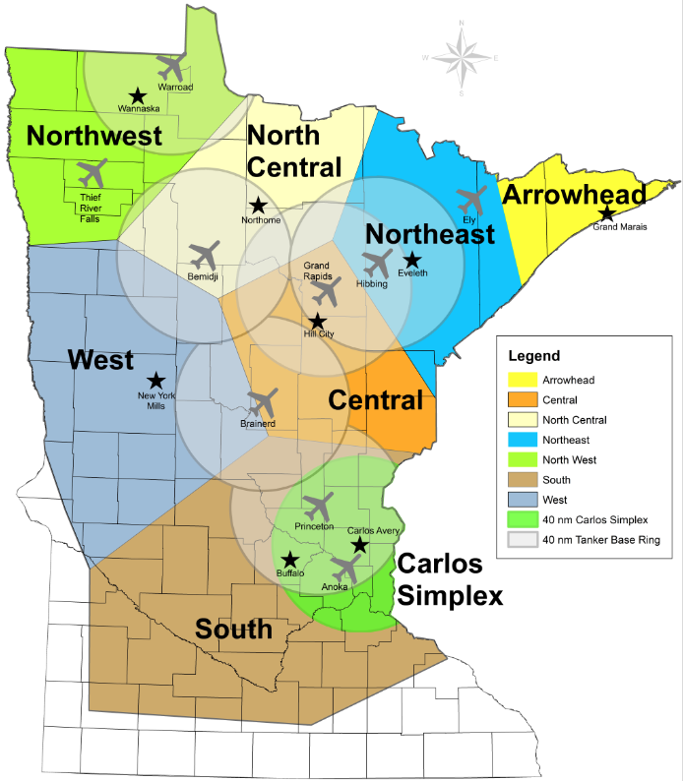
MN DNR Fire
Air Net
Repeater Locations and
Simplex Circles
A kml file for overlay on
ForeFlight will be available for download.

Slide 26
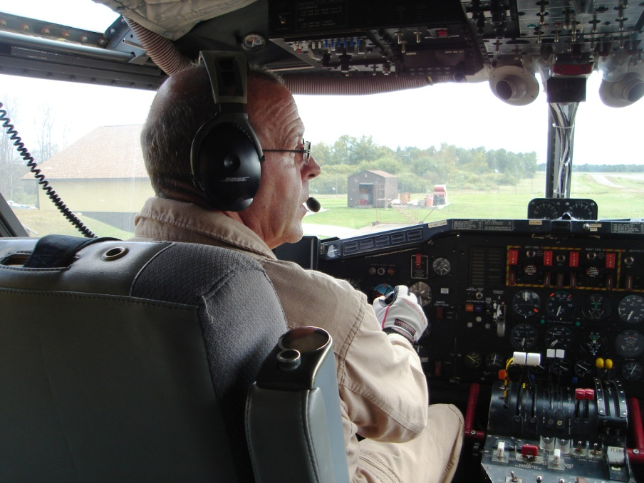
Radio Checks
Do a complete radio check with Air Attack/SEMG/Tanker Base at startup
Check tones, narrow banding, etc
Check Guard
Air Net and Air Net repeaters

Slide 27
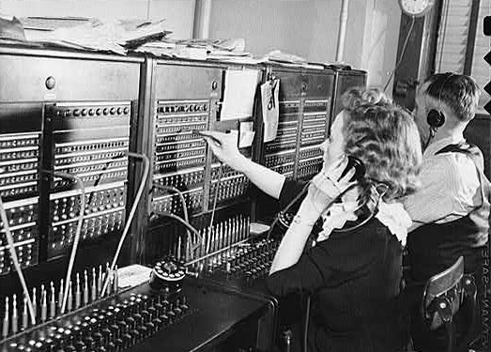
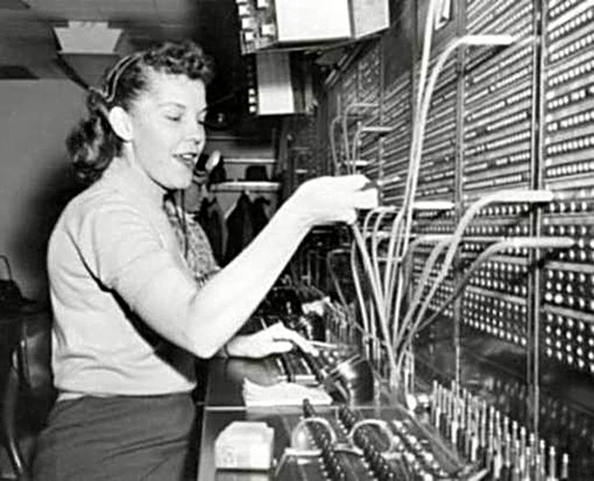
FLIGHT FOLLOWING
FLIGHT FOLLOWING COMMUNICATION IS WITH FIRECENTER

Slide 28
Flight Following Fixed Wing Aircraft
Flight following will be accomplished with AFF.
Communicate directly with “Fire Center” on appropriate AirNet repeater
Initial call when airborne (Flight Following Vitals)
Identifier/call sign
# on board
Hours of fuel
ETE
Destination or Fire name
Confirm AFF

Slide 29
Flight Following Fixed Wing Aircraft
After making contact with the fire (ATGS or IC), the pilot will contact “Fire Center” on the appropriate AirNet Repeater to inform they are in contact with the fire and will flight follow local.
The Fire Center will continue to track the aircraft on AFF

Slide 30
Flight Following Fixed Wing Tankers
Load and return - Pilots will contact “Fire Center” on the appropriate AirNet repeater to inform load and return.
Release - Upon release from the fire and Fire Traffic Area, the pilot will contact “Fire Center” on the appropriate AirNet Repeater with their intentions to return to base and hold.

Slide 31
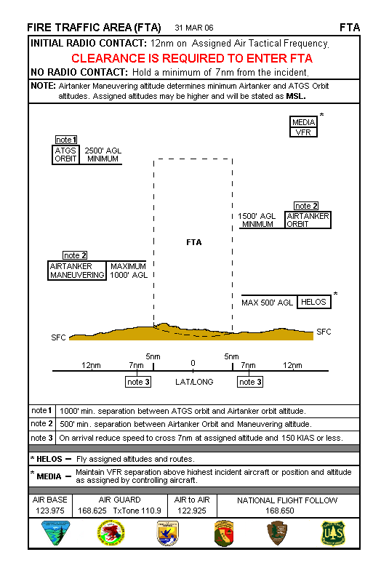
Fire Traffic Area
12nm+
Initial call – Call sign
Distance
Location
Altitude
7nm
No entry unless: Clearance
Commo
Comply
Close out with
“Fire Center” when in contact
with Air Attack or the fire

Slide 32
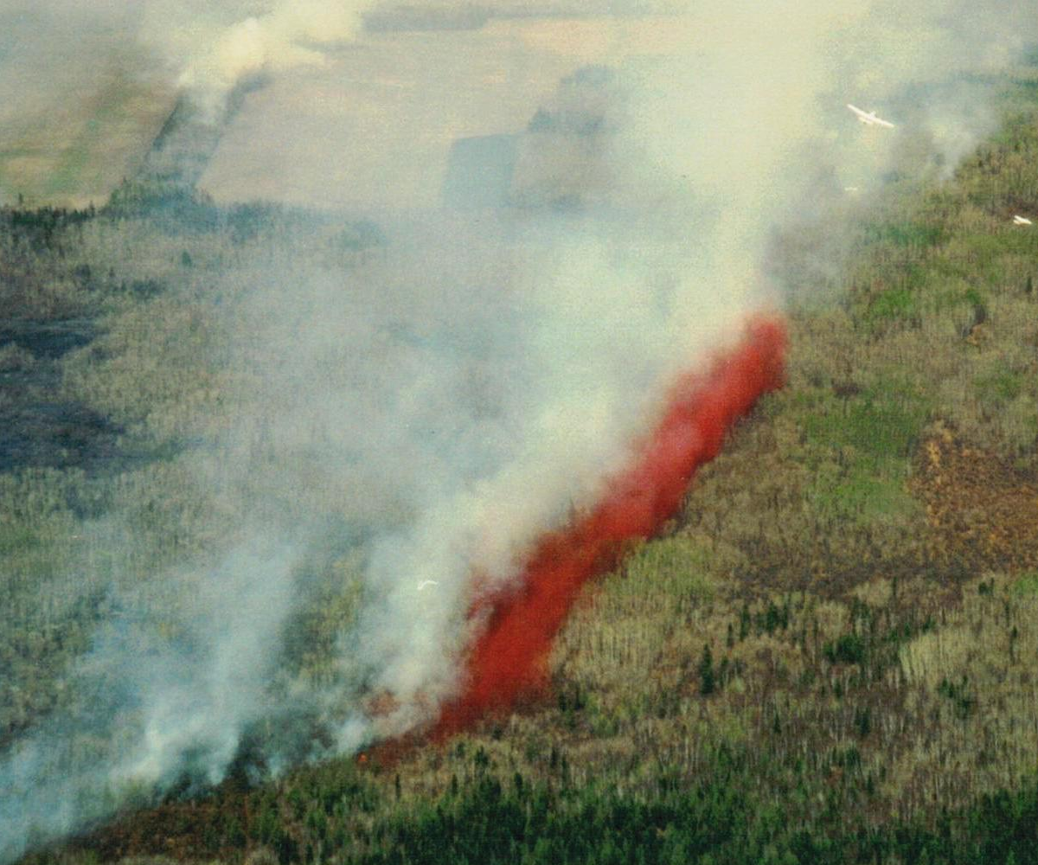
Tactical briefing
To include:
- Orientation to the fire
- Objective
- Coverage level
- Portion
- Turn out - if needed
- Specific hazards
- Clearance to maneuver
- Line is clear
- Clearance to drop

Slide 33
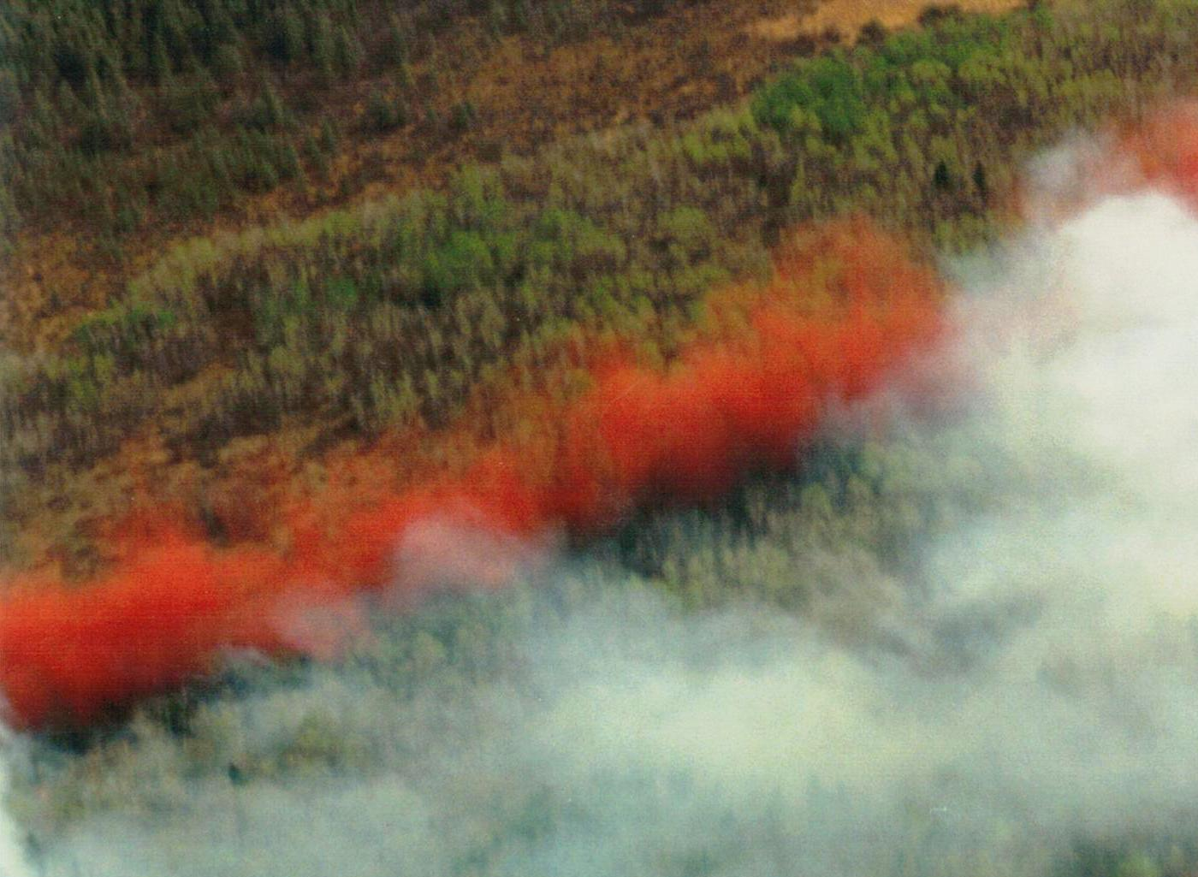
Drop Evaluation
Load placement
-Line
-Start/stop
-Drift
Load and return or return and hold

Slide 34
Blazetamer
Application – ATGS will call for Blazetamer as appropriate (and if allowed by the host agency) prior to starting scooping operations.
Concentration
Default concentration will be set for approximately 0.3% with a second push of the button making 0.6%.

Slide 35
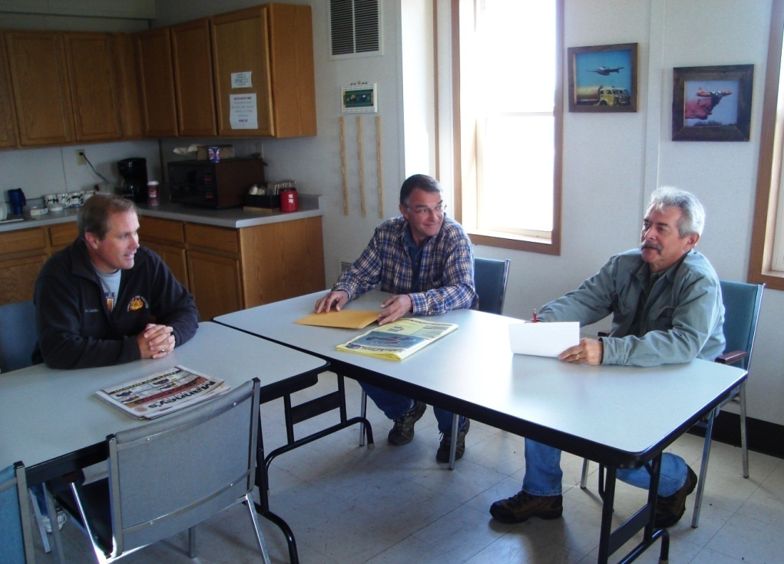
Debriefings
Will be done by the ATGS after every fire as soon as practical.
Expected to attend and encouraged to give candid observations.

Slide 36
UAS (DRONE) INTRUSION
REPORTED UAS INTRUSION PROTOCOLS
Incident aircraft will immediately disengage
ATGS will coordinate disengagement (if assigned)
Designate and assign aircraft to holding areas and flight altitudes or return to base or nearest airport
Assess/manage tanker fuel situation
Coordinate with Dispatch and IC
Remain disengaged until reported all clear
ATGS will coordinate re-engagement when safe

Slide 37
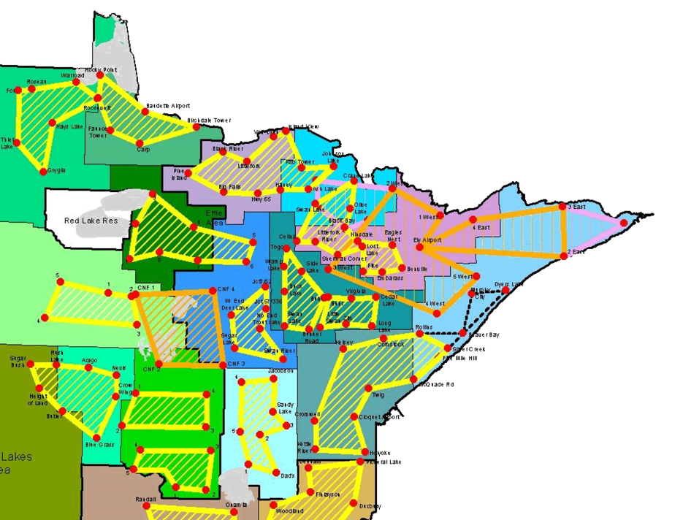
Detection Aircraft
A pilot and aerial observer fly a predetermined route over a large area to locate fires from the air.
Detection is often the first aircraft over the fire and are typically found
at 2500-3500 MSL on 122.925

Slide 38
Initial Attack without ATGS
The following procedures are recommended:
Establish communications with the IC on the assigned A/G frequency
Fly a high level (1000’ AGL) recon to size up fire
Relay your size up to the IC on the A/G frequency
Relay size up to “Fire Center” on AirNet repeater
Coordinate with the IC to form a suppression plan
Confirm that the line is clear/clear to drop
If requested to scoop, determine INV species

Slide 39
Infested Waters Procedure
UTILIZE INFESTED WATERS OR NOT??
Questions to ask:
-If I don’t use this water, is loss of life or property likely?
If yes, use the infested lake.
If no, do not use the infested lake.
-Is there a non infested lake within a reasonable distance?
-Can I contain the fire using a farther, non-infested source?
If yes, do not use the infested water.
If no, use the infested water.
*If infested water was used and requested for another fire, notify Fire Center and ask for guidance.

Slide 40
INFESTED WATERS AVENZA MAP
KML for ForeFlight available. KMZ for GPS available.

Slide 41
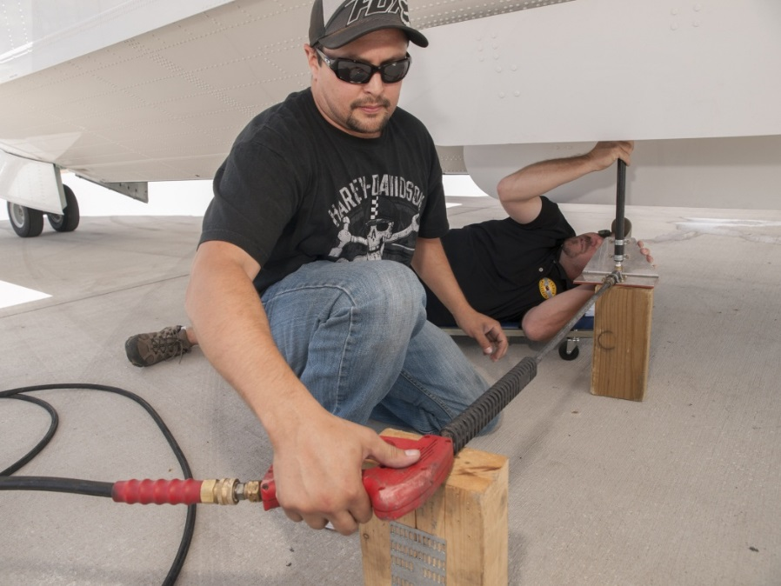
Infested Lakes
For Plants, visually inspect the aircraft. Pick off any plant material and discard on high ground.
For Animals, drain the floats, pressure wash the tank and floats with 140° water thoroughly.
Allow to dry for 24 hours
if feasible

Slide 42
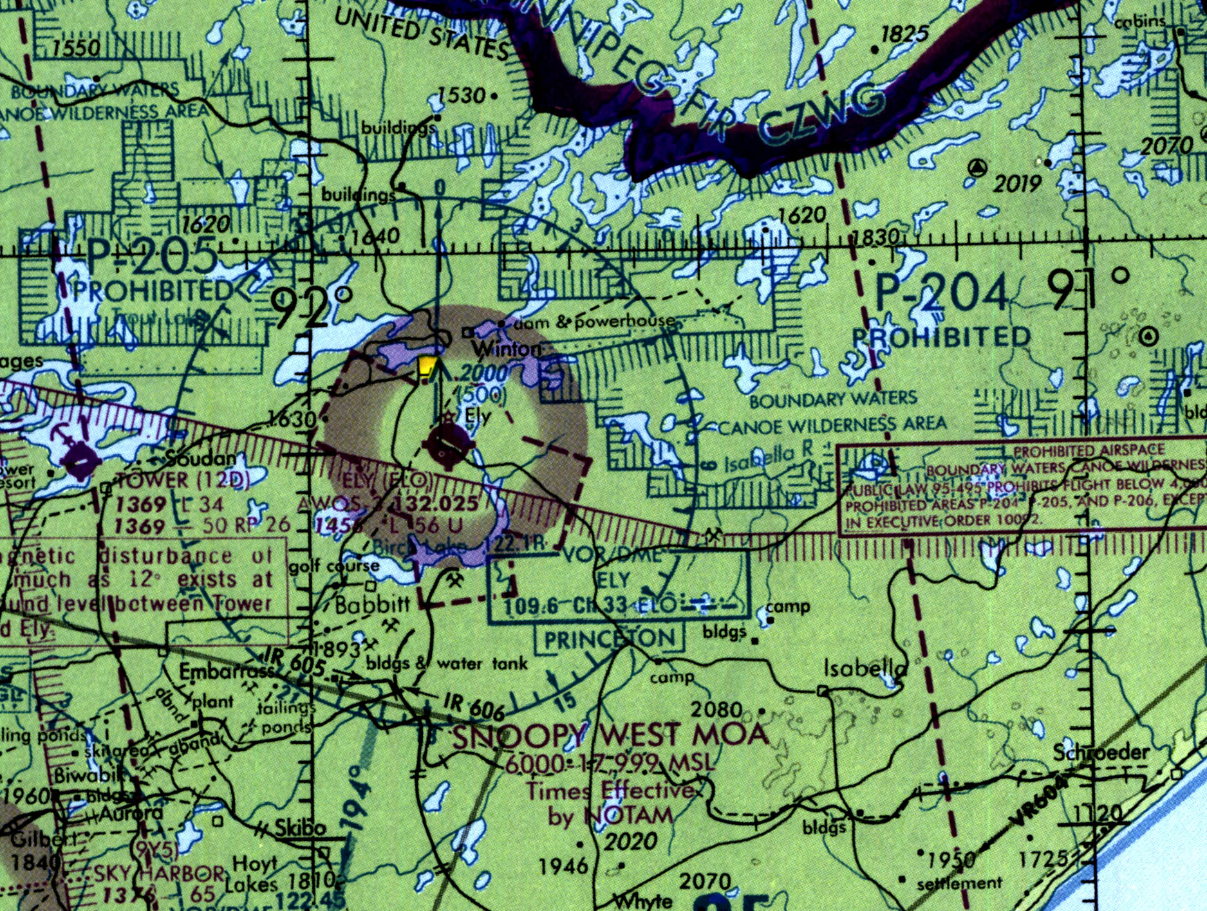
SPECIAL USE AIRSPACE

Slide 43
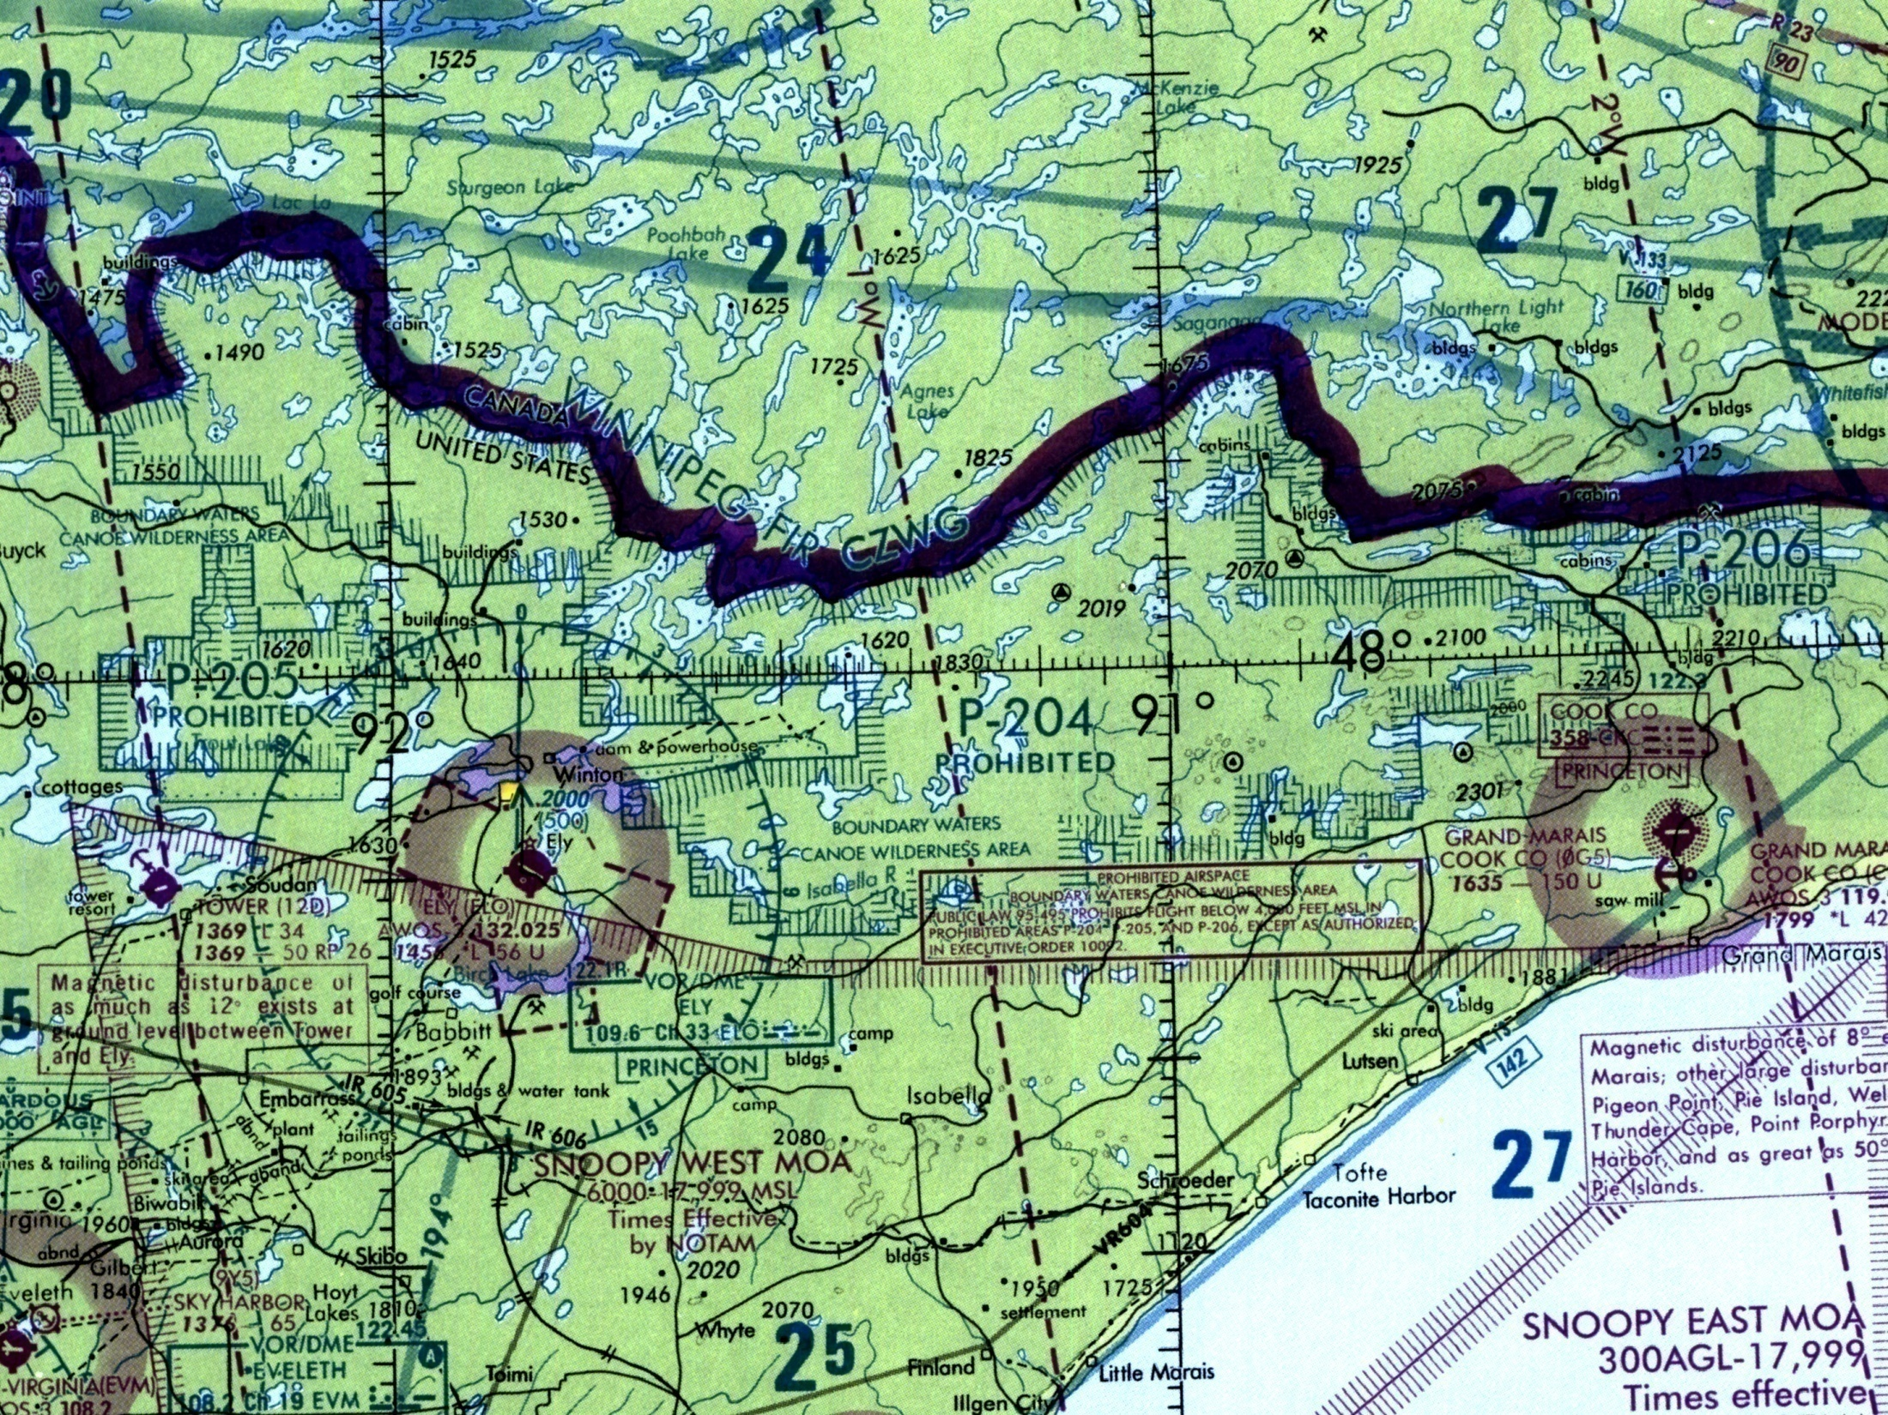
Prohibited Areas Boundary Waters Canoe Area (BWCA)
P-204, P-205, P-206
Flight prohibited under 4000ft. MSL unless authorized by USFS for firefighting aircraft.

Slide 44
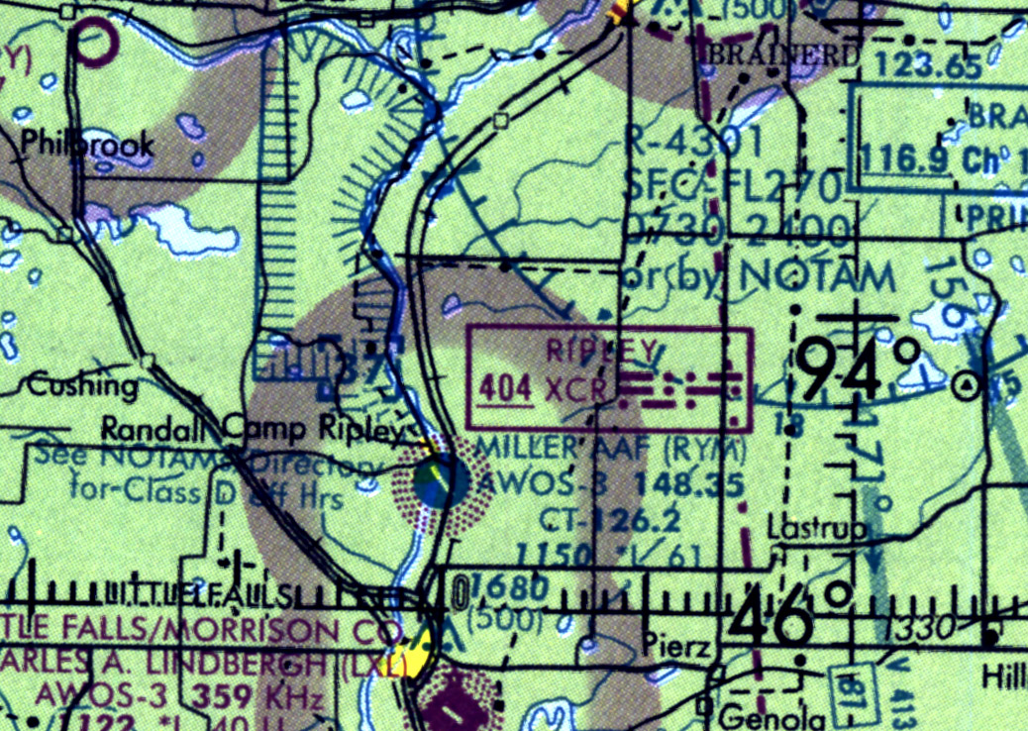
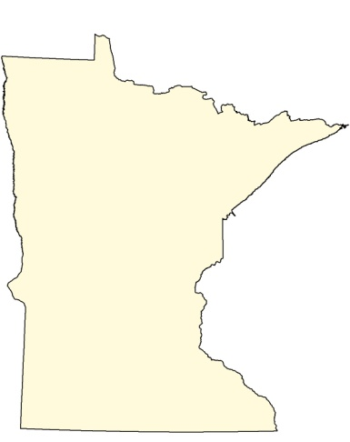
Restricted Area Camp Ripley
R-4301, Artillery
0730-2400 or by NOTAM
Must be cleared to fly through,
Miller Tower 126.2,
or call Mpls. Center

Slide 45
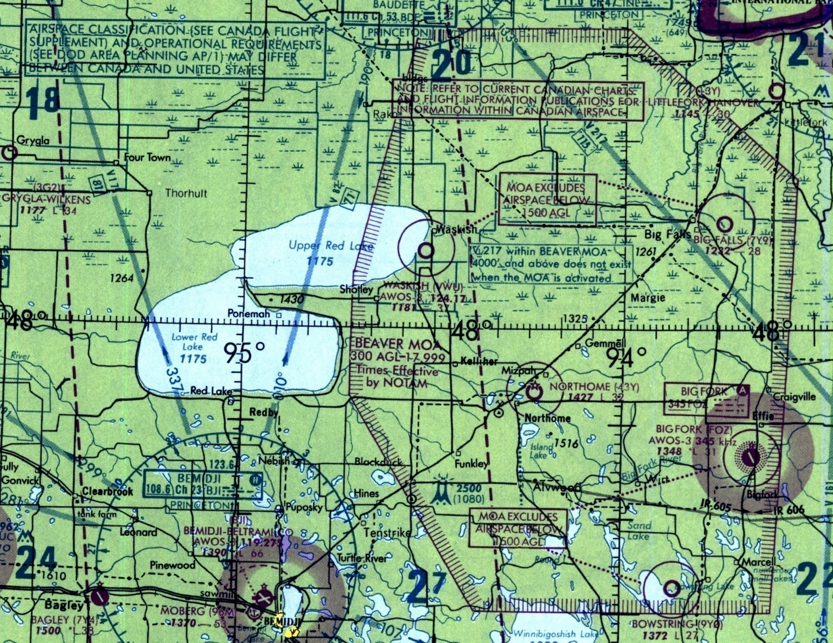
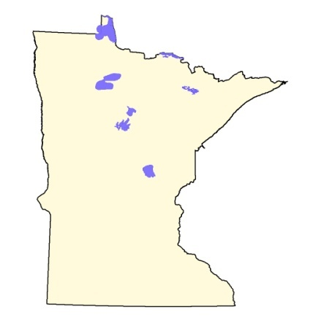
Beaver MOA
300 AGL – 17,999

Slide 46
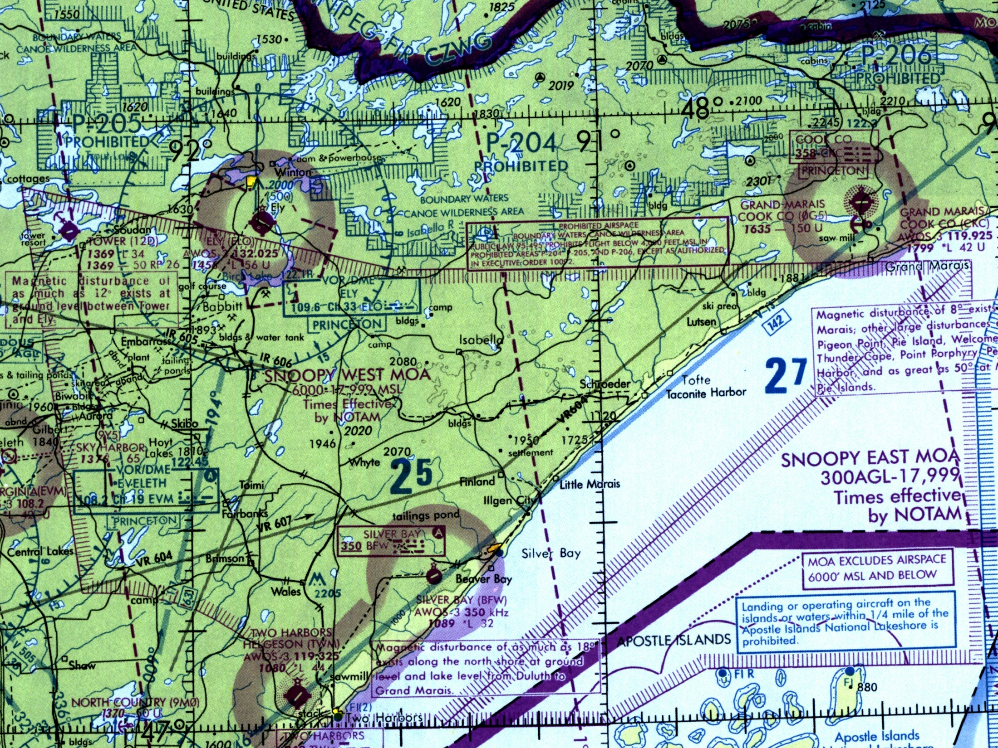
Snoopy West / East MOA
Snoopy West
6000 – 17,999 MSL
Snoopy East
300 AGL – 17,999

Slide 47
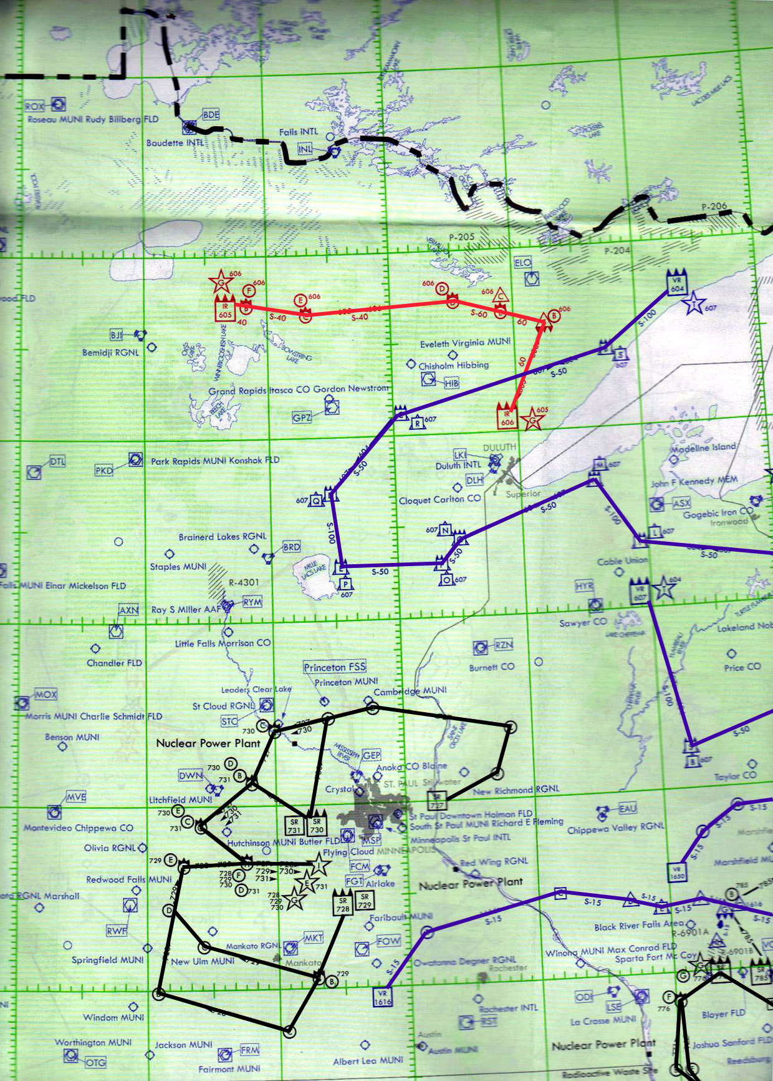
MTRs
IR605 / IR606
There are three primary
MTRs in Minnesota.
Status is updated daily as noted on Aircraft Status
Report
Aviation Desk can deconflict airspace if needed
VR604 / VR607
Aerial Refueling
Routes

Slide 48
IRON MINE BLASTING TFR’S
Numerous mines from Grand Rapids, ENE for about 75 NM to Ely/Babbitt.
Large scale blasting occurs frequently.
TFR’s are routinely placed over mines when a blast is planned.
TFR’s are generally short term, 2 hours, usually during late morning to midday, and are usually surface to approx. 5,000’ MSL.
TFR’s are briefed at the morning briefing, listed on the aircraft status report, and found on ForeFlight.

Slide 49
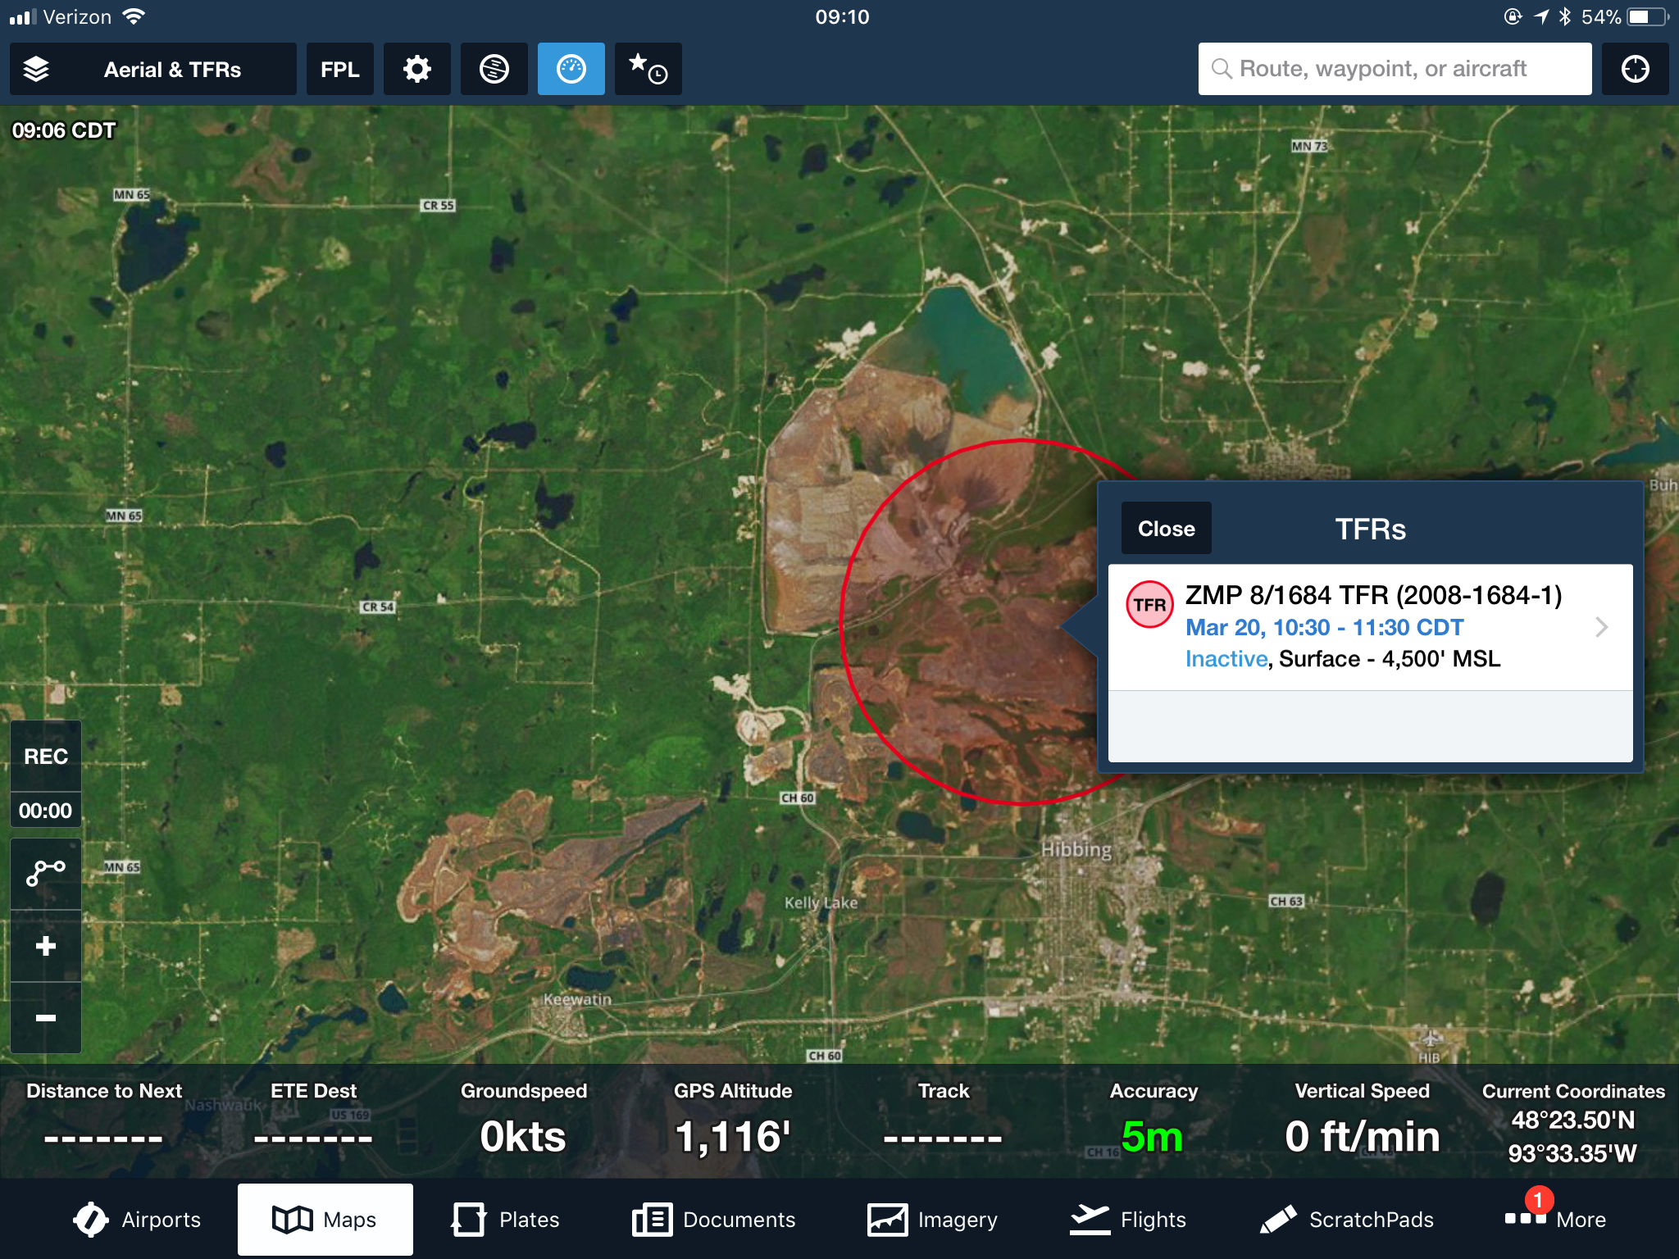

Slide 50
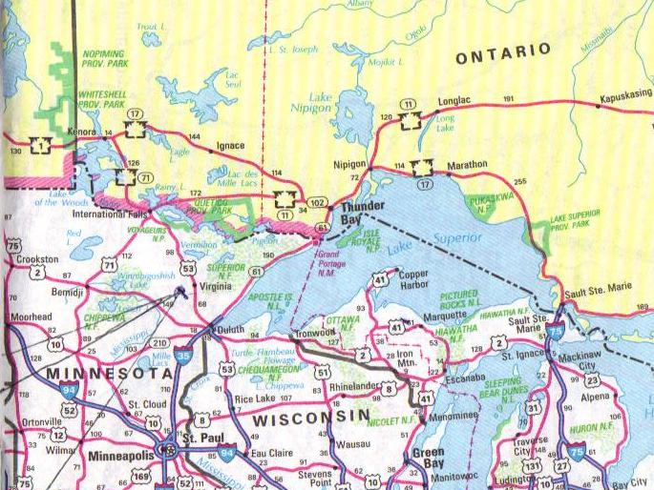
BORDER OPS

Slide 51
US / Canadian Border Issues
122.925 is a dedicated frequency 7 miles either side of border
Border Patrol / Airbust
Unmanned Aircraft Systems (UAS)
Quickstrike Agreement

Slide 52
Border Crossing Procedures
The Air Desk at MIFC will:
Call Minneapolis Center Watch Desk (FAA), Customs and
Border Protection, and AMOC with aircraft and flight info.
Provide aircraft and pilot information to the requesting
dispatch office.
Canadian fire agency will advise US aircrew:
Where to land for fuel
Confirm CBSA has been advised and clearance to land
has been obtained

Slide 53
Pilot’s Responsibilities
Quickstrike:
Pilots do not need to file a flight plan
Contact Fire Center with flight information
Prior to crossing the border, ensure aircraft will squawk the frequency assigned by the FAA

Slide 54
Pilot’s Responsibilities
Pre-positioning
Pilots need to file a flight plan
Contact Fire Center with flight information
Prior to departure, pilot should contact CANPAS and eAPIS with aircraft and pilot information
Prior to crossing the border, ensure aircraft will squawk frequency assigned by the FAA

Slide 55
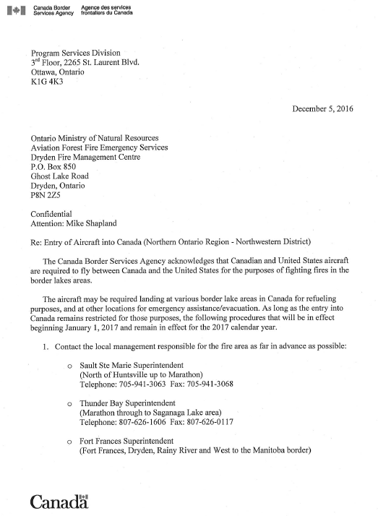
Canadian Customs
Letter
For placement in the Tanker

Slide 56
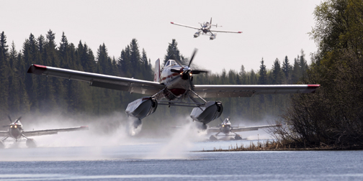
CIRCUIT DISCIPLINE

Slide 57
FIVE CHARACTERISTICS OF A QUALITY CIRCUIT
Efficient, shortest possible turnaround time
All aircraft following same flight pattern
Coordinated and controlled
Well communicated
Rhythmic

Slide 58
CONFIGURATION
Staggered
One tanker at the lake, the other at the fire
Factors to consider
Very quick turnarounds-close water source
Smaller narrow scoop lakes
Tactics may influence staggered configuration
Multiple changing targets (structure protection)

Slide 59
CONFIGURATION
Flight
Flight lead established
Factors to consider:
Adequate size lake to minimize wake turbulence
Sequencing helicopters in same target area
Working closely with ground suppression
MNDNR recommends approximately half mile separation or approximately 6-8 seconds between drops
Adequate spacing is required to evaluate drops and make adjustments for subsequent drops to maximize effectiveness

Slide 60
CIRCUIT DISCIPLINE
EXPECTATIONS
Scooper pilots will call “up with a load” from the lake on every scoop
Deviations from the established flight pattern must be communicated/pre-approved
ENCOURAGED
Continually assess risk/benefit. Not all fires are urgent, not all phases of the fire are urgent.
Pilot to pilot reports

Slide 61
SAFETY
Safety is a priority in the MNDNR Aviation Program.
Identifying potential safety issues is encouraged.
Reporting safety related and/or mechanical occurrences is supported and respected.
Our safety program is supportive and not punitive.
IF YOU SEE SOMETHING,
SAY SOMETHING!

