Slide 1
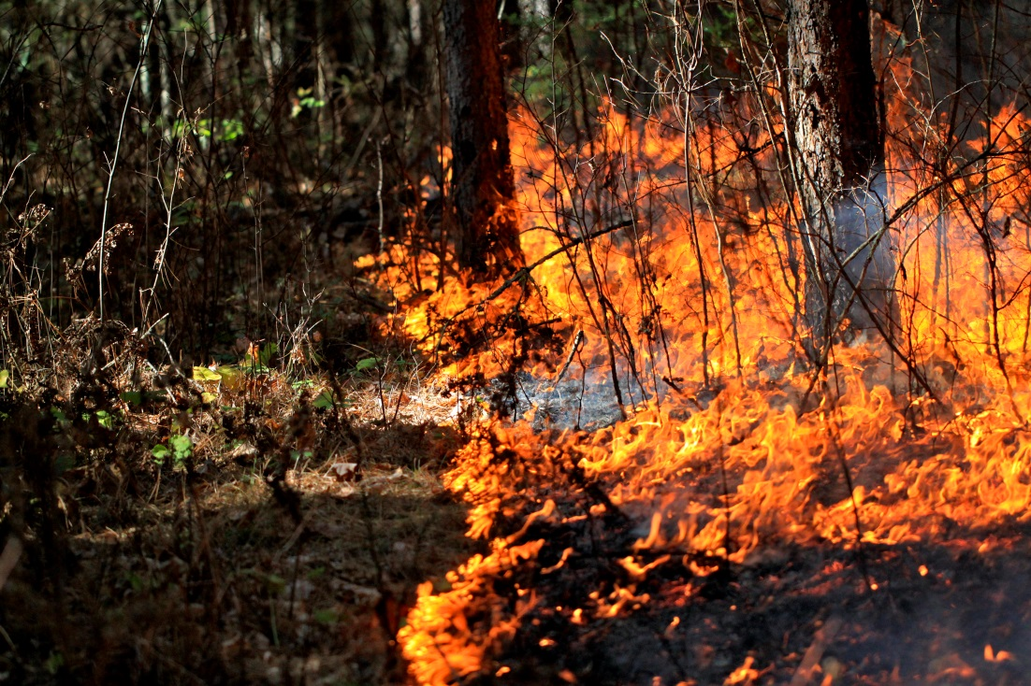
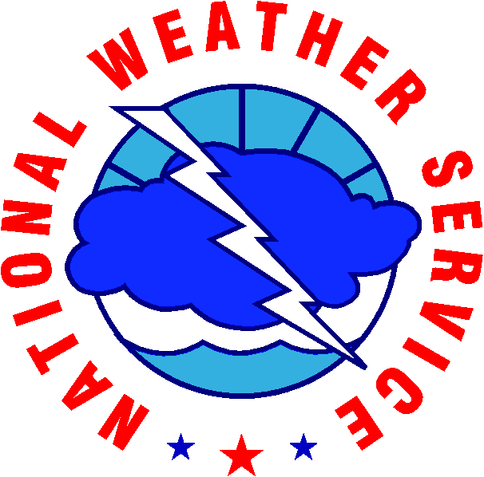






2016 Annual Fire Weather Meeting
2016 MN Fire Weather Meeting
12/5/2016
Duluth, MN

Slide 2
2016 Meeting Agenda
Review 2015 Meeting Notes – Bill L.
Review Weather of 2016 – Mike G.
MN 2016 Fire Summary– BJ
Climate Outlooks for 2017 – Mike G.
IMET Program Update – Bill L.
New SPOT Page – Mike G.
NFDRS, New Fuel Models – BJ
Weather Shield – BJ
Forecaster Builder/Future of NWS – Geoff G.
Group discussion – Fire Weather Forecast (FWF)
NWS SPOT/Red Flag Statistics – Focal Points

Slide 3
Review 2015 Meeting Notes
Review of the 2015 Fire Season (BJ – MN DNR)
  Number of wildfires was just barely above average with the number of acres burned due to wildfires below average
  221 days of fire danger
  Largest fire of the season was the Palsburg fire near Warroad, MN
  New RAWS soil moisture monitors, currently only at Bemidji. Roseau and St. Croix expected to be added this (2016) spring?
Review of the 2015 Fire Weather Season (Mike G. – NWS MPX)
  Increased number of Red Flag Warnings compared to past couple of years
  Majority of Red Flag Warnings issued in April
NWS Office | 2015 SPOT Requests | 2015 Red Flag Events (Days)
Grand Forks | 154 | 9
Duluth | 156 | 6
Chanhassen | 265 | 11
La Crosse | 77 | 2
Sioux Falls | 120 | 11
Aberdeen | 81 | N/A
For a copy of the 2015 notes please email:
William.Leatham@noaa.gov

Slide 4
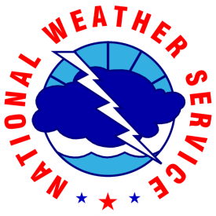


2016 Weather Review
Twin Cities National Weather Service
Michael Griesinger
Forecaster
National Weather Serivce
Chanhassen, MN
Decision
Support
Services

Slide 5
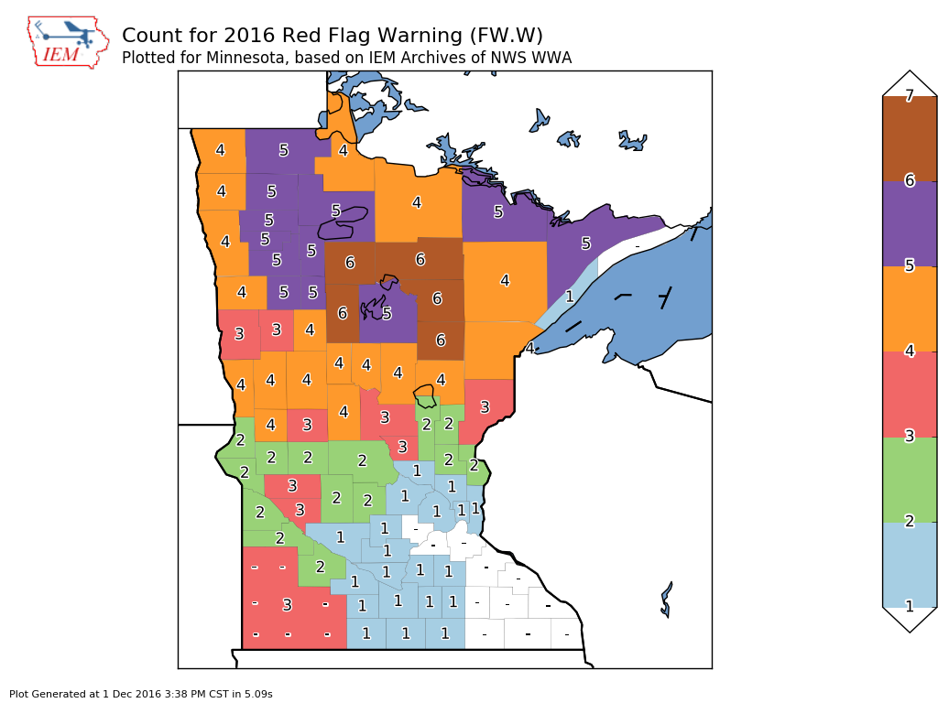
Twin Cities National Weather Service
RFWs Per County
Decision
Support
Services

Slide 6
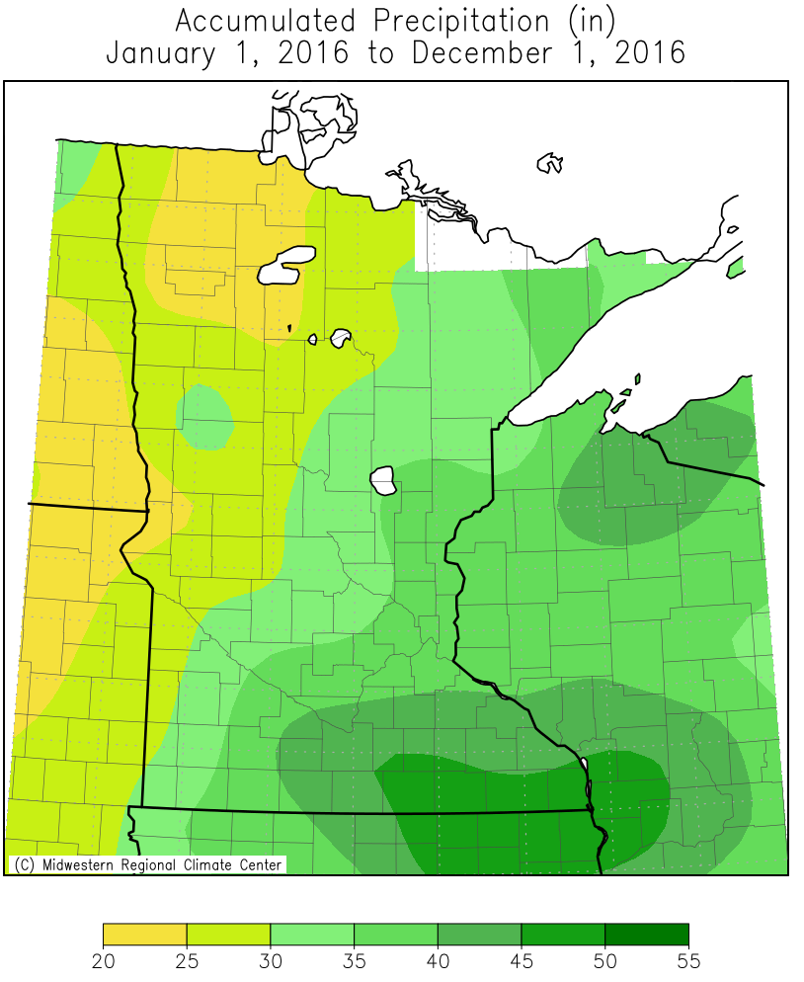
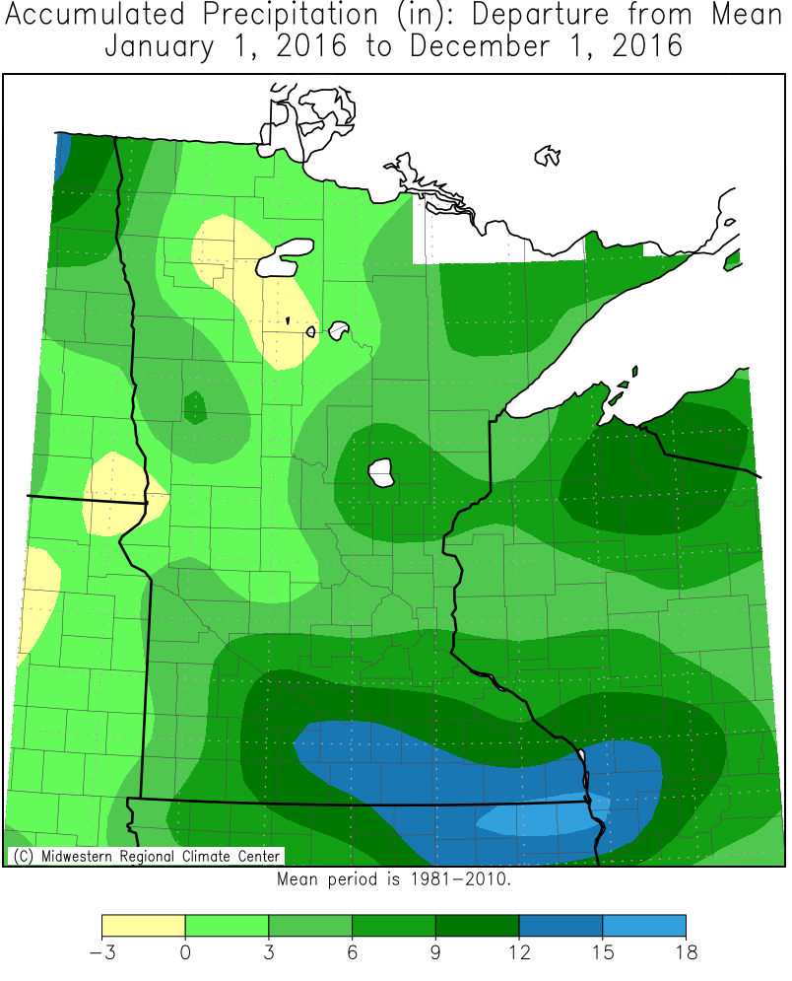
Twin Cities National Weather Service
2016 Precip and Departure from Normal (thru 12/1)
Decision
Support
Services

Slide 7
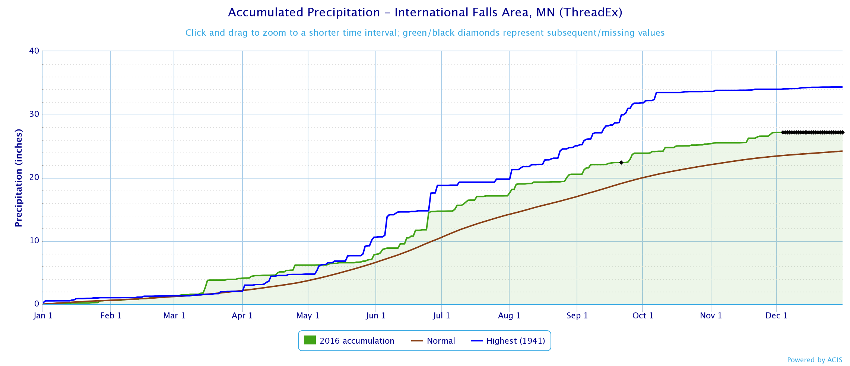
Twin Cities National Weather Service
2016 Precip…International Falls
Decision
Support
Services

Slide 8
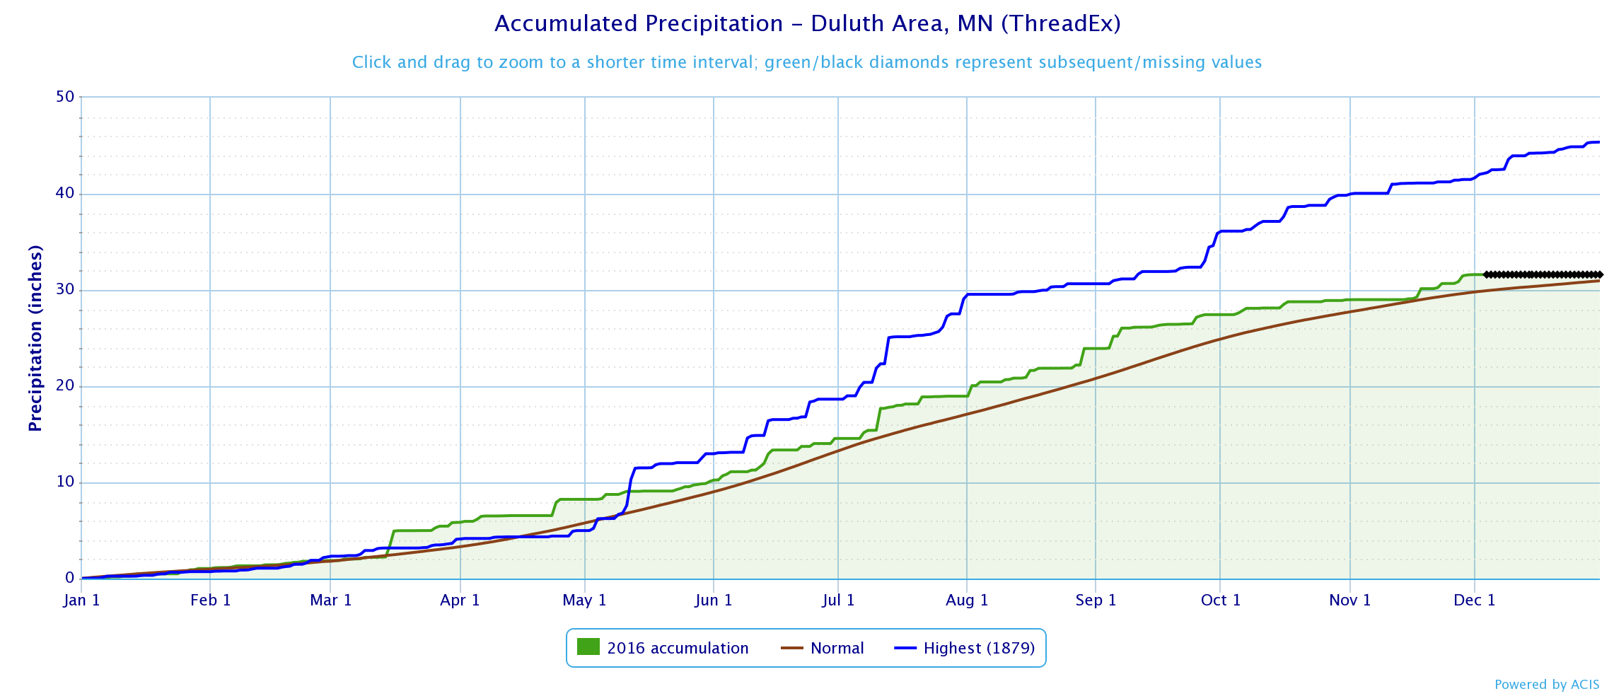
Twin Cities National Weather Service
2016 Precip…Duluth
Decision
Support
Services

Slide 9
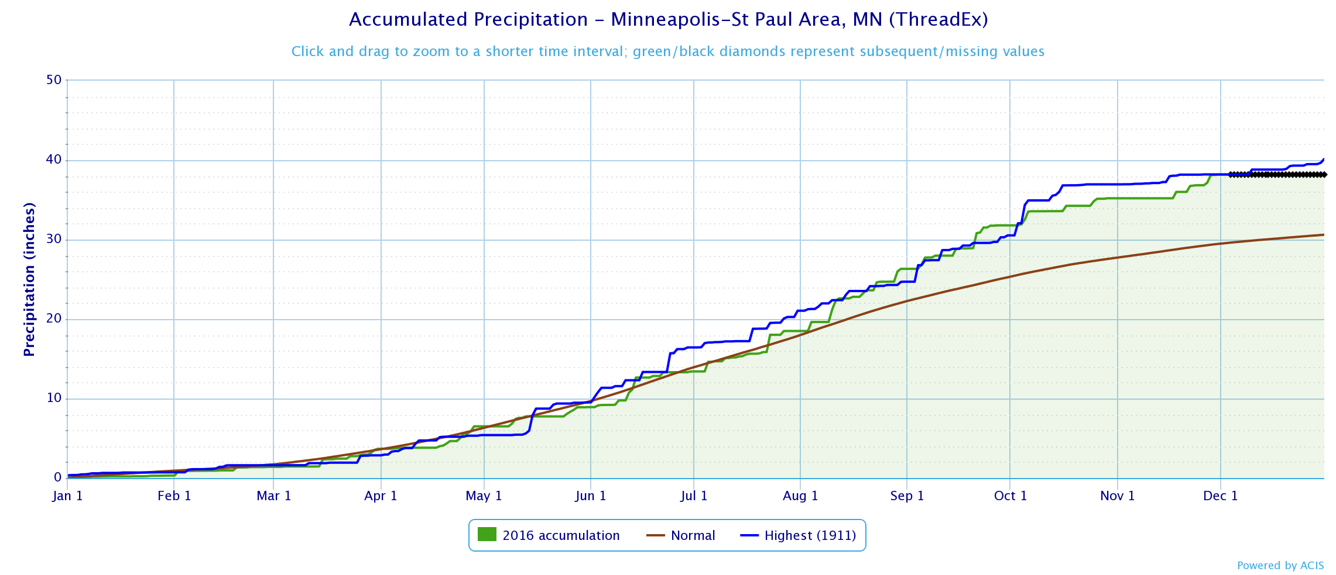
Twin Cities National Weather Service
2016 Precip…Twin Cities
Decision
Support
Services

Slide 10
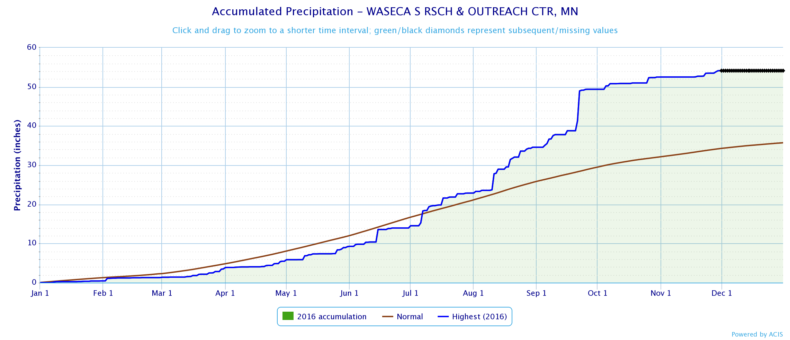
Twin Cities National Weather Service
2016 Precip…Waseca
Wettest year on record for a weather station in MN
Decision
Support
Services

Slide 11
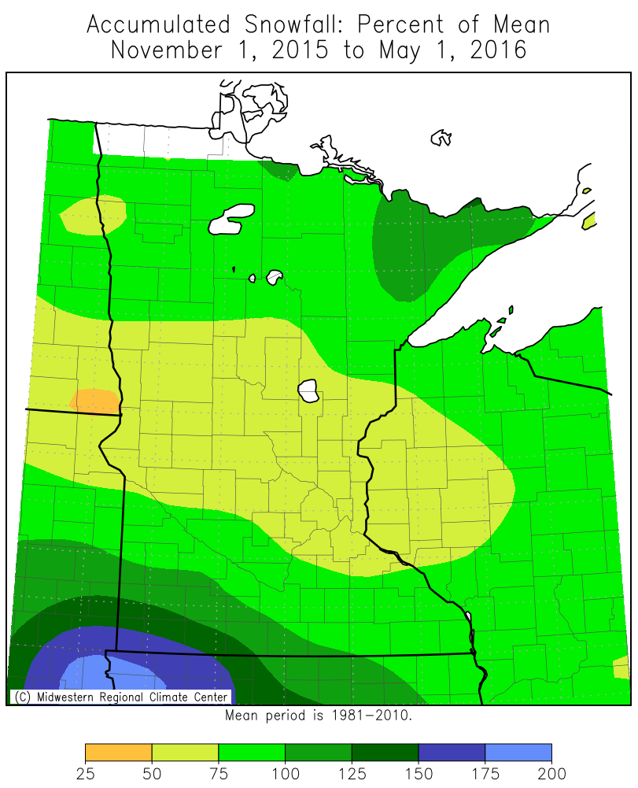
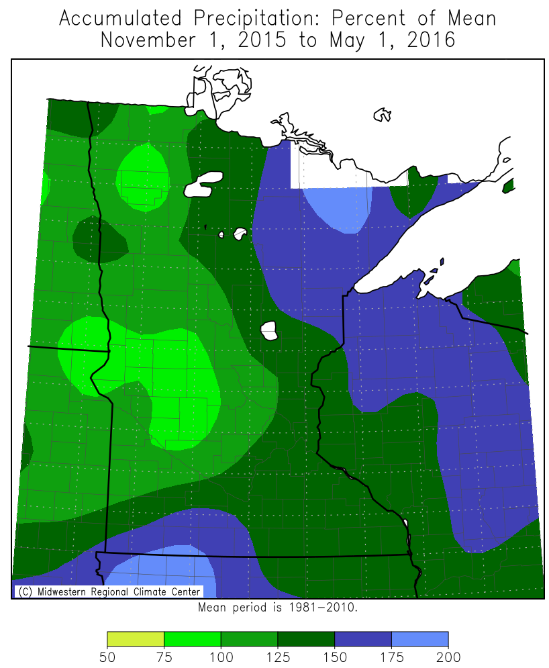
Twin Cities National Weather Service
Winter Snowfall/Liquid Departure from Normal
Decision
Support
Services

Slide 12
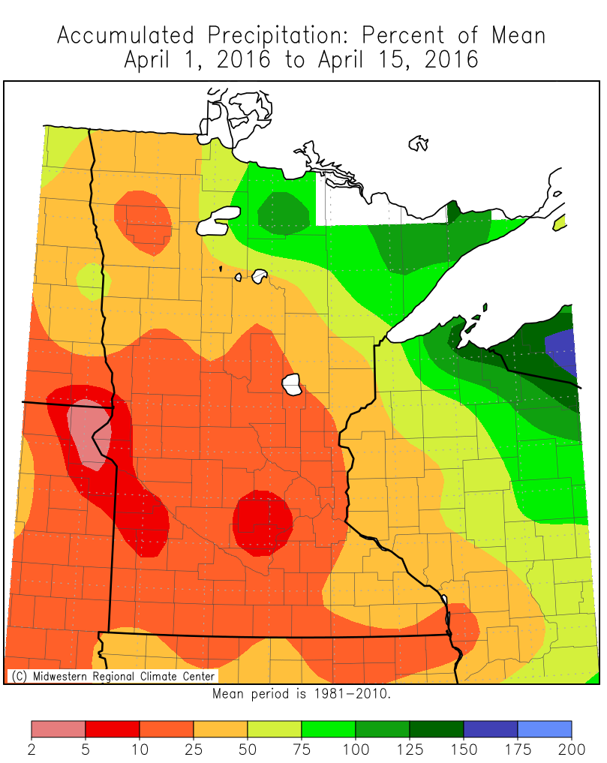
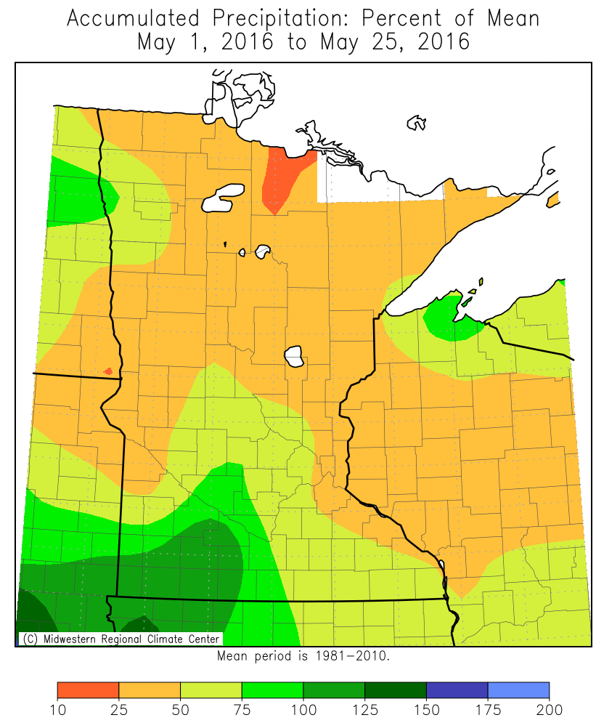
Twin Cities National Weather Service
Two Active Fire Weather Periods
Decision
Support
Services

Slide 13
Twin Cities National Weather Service
Days with RFWs
RFWs were issued in the state on 13 days
RFWs by office
  FGF 7: 4/14, 5/3, 5/5, 5/6, 5/7, 5/9, 5/22
  DLH 7: 5/3, 5/5, 5/7, 5/9, 5/10, 5/21, 5/22
  MPX 5: 4/9, 4/14, 5/3, 5/6, 5/7
  FSD 3: 4/9, 4/12, 4/15
  ABR 2: 4/9, 4/14
  ARX: none in MN
Decision
Support
Services

Slide 14
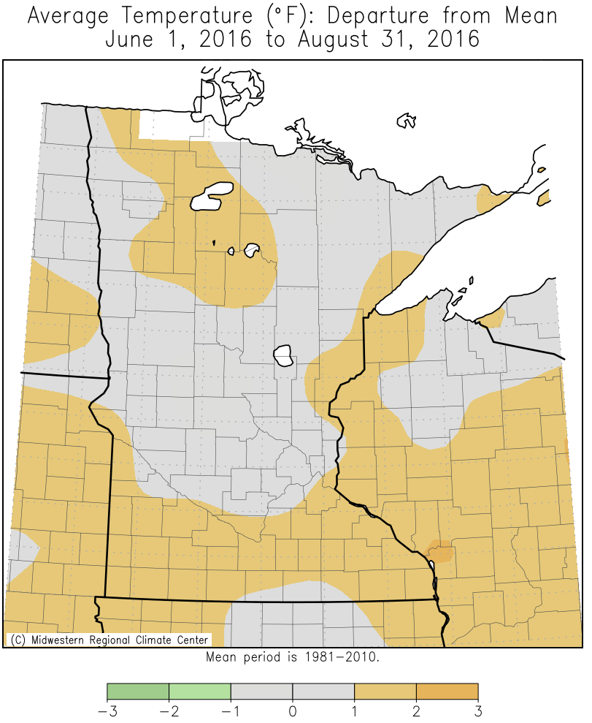
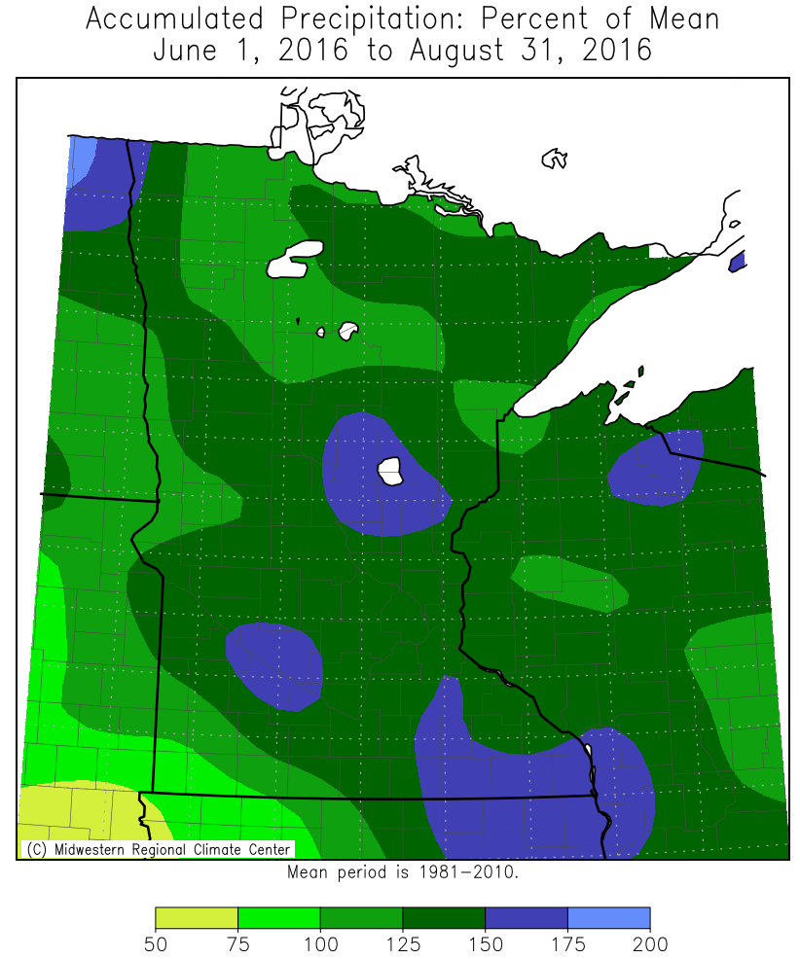
Twin Cities National Weather Service
Summer Temp/Precip Anomalies
Decision
Support
Services

Slide 15
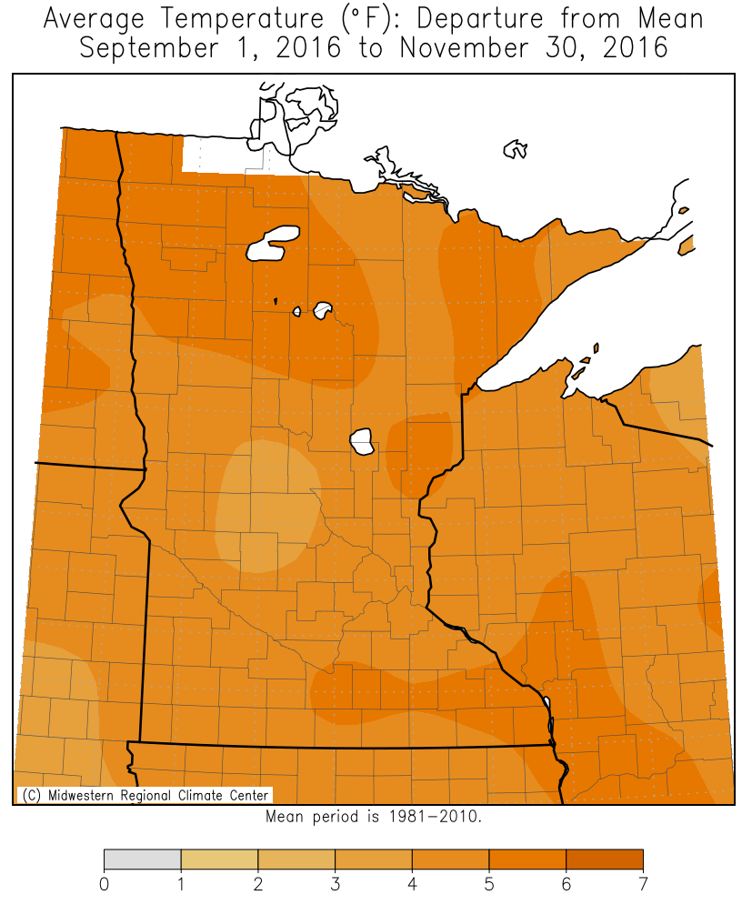
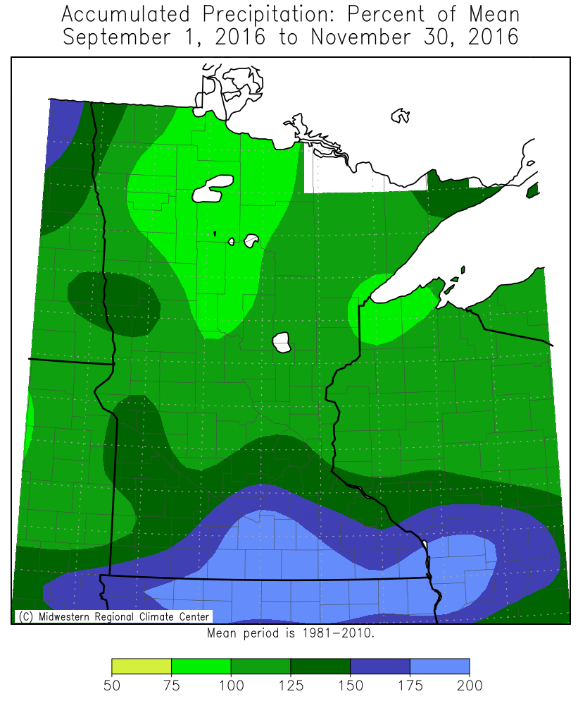
Twin Cities National Weather Service
Fall Temp/Precip Anomalies
Decision
Support
Services

Slide 16
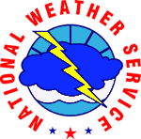
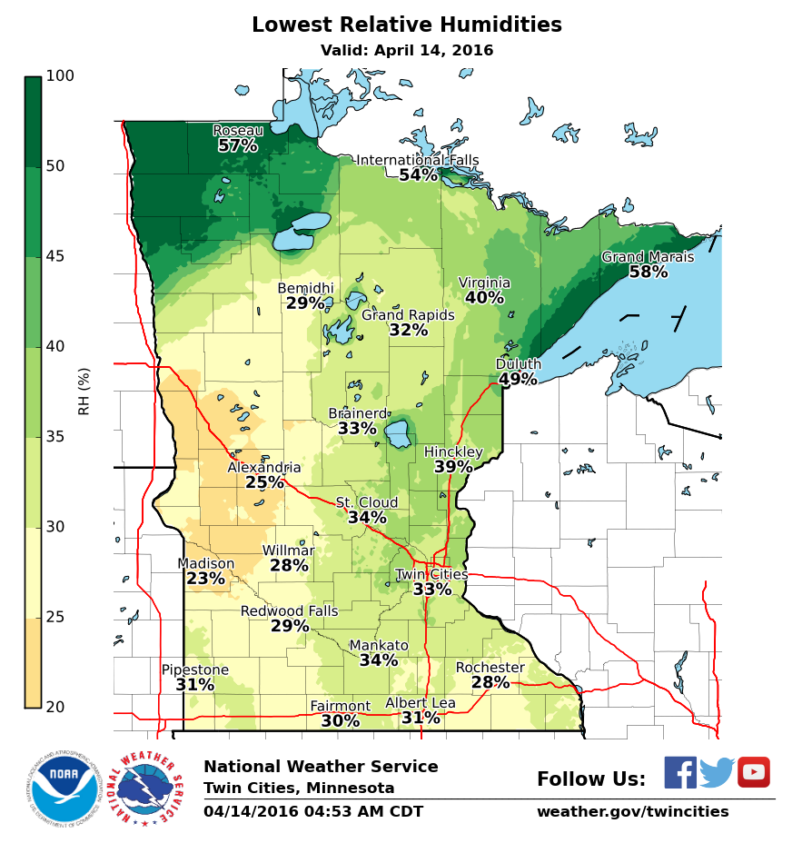
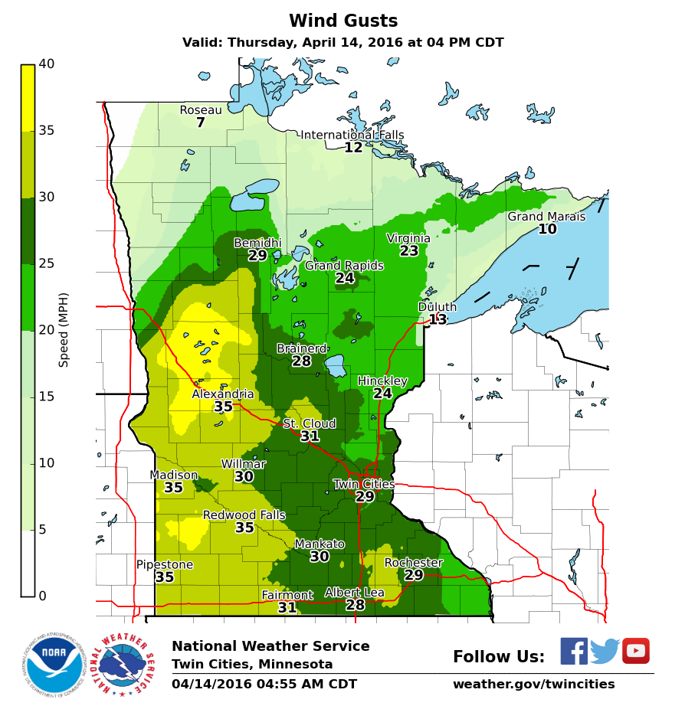
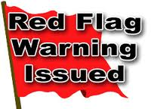
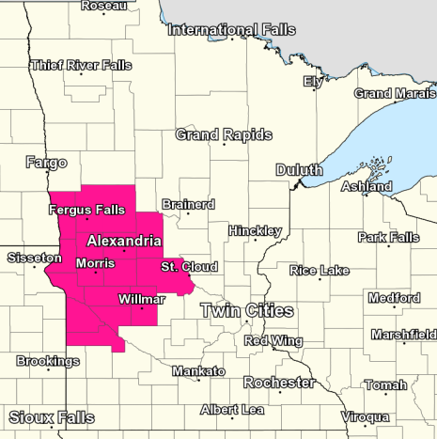

National Weather Service - Twin Cities
Your 24/7 partner for critical weather information, so you can make the best possible decisions
Elevated Fire Danger April 14, 2016
Created 5:15 a.m. CDT April 14, 2016
Red Flag Warning for West Central MN with elevated fire weather for much of the rest of MN
Red flag warning coincides with areas where highs are forecast to reach into the lower 80s today. Though the worst conditions are expected where the Red Flag Warning is, elevated fire weather conditions will exist across much of the state today. The National Weather Service offices in Duluth, Chanhassen, and La Crosse have special weather statements (SPS) to cover the highetented fire weather threat to as far north as a Bemidji to Hibbing line.
For updated forecast details at your location, please visit www.weather.gov/mpx

Slide 17
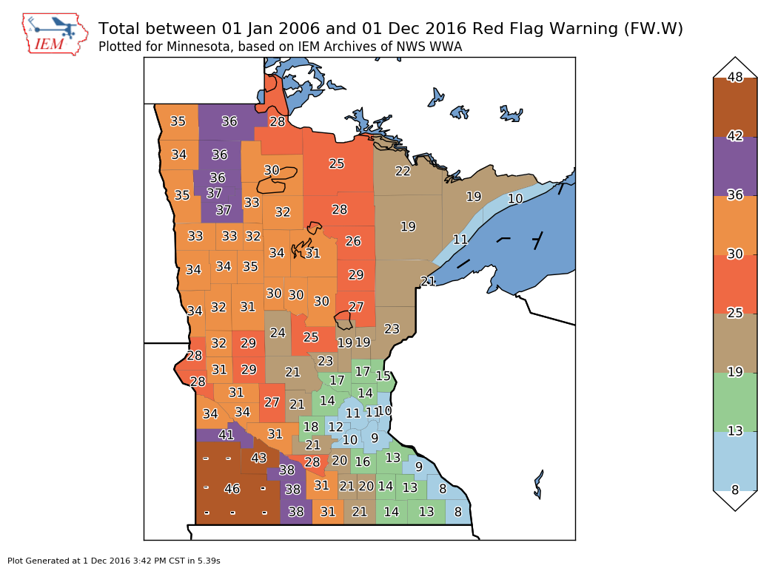
Twin Cities National Weather Service
RFWs Issued Since 2006
Decision
Support
Services

Slide 18
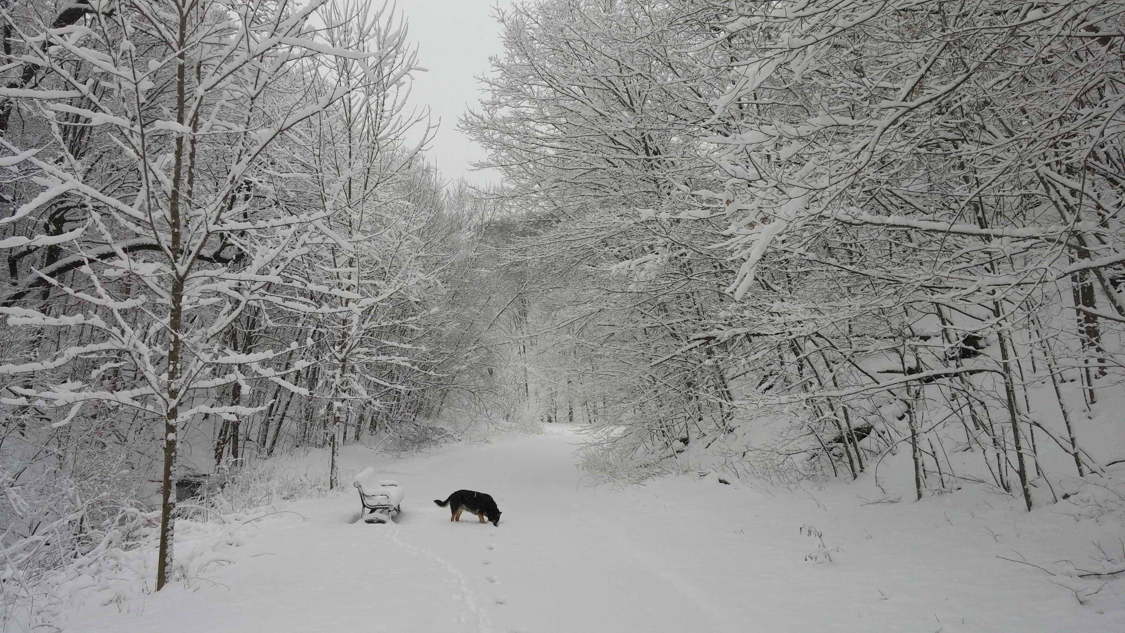
2016-2017 Winter Outlook
National Weather Service
Twin Cities, MN

Slide 19
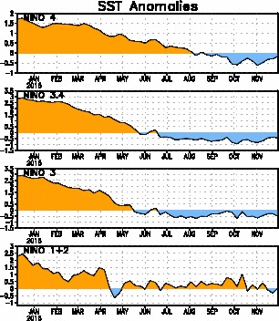
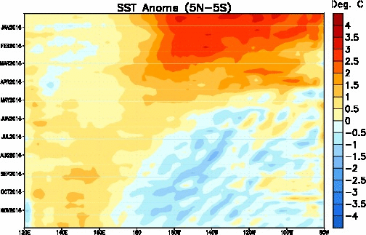
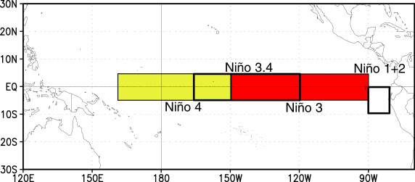
Tropical Pacific SST Anomaly Trends
Last winter’s
strong El Niño
Spring El Niño
weakening
Neutral/weak
La Niña
Last winter’s strong El Niño has been replaced by neutral/weak La Niña conditions
From east to west, anomalies across the basin are minimal

Slide 20
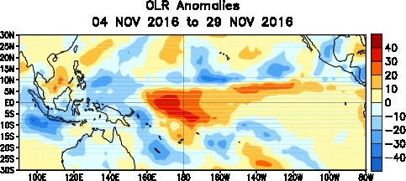
Atmospheric Response:
Outgoing Longwave Radiation (OLR)
Cool colors associated with less OLR than normal, caused by increased cloud cover
Warm colors associated with more OLR than normal, caused by less cloud cover (fewer thunderstorms)
Lack of convection across the central Pacific is typical

Slide 21
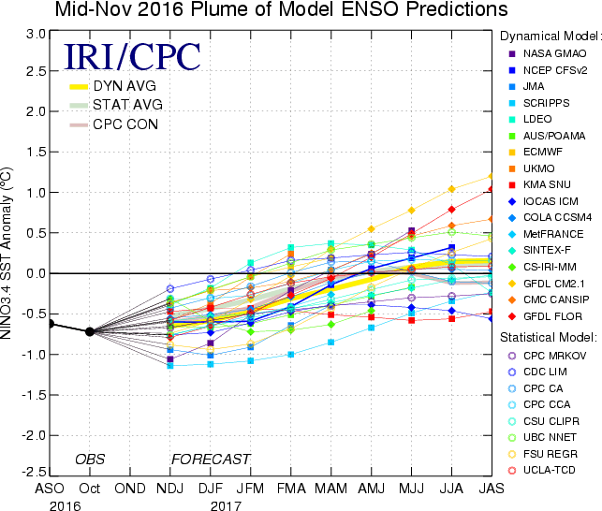
2016-17 ENSO Region 3.4 SST Anomaly Outlook:

Slide 22
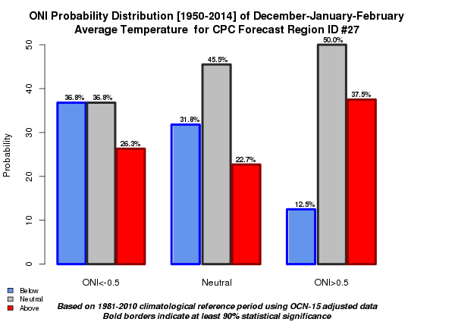
ENSO Phase and Temperature Anomaly Probabilities for SE MN

Slide 23
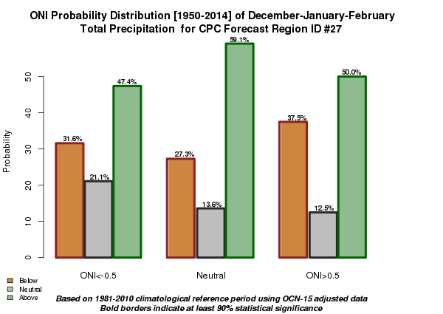
ENSO Phase and Precipitation Anomaly Probabilities for SE MN

Slide 24
El Niño’s since 1950 and ENSO Phase the Following Winter
El Niño Winters | ENSO Phase following winter
1951-1952 | El Niño
1952-1953 | El Niño
1953-1954 | La Niña
1957-1958 | El Niño
1958-1959 | Neutral
1963-1964 | La Niña/Neutral
1965-1966 | Neutral
1968-1969 | El Niño
1972-1973 | La Niña
1976-1977 | El Niño
1977-1978 | Neutral
1979-1980 | Neutral
El Niño Winters | ENSO Phase following winter
1982-1983 | Neutral
1986-1987 | El Niño
1987-1988 | La Niña
1991-1992 | Neutral
1994-1995 | La Niña
1997-1998 | La Niña
2002-2003 | Neutral
2004-2005 | Neutral
2006-2007 | La Niña
2009-2010 | La Niña
2014-2015 | El Niño
2015-2016 | La Niña/Neutral

Slide 25
Paring the list down to El Niño’s followed by Neutral Conditions the Follow winter
Highlighted years were strong El Niño’s followed by neutral conditions the next winter
This is a good corollary to what we are anticipating this winter (strong El Niño to neutral conditions)
El Niño Winters | ENSO Phase following winter
1958-1959 | Neutral
1963-1964 | La Niña/Neutral
1965-1966 | Neutral
1977-1978 | Neutral
1979-1980 | Neutral
1982-1983 | Neutral
1991-1992 | Neutral
2002-2003 | Neutral
2004-2005 | Neutral
2015-2016 | La Niña/Neutral

Slide 26
Average Temperature and Snowfall Difference Between Neutral Winter and Previous El Niño Winter (MSP)
El Niño Winters | ENSO Phase following winter | Ave T and Diff from previous EN winter | Season Snowfall and Diff from previous EN winter
1958-1959 | Neutral | 21.8⁰ (+7.3) | 31.8” (+12.7)
1963-1964 | La Niña/Neutral | 12.2⁰ (-5.8) | 73 .7” (+44.8)
1965-1966 | Neutral | 13.8⁰ (-2.1) | 78.4” (+42.3)
1977-1978 | Neutral | 9.4⁰ (-1.1) | 68.4” (+17.7)
1979-1980 | Neutral | 20.4⁰ (+1.5) | 21.1” (-32.2)
1982-1983 | Neutral | 14.3⁰ (-5.7) | 98.6” (+24.2)
1991-1992 | Neutral | 17.7⁰ (-6.0) | 47.4” (-36.7)
2002-2003 | Neutral | 19.3⁰ (+0.2) | 66.3” (+31.3)
2004-2005 | Neutral | 22.7⁰ (+1.2) | 44.4” (+18.9)
2015-2016 | Neutral? | ???? | ????
Average DJF temp at MSP is about 18º and average seasonal snowfall is ~52”

Slide 27
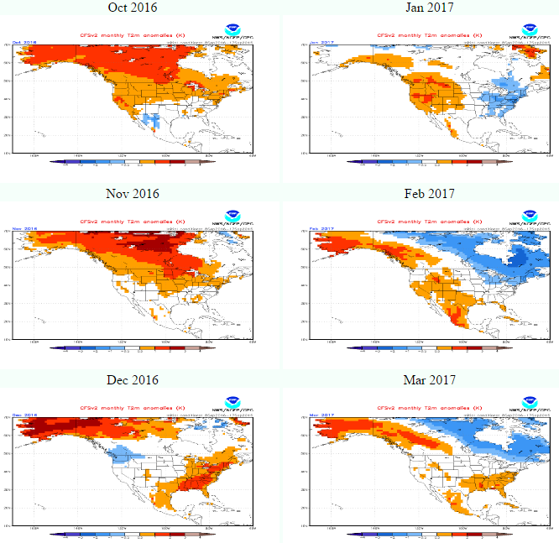
CFS Monthly Temperature Forecast (Early Oct)

Slide 28
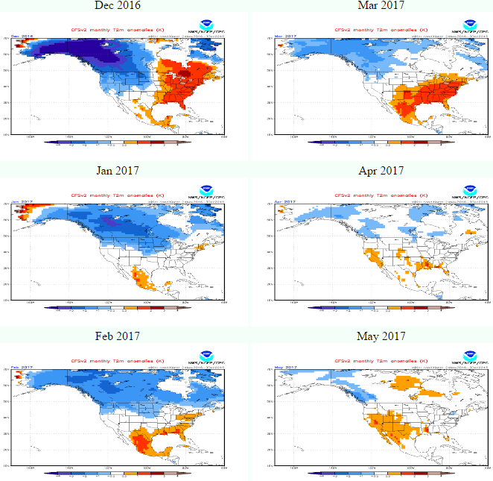
CFS Monthly Temperature Forecast (This morning)

Slide 29
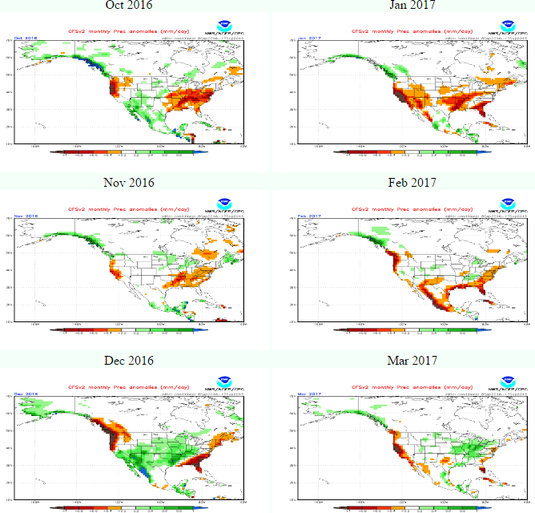
CFS Monthly Precipitation Forecast (early Oct)

Slide 30
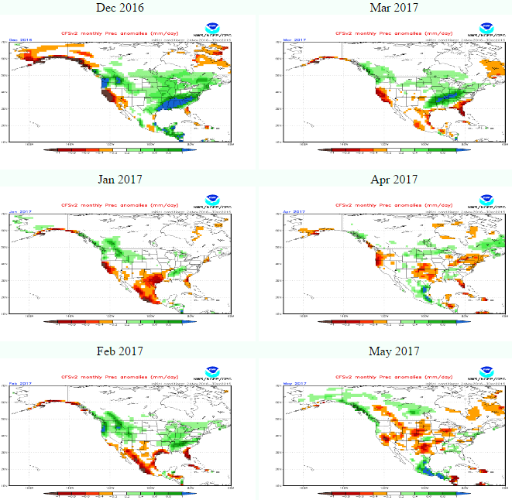
CFS Monthly Precipitation Forecast (this morning)

Slide 31
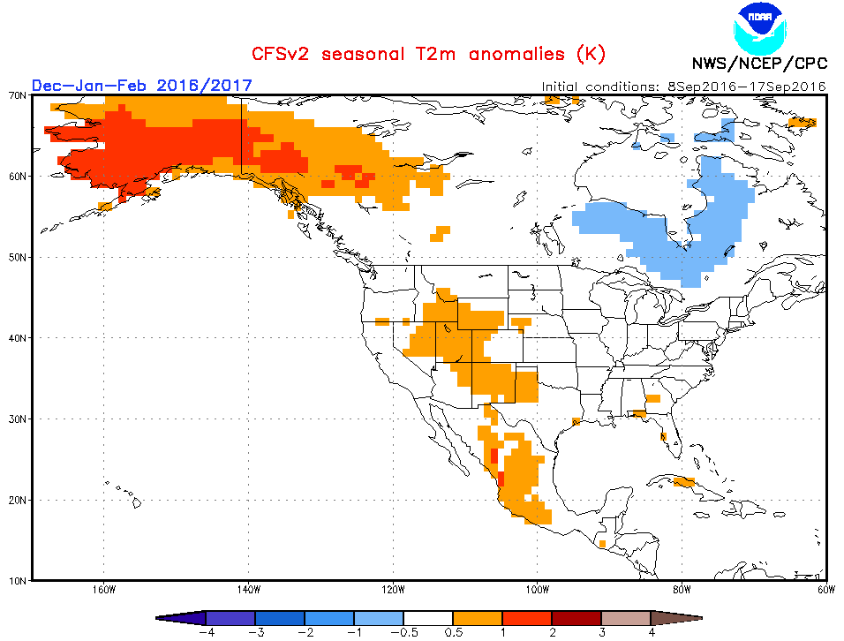
CFS Winter Temperature Outlook (Sept)

Slide 32
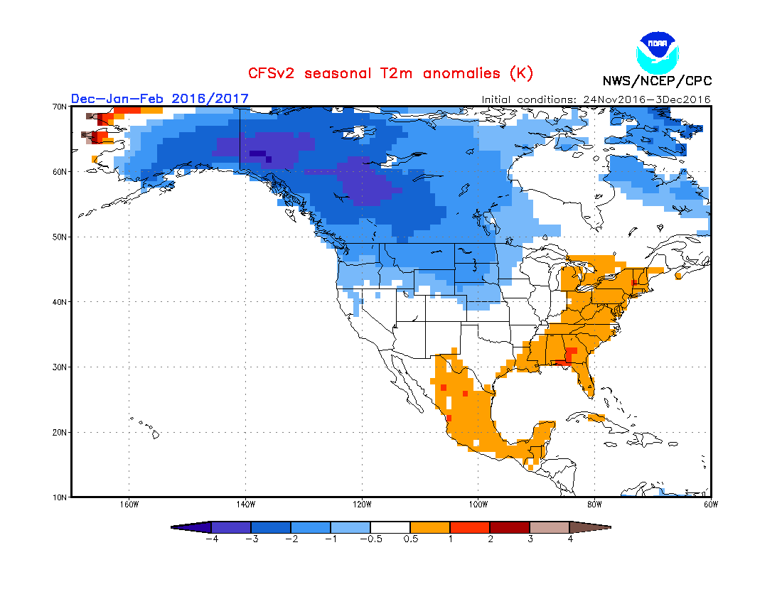
CFS Winter Temperature Outlook (this morning)

Slide 33
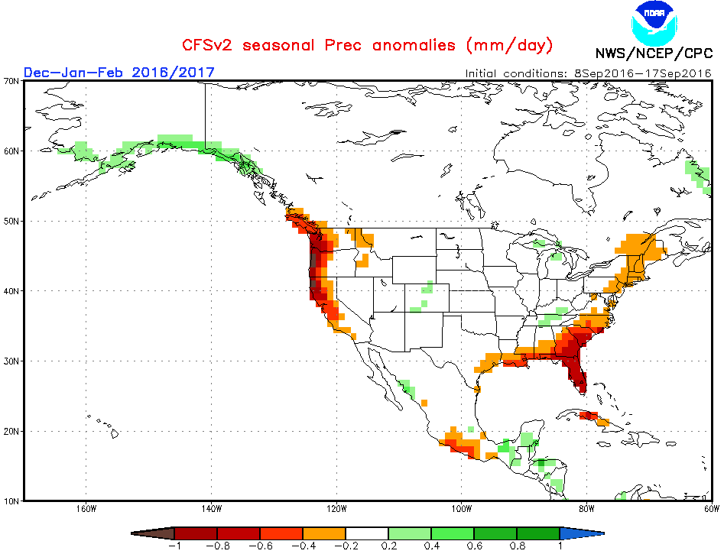
CFS Winter Precipitation Outlook (Sept)

Slide 34
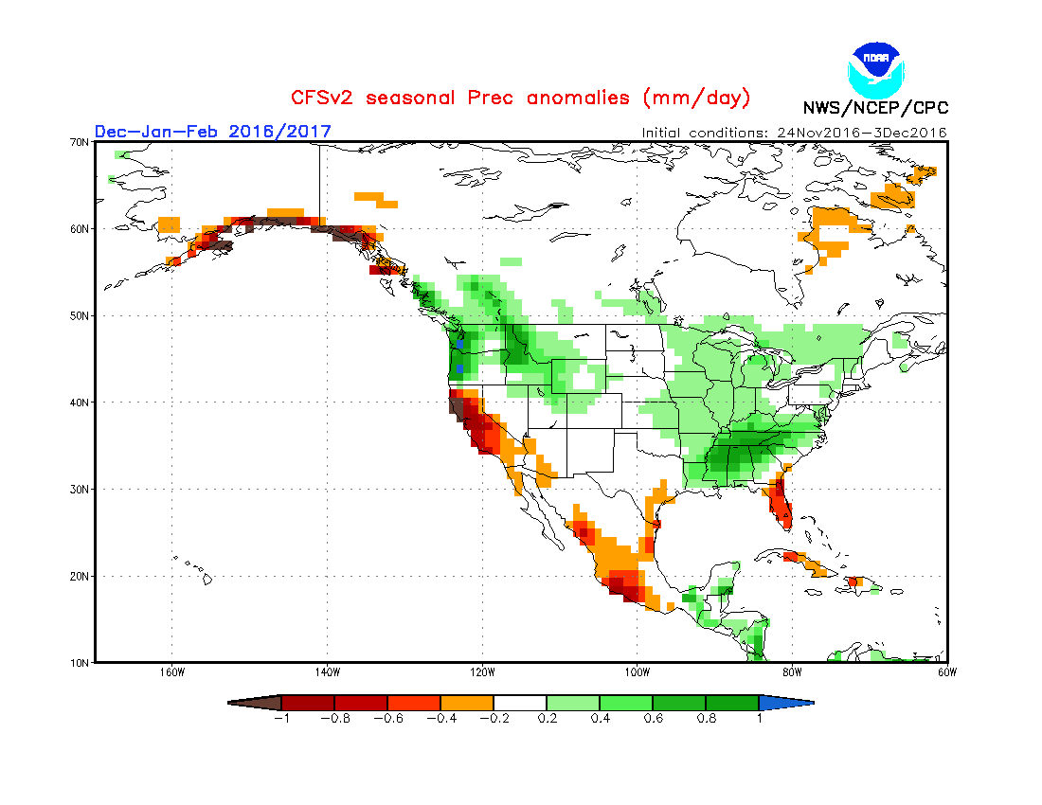
CFS Winter Precipitation Outlook (this morning)

Slide 35
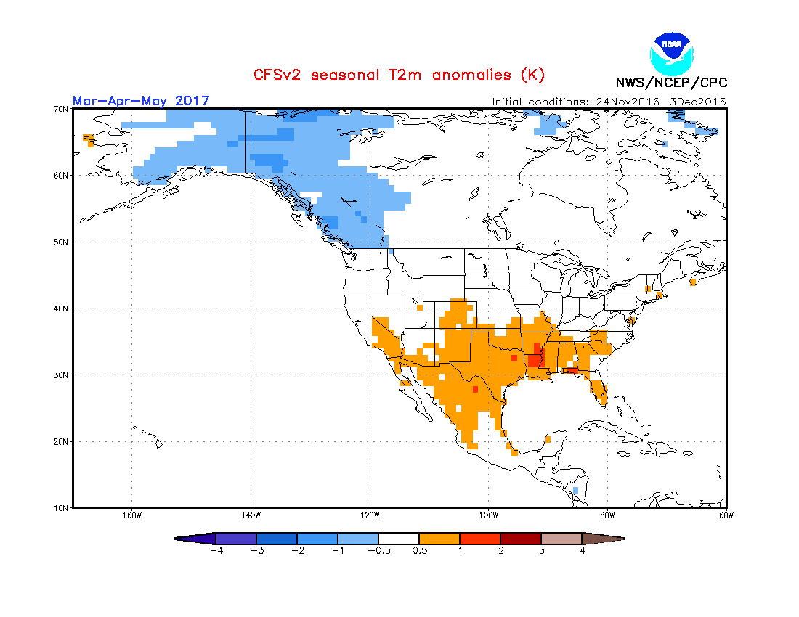
CFS Spring Temperature Outlook

Slide 36
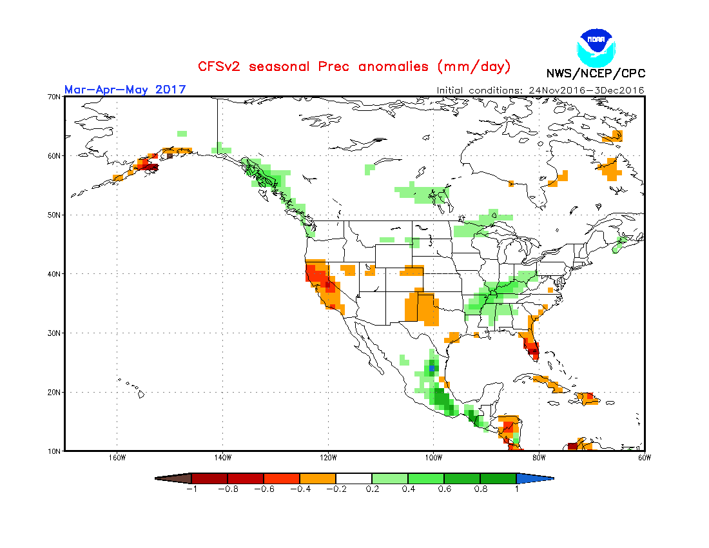
CFS Spring Precipitation Outlook

Slide 37
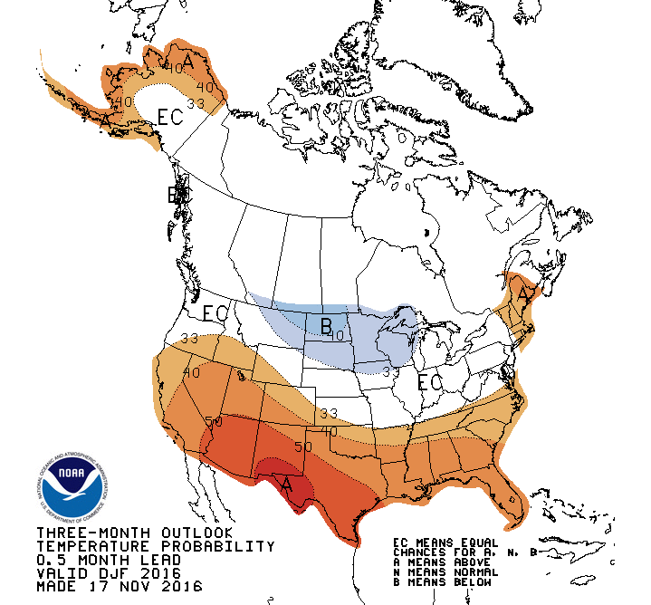
CPC Winter Temperature Outlook

Slide 38
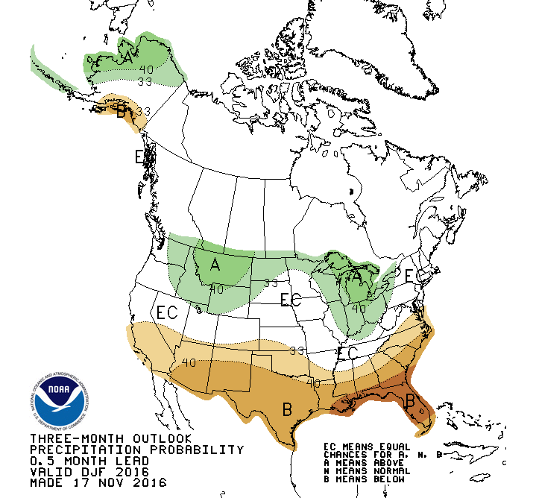
CPC Winter Precipitation Outlook

Slide 39
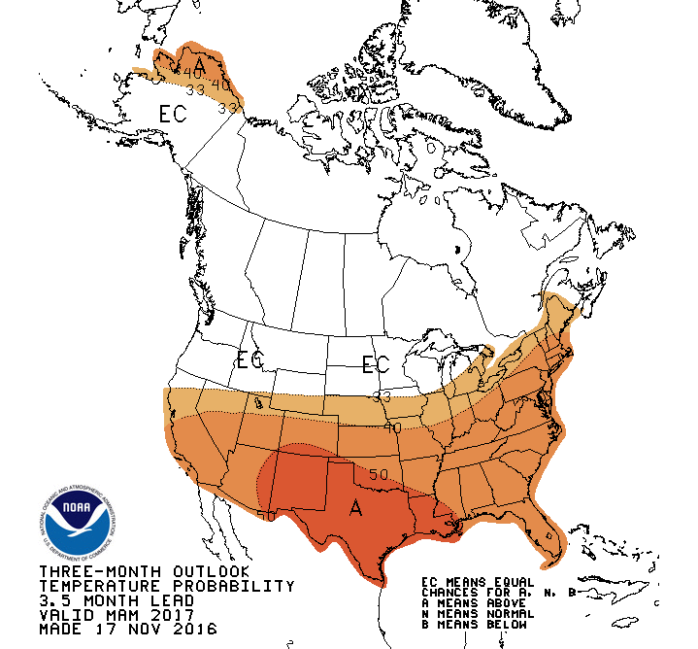
CPC Spring Temperature Outlook

Slide 40
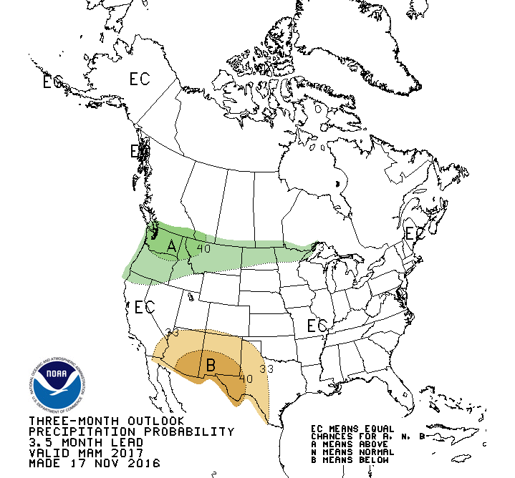
CPC Spring Precipitation Outlook

Slide 41
So What About this Winter?
Temperature
  We will be significantly colder than last winter, though even an average temperature 6º colder than last winter would put is right near average
  CFS has mixed feelings, with CPC favoring cooler conditions
  Based on past neutral ENSO winters following an El Niño winter, expect this to be a cold winter…somewhere between 2013-2014’s cold and a average winter
Precipitation/Snowfall
  Mixed signal for amount of liquid precipitation, though the caveat here is colder air holds less moisture and therefore produces less liquid equivalent precipitation (though this does not necessarily mean less snow!)
  ENSO neutral winters following an El Niño winter have shown significant snowfall gains over the previous winter…more of the same is expected this winter
Looking at forecasts and past winters, the following is expected this winter
  Average temperature 3-6 degrees BELOW normal with snowfall ABOVE normal (something in the 60s/70s) looks achievable

Slide 42
What About the Spring Fire Season
Everything about this winter looks “normal” and that should continue into the spring
Like most springs, we will likely see a stretch of weather that’s dry, warm, and breezy and ripe for a couple of Red Flag warnings
Main concern going into the spring…flooding!

Slide 43
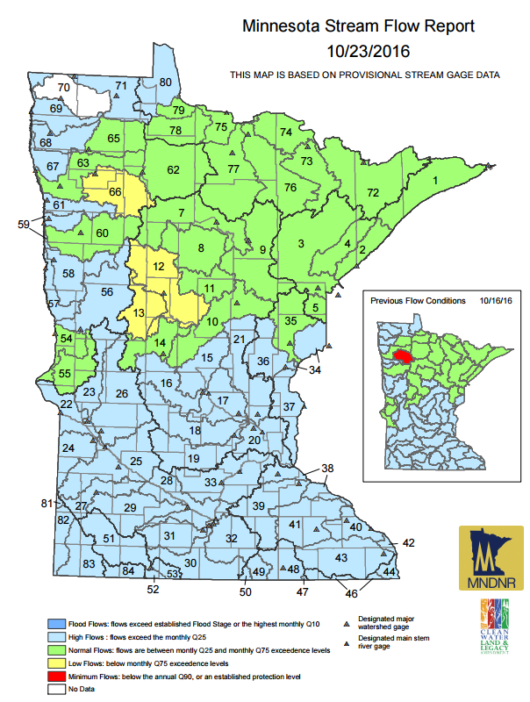
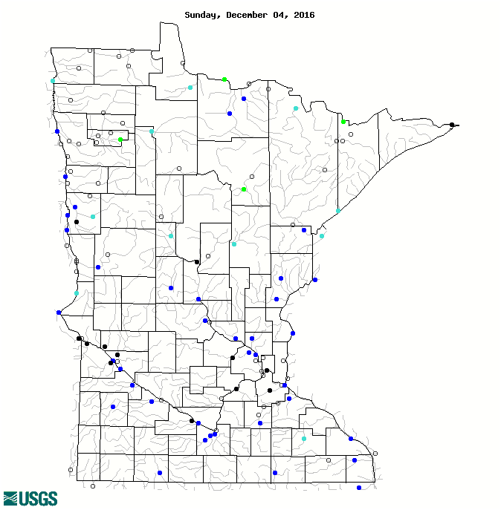

Current Hydrologic Conditions

Slide 44
Current Hydrologic Conditions and Potential Implications
Rivers across the entire state are running WELL ABOVE normal for the end of September
Flows remain high as we approach winter freeze up, will result in increased risk for spring flooding
If a cold/snowy winter occurs as expected as well, MN could be dealing with significantly increased risk of snow melt flooding next spring

