Slide 1
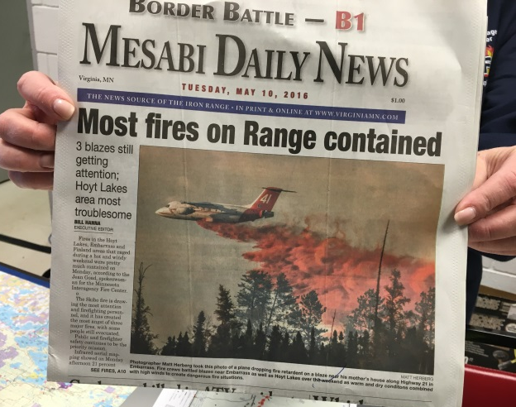
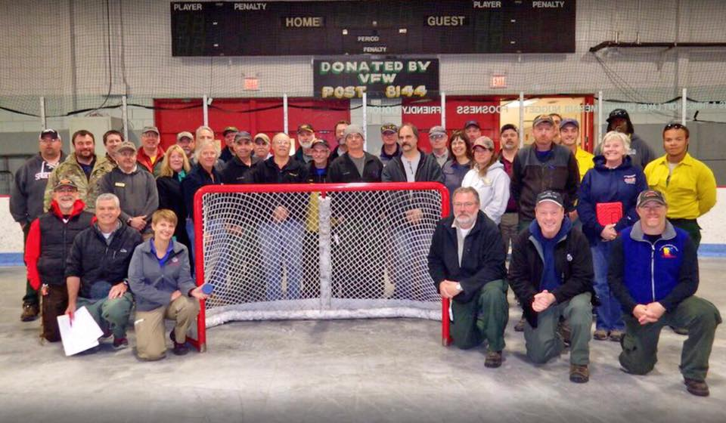
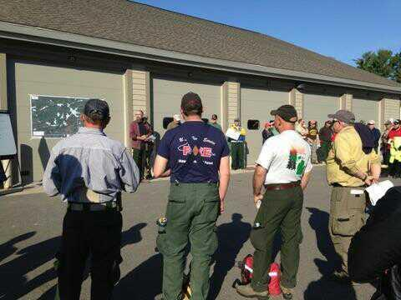
Incident Meteorologist
Local Dispatches
Amanda, IMET - Skibo Fire
Hoyt Lakes, MN
May 6th, 2016
Shawn, IMET - Foss Lake Fire
Ely, MN
May 20th, 2016

Slide 2
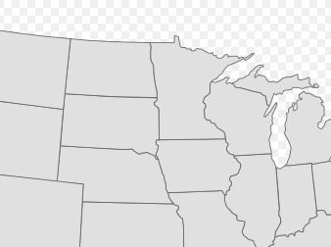

Incident Meteorologist Locations
Amanda Graning, MNDNR
Duluth, MN
218-213-8089
Temp email: Imetamanda@gmail.com
Kari Fleegel, NWS
Aberdeen, SD
605-225-0519
Shawn Jacobs, NWS
North Platte, NE
(308) 532-0921
Notes:
Some changes to the available IMETs in our region. Kari, the IMET that was stationed in MQT…has moved to ABR.
Amanda is still available for teaching classes, weather support for RX burns/wildfires. However, she will be affiliated with MN DNR rather than with NWS. Feel free to contact her with any questions…her phone # is still the same. Temporary email is IMETamanda@gmail.com

Slide 3

The Future of the National Weather Service
And What it may mean to Fire Weather users
Geoff Grochocinski
NWS Duluth

Slide 4

NWS Challenges in Recent Years
Budgets not keeping pace with organization costs
Difficulty in filling job vacancies
Difficulty covering shifts, managing programs
Increasing workload
Reduced budgets for travel and training
To Post a YEAR from now?
LOTS OF
Weather “Service” lacking in its service
to users and partners

Slide 5
The OPERATIONAL and WORKFORCE ANALYSIS
NWS hired a consulting company to conduct an organization-wide analysis of its operations and structure
The following are the goals to evolve certain functions of the agency:

Slide 6
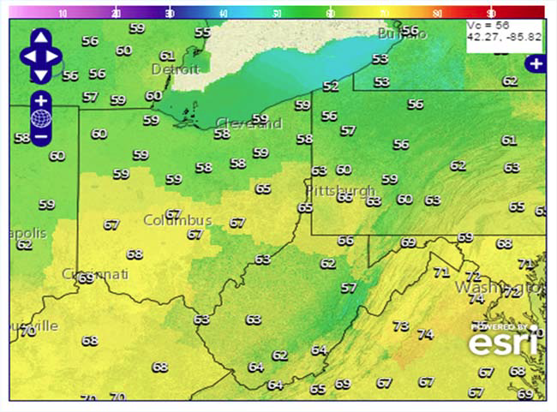
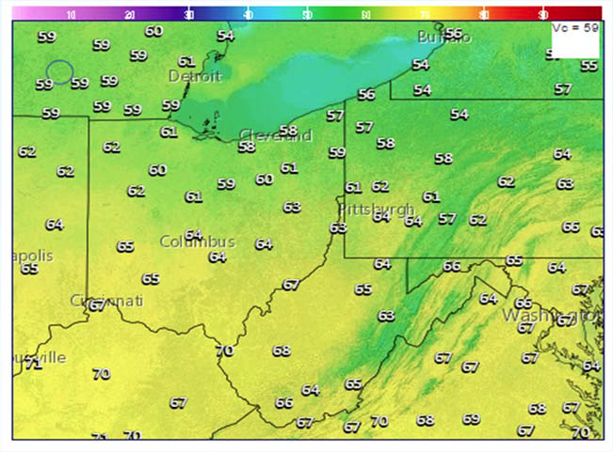
Forecast Consistency
Build a better collaborative forecast process
“Forecast Builder” tool/process
Create more consistent forecasts between offices
Discrepancies happen too much
We want more seamless forecasts

Slide 7
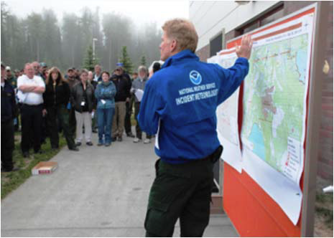
Impact-Based Decision Support services (IDSS)
Build better relationships with partners
Offer support beyond the simple forecast – interpretation based on accessibility and trust
Provide more consistent support to partners

Slide 8
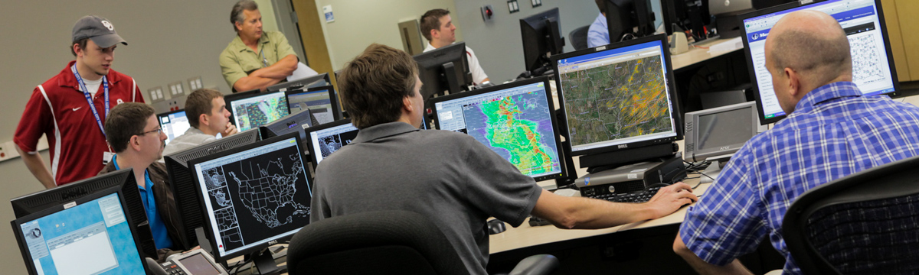
Training
Unlocking time and resources for science-based training for staff
Using the training to enhance skills and improve forecasting capabilities and communication

Slide 9
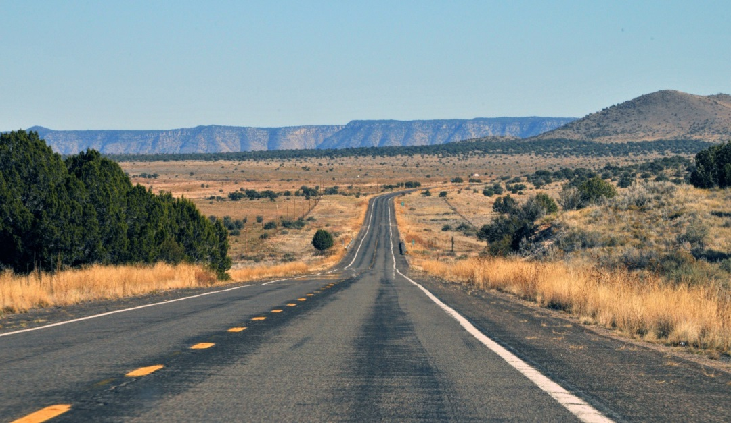
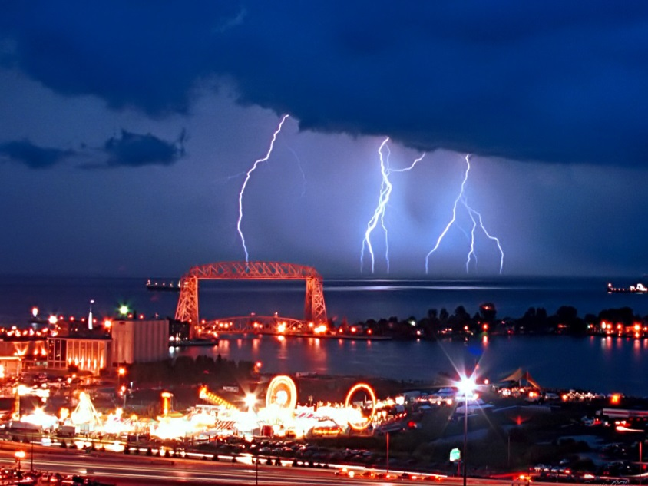
Staffing
Realign staff time to better achieve IDSS and training goals
Possible changes to career progression
Possibly moving away from 24/7 staffing at all offices
Does a typically sunny Arizona office…
need the same staffing as a Minnesota office?

Slide 10

What this means for Fire weather partners
NWS is evolving: Watch for changes over the coming few years
Will staffing change at MN area offices?
How would that impact fire weather forecasting?
Will the new presidential administration and Congress change NWS leadership and plans?
Bottom line: The plans of how to achieve the goals are still murky…and
NO OFFICES WILL CLOSE

Slide 11
Thank You!
Any questions?
Geoffrey.grochocinski@noaa.gov

Slide 12
Grand Forks Spot forecast requests
Year Total Wildfire
2007 188
2008 224
2009 196
2010 199
2011 219 34
2012 240 34
2013 154 9
2014 172 1
2015 154 12
2016 138 3
10 year average 188

Slide 13
Grand Forks Red Flag Verification
Year Total POD CSI FAR lead time
2012 198 1.00 0.97 0.03 10 hours
2013 58 1.00 1.00 0.00 9
2014 30 1.00 1.00 0.00 9
2015 140 0.97 0.70 0.03 9
2016 41 0.89 0.53 0.11 6

Slide 14
2016 Duluth
SPOT Forecast Statistics
17 Wildfire
These values include NW WI zones

Slide 15
2016 Duluth
Red Flag Warning Verification
YEAR | 2016 | 2015 | 2014 | 2013 | 2012 | 2011 | 2010 | 2009 | 2008 | 2007
POD | 0.83 | 0.93 | - | 1.0 | 1.0 | 1.0 | 0.72* | 0.53 | - | 0.86
FAR | 0.17 | 0.07 | - | 0 | 0 | 0.15 | 0* | 0.34 | - | 0.6
CSI | 0.66 | 0.68 | - | 1.0 | 1.0 | 0.85 | 0.72 | 0.41 | - | 0.37
Events | 8 | 7 | 0 | 2 | 4 | 3 | 4 | 6 | 0 | -
Warned Zones | 72 | 55 | 0 | 11 | 33 | 39 | 36 | 32 | 0 | 70
Lead Time (hours) | 8.98 | 8.30 | - | 17.7 | 8.75 | 18.2 | 7.5 | 7 | - | -
Red Flag Events
May 3rd: 7 MN zones – No watch issued
May 6th: 13 MN zones – Watch issued
May 7th: 13 MN zones – Watch issued
May 9th: 8 MN zones – No watch issued
May 10th: 2 MN zones – No watch issued
May 21st: 8 MN zones – No watch issued
May 22nd: 9 MN zones – No watch issued
May 23rd: No MN zones
These statistics include NW WI zones

Slide 16
2016 Duluth
Red Flag Warning Verification
YEAR | 2016
POD | 0.90
FAR | 0.10
CSI | 0.71
Events | 7
Warned Zones | 61
Lead Time (hours) | 8.62
These statistics are MN zones only
82% of the time sustained winds were < 20 mph, but gusts were ≥ 25 mph on critical fire weather days
18 % of the time sustained winds were ≥ 20 mph on critical fire weather days

Slide 17


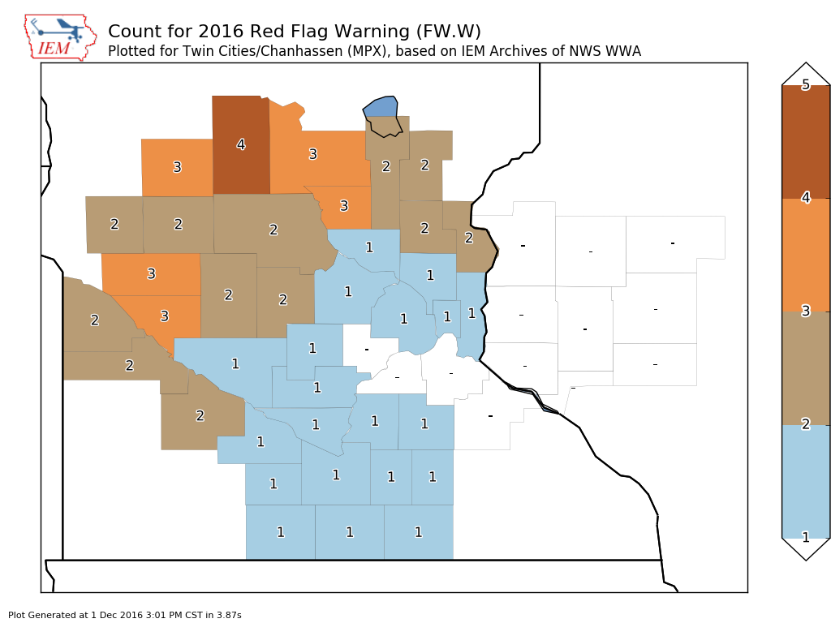

Twin Cities National Weather Service
2016 MPX Summary
Decision
Support
Services

Slide 18
Twin Cities National Weather Service
RFW Event Verification
Date | Counties Warned | Event Occurrences | Missed Counties | POD | FAR | CSI | Lead Time (hrs)
April 9 | 5 | 13 | 8 | 0.38 | 0.0 | 0.38 | 1.1
April 14 | 28 | 25 | 3 | 1.00 | 0.11 | 0.89 | 4.43
May 3 | 2 | 3 | 1 | 0.67 | 0.0 | 0.67 | 9.98
May 6 | 21 | 19 | 1 | 0.95 | 0.14 | 0.82 | 11.78
May 7 | 7 | 15 | 8 | 0.47 | 0.0 | 0.47 | 10.35
Decision
Support
Services

Slide 19
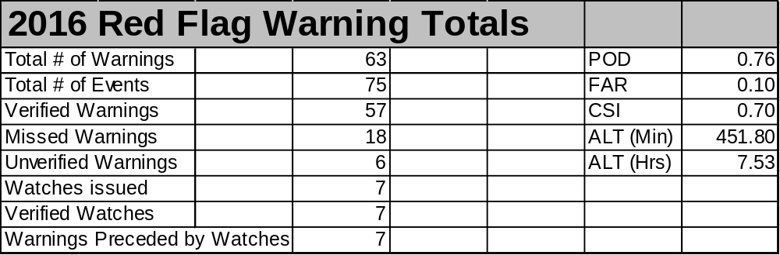
Twin Cities National Weather Service
2015 Overall RFW Verification
Decision
Support
Services

Slide 20
Twin Cities National Weather Service
RFW Verification Through the Years
 | 2016 | 2015 | 2014 | 2013 | 2012 | 2011 | 2010 | 2009 | 2008 | 2007
POD | 0.76 | 0.85 | 0.69 | 0.81 | 0.93 | 1.0 | 0.94 | 0.98 | 0.83 | 0.94
FAR | 0.10 | 0.11 | 0.48 | 0.00 | 0.21 | 0.19 | 0.04 | 0.38 | 0.00 | 0.30
CSI | 0.7 | 0.78 | 0.42 | 0.78 | 0.74 | 0.81 | 0.91 | 0.61 | 0.83 | 0.67
Events | 5 | 11 | 4 | 1 | 14 | 5 | 5 | 5 | 2 | 2
Lead Time (hrs) | 7.53 | 10.1 | 13.6 | 20.1 | 11.3 | 19.7 | 4.9 | 8.2 | 2.6 | 8.8
Decision
Support
Services

Slide 21
Twin Cities National Weather Service
MPX Spot Forecasts Issued
2016 | 2015 | 2014 | 2013 | 2012 | 2011 | 2010 | 2009 | 2008 | 2007 | 2006
328* | 265 | 262 | 172 | 309 | 200 | 244 | 271 | 270 | 197 | 212
* Record for spot requests in one year
323 prescribed, 3 wildfire*, and 2 HAZMAT
Average turn around time was about 11 minutes
2016 Spot Requests by Month
Jan | Feb | Mar | Apr | May | Jun | Jul | Aug | Sep | Oct | Nov
3 | 6 | 16 | 108 | 137 | 3 | 1 | 1 | 2 | 18 | 33
The outlier for spot numbers in 2016 was November
Decision
Support
Services

Slide 22
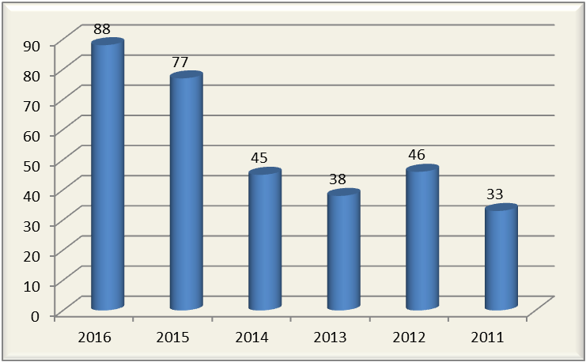
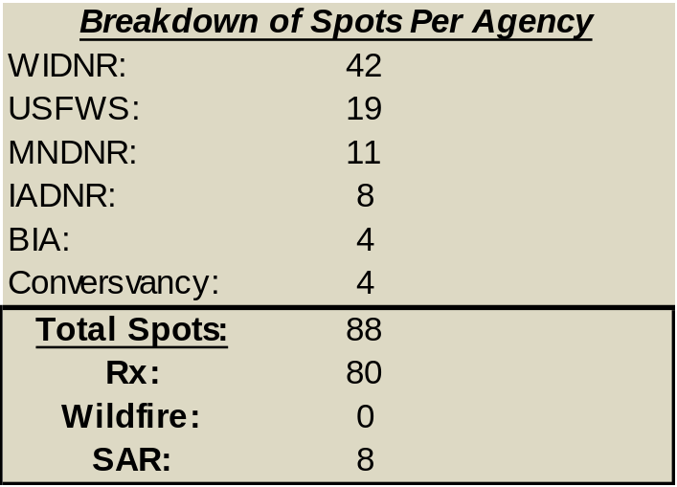
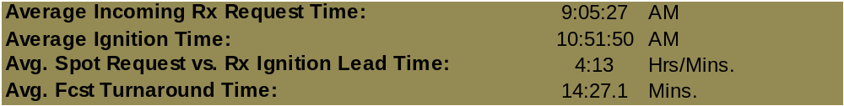
2016 WFO La Crosse Spot & RFW Stats
Number of Spots Since 2011
No Red Flag Warnings in 2016
1 Fire Weather Watch in Southeast Minnesota 4/15/16

Slide 23
Sioux Falls Fire Wx Stats
Spot Burns Since 2002
Year | Total Spot Burn Requests | No. of MN requests
2016 | 113 | 48
2015 | 120 | 57
2014 | 155 | 54
2013 | 133 | 38
2012 | 217 | 75
2011 | 197 | 36
2010 | 126 | 47
2009 | 148 | 68
Year | Total Spot Burn Requests | No. of MN requests
2008 | 137 | 74
2007 | 105 | 42
2006 | 126 | N/A
2005 | 104 | 65
2004 | 83 | 48
2003 | 71 | 51
2002 | 92 | N/A

Slide 24
Number of Spot Burn Requests since 2002, total and Minnesota Requests. Note that specific Minnesota requests for 2002 and 2006 are not available.

Slide 25
Sioux Falls Fire Wx Stats
Red Flag Warning Verification
Sioux Falls Red Flag Warning Verification by Year
 | POD | FAR | CSI | Mean Lead Time
2016 | 0.84 | 0.04 | 0.82 | 4.9 hours
2015 | 0.84 | 0.09 | 0.78 | 10.5 hours
2014 | 0.95 | 0.05 | 0.90 | 18.2 hours
2013 | 0.75 | 0.25 | 0.60 | 11.9 hours
2012 | 0.89 | 0.11 | 0.83 | 11.5 hours
2011 | 0.92 | 0.08 | 0.85 | 11.0 hours
2010 | 0.95 | 0.00 | 0.95 | 3.3 hours
2009 | 1.00 | 0.00 | 1.00 | 5.8 hours
2008 | 0.83 | 0.00 | 0.83 | 3.1 hours
2007 | 1.00 | 0.00 | 1.00 | 0.0 hours
2006 | 0.93 | 0.13 | 0.82 | 9.2 hours
2005 | 0.80 | 0.00 | 0.80 | 5.8 hours
2004 | 0.30 | 0.00 | 0.30 | 5.0 hours
2003 | 0.87 | 0.00 | 0.87 | 6.2 hours
Small number of events in 2014 helped to give favorable statistics concerning red flag verification

Slide 26
Sioux Falls Fire Wx Stats
Number of Red Flag “Days”
Number of Red Flag days by state and year in the Sioux Falls forecast area
 | South Dakota | Minnesota | Iowa | Nebraska
2016 | 8 | 3 | 6 | 5
2015 | 20 | 9 | 9 | 12
2014 | 3 | 2 | 3 | 3
2013 | 3 | 3 | 5 | 3
2012 | 24 | 14 | 18 | 17
2011 | 8 | 7 | 9 | 6
2010 | 5 | 2 | 4 | 2
2009 | 2 | 2 | 2 | 2
2008 | 5 | 3 | 5 | 4
2007 | 1 | 1 | 2 | 1
2006 | 8 | 1 | 1 | 0
2005 | 4 | 3 | 3 | 2
2004 | 3 | 2 | 2 | 0
2003 | 1 | 2 | 1 | 1
The hot and dry summer of 2012 really stands out

Slide 27
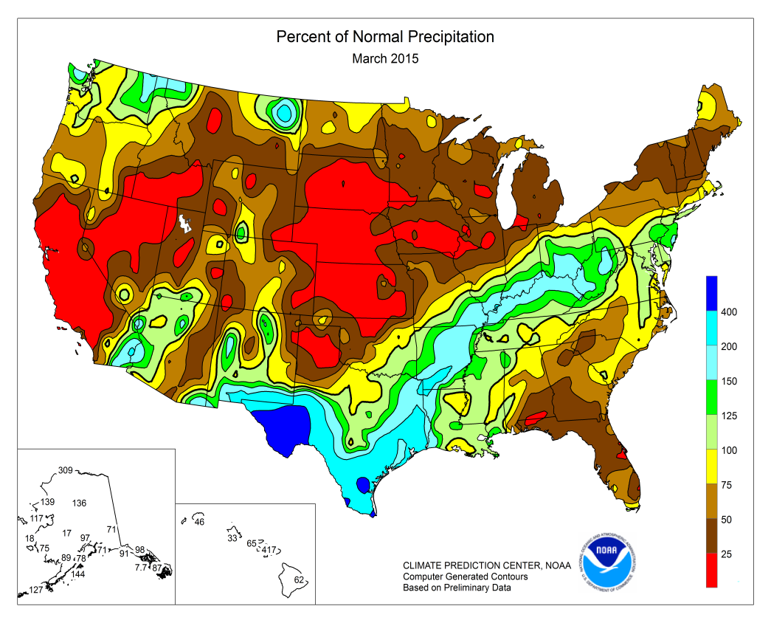
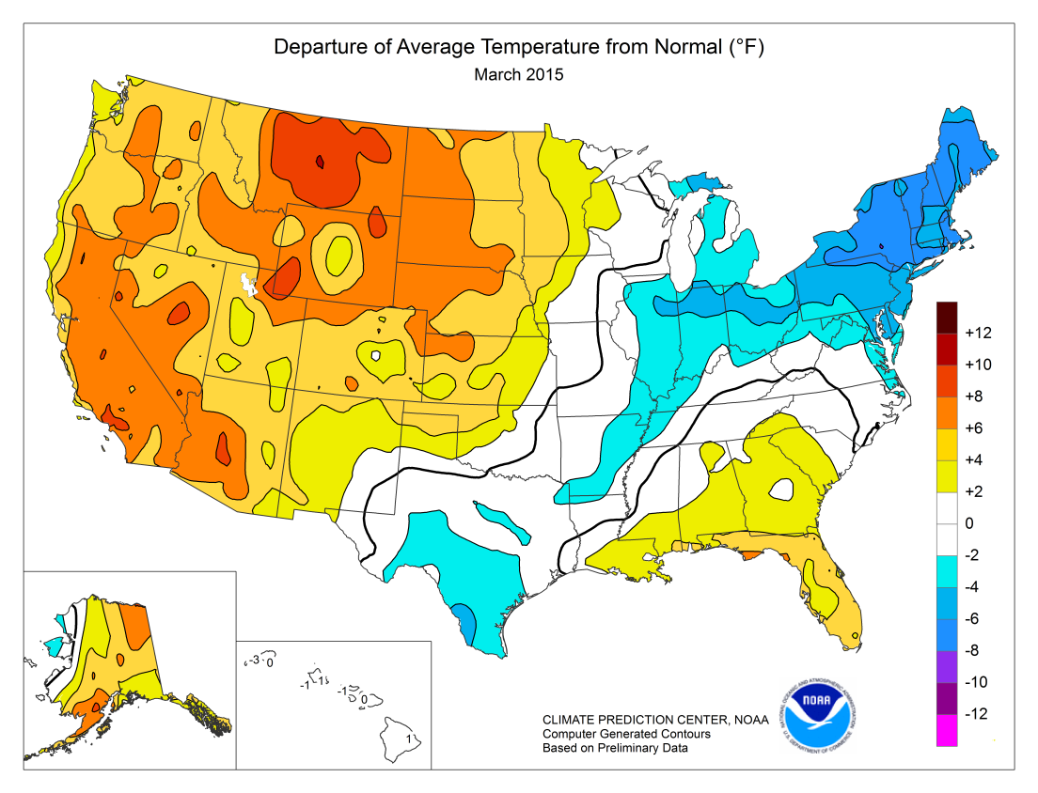
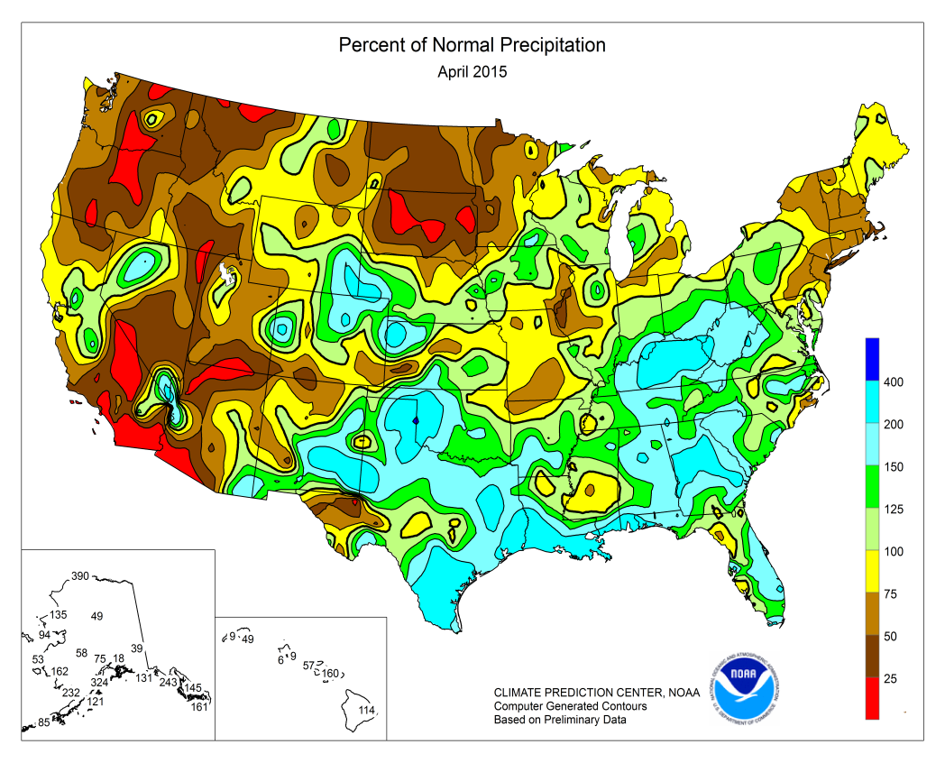
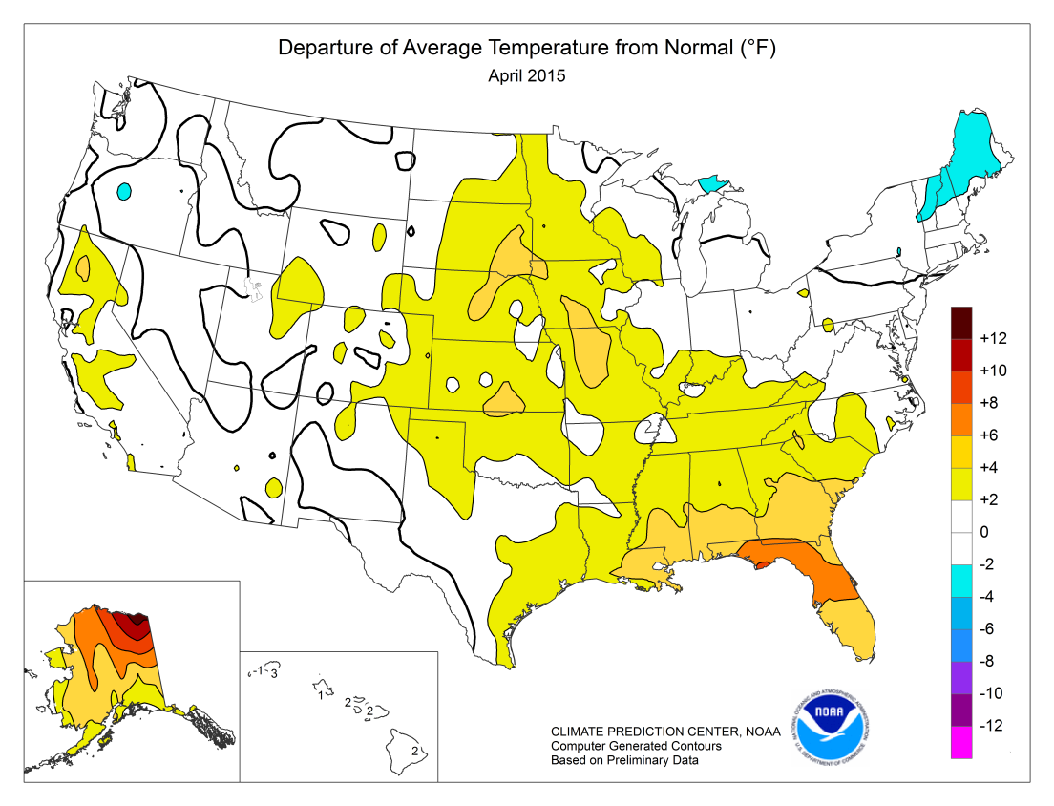

Slide 28
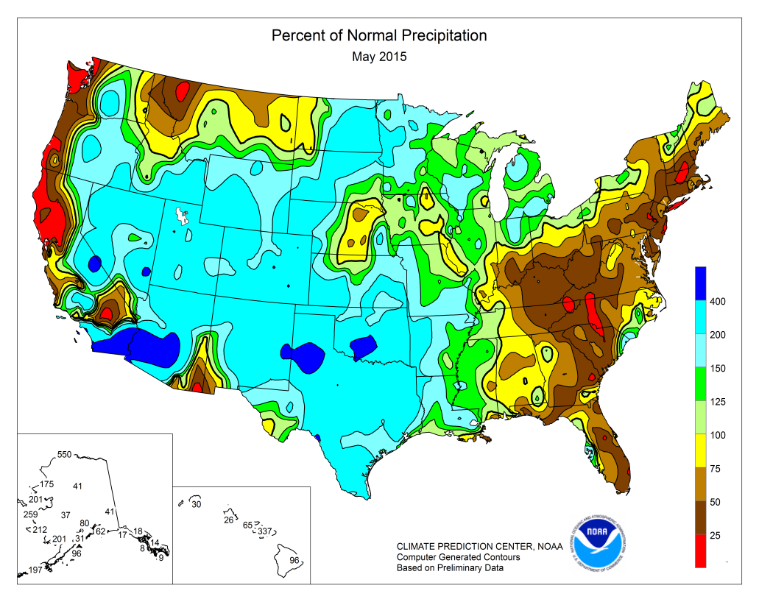
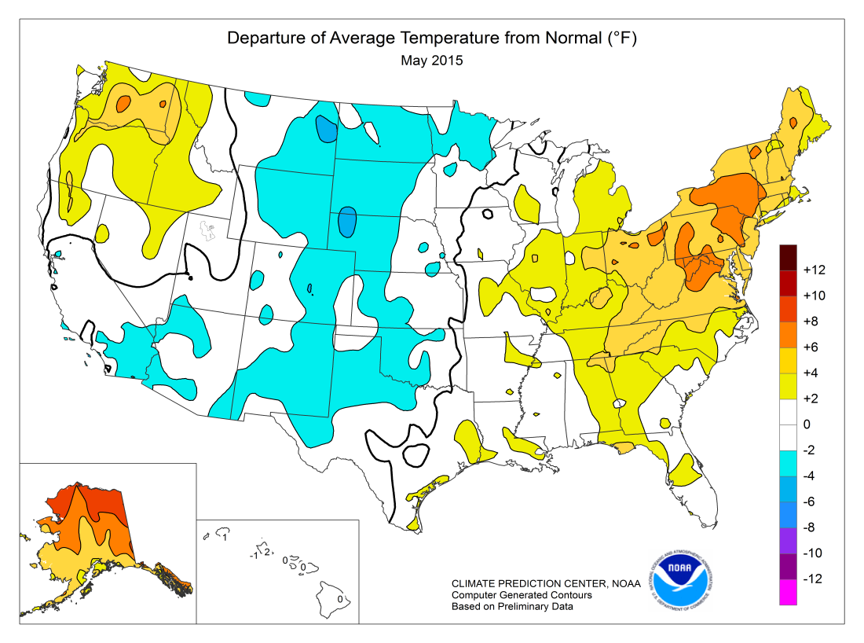
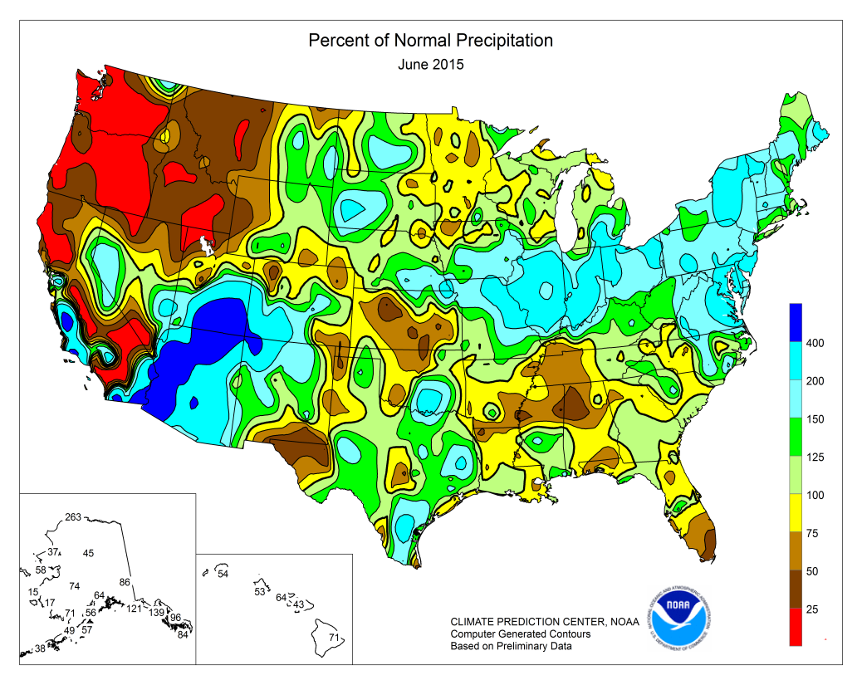
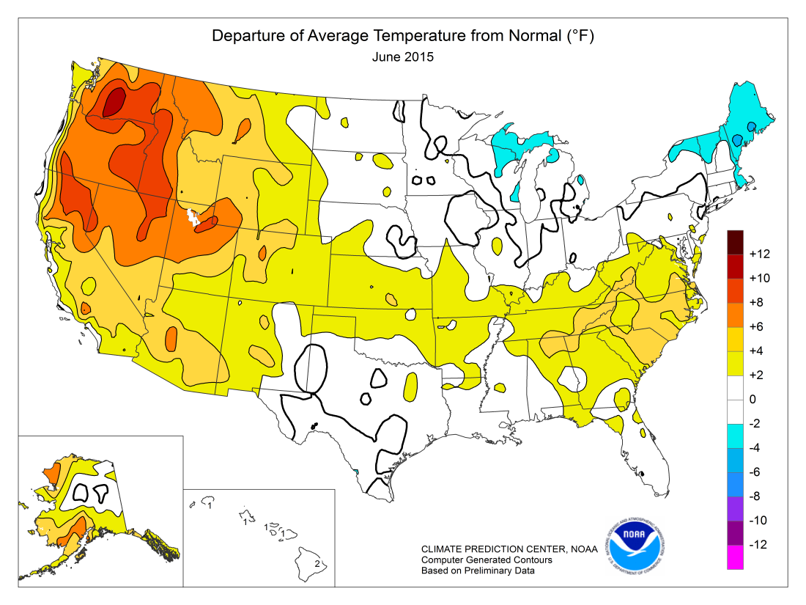

Slide 29
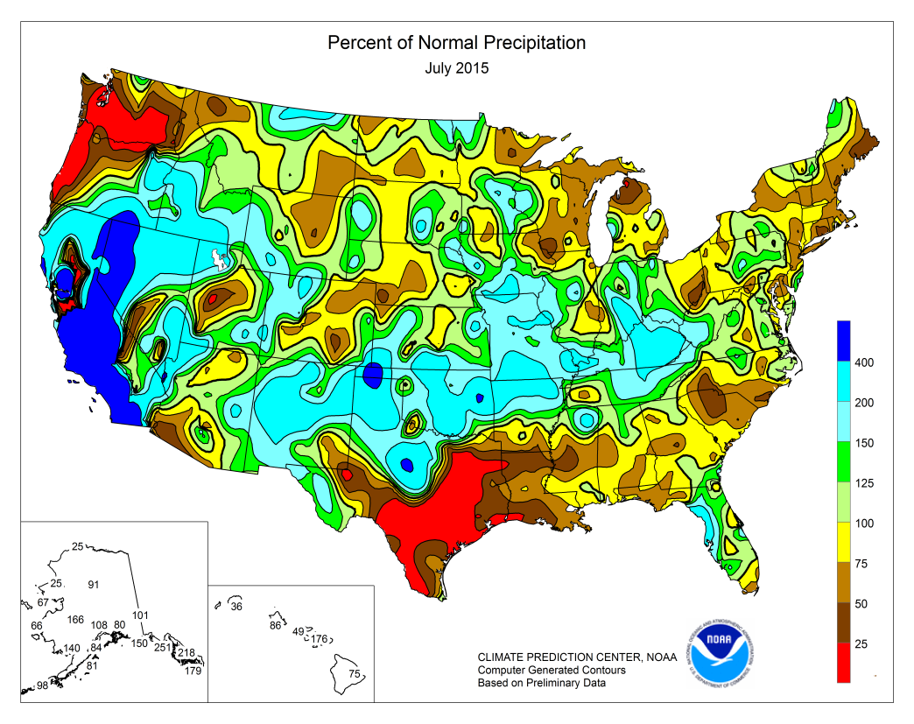
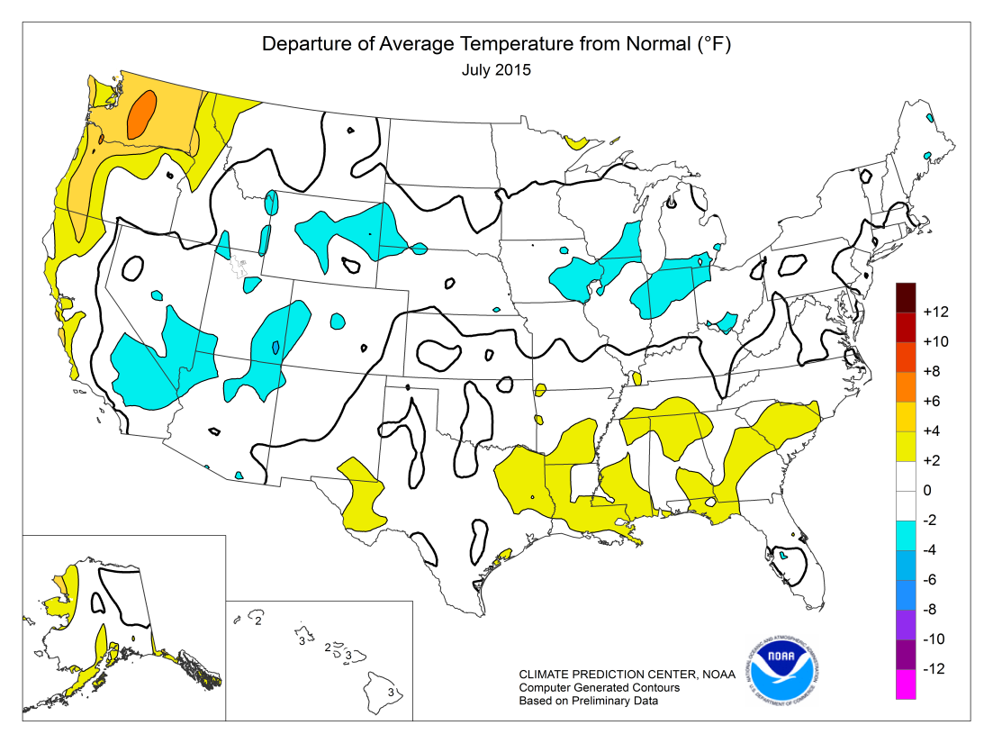
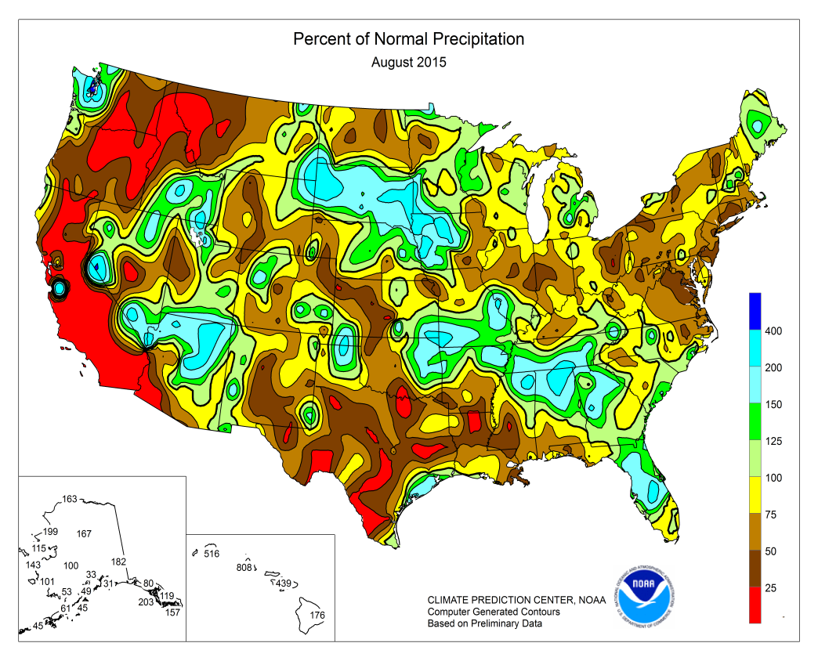
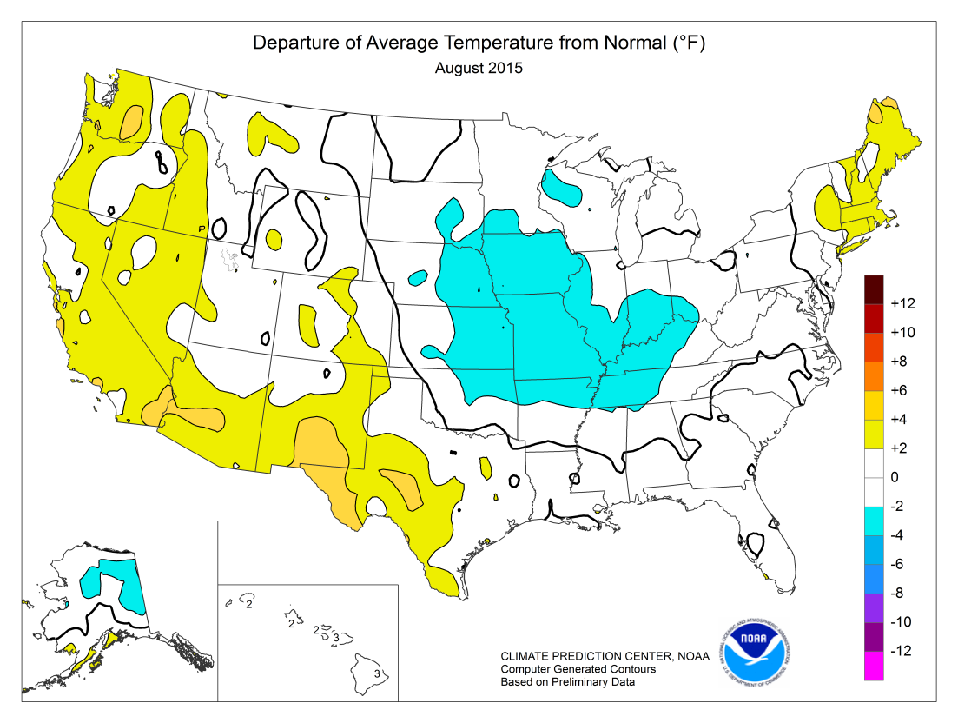

Slide 30
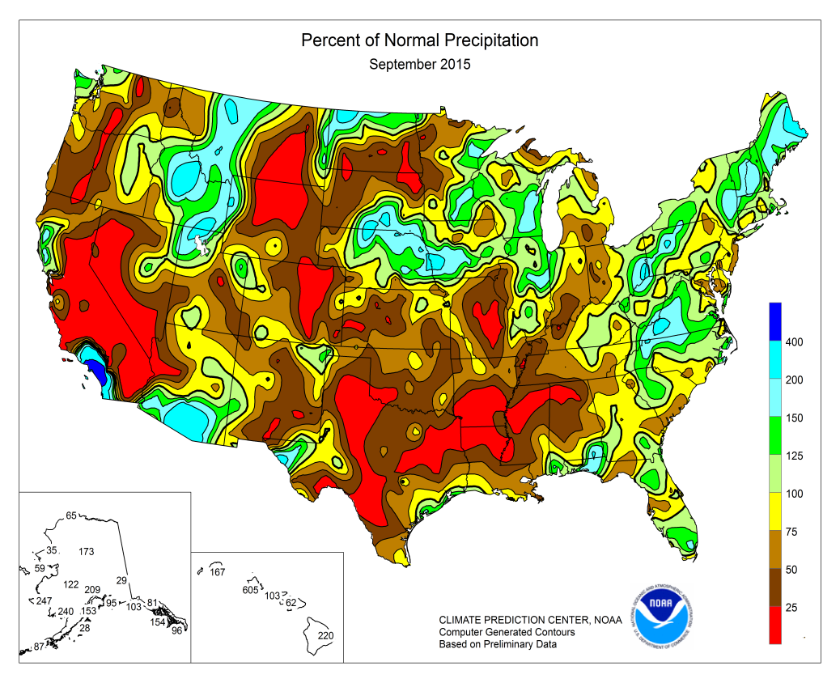
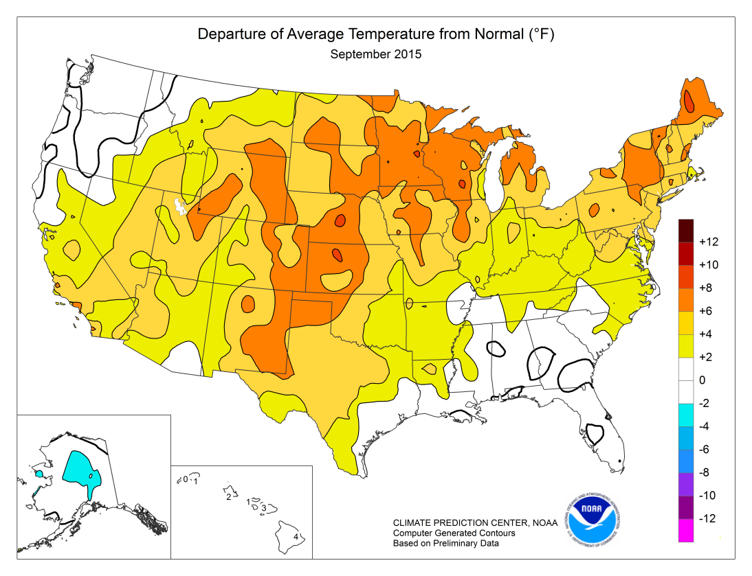
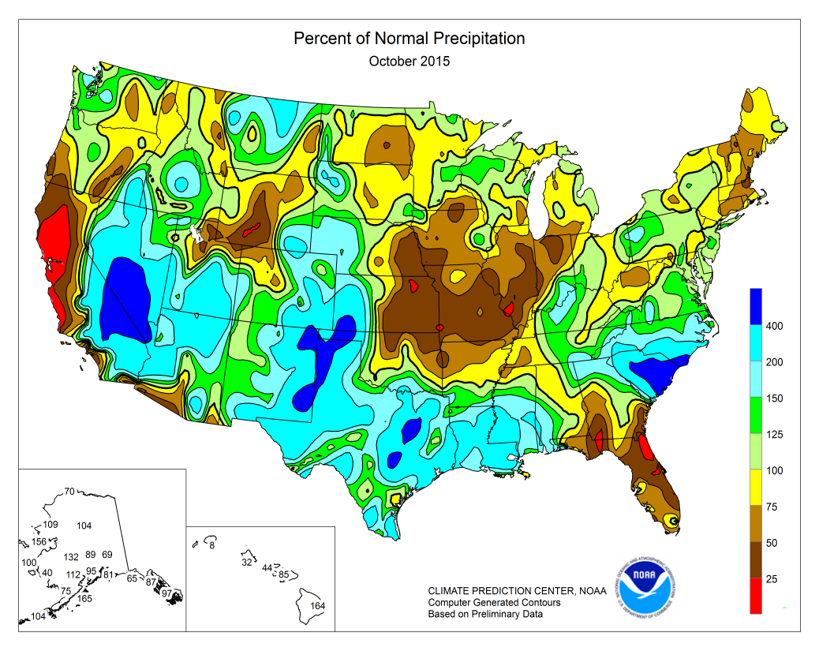
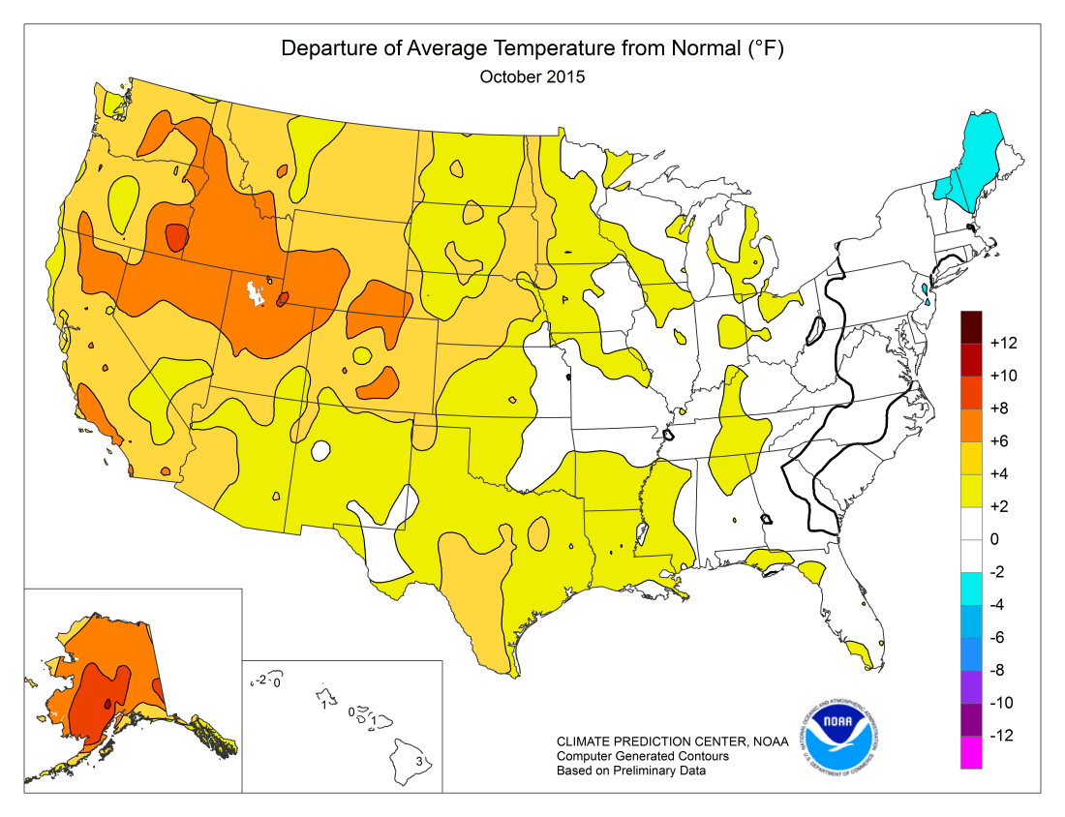

Slide 31
Spot Forecasts for NWS Aberdeen
2005 – 2016
Big spike this year due to large prescribed burn training in May
Hosted by the Sand Lake Wildlife Refuge

Slide 32
2016 Red Flag Stats
NWS Aberdeen
2016 Red Flag Warning Totals
Total # of Warnings |  | 31 |  |  | POD |  | 0.85
Total # of Events |  | 27 |  |  | FAR |  | 0.26
Verified Warnings |  | 23 |  |  | CSI |  | 0.66
Missed Warnings |  | 4 |  |  | ALT (Min) |  | 436.63
Unverified Warnings |  | 8 |  |  | ALT (Hrs) |  | 7.28
Watches issued |  | 8 |  |  | Total Min |  | 11789
Verified Watches |  | 6
Warnings Preceded by Watches |  | 8
Big Stone / Traverse Counties
4/9/16 – Verified Red Flag warning with 20-25% RH and 35-45 mph wind gusts
4/14/16 – Verified Red Flag warning with 20-25% RH and 30-40 mph gusts

