Slide 1
Great Lakes Fire Weather Upgrade
GLFFC

Slide 2
GLFFC Weather Project
Move the project to cloud base computing
3 day hourly forecast or however long precip forecast are predicted
Calculate behave run values for Canadian behave models
Graphically display the behave spread shape by a selected point on the map or latitude and longitude
Display Growing season index
Grab historical NFDRS
Allow a staffing level to be calculated and displayed similar to current fire danger
Have an option to export data directly into the Red App
Develop a “Fire Prescription Planner” (additional proposal)

Slide 3
1. Move the project to cloud based computing
Existing infrastructure is aged.
Rather than replace hardware, cloud service will be upgraded more frequently.
Allows for redundancy and minimizes risk of downtime.
Costs will be distributed across the entire maintenance agreement period.

Slide 4
2. 3 day hourly forecast
Dependent on the timing of the NDFD grids provided by the NWS
  Certain times of the day it might be 66-72 hours in length.
  Possibly able to leverage some work for Alaska and do daily calcs out longer using NWS model guidance.

Slide 5
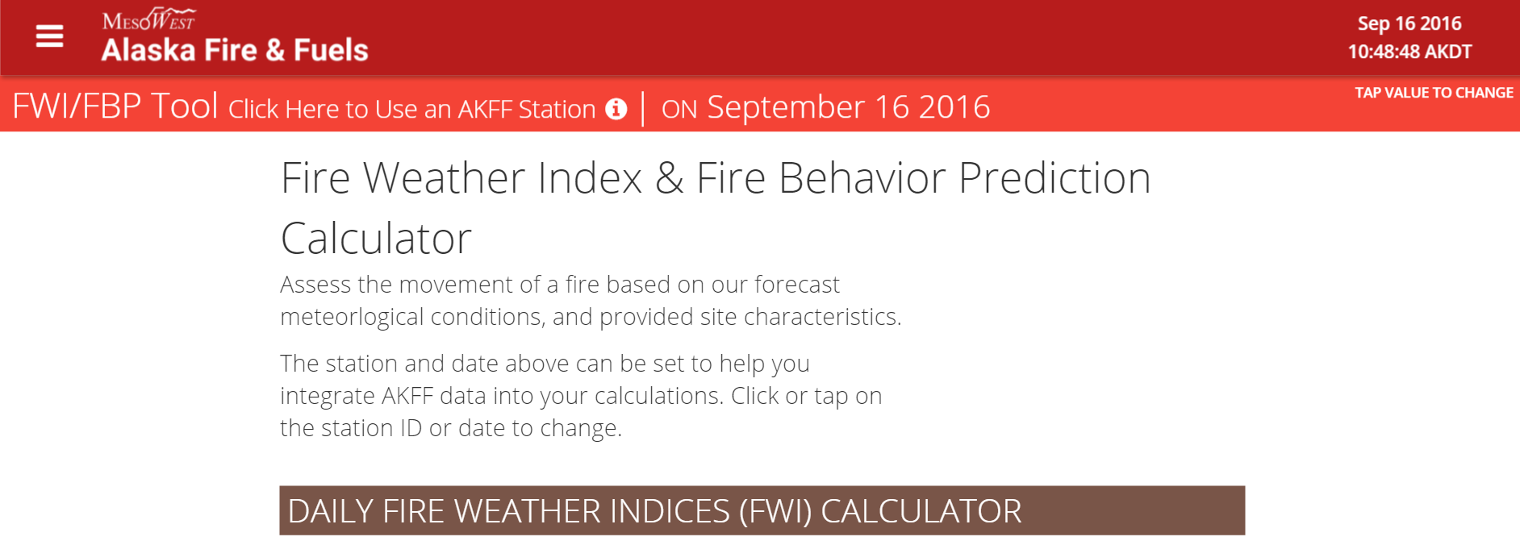
3. Calculate fire behavrior for Canadian models
This would take advantage of the development work for Alaska for the Fire Behavior Calculator.
http://akff.mesowest.org/tools/fbp/

Slide 6
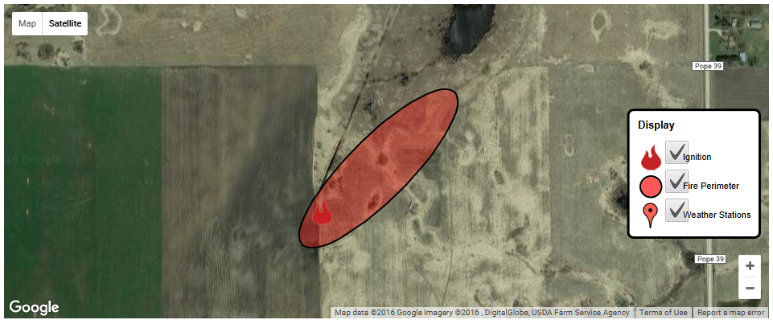
4. Graphically display the spread ellipsoid
Selected point on the map or latitude and longitude
Also shift the location after you run it the first time, etc.
Similar to RedApp process.

Slide 7
5. Display Growing season index
New element in the NFDRS 2016 version.
The Growing Season Index is a simple metric of plant physiological limits to photosynthesis.
It is highly correlated to the seasonal changes in both the amount and activity of plant canopies.
It predicts the green-up and senescence of live fuels and the influence of water stress events on vegetation.

Slide 8
6. Grab historical NFDRS
Continue to provide NFDRS values that are calculated from WIMS.
Show historical values that are provided from WFAS.

Slide 9
7. Allow a staffing level to be calculated
Displayed similar to current fire danger
Will be able to be toggled by state for those that don’t wish to display publicly

Slide 10
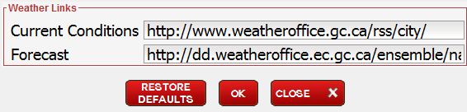
8. Have an option to export data directly into the Red App
RedApp will have US conversion installed in the next version that will be out this Fall.
Two data streams will need to be maintained for:
  Current Conditions
  Forecast Conditions
Will allow for offline calculations and act as a replacement for the current Remsoft Behave+ software.

Slide 11
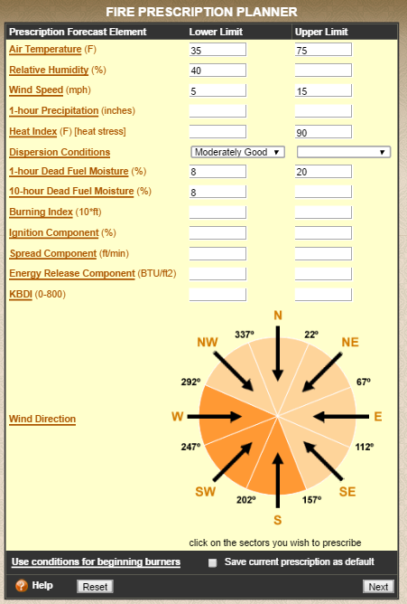
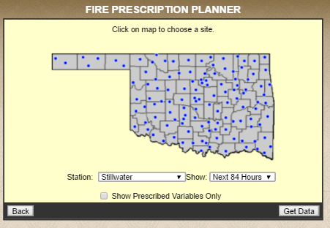
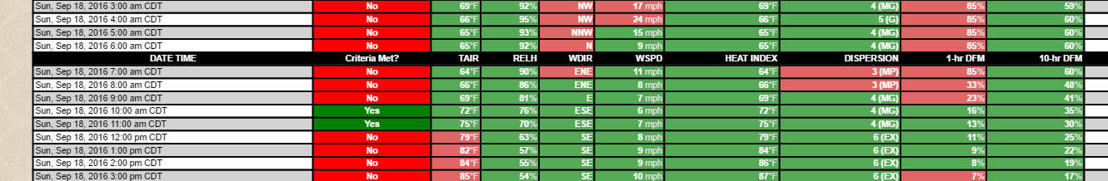
9. Develop a “Fire Prescription Planner” (additional proposal)
Similar to the OK Mesonet product
Will use CFFDRS / FBP indices and values.

Slide 12
GLFFC Weather Project
Current proposed estimated cost for items 1-8:
  $50,000
New “Fire Prescription Planner” (additional proposal):
  $10,000
Total Project cost: $60,000 plus
Annual Maintenance cost of $12,500 per year
Questions

