Slide 1
MN 2016 Fire Summary
2016 MN Fire Weather Meeting
Notes:
Review 2016 Meeting Notes - ??
Review Weather of 2016 - ??
MN 2016 Fire Summary - B.J. (MN DNR)
Climate Outlooks for 2017 – ??
IMET Program Update - Amanda
New SPOT Page - OMG Finally - ??
NFDRS, New Fuel Models - B.J. (MN DNR)
Weather Shield - B.J. (MN DNR)
New Forecast Builder/Future of NWS - ??
Routine FWF morning update - Amanda/Bill (DLH)
SPOT/Red Flag Statistics – Focal Points

Slide 2
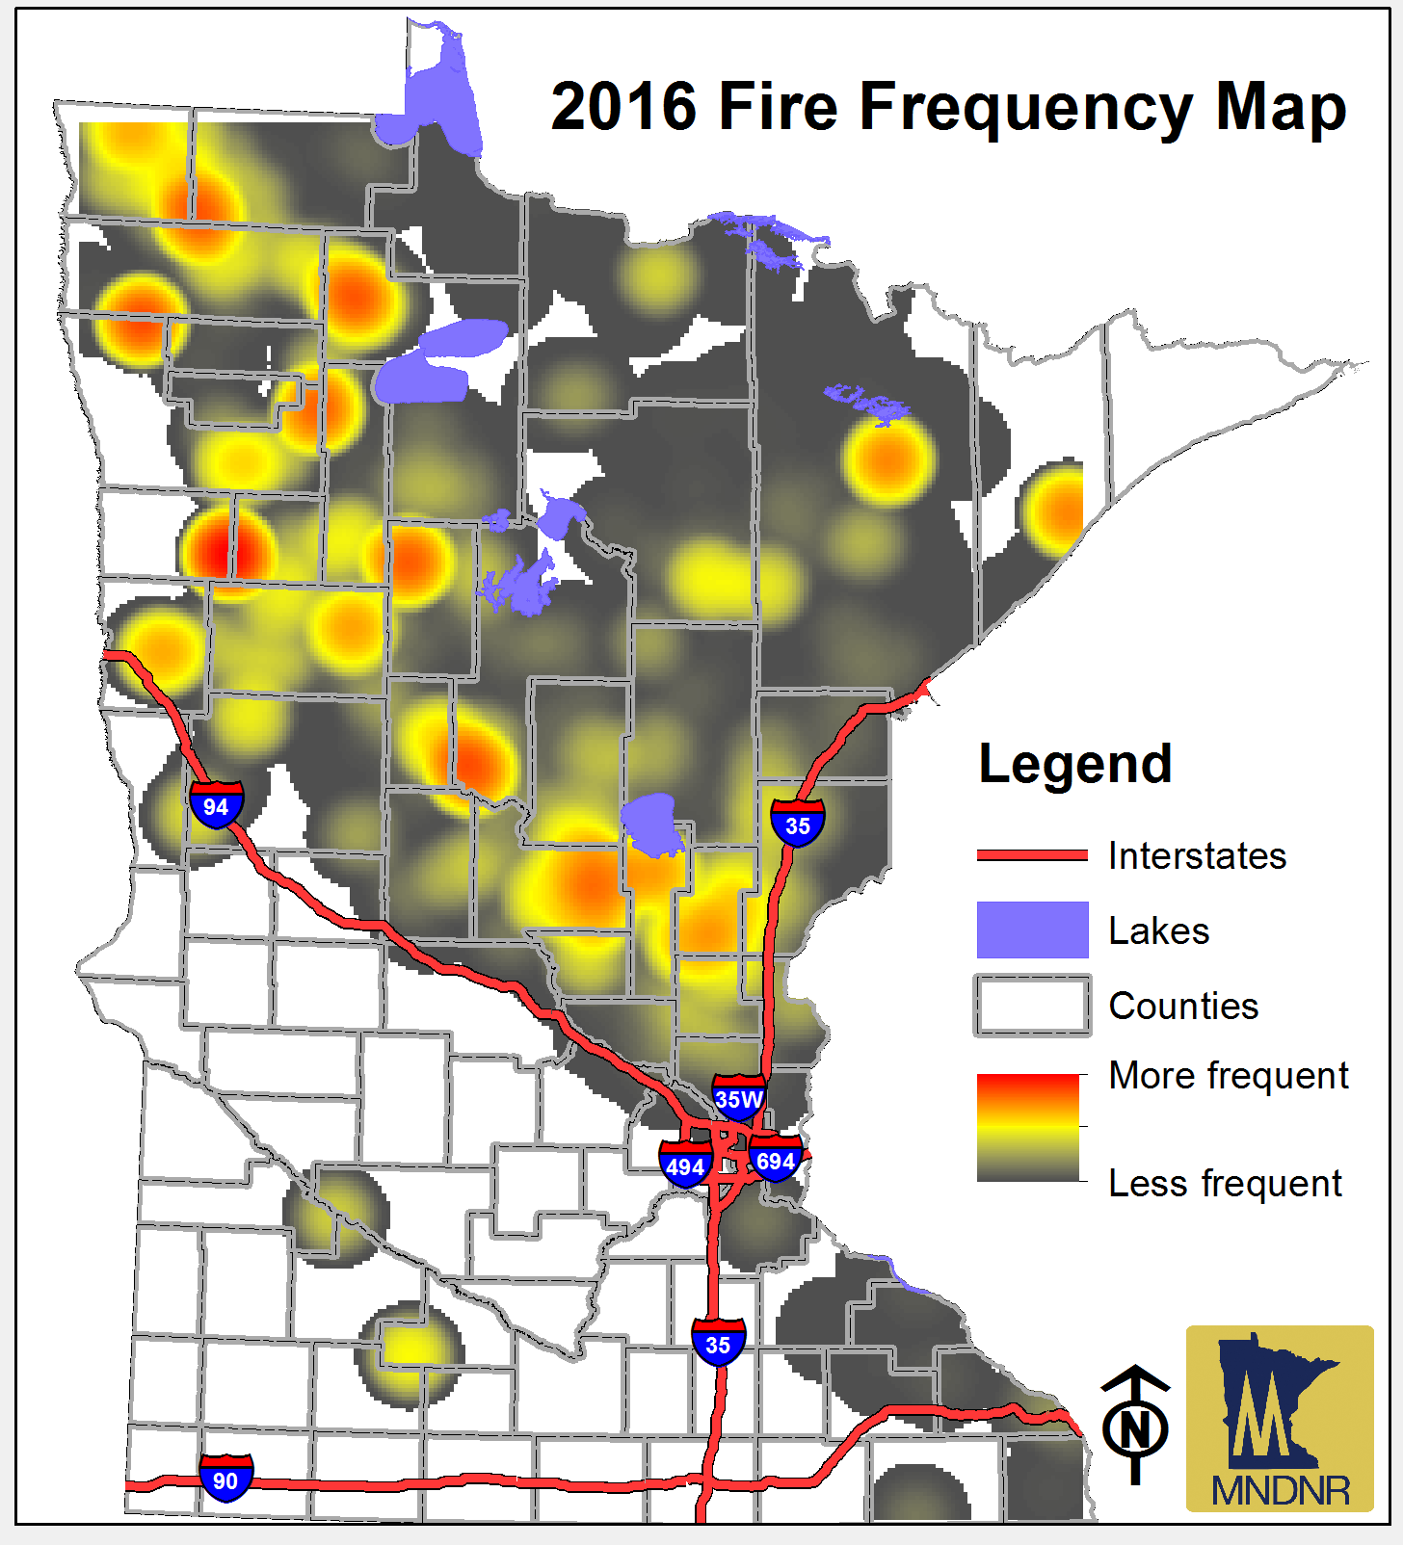
2016 Fire Activity
Agency | RX | RX acres | WF | WF Acres
State | 259 | 31045 | 821 | 7567
BIA | 29 | 44229 | 509 | 1781
USFS | 91 | 5600 | 64 | 2016
NPS | 5 | 350 | 4 | N/a
USFWS | 147 | 26016 | 14 | 933
TOTAL | 531 | 107,240 | 1412 | 12,297
Days at Planning Levels (June – Sept) | 1 | 2 | 3 | 4 | 5
 | 6 | 74 | 28 | 14 | 0
Notes:
Above average Rx Acres
Below average wildland f

Slide 3
Synopsis of Large Fire Activity
Wildland Fire
  Lyons
  Lake Hattie
  Skibo
  Foss Lake
  Hut Two
  Taylor Road
All Hazard
  July 5 Blowdown
  July 21 Blowdown
  Beartown Assist
  2o16 Wildfire Academy

Slide 4
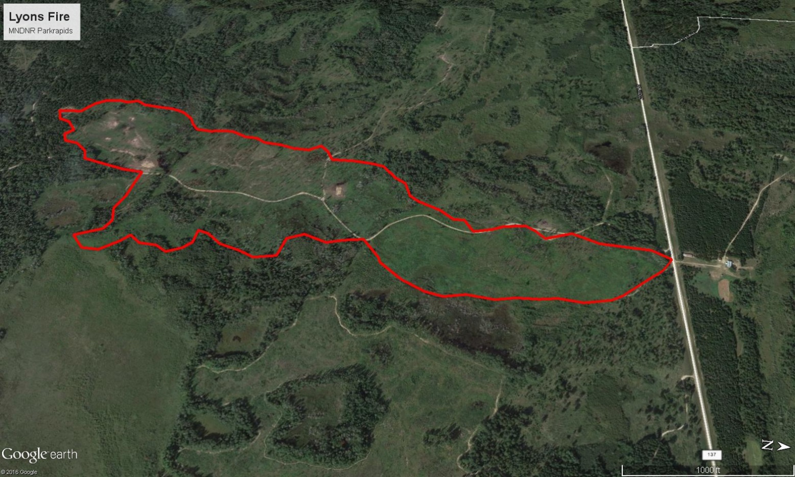
Lyons
FFMC | DMC | DC | ISI | BUI | FWI | County | Acres burned
93.6 | 36 | 92.5 | 13.6 | 36.5 | 23.7 | Wadena | 100
Notes:
2 Residences threatened.

Slide 5
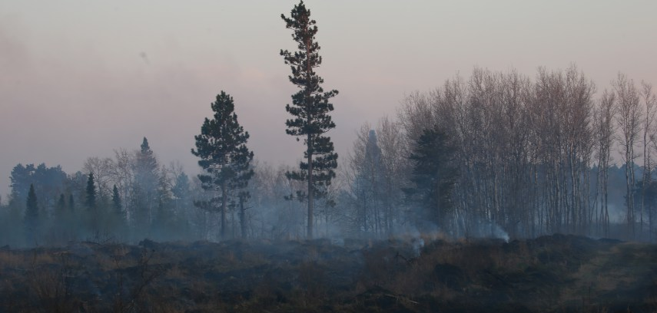
Lake Hattie
FFMC | DMC | DC | ISI | BUI | FWI | County | Acres burned
94 | 38.8 | 85.9 | 12.3 | 38.8 | 22.7 | Hubbard | 356
Notes:
2 residences threatened
99 personnel assigned

Slide 6
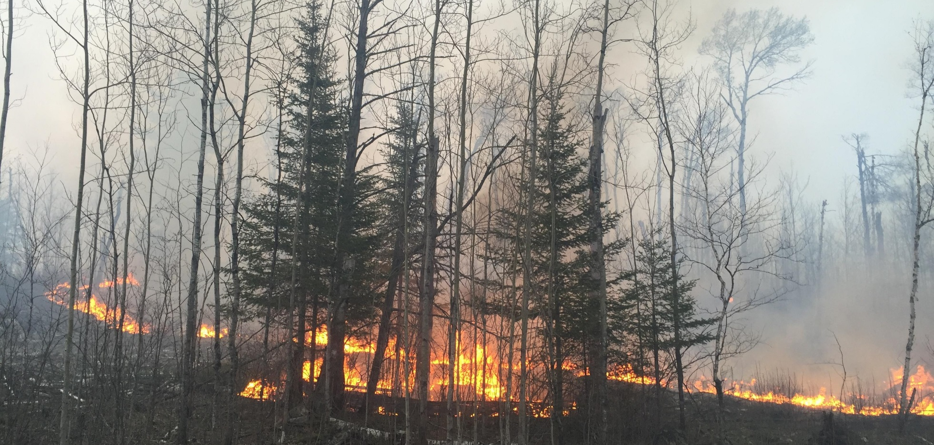
Skibo
FFMC | DMC | DC | ISI | BUI | FWI | County | Acres burned
94.6 | 37.8 | 65.1 | 15.7 | 37.6 | 26.5 | St. Louis | 973

Slide 7
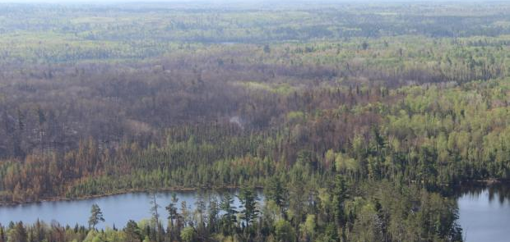
Foss Lake
FFMC | DMC | DC | ISI | BUI | FWI | County | Acres burned
92 | 43.7 | 126.8 | 15.2 | 47 | 28.8 | St. Louis | 936

Slide 8
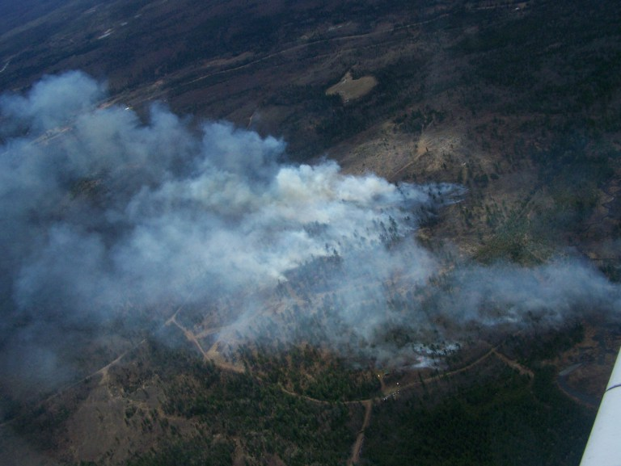
Hut Two
FFMC | DMC | DC | ISI | BUI | FWI | County | Acres burned
89.1 | 32 | 50.1 | 7.8 | 31.8 | 14.7 | Lake | 257

Slide 9
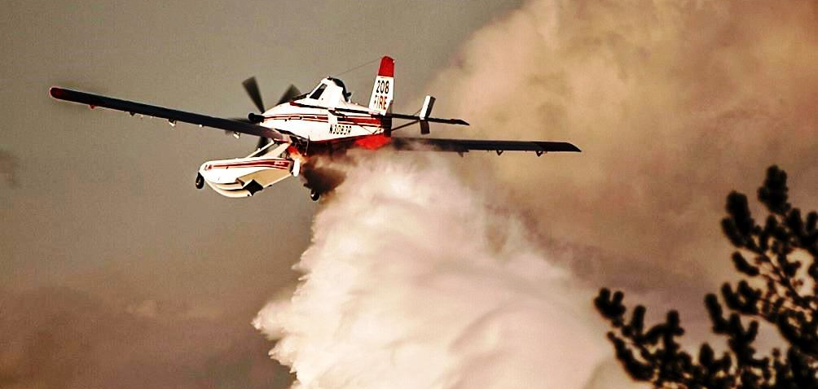
Taylor Road
FFMC | DMC | DC | ISI | BUI | FWI | County | Acres burned
93.3 | 41.1 | 70.4 | 13.1 | 40.9 | 24.4 | St. Louis | 250
Notes:
30 residences, 60 minor structures
2 injuries; IMT 3 Metro All Hazard Team assigned

Slide 10
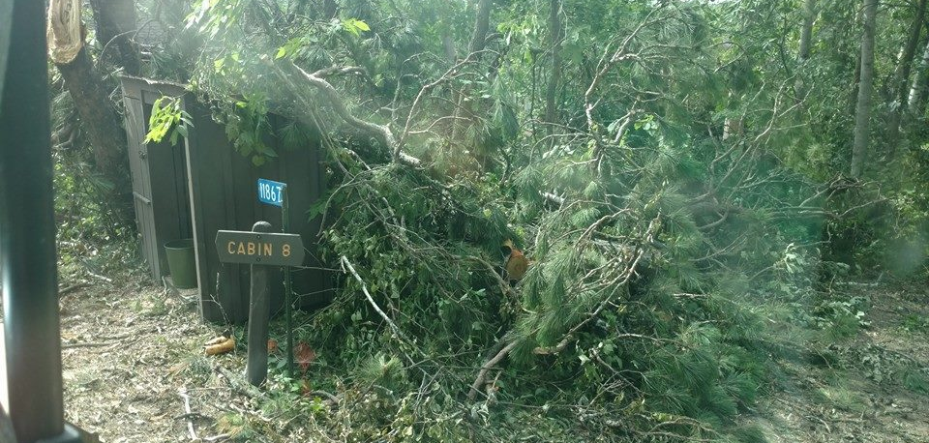
July 5 & July 21 Blowdown
A total of 21 counties had been affected by summer storms. Summer rains exceeded 200% of normal in many areas.

Slide 11
MN 2017 Fire Outlook
2016 MN Incident Command System Annual Meeting
Notes:
Review 2016 Meeting Notes - ??
Review Weather of 2016 - ??
MN 2016 Fire Summary - B.J. (MN DNR)
Climate Outlooks for 2017 – ??
IMET Program Update - Amanda
New SPOT Page - OMG Finally - ??
NFDRS, New Fuel Models - B.J. (MN DNR)
Weather Shield - B.J. (MN DNR)
New Forecast Builder/Future of NWS - ??
Routine FWF morning update - Amanda/Bill (DLH)
SPOT/Red Flag Statistics – Focal Points

Slide 12
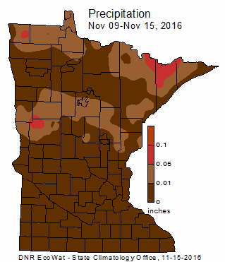
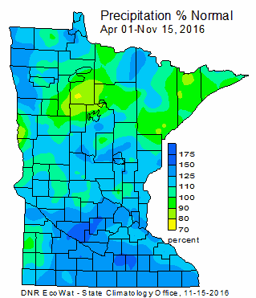
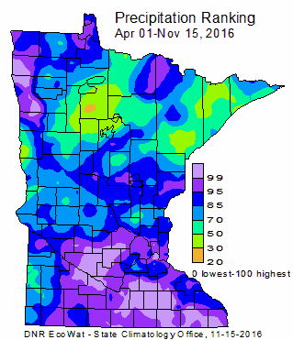
Current Conditions

Slide 13
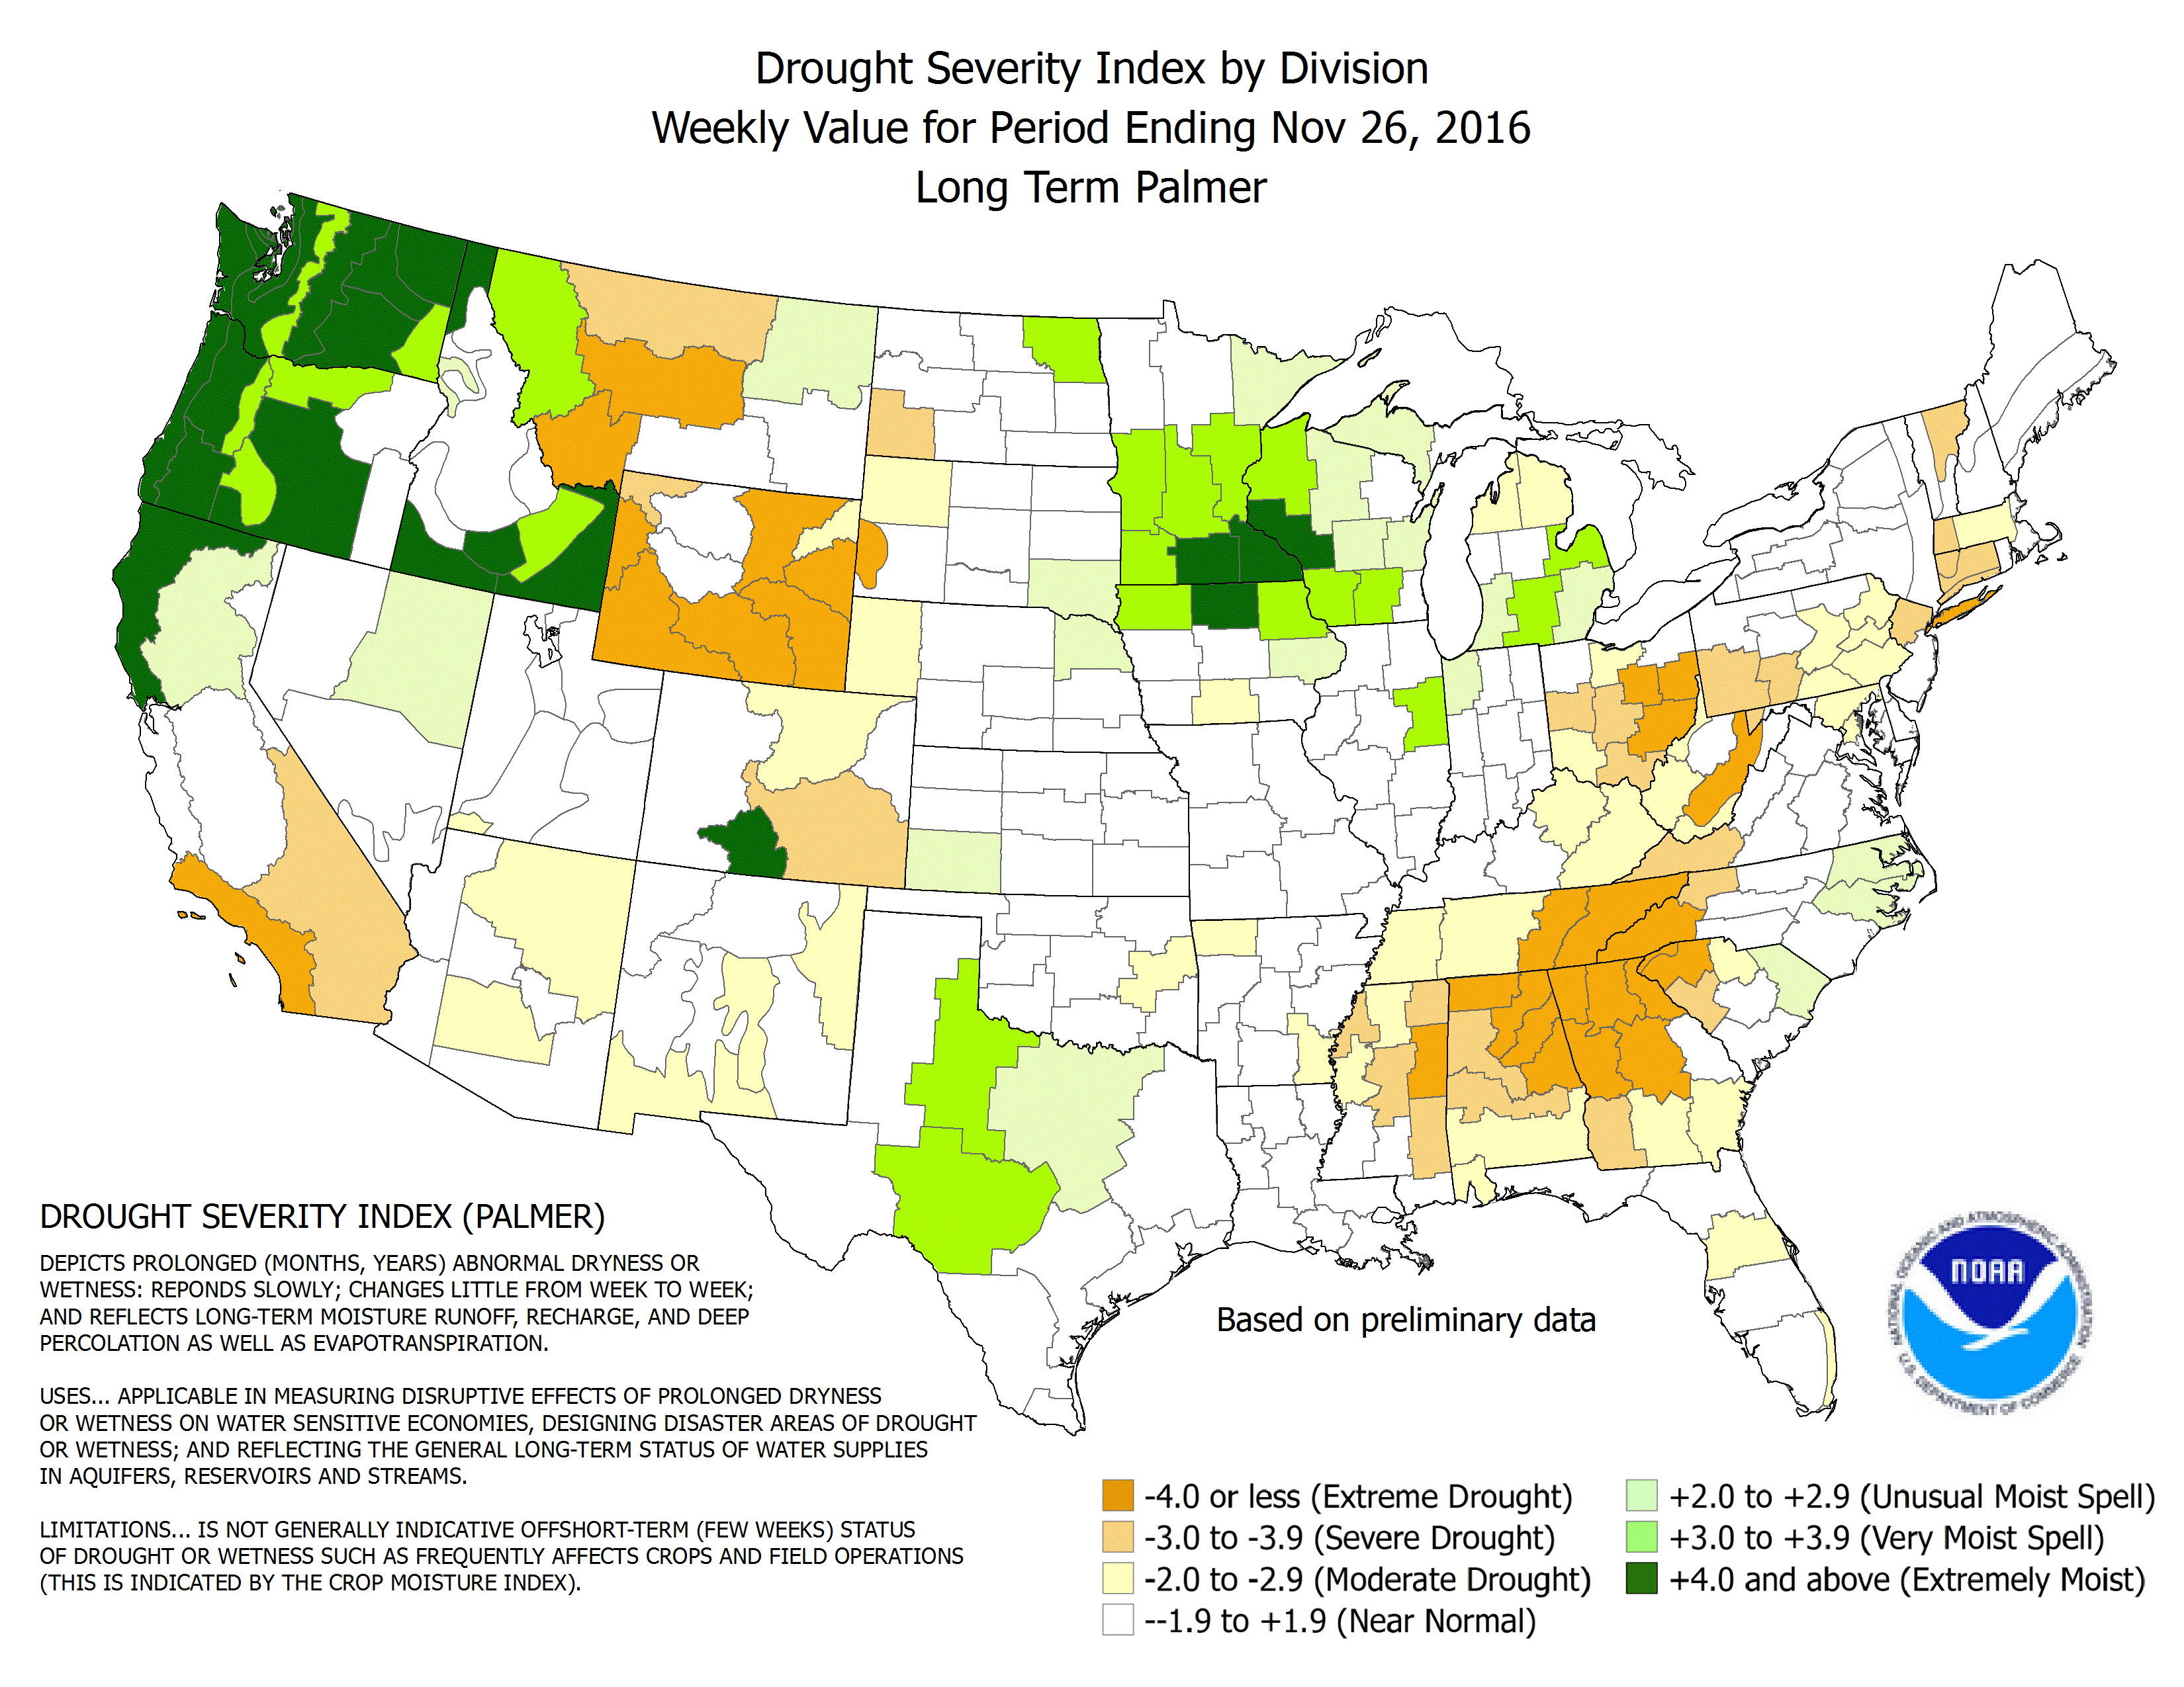
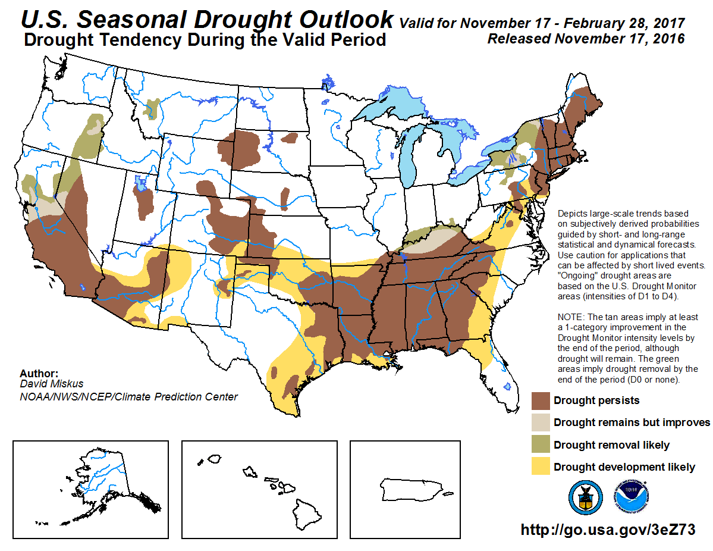
Current Drought Conditions

Slide 14
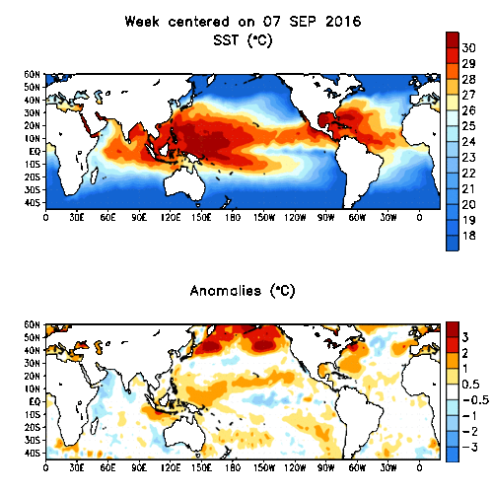
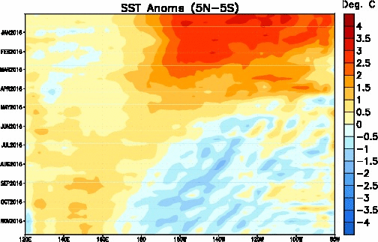
SST and Anomaly Maps
La Nina
Notes:
La Niña conditions are present.*
Equatorial sea surface temperatures (SST) are below average in the central and east-central Pacific Ocean.
La Niña is slightly favored to persist (~55% chance) through winter 2016-17.*

Slide 15
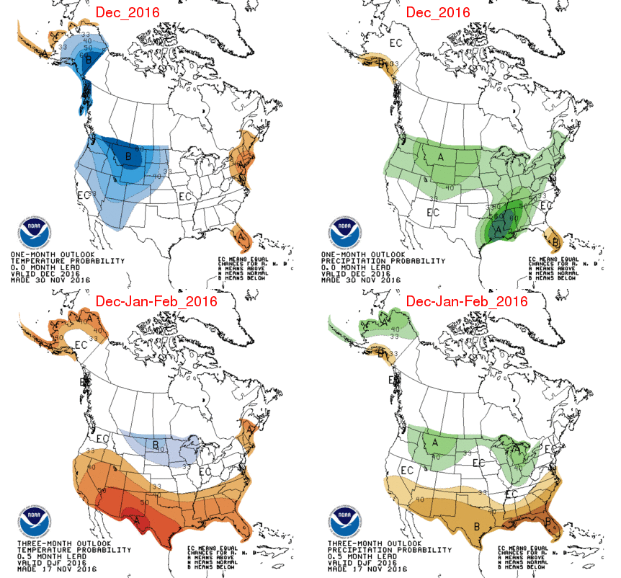
Climate Prediction Center Anomaly Maps

Slide 16
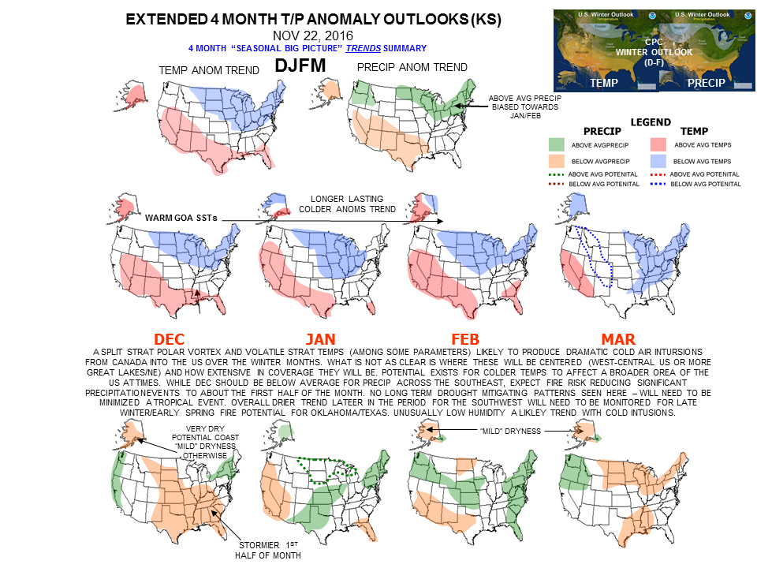
Predictive Services Anomaly Maps

Slide 17
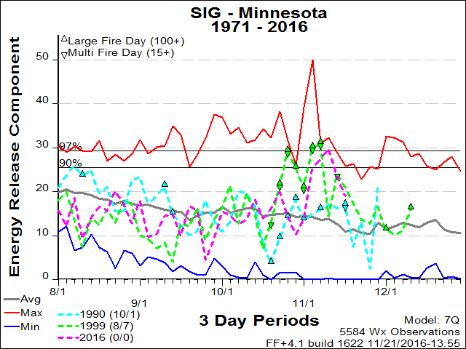
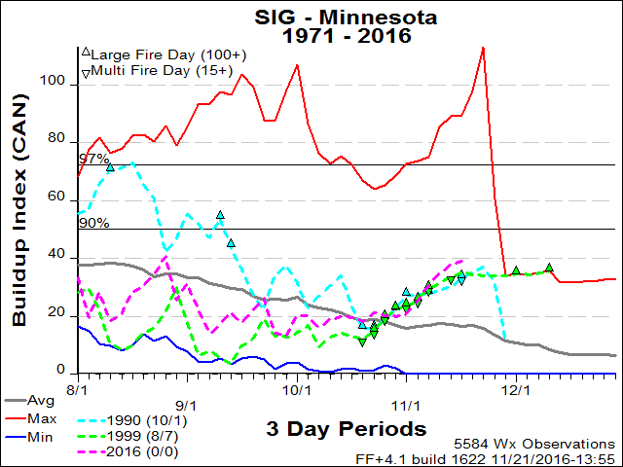
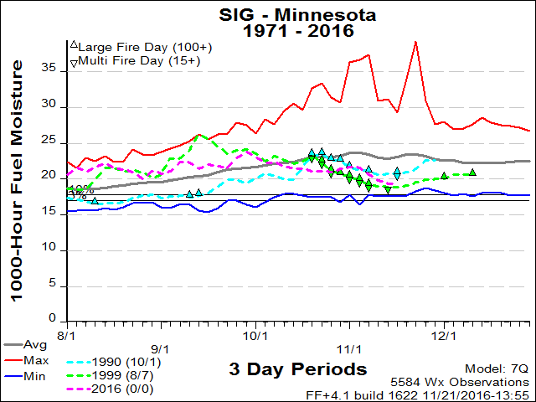
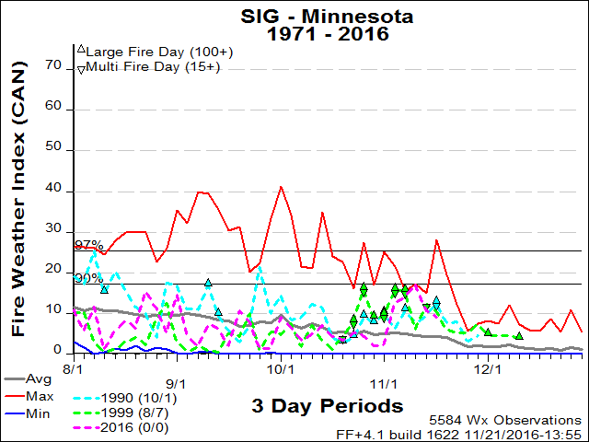
Fire Family Plus Comparisons

Slide 18
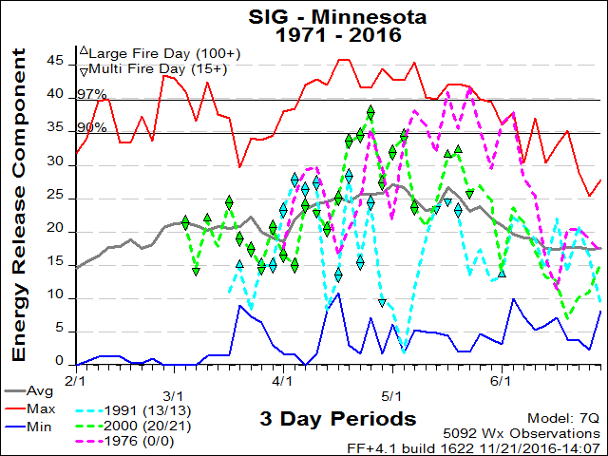
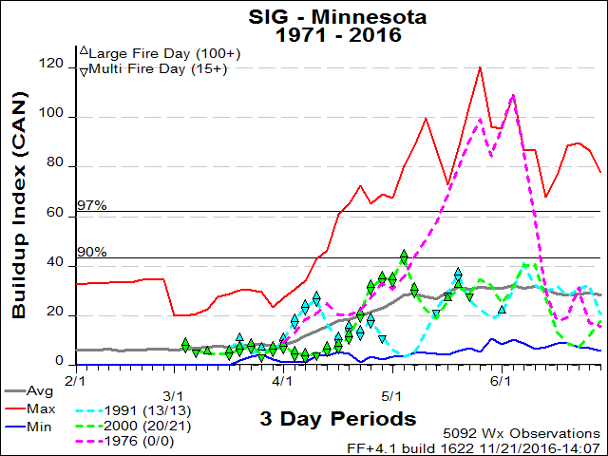
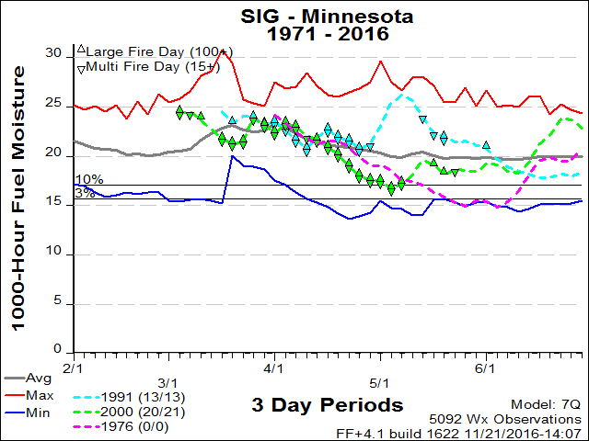
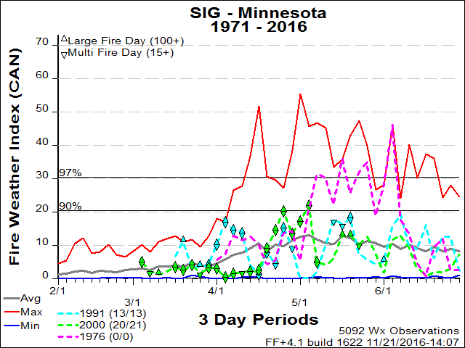
FF+ Spring 2017 Analog Years

Slide 19
Summary
Cooler winter with more snow in January and February.
May see a somewhat earlier start if March drying occurs…
With normal fire occurrence for the start of the season.
End of April / beginning of May will be telling.
Potential for a late spring season more like 1976.
3-5 large fires
Initiation of the next Drought Cycle.
Will revisit in February and…after…

Slide 20
