Slide 1

Chun Yi Wu
Air Emission Inventory – Update on 2014 Wildland Fires
Air Emissions Inventory
Minnesota Pollution Control Agency
Environmental Analysis and Outcomes Division

Slide 2
EPA has addressed all comments EPA received on the draft inventory that was posted in June
EPA has also included all activity data that was submitted into the processing of the v1 emission estimates
For those states that did not submit activity data, we used nationally available datasets and satellite detects.

Slide 3
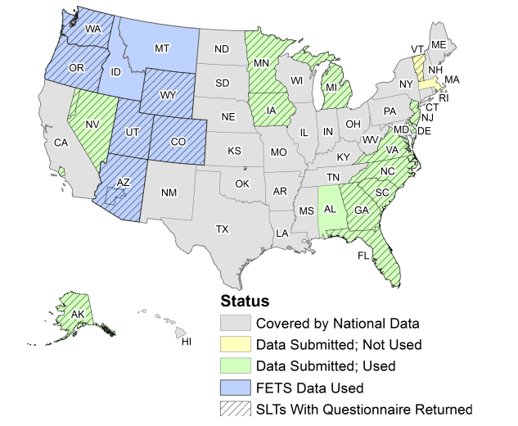

Slide 4
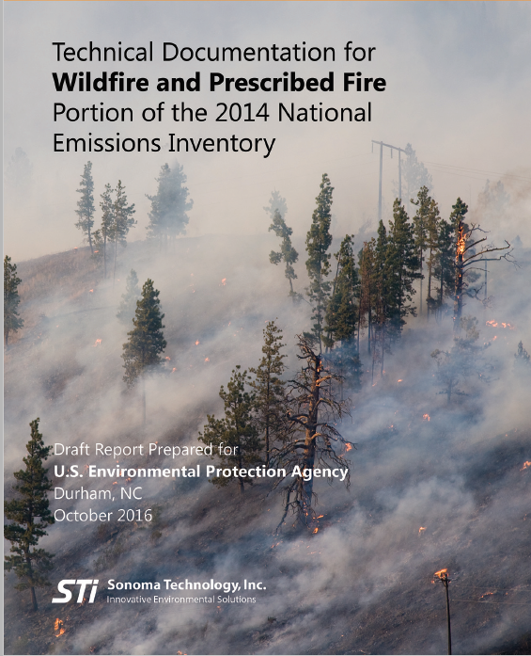
USDA Forest Service AirFire Team and Sonoma Technology, Inc. have developed a SMARTFire Emissions Inventory website http://sfei.sonomatechdata.com/

Slide 5
View summary results by state
  Burned area
  Emissions for PM2.5, EC, OC, SO4, NO3, PM FINE, PM10, CO, CO2, CH4, NOx, NH3, SO2, VOC, and 34 HAPs
  Annual totals
  Annual by type phase (smoldering or flaming)
  Annual by state
  Annual by county
  Monthly totals
  Monthly by state
  Monthly by state type
  Monthly by type phase
  Daily totals
  Daily by type
  Daily by type phase

Slide 6
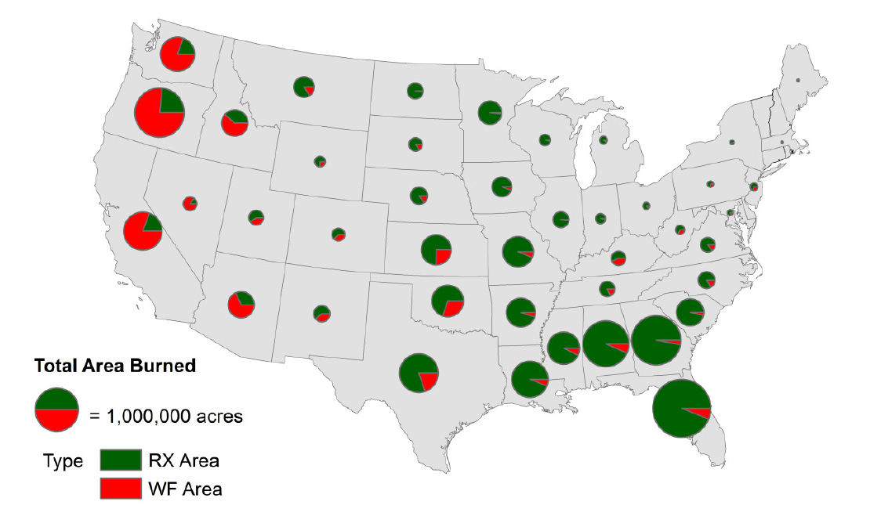

Slide 7
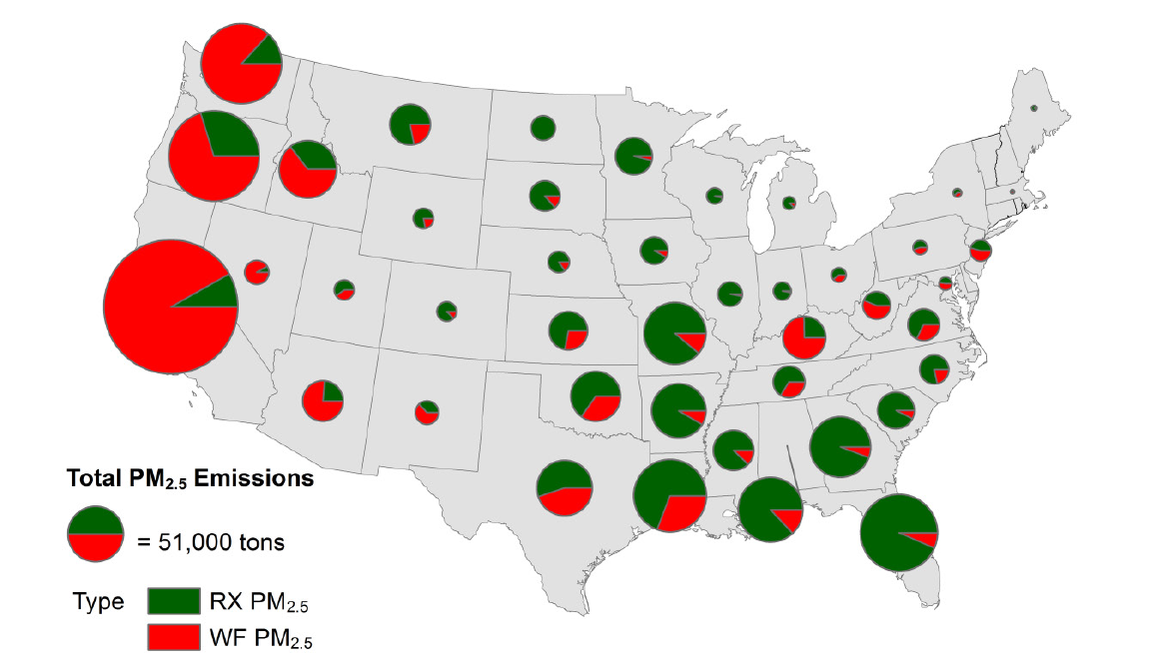

Slide 8
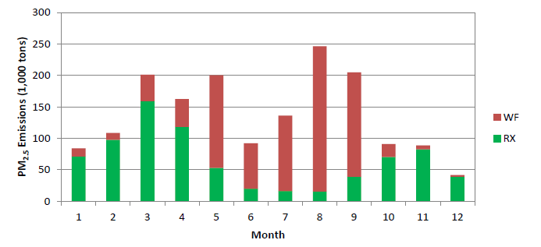
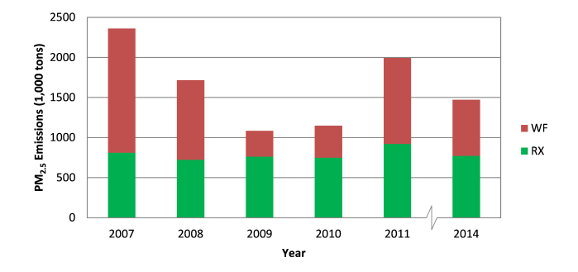

Slide 9
Download state-specific KML files for viewing fire and emissions data in Google Earth
Questions
  Tesh Rao at EPA (rao.venkatesh@epa.gov)
  ShihMing Huang at STI (shuang@sonomatech.com )

