Slide 1

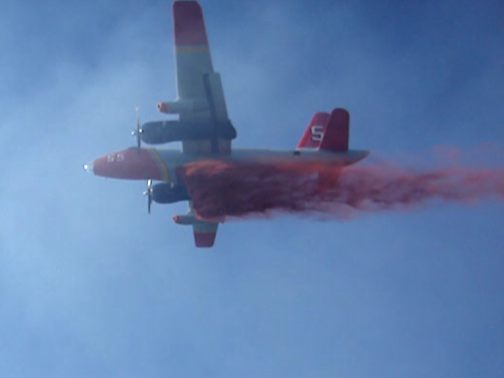
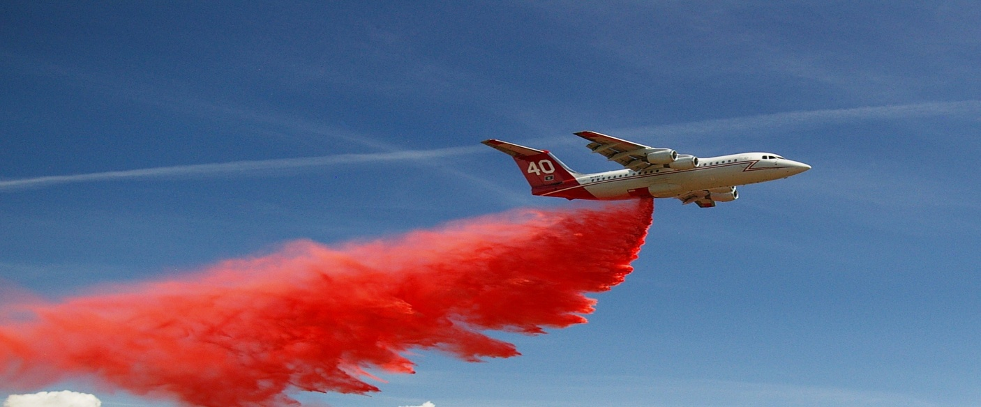
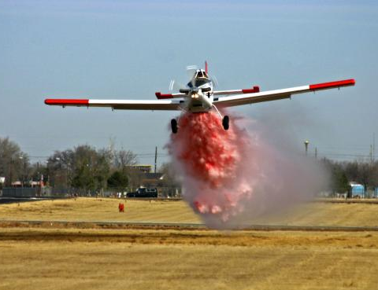
MNDNR
ATGS INBRIEF
3/1/17

Slide 2
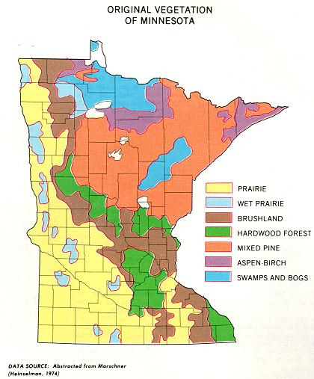

Slide 3
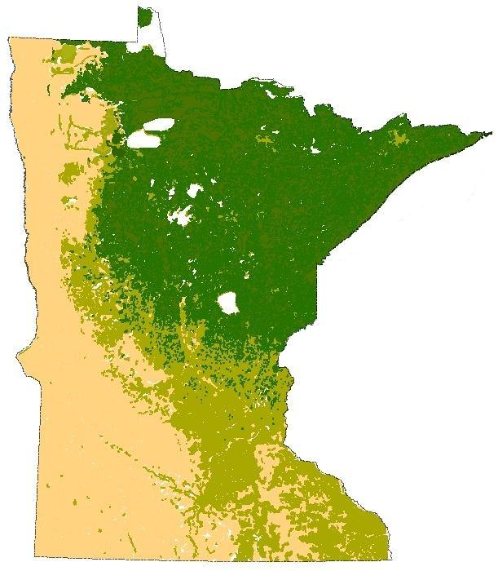

Slide 4





MIFC – MNICS AGENCIES
DNR USFS
BIA USFWS
HSEM NPS

Slide 5
MNDNR Divisions
Forestry
Fish and Wildlife
Parks and Trails
Ecological Resources and Waters
Enforcement
Lands and Minerals

Slide 6
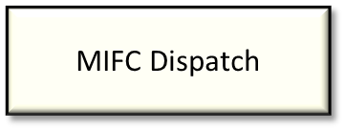
MN DNR Forestry
Air Operations
Wildfire Aviation Supervisor
Darren Neuman
Division Aviation Safety Advisor
Darren Neuman
Assistant Wildfire Aviation Supervisor
Matt Woodwick
Helicopter Program Coordinator
Rob Johnson
Fixed Wing Program Coordinator
Paul Wannarka
Aviation Desk
Linda Bruss
Pilots & ATGS
Administrative & Logistical Support
Tanker Base Personnel, NR Technician (Fire)
NR Technicians (Fire)

Slide 7
MN DNR Forestry
Areas
Warroad
Baudette
Littlefork
Tower
Deer
River
Two
Harbors
Bemidji
Hibbing
Cloquet
Backus
Aitkin
Park
Rapids
Sandstone
Little Falls
Lewiston

Slide 8
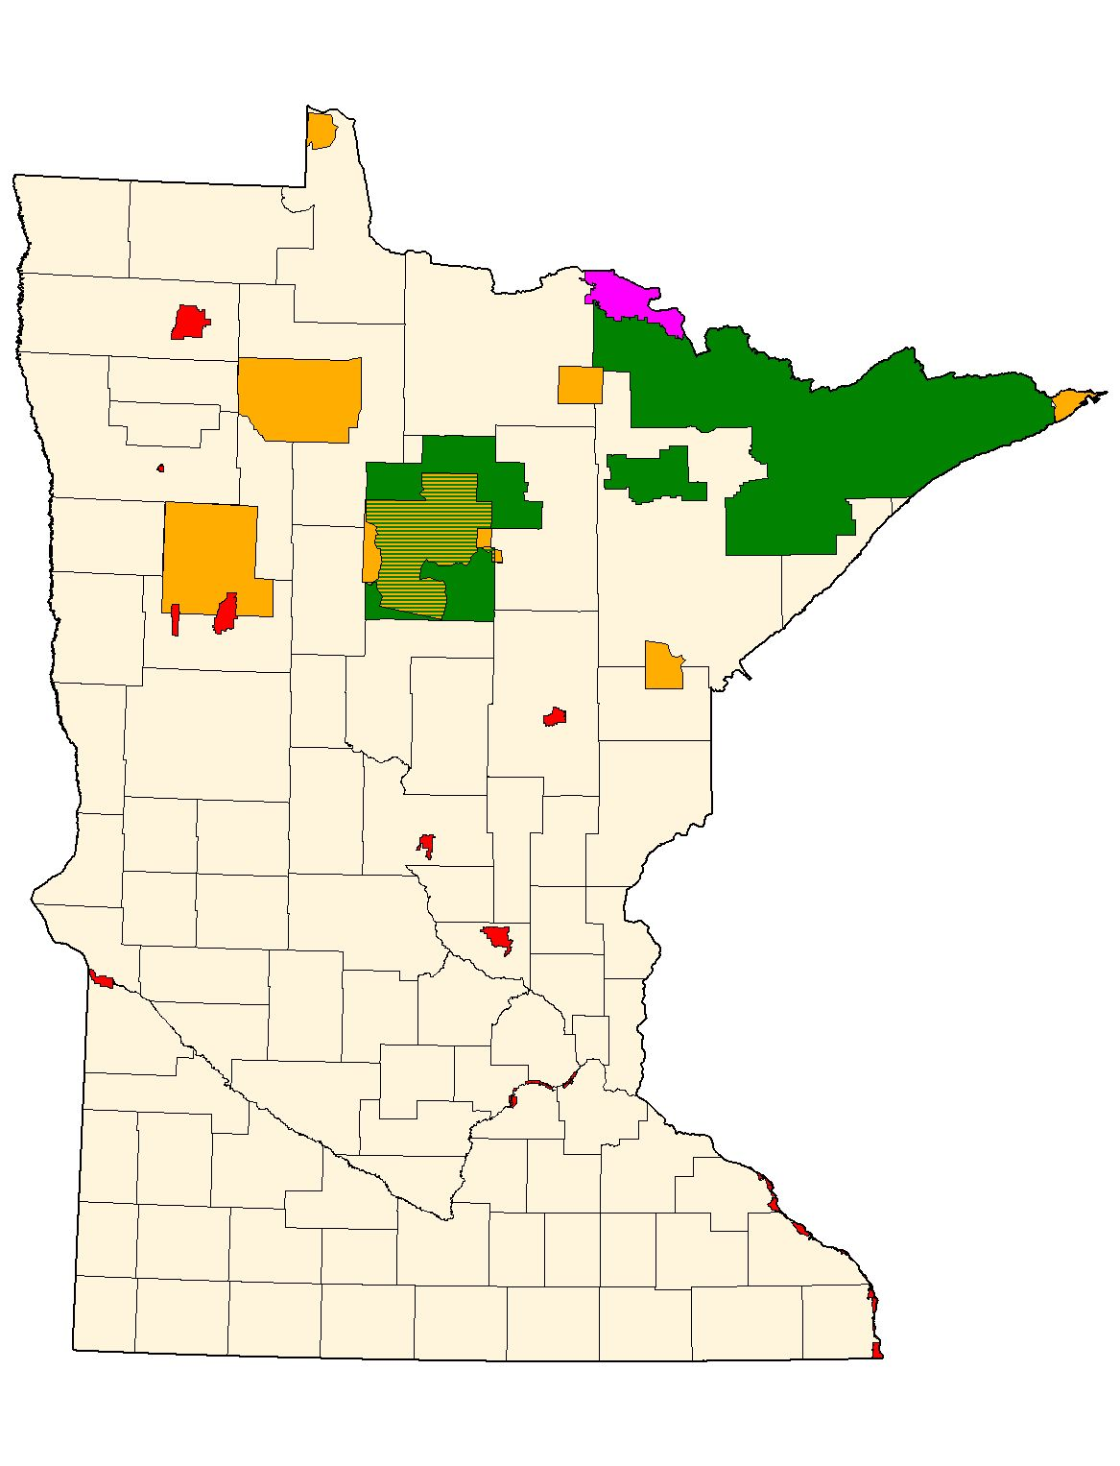
Federal
Agencies
USFS
BIA
NPS
FWS

Slide 9
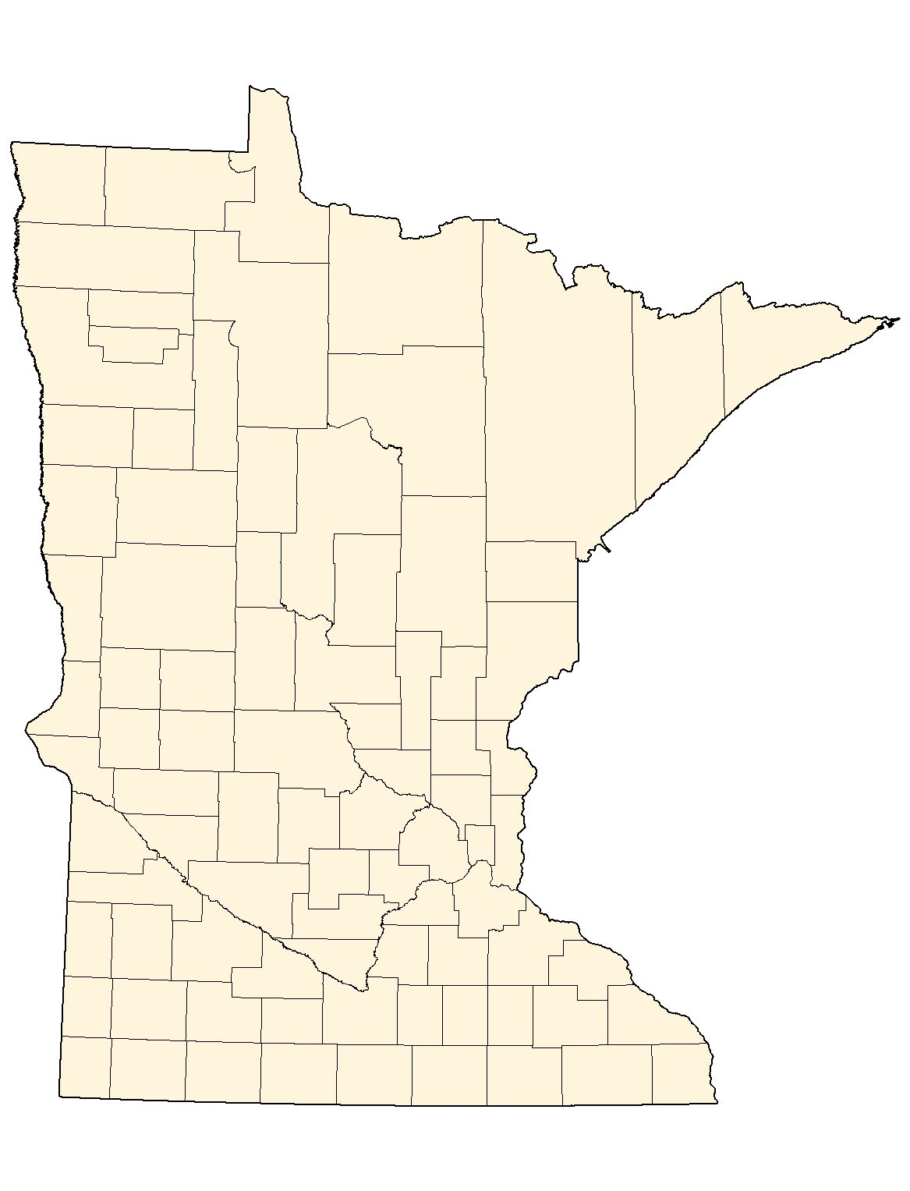


Tankerbases
MN Aviation Bases
Warroad
Thief River Falls
Ely
Grand
Marais
Bemidji
Grand
Rapids
Hibbing
Brainerd
Princeton
Alexandria
Anoka

Slide 10
Helibases
MN Aviation Bases
Roseau
Bemidji
Hibbing
Hill City
Cloquet
Brainerd
Sandstone
Princeton

Slide 11
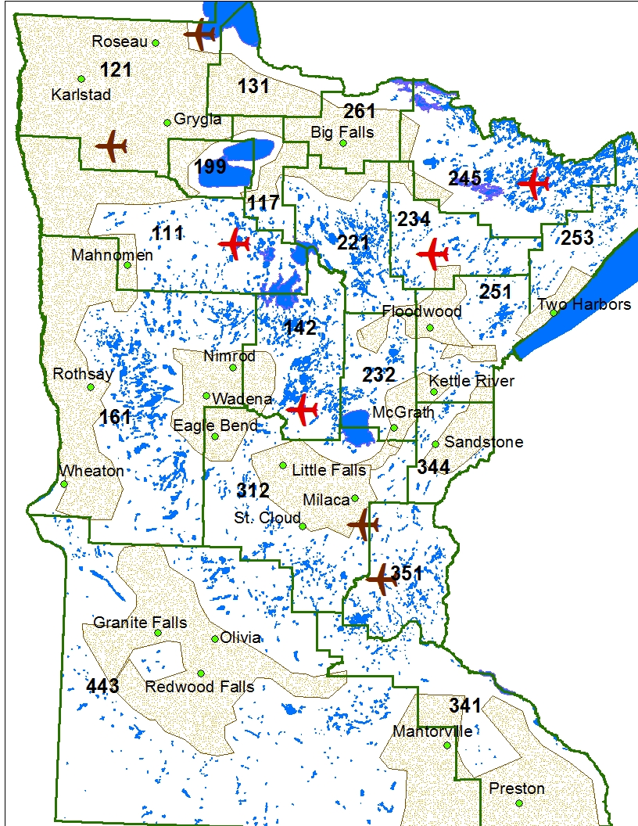

Slide 12
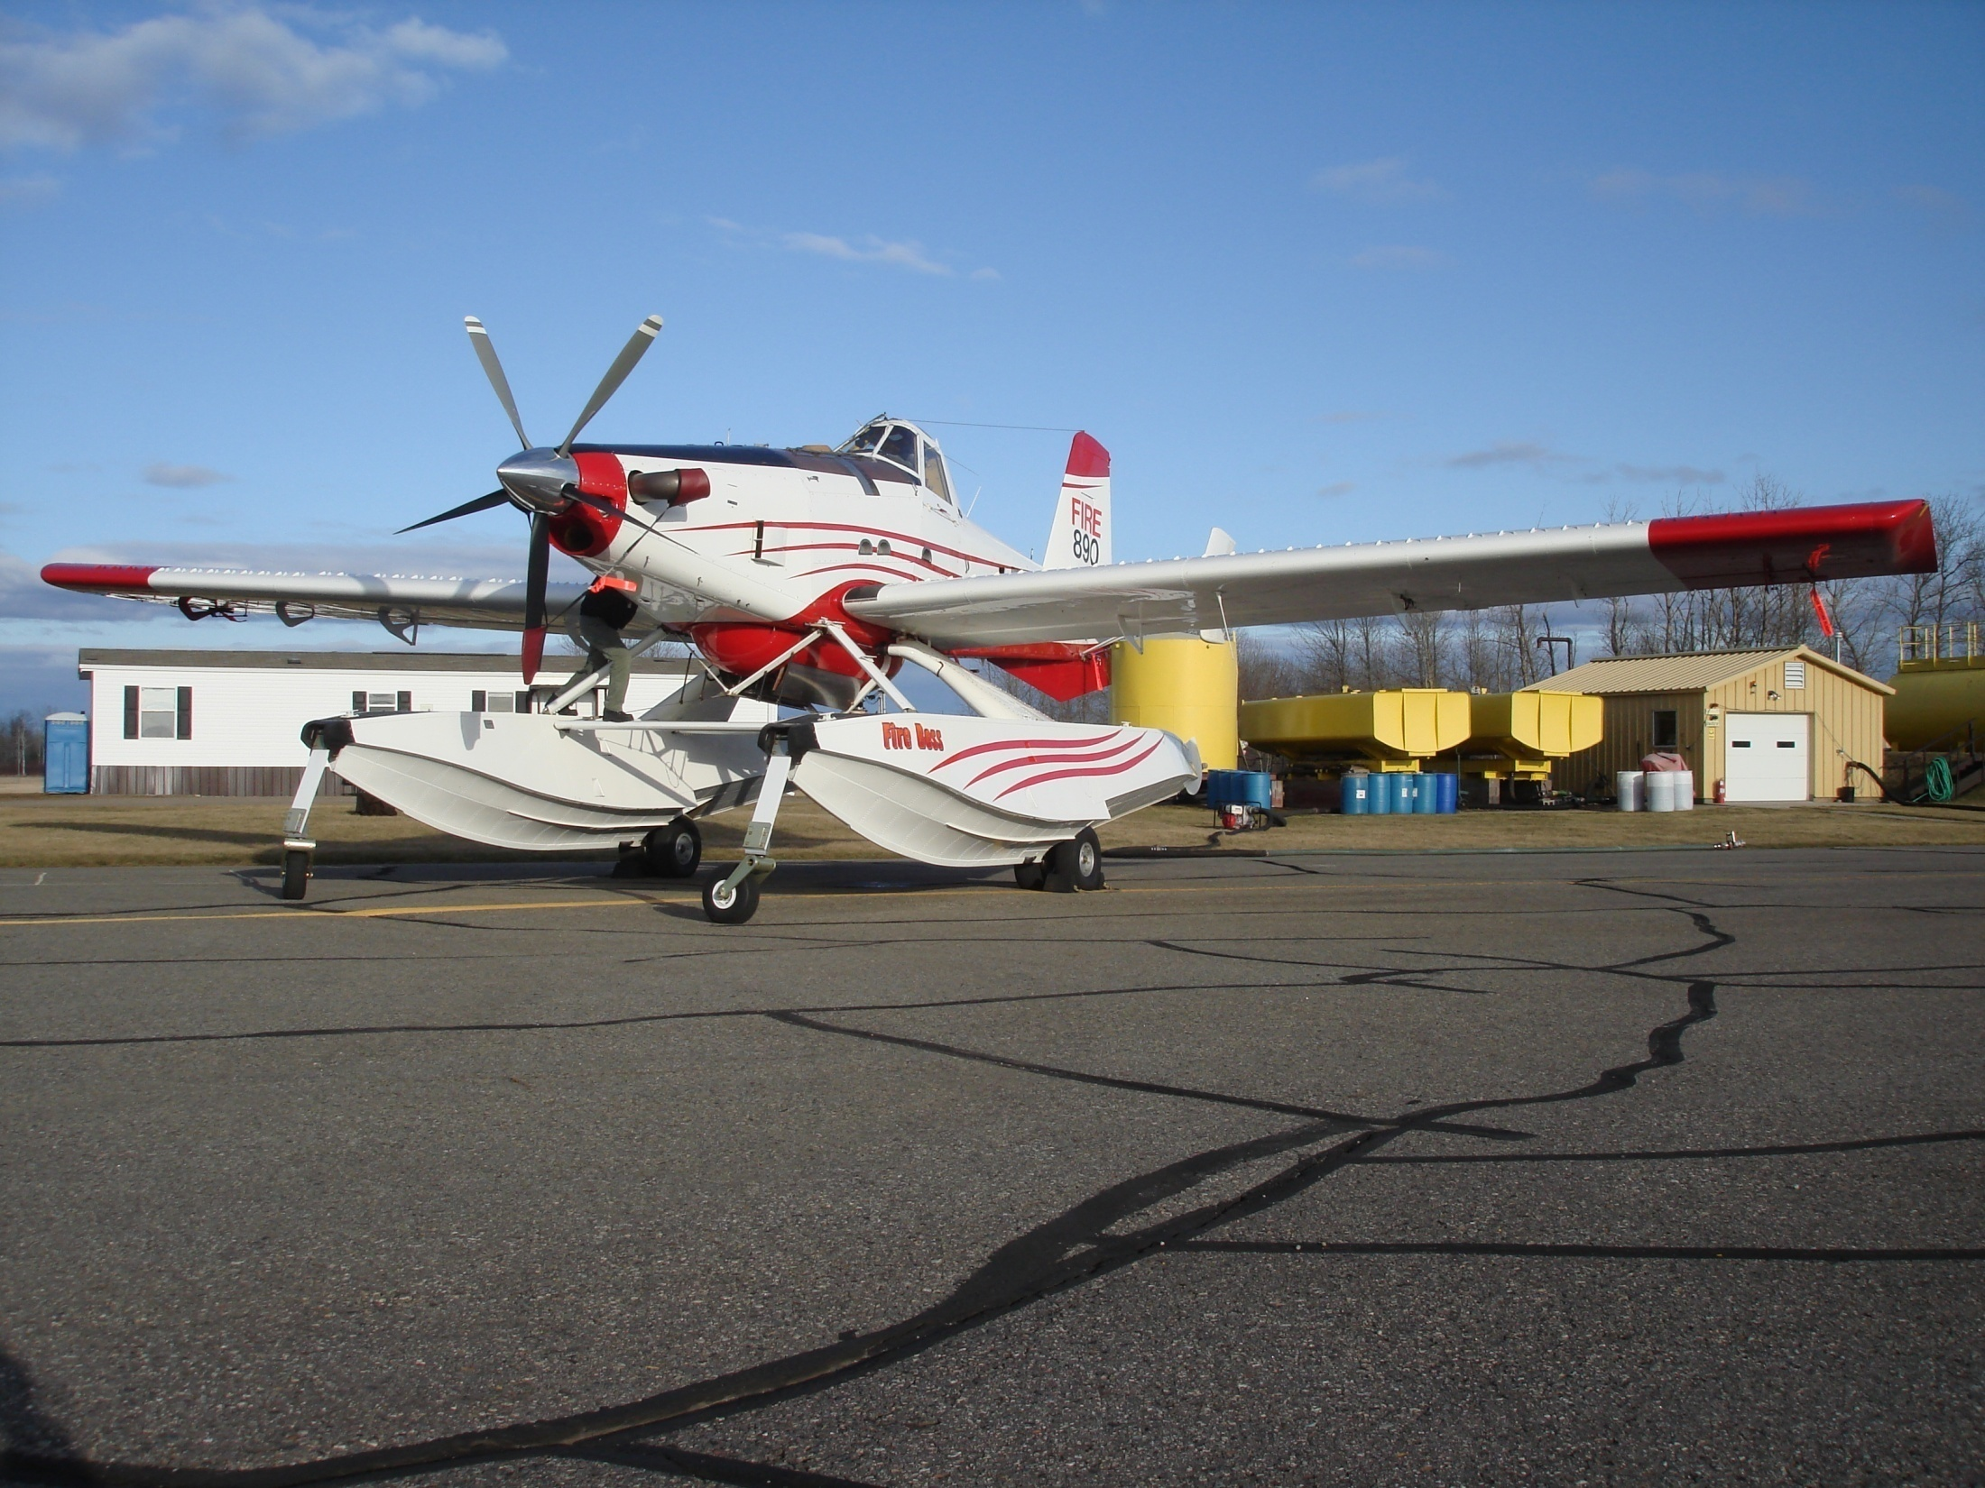
Ops

Slide 13

State Contract Duty Day
Could be anytime from ½ hour prior to sunrise to ½ hour after sunset-14 hour maximum.
Determined by Fire Center according to staffing guidelines.
Pre-flight normally at 09:30, flight ready at 10:00, briefing at 10:00.

Slide 14
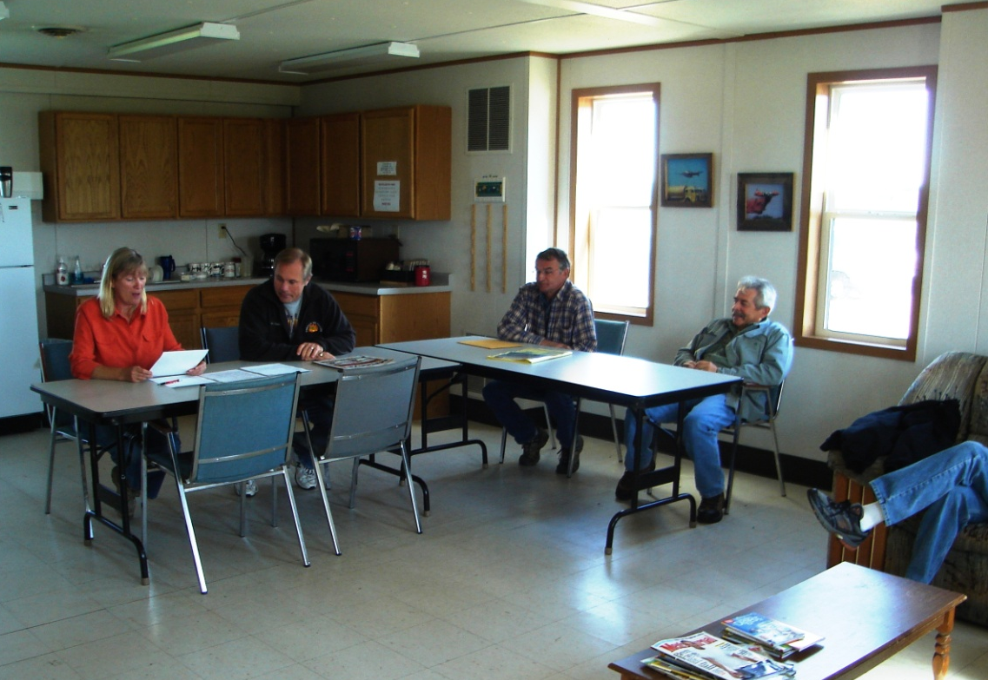
Briefings
Daily morning briefing: Normally at 10:00 am-State bases
Normally at 10:30 am-Bemidji T.B.
Expected to attend
Notes:
Weather, status reports, etc. Determine lunch, usually at base.

Slide 15
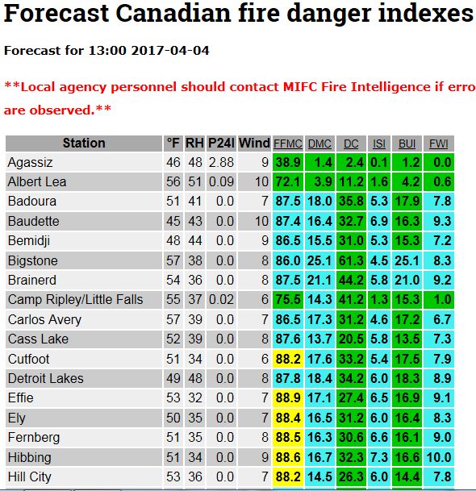
Considerations:
Winds > 10 mph
RH < 40%
Frontal boundaries

Slide 16
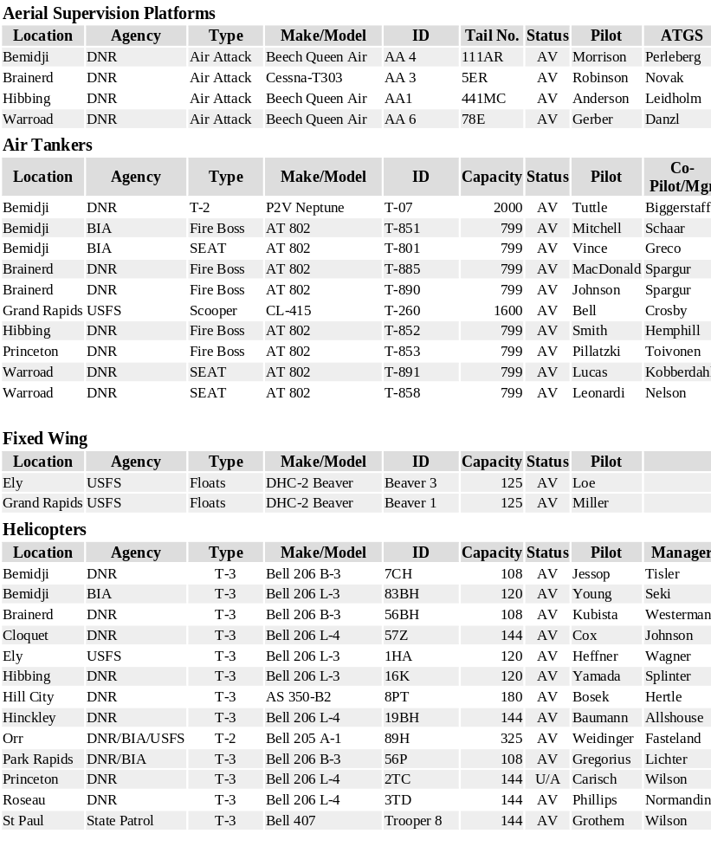
Notes:
Aircraft status report. MOAs, TFRs, Duty day length, etc. Standard compliment is 5 FireBosses, 3 Wheeled SEATS, 9 light helicopters.

Slide 17
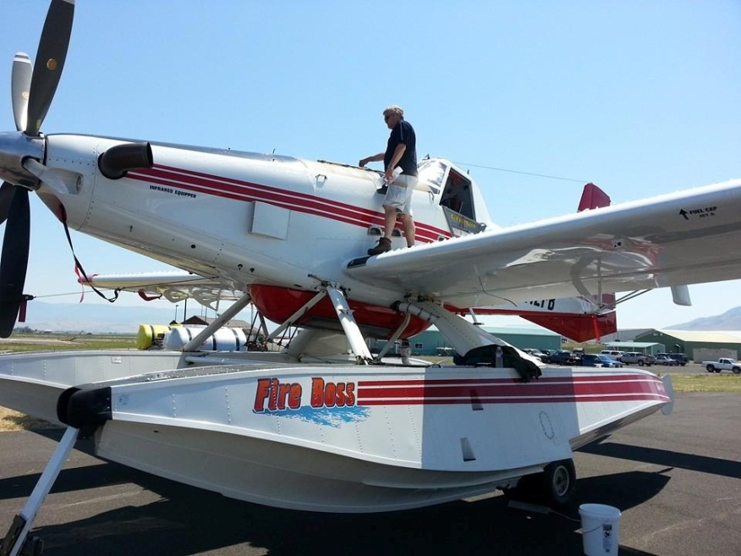
Dispatch Procedures
Paper Dispatch
Tactical Aircraft Request form
Landview printout
Expected to be launched no more than 15 min. after receipt of dispatch

Slide 18
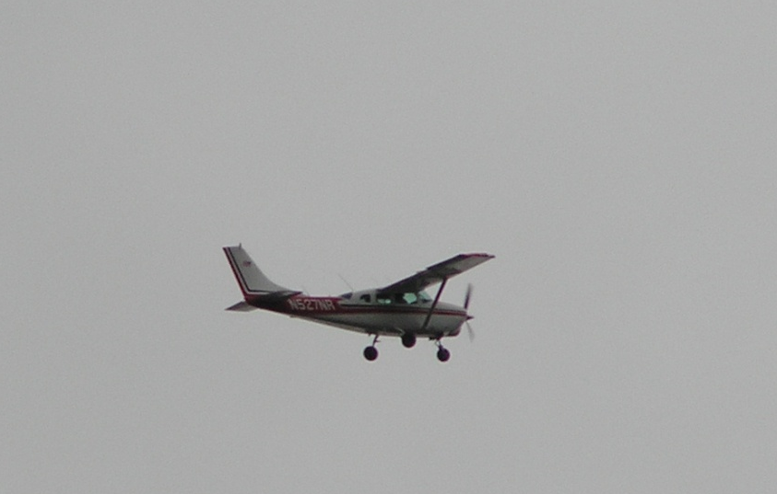
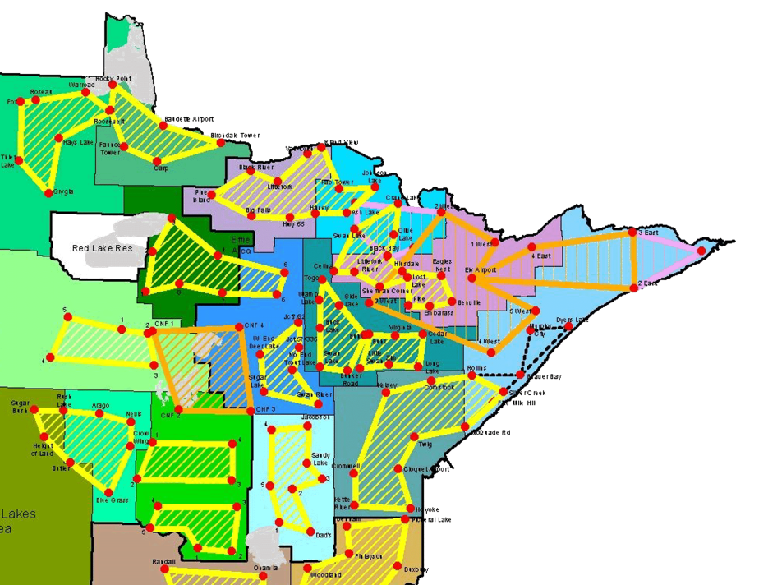
Detection Aircraft
A pilot and aerial observer fly a predetermined route over a large area to locate fires from the air.
Detection is often the first aircraft over the fire and are typically found
at 2500-3500 MSL on 122.925 frequency

Slide 19
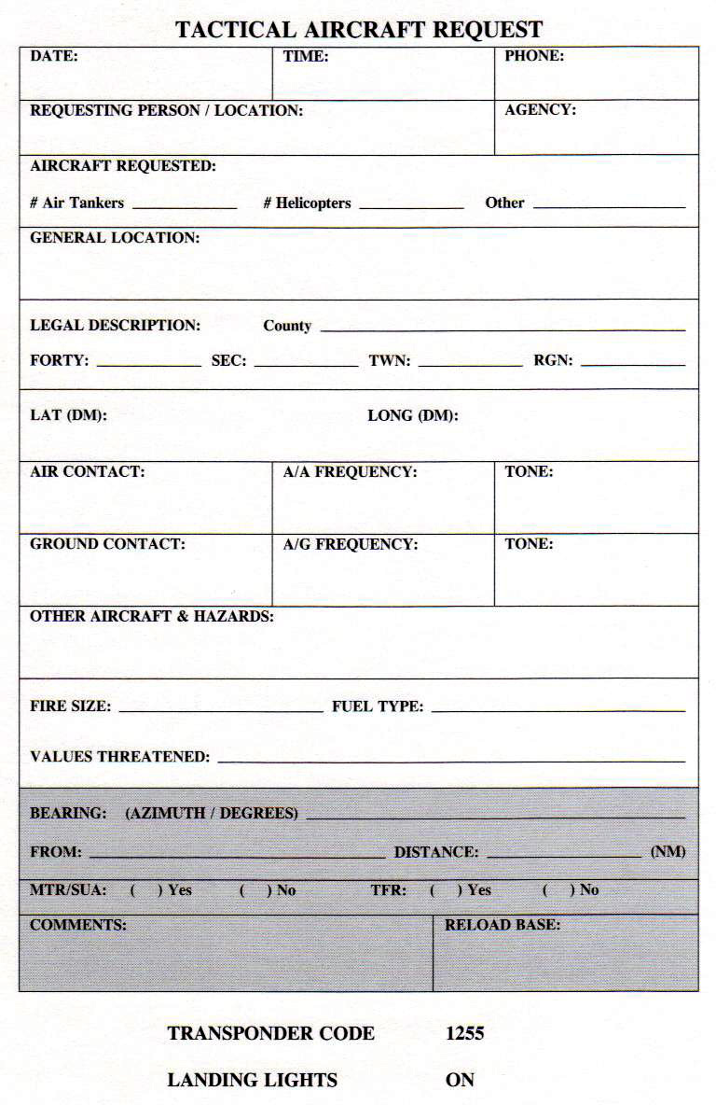
Paper Dispatch
Tactical Aircraft
Request Form

Slide 20
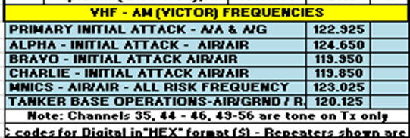
Notes:
Detection aircraft and helicopters are dispatched on 122.925. ATGS should move off of 122.925 as early as possible, request other frequency from FireCenter.

Slide 21
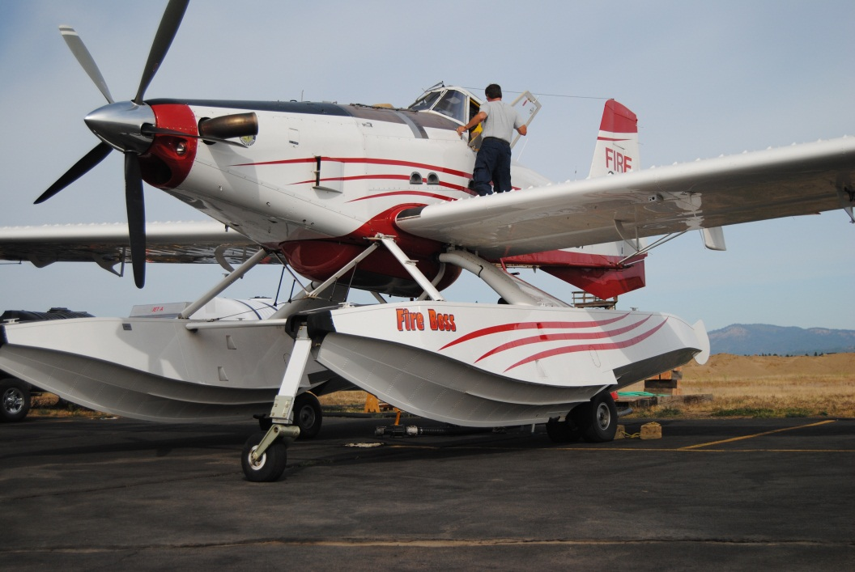
Ramp Procedures
All aircraft movements, operations, maintenance and parking on the ramp to be coordinated with the Ramp Manager.
Ramp frequency: 120.125

Slide 22
Flight Following
Flight following will be accomplished with AFF
Tankers will communicate directly with the Tanker Base they departed from on AirNet simplex
Aerial Supervision Platforms and Federal Tankers communicate directly with FIRECENTER on Air Net Simplex or appropriate Air Net Repeater.

Slide 23
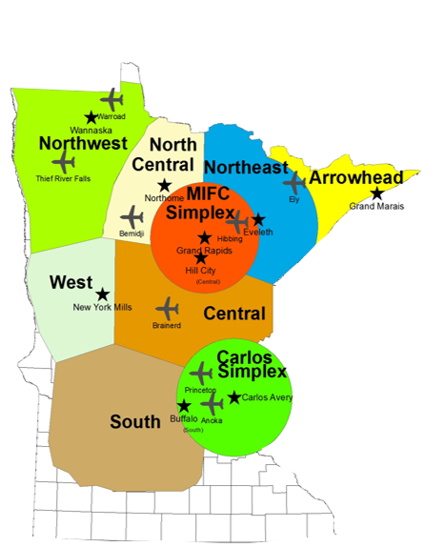
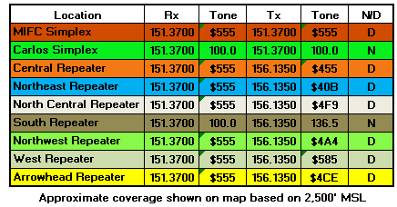
MN DNR Fire Air Net
Simplex and Repeater Zones

Slide 24
Call Signs
Fire Center (Air Desk) ALL FLIGHT FOLLOWING VITALS
Tanker Base (BRD,BJI, HIB, ELO)
Superior Dispatch, Chippewa Dispatch (National Forests)
Red Lake 50 (five-oh)
Air Attack 1 (2,5,6,7,9)
MNDNR Administrative Areas (by name- Bemidji Area)

Slide 25
Retardant/FireIce
Retardant and FireIce gel are both available
Unless retardant is specifically requested, FireIce gel will be used
Cold temperature operations
  Above 40 degrees Fahrenheit-FireIce
  Below 40 degrees Fahrenheit-Retardant

Slide 26
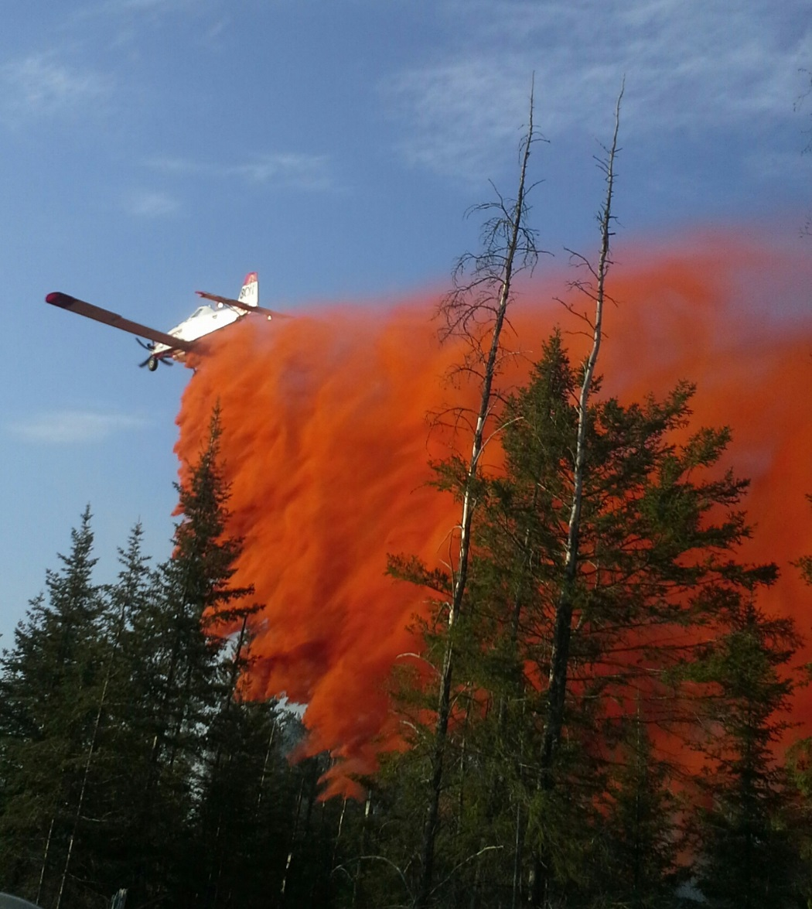
Retardant/FireIce
Drops
No retardant or gel within 300’ of streams, ponds and lakes.

Slide 27
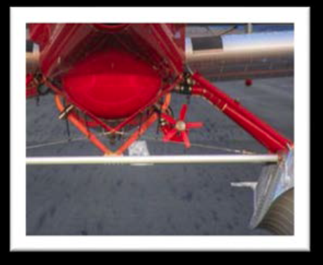
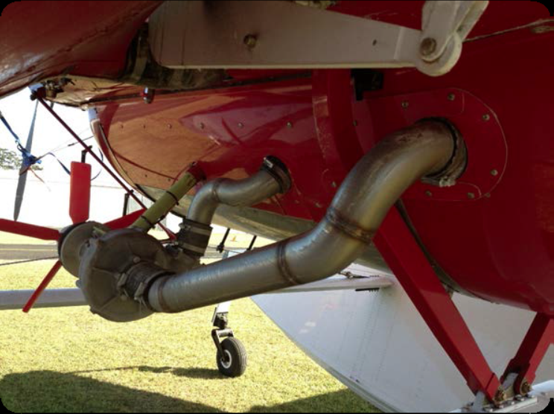
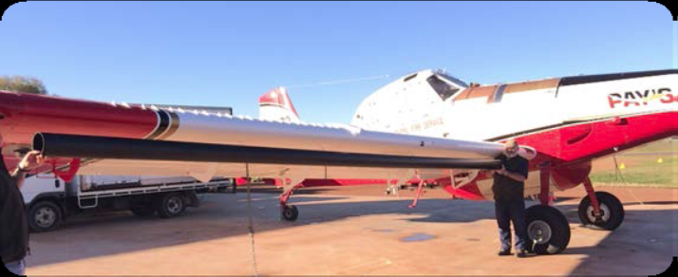
Pay’s Aerial Mixing System
Liquid Water Enhancer Blazetamer 380 can be mixed airborne with Pay’s system installed on FireBoss (clear drop-no dye).
FireBoss’ with Pay’s System may depart empty or be loaded with water, retardant, or FireIce gel at the agency’s discretion. This should be determined pre-mission or start of the day.
In most cases, the FireBoss will be loaded upon departure.

Slide 28
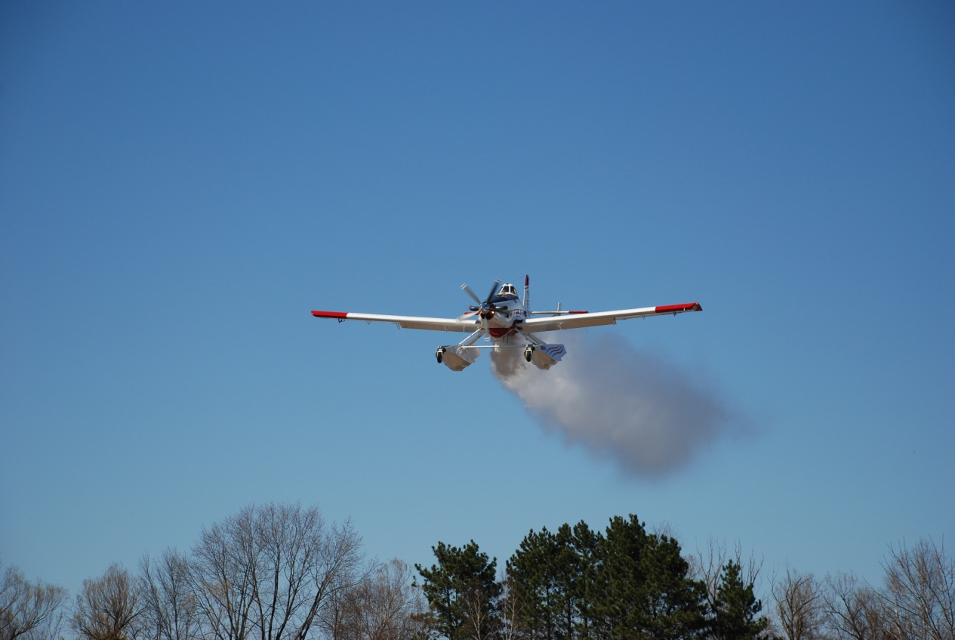
FireBoss-Blazetamer
Application – ATGS will call for Blazetamer (if needed and allowed by the host agency) prior to starting scooping operations
Concentration
Normal default concentration will be set for approximately 0.3% with a second push of the button making 0.6%.
Any change in desired concentration should take place prior to scooping ops.

Slide 29
JETTISON AREAS
List of 10 approved jettison areas included in pilot briefing pkt.
Each has a Lat/Long.
Some have a descriptive advisory.
Some have aerial photos
Recommend entering as waypoints-GPS or iPad
WARROAD JETTISON AREA
Describe the jettison area establish for the base: Lat: 48:56.140 Long: 95: 20.716
Descriptive area: NE of Hangar’s along the tree line in the grass.
THEIF RIVER FALLS JETTISON AREA
Describe the jettison area establish for the base: Lat: 48: 03.9’ Long: 96: 11.1
Descriptive area: Jettison area is located west of the runways inside the perimeter of the fence.
PRINCETON JETTISON AREA
Describe the jettison area establish for the base: Lat: 45:25.980 Long: 93: 43.020
Descriptive area: Off airport on state land.
MORA JETTISON AREA
Describe the jettison area establish for the base: Lat: 46: 09.886 Long: 93: 11.862
Descriptive area: Off airport on state land.
HINKLEY JETTISON AREA
Describe the jettison area establish for the base: Lat: 45:56.259 Long: 92: 48.121
Descriptive area: Off airport on state land.
DETROIT LAKES JETTISON AREA
Describe the jettison area establish for the base: Lat: 46: 43.218 Long: 95: 48.344
Descriptive area: Section 36 of Lakeview Twp. TWP 138 Rng 41 Sec 36. Note: Adhere to the 300' buffer for lakes, wetlands, creeks & rivers.
ANOKA JETTISON AREA
Describe the jettison area establish for the base: Lat: 45: 19.97” Long: 93: 07.08”
Descriptive area:Upland grass field Carlos Avery Wildlife Refuge. Note: Adhere to the 300' buffer for lakes, wetlands, and rivers creeks & rivers.
BEMIDJI JETTISON AREA
Describe the jettison area establish for the base: Lat: 47 :22.583 Long:95 : 07.783
Descriptive area: 16-145-35
HIBBING JETTISON AREA
Describe the jettison area establish for the base: Lat: 47 : 13.850 Long: 92 : 51.950
BRAINERD JETTISON AREA
Describe the jettison area establish for the base: Lat: 46 : 36.360 Long: 94 : 02.500

Slide 30
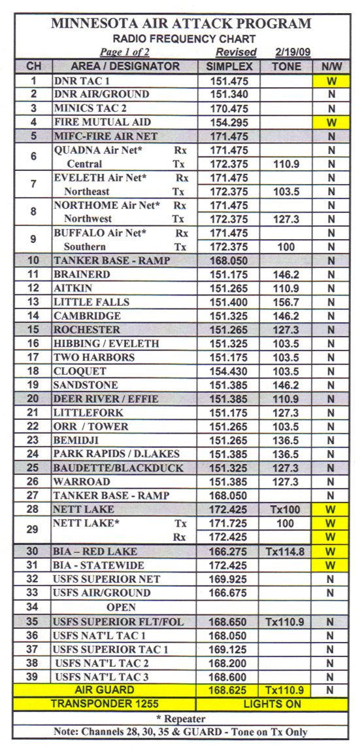
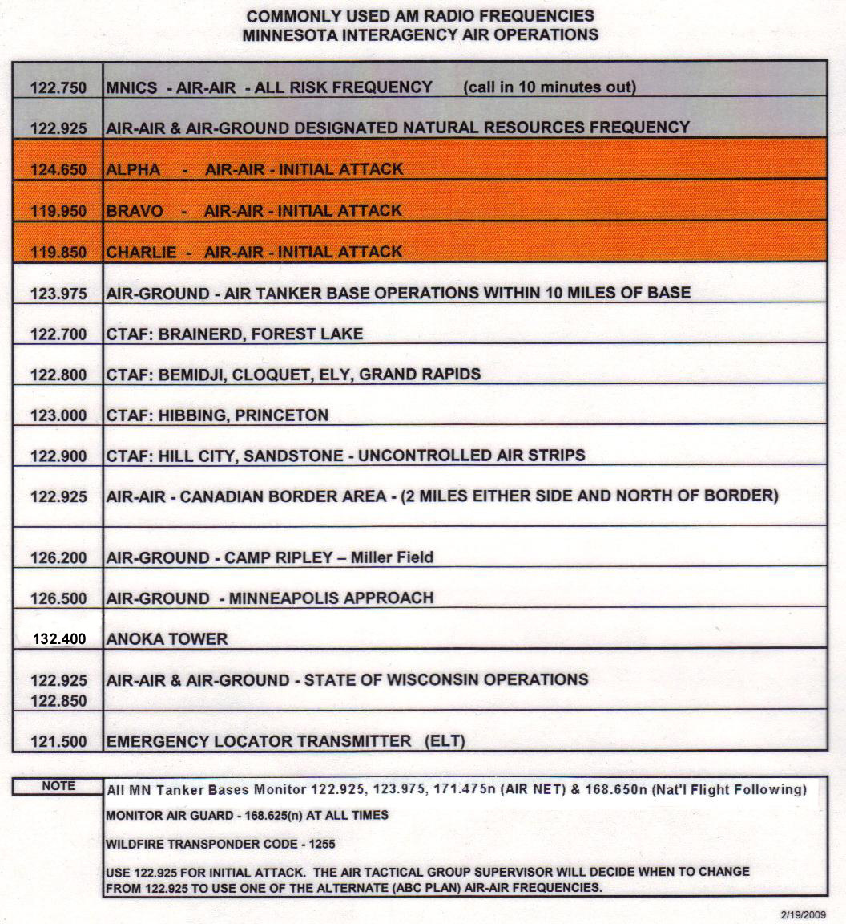
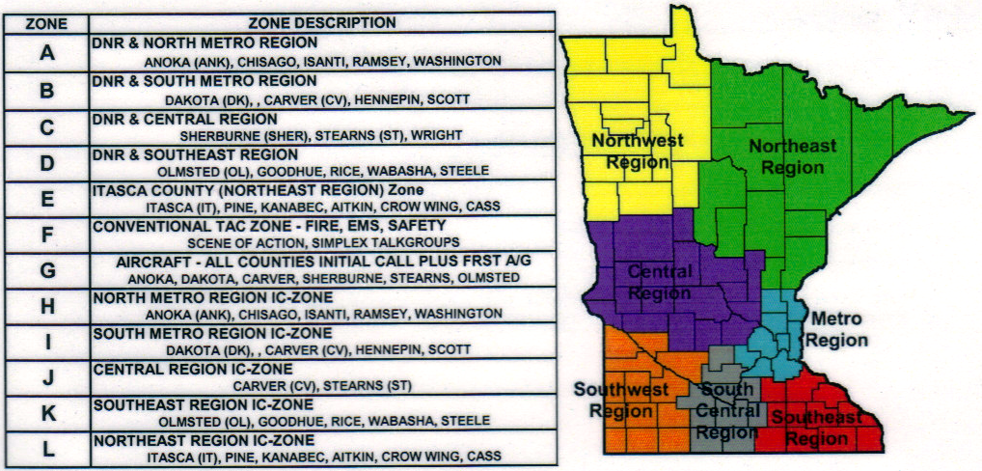
COMMUNICATIONS PLANS

Slide 31
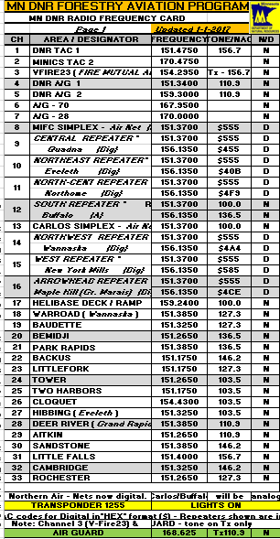
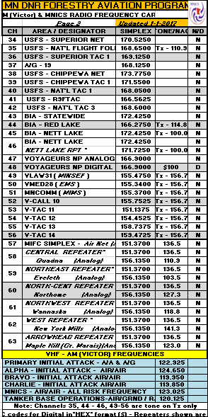
Air Attack Plan (FM/AM)
Air-to-Ground
Air-to-Air Communications
VHF-AM Frequencies

Slide 32
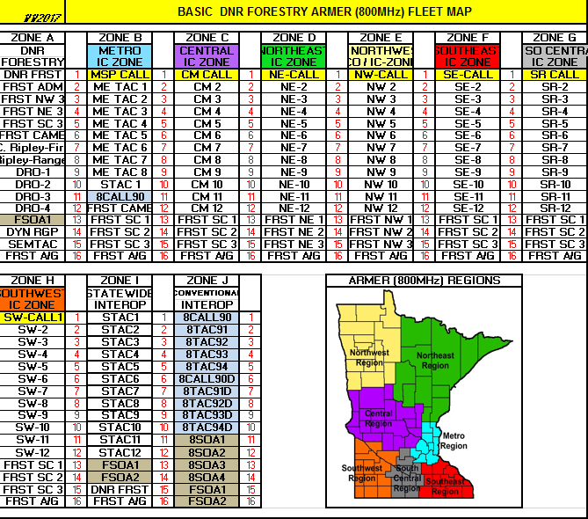
ARMER Fleet Map (800Mhz)

Slide 33
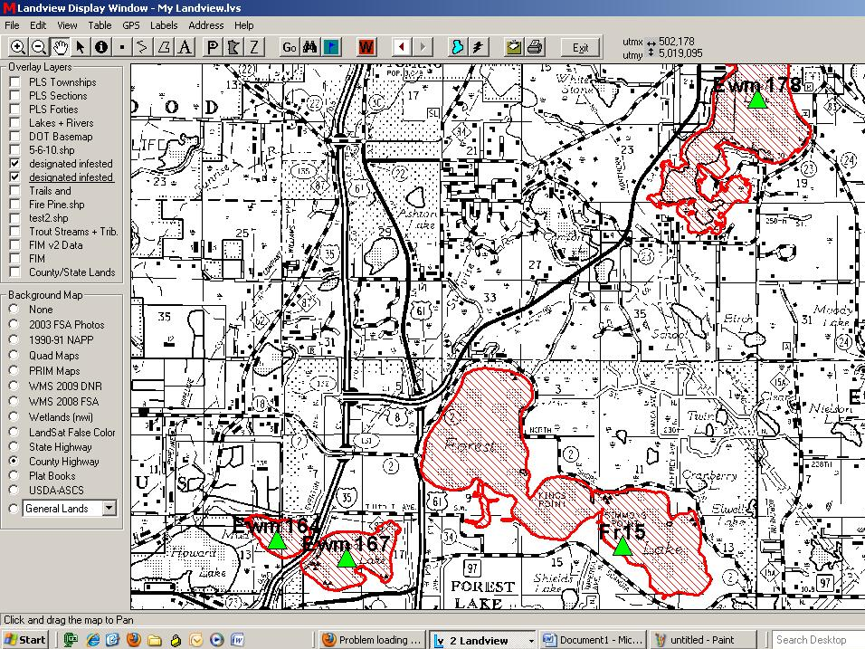
INFESTED WATERS
PLAN / MITIGATION

Slide 34

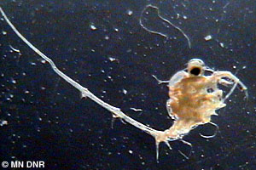
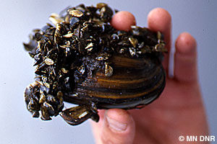
Invasive Species
Eurasian Water Milfoil
Spiny Water Flea
Zebra Mussels
Others
many

Slide 35
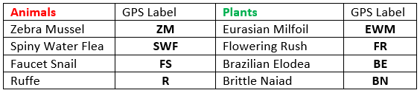
Common Animals and Plants
Cleaning Procedures
Identify the water body and invasive specie.
For Plants, visually inspect the aircraft. Pick off any plant material and discard on high ground.
For Animals, drain the floats, pressure wash the tank and floats with 140° water thoroughly.
Allow to dry for 24 hours if feasible

Slide 36
Infested Waters Procedure
UTILIZE INFESTED WATERS OR NOT??
Questions to ask yourself:
-If I don’t use this water, is loss of life or property likely?
If yes, use the infested lake.
If no, do not use the infested lake.
-Is there a non infested lake within a reasonable distance?
-Can I contain the fire using a farther, non-infested source?
If yes, do not use the infested water.
If no, use the infested water.
-If infested water was used and requested for another fire, notify Fire Center and ask for guidance. *Show pdf map*
Notes:
SHOW 2017 ATGS MAP

Slide 37
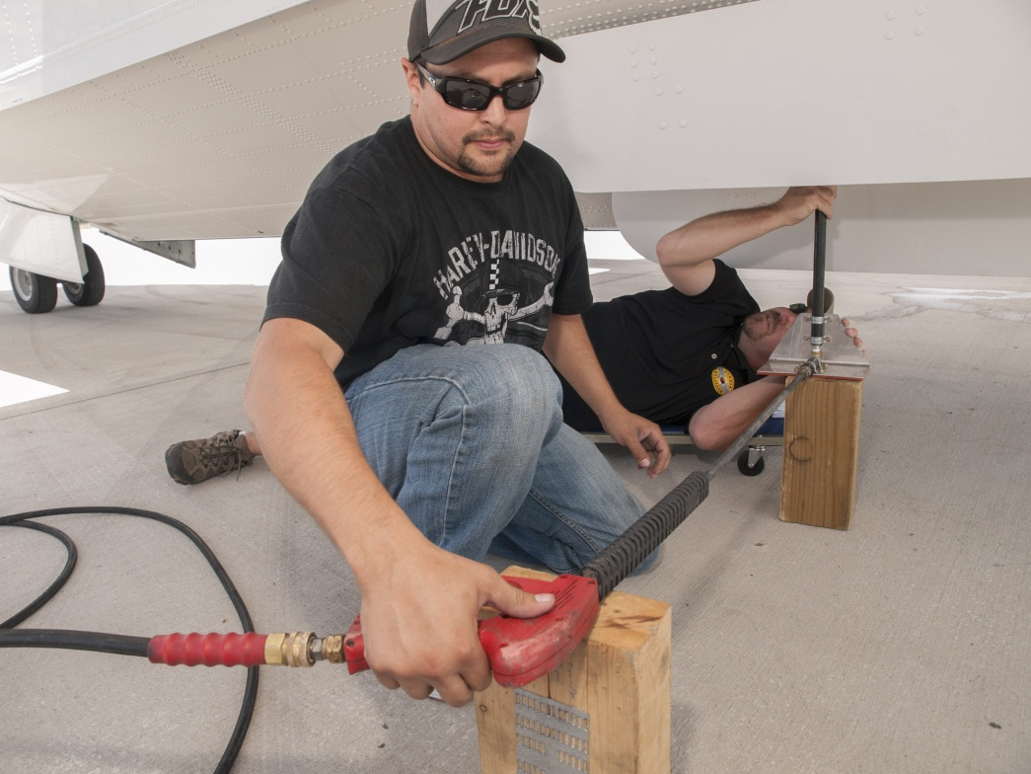
Infested Lakes
If infested lake is used, take appropriate measures to clean/remedy tank before scooping in a clean lake.
Plant-inspection needed
Critter-hot water wash required

Slide 38
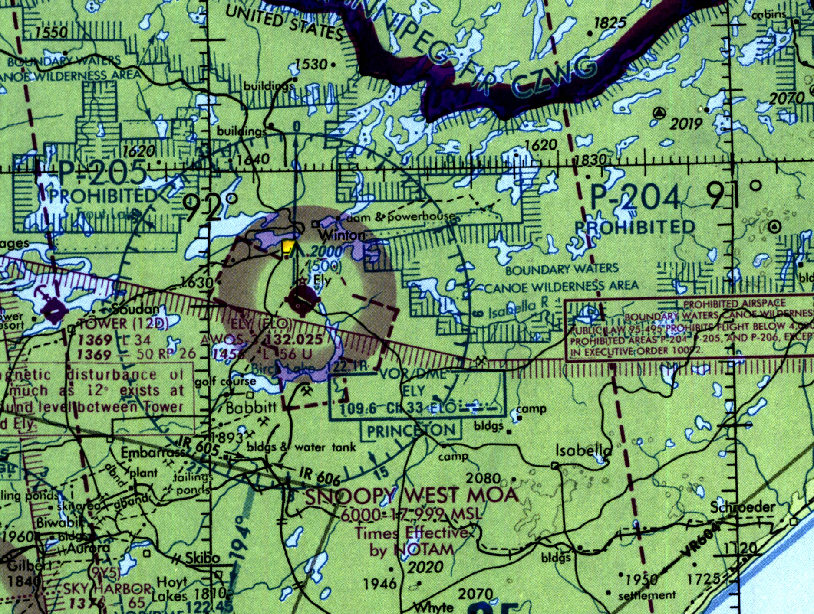
SPECIAL USE AIRSPACE
Airspace Considerations

Slide 39
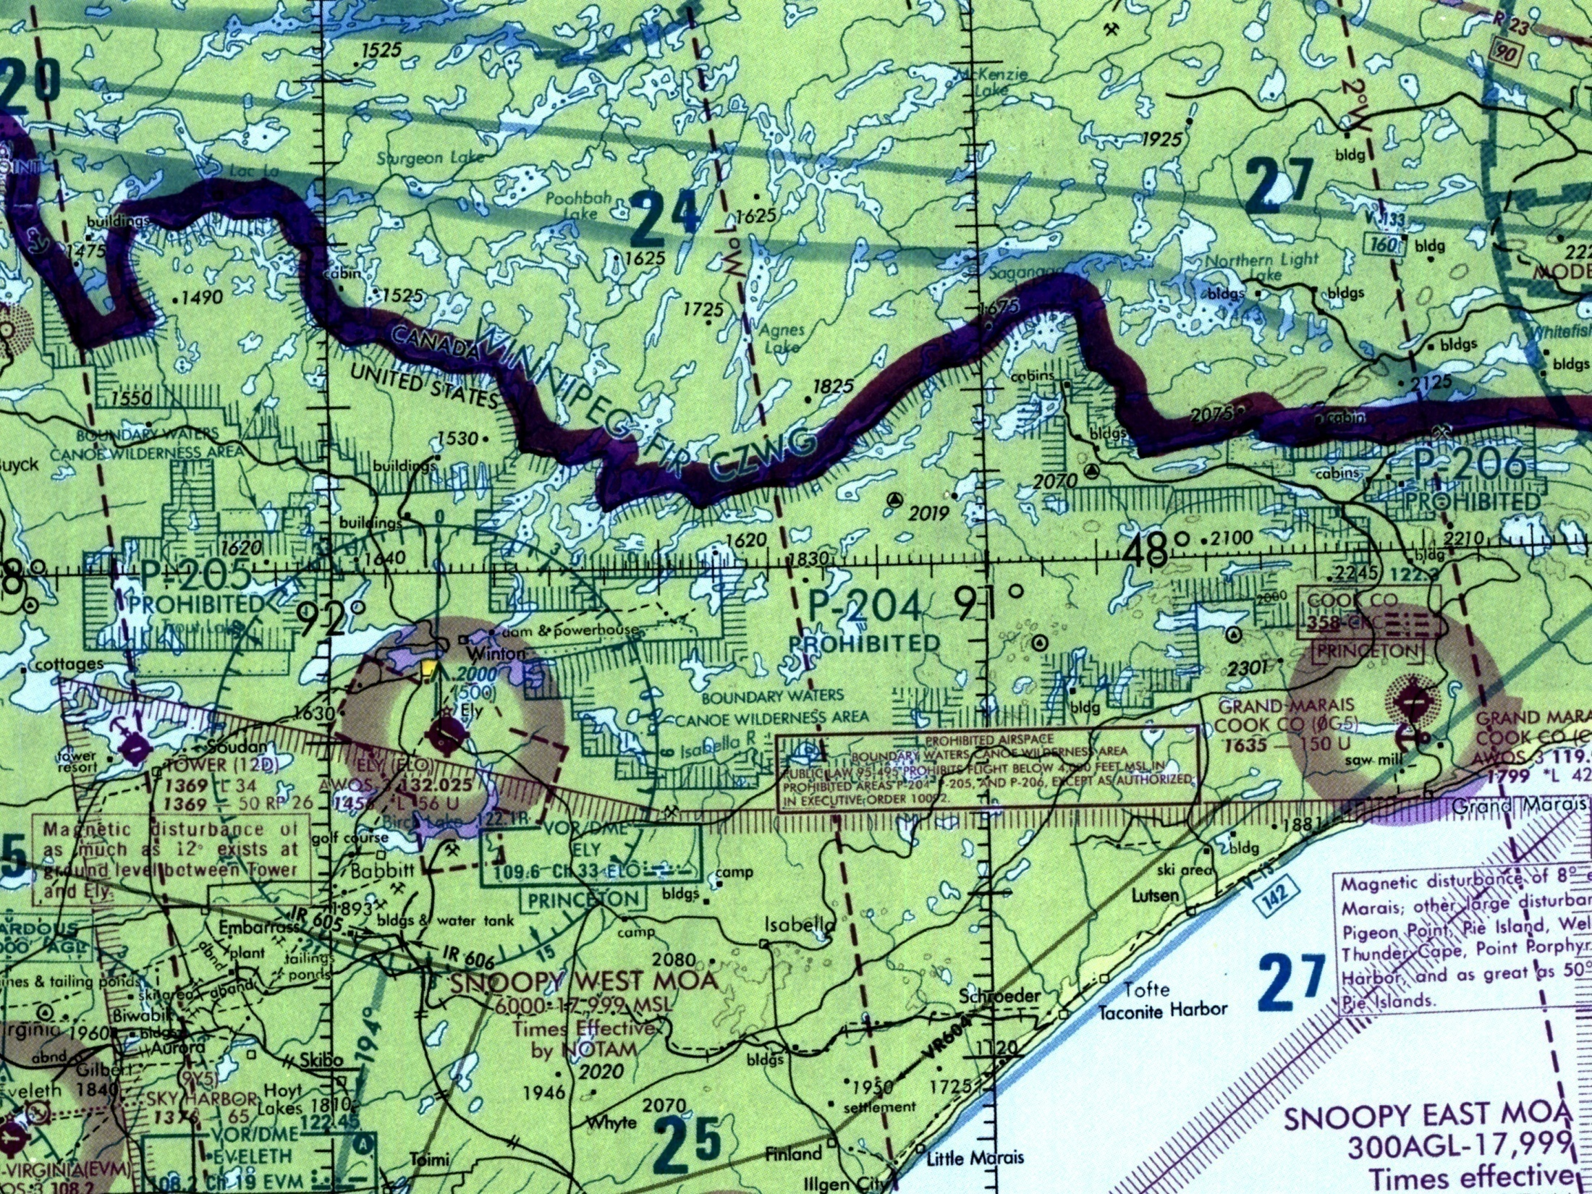
Prohibited Areas
Boundary Waters Canoe Area
(BWCA)
P-204, P-205, P-206
Flight prohibited under 4000ft. MSL unless authorized by USFS for firefighting aircraft.

Slide 40
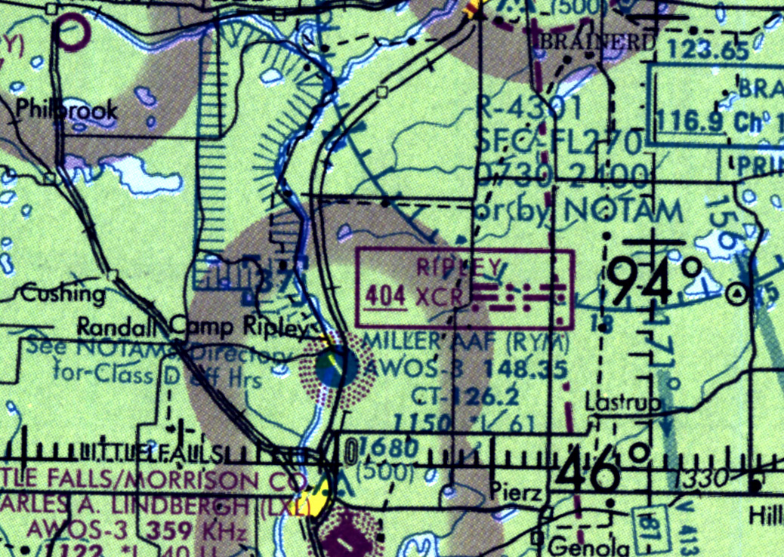
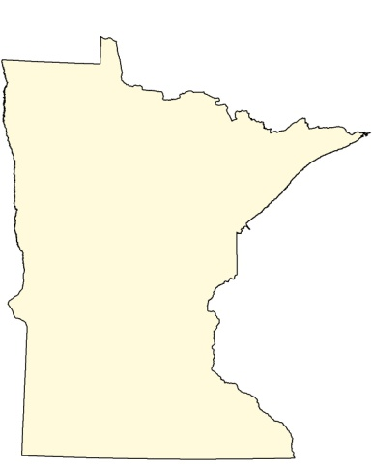
Restricted Area
Camp Ripley
R-4301, Artillery
0730-2400 or by NOTAM
Must be cleared to fly through,
Miller Tower 126.2,
or call Mpls. Center

Slide 41
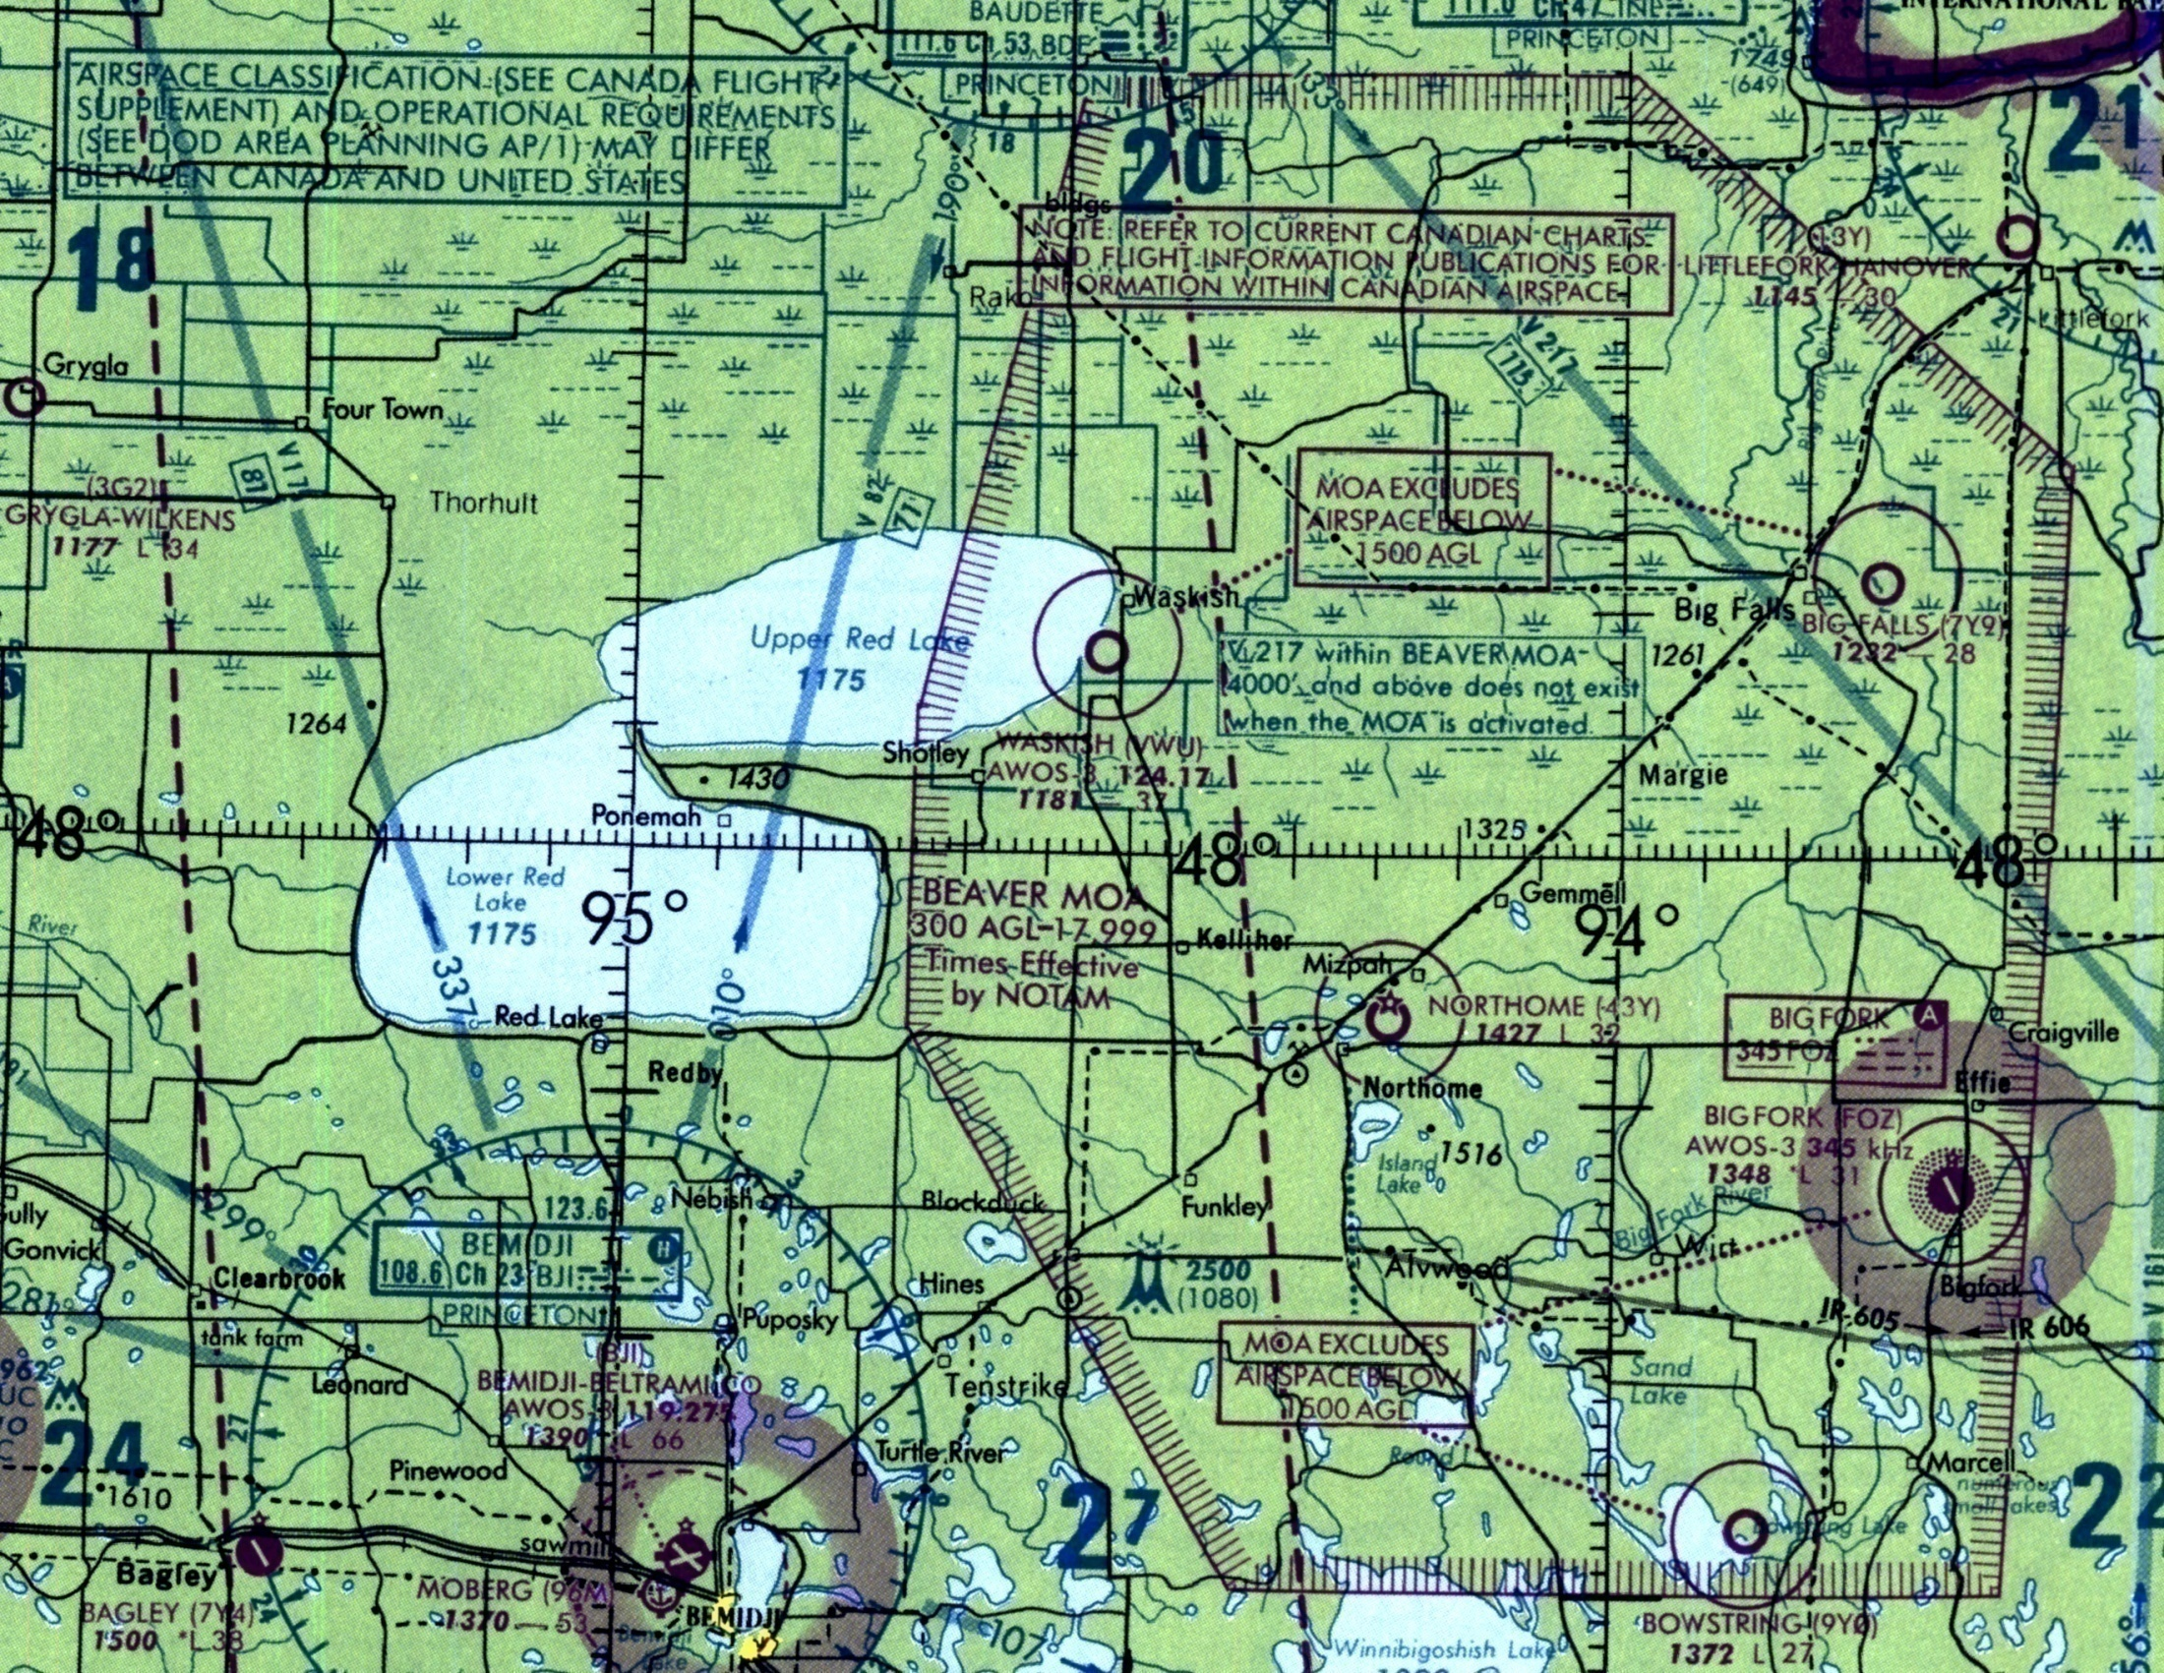
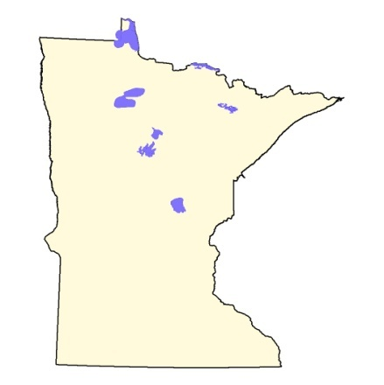
Beaver
MOA
300 AGL – 17,999

Slide 42
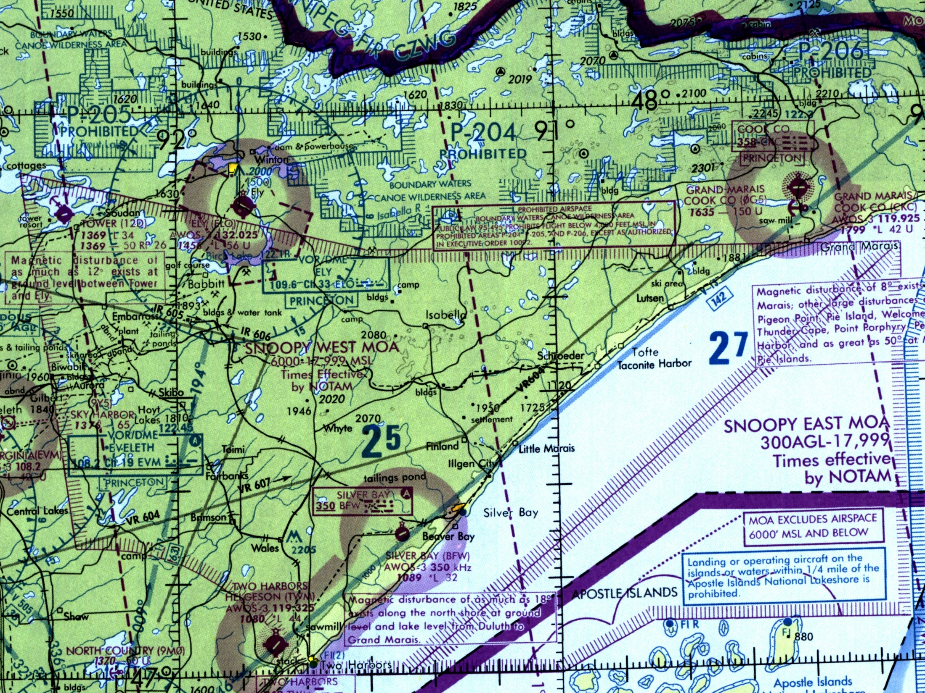
Snoopy West / East MOA
Snoopy West
6000 – 17,999 MSL
Snoopy East
300AGL – 17,999

Slide 43
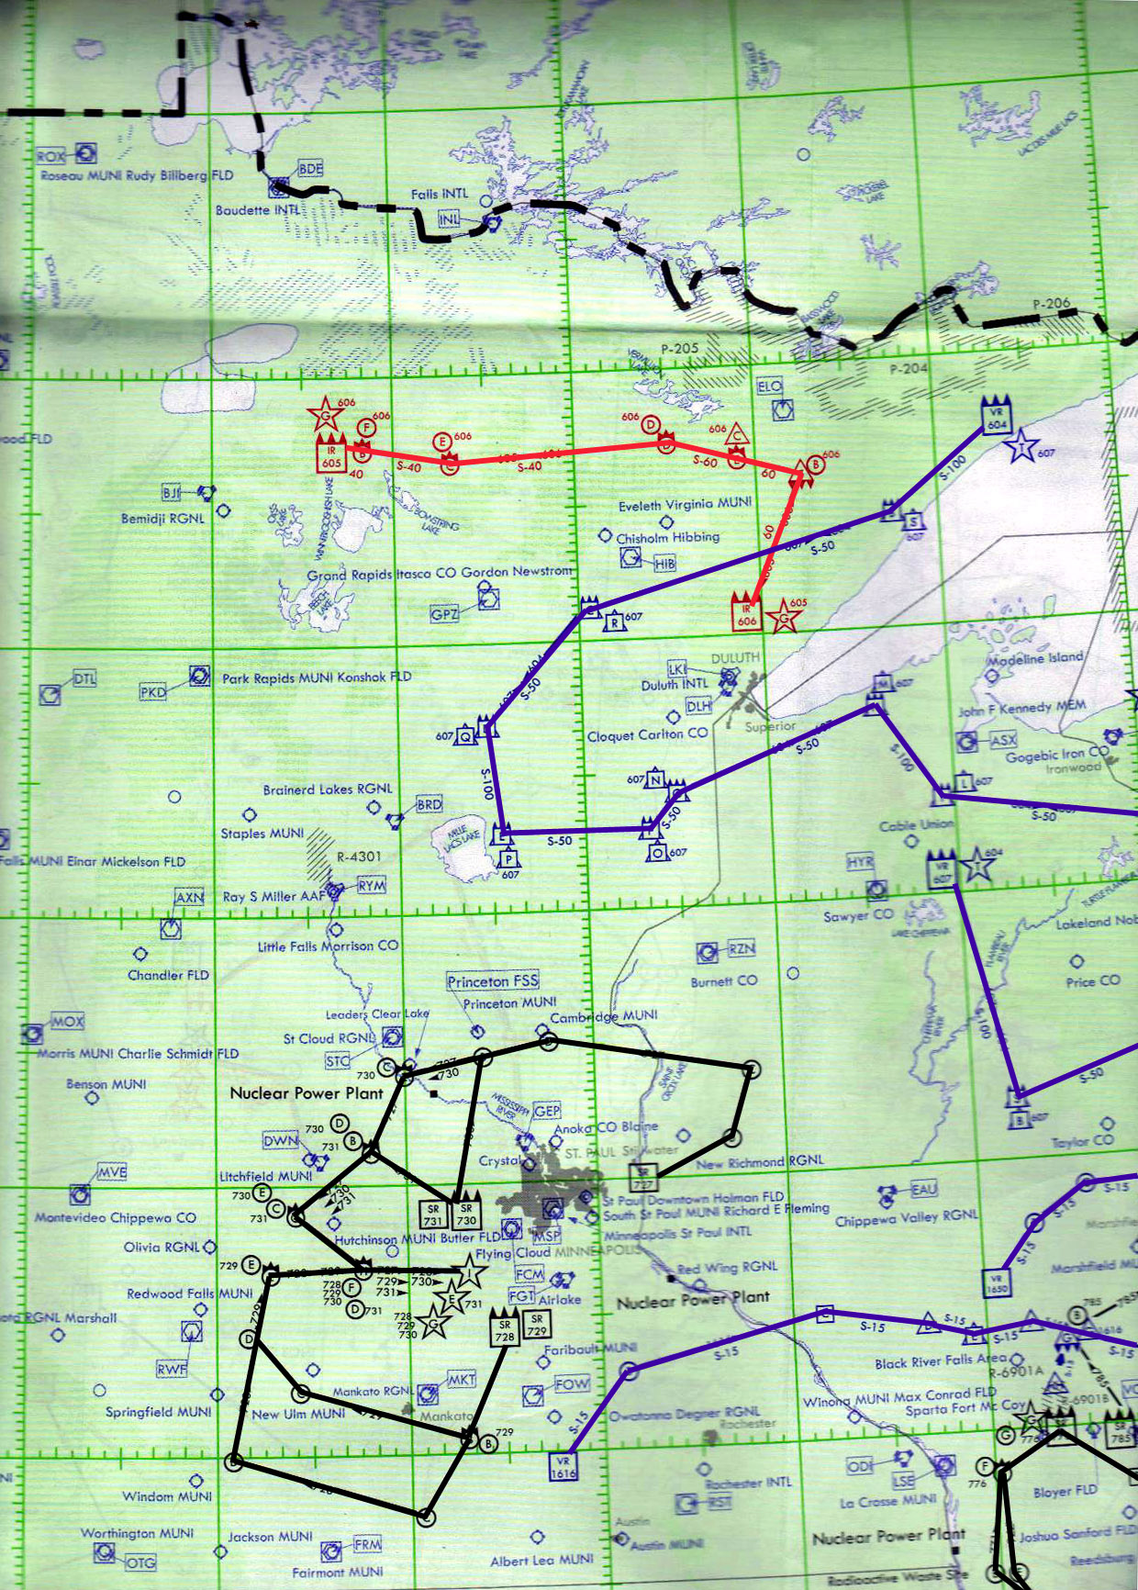
MTRs
IR605 / IR606
There are three primary
MTRs in Minnesota.
Status is updated daily as noted on Aircraft Status
Report
Aviation Desk can deconflict airspace if needed
VR604 / VR607
Aerial Refueling
Routes

Slide 44
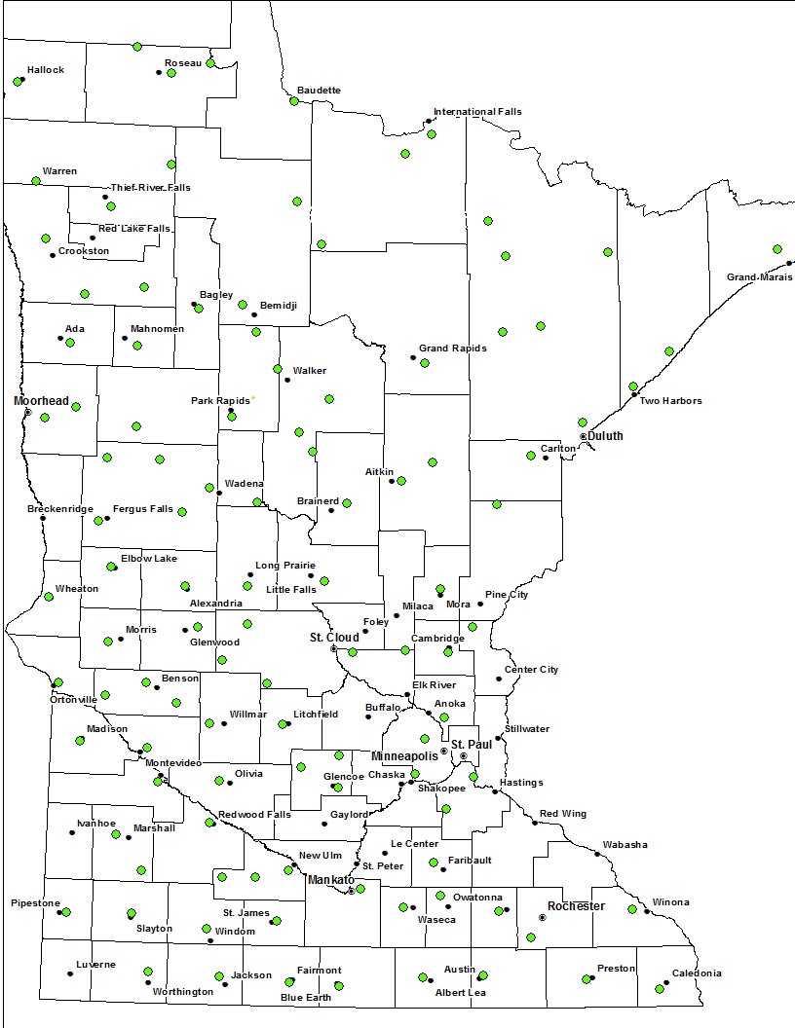
Notes:
A bunch of airports and a bunch of obstacles.

Slide 45
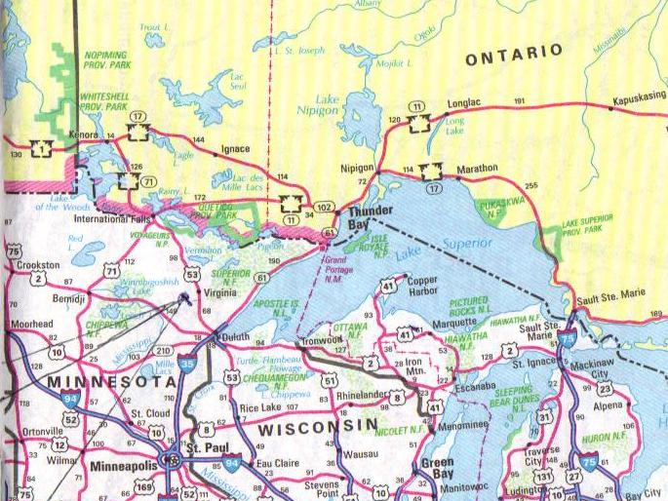
BORDER OPS
Notes:
Manitoba and Ontario.

Slide 46
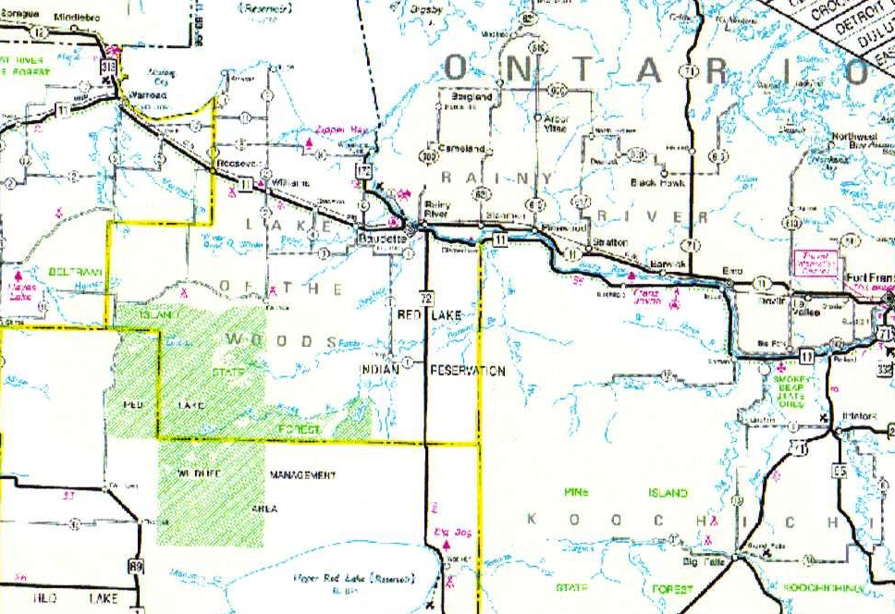
US / Canadian Border
122.925 is a dedicated frequency 2 miles either side of border
Border Patrol / Airbust
Unmanned Aircraft Systems (UAS)
Quickstrike Agreement
Notes:
Birddog and 415s

Slide 47
Pilot’s Responsibilities
Quickstrike:
Pilots do not need to file a flight plan
Contact Fire Center with flight information
Prior to crossing the border, ensure aircraft will
squawk the code assigned by the FAA

Slide 48
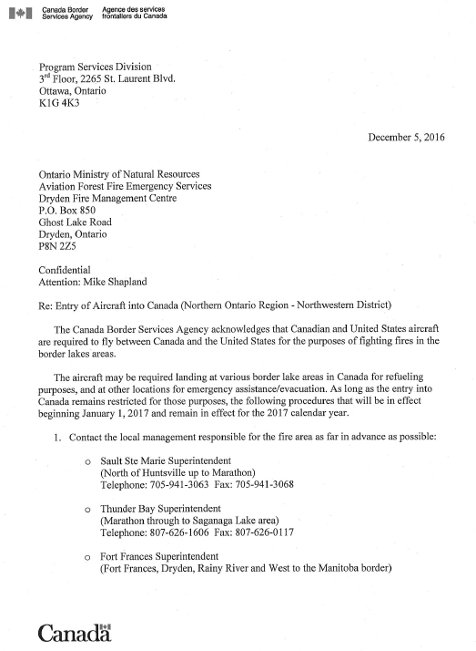
Canadian Customs
Letter
For placement in the aircraft

Slide 49
Coordination w/ Ground
They call early
Direct attack
Standard group is ATGS with 2 fixed wing.
Most DNR Firefighters have 2 AG Frequencies in their main group.
Helicopter crews fly with 1 manager and 2 crewmembers. Manager will evaluate bucket drops.
Notes:
Success is a 2 hour mission or less. Couple loads a piece from the fixed wing, let the helicopters mop up.

Slide 50
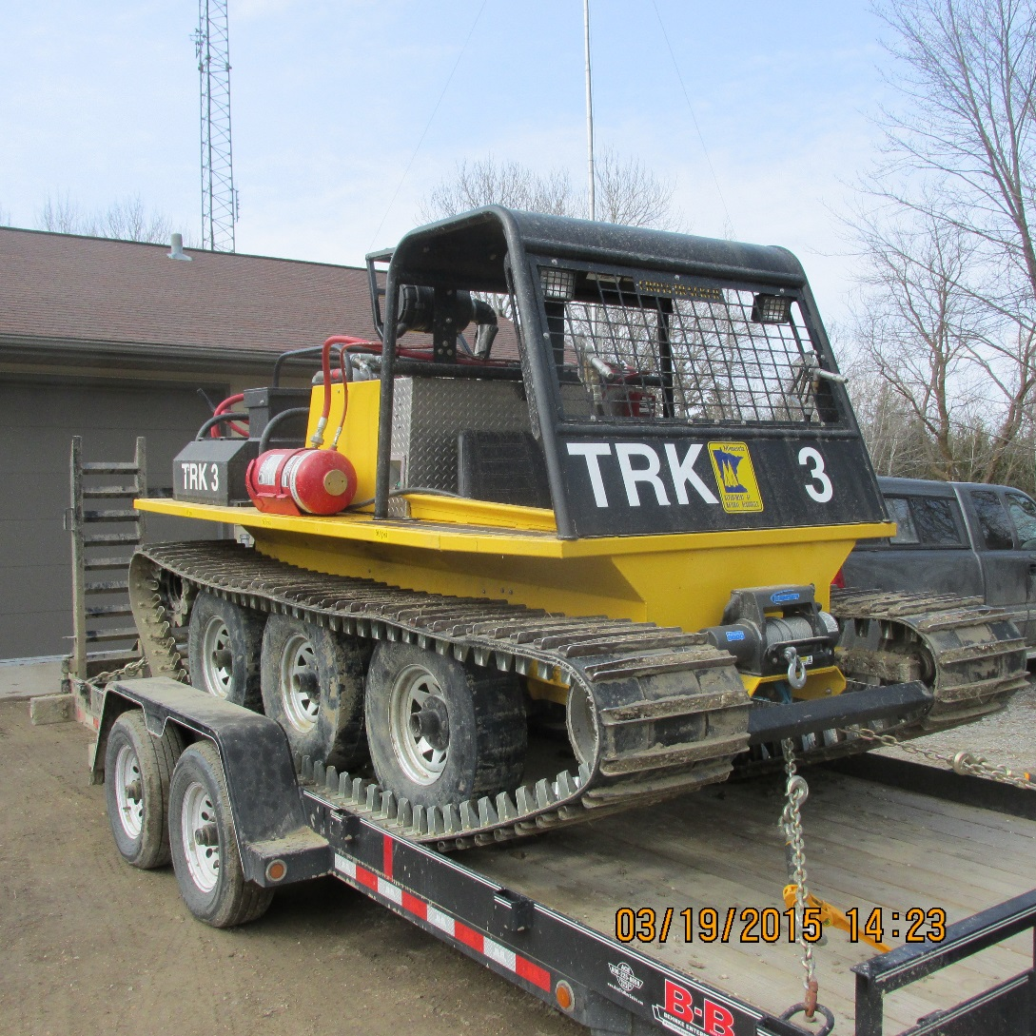

Cross Tracker
J-5
Notes:
Other tracked machines are Muskeg and Marshmasters.

Slide 51
Drop Area Clearances
CLEARING THE DROP AREA OF PERSONNEL
  FIXED WING OPERATION MINIMUMS:
    200’ laterally for personnel & equipment
    300’ in front of or behind canopied equipment 500’ in front of or behind unprotected personnel

Slide 52

CIRCUIT DISCIPLINE

Slide 53
FIVE CHARACTERISTICS OF A QUALITY CIRCUIT
Direct, efficient, shortest possible turnaround time
All aircraft following same flight pattern
Coordinated and controlled
Well communicated
Rhythmic

Slide 54


SINGLE CIRCUITS
Typical
Water pick-up into the wind.
Wind direction
Drop downwind.
Notes:
The typical circuit is approximately rectangular shaped. The water pick-up is made into the wind and the direction of the drop leg is usually downwind. This is the most widely used circuit because maneuvering time is reduced to a minimum which permits a high drop frequency rate. The typical circuit also permits good visibility for the air tanker crew on the approach to the target.
Whether a right hand circuit or a left hand circuit is flown depends on the wind direction and the position of the pick-up lake relative to the fire.

Slide 55


CIRCUIT TYPES
Single Circuits
Multiple Circuits
Notes:
Next, we look at the different types of circuits. Circuit types are grouped into two broad categories:
single circuits; and
multiple circuits.

Slide 56


SINGLE CIRCUITS
Figure Eight
Wind direction
Notes:
The figure eight circuit is used in situations where crosswind or into the wind drops are required on a fire that is relatively close to the water pick-up source.
For crosswind drops, the turn around time can be less than with the typical circuit.
When more than one tanker is in this circuit, situational awareness is extremely important. The Birddog Team and tanker crews must pay close attention to the position of the tankers in the circuit relative to the point of intersection of this circuit. Good visibility is essential for this circuit type to be used.

Slide 57



MULTIPLE CIRCUITS
Intersecting
Wind direction
Notes:
Intersecting circuits are commonly established when air tankers use the same pick-up lake to attack different target areas on the same fire, as shown on the slide, or when different pick-up lakes are being used to attack the same target area.
With intersecting circuits, the Birddog Team and tanker crews must pay close attention to the intersection of the circuits (relative to horizontal and vertical separation). (Point out red box on the slide.) Good visibility is essential.

Slide 58


MULTIPLE CIRCUITS
Parallel - Same Target
Wind direction
Notes:
Parallel circuits are two typical single circuits that are adjacent to each other with tankers in both circuits making water pick-ups into the wind and dropping downwind. Parallel circuits are most commonly established to allow air tankers of different performance characteristics to use separate water sources. (Click to reveal red box.) If the tankers are dropping on the same target, the circuits intersect at the start of the drop leg. Situational awareness is critical for a safe operation.

Slide 59


MULTIPLE CIRCUITS
Concentric
Wind direction
Notes:
Concentric circuits are two separate circuits of different size that do not intersect and one circuit surrounds the other. Generally, the circuits would be flown in the same direction.
Concentric circuits are used in situations where a high performance air tanker such as the CL-415 uses a separate water source and drops on a different target than a lower performance aircraft such as the Twin Otter. The higher performance air tanker operates on the smaller inside circuit while the lower performance aircraft uses the larger outside circuit.
As with parallel circuits, the separation point between the circuits must be clearly identified and easily understood. Good visibility is essential.

Slide 60
STAGGER OR GROUP FLIGHT
ATGS will determine staggered or group flight as appropriate for each fire
Staggered flight
  Short turnarounds
  Smaller scoop lakes
  Tactics may dictate
    Multiple targets
    Changing conditions

Slide 61

STAGGER OR GROUP FLIGHT
Group flight
  Adequate size scoop lake
  Working closely with ground suppression
  Approximate half mile separation recommended
  or approximately 15 seconds between drops
  Adequate spacing is required to evaluate drops and make adjustments for subsequent drops to maximize effectiveness
  MNDNR doesn’t support formation flight

Slide 62
CIRCUIT DISCIPLINE
EXPECTATIONS
Scooper pilots will “call up” from the lake on every scoop
Scooper pilots will contact the ATGS at a checkpoint if established on long turns
Freelancing will not be tolerated. All deviations from the established circuit flight pattern must be communicated/pre-approved

Slide 63
FACTORS AFFECTING CIRCUIT CHARACTERISTICS
Wind direction change
Change of scoop heading on same lake
Change to new lake
Fire behavior change resulting in possible tactics change and new target(s)
Pilot skill level
415 vs. FireBoss
Invasive Species

Slide 64
UAS (DRONE) INTRUSION
REPORTED UAS INTRUSION PROTOCOLS
Incident aircraft will immediately disengage
ATGS will coordinate disengagement
  Designate and assign aircraft to holding areas and flight altitudes or return to base or nearest airport
  Assess/manage tanker fuel situation
Remain disengaged until reported all clear
ATGS will coordinate re-engagement when safe

Slide 65

Debriefings
Will be done by the ATGS after every fire as soon as practical.
Expected to attend and encouraged to give candid observations.
Could be by phone if not based with ATGS.

Slide 66

SAFETY
Safety is a priority in the MNDNR Aviation Program.
Identifying potential safety issues is encouraged.
Reporting safety related and/or mechanical occurrences is supported and respected.
Our safety program is supportive and not punitive.
IF YOU SEE SOMETHING,
SAY SOMETHING!

