Slide 1
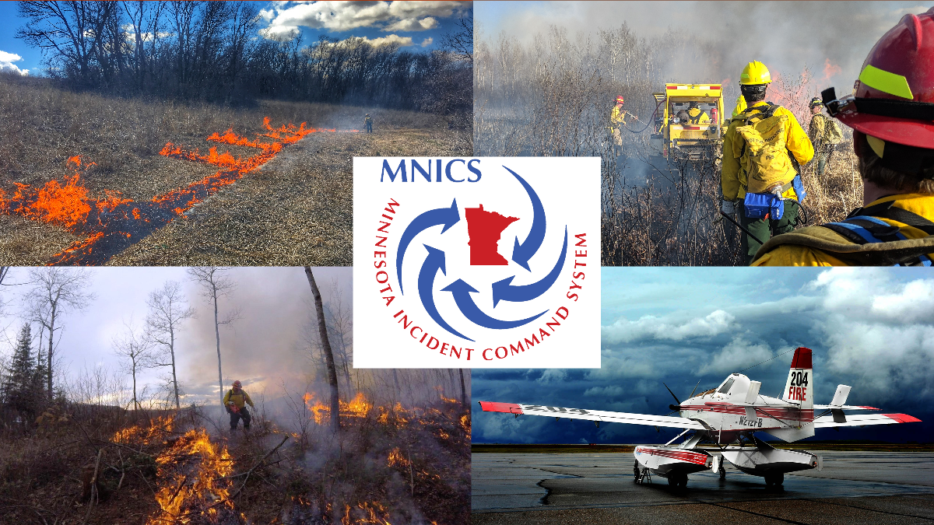
2020 MNICS PIO Workshop

Slide 2

Welcome
Leanne Langeberg – MNICS/MN DNR
Plan for the Day
PIO Bulletin Board
  https://www.nifc.gov/PIO_bb/pio_main.html
  PIO Incident Organizer - https://www.nifc.gov/PIO_bb/pio_incidents.html
The most important topic …Dinner Plans for Tonight

Slide 3







MNICS Task Force Updates
Chase Marshall – US Forest Service - Task Force Chair

Slide 4

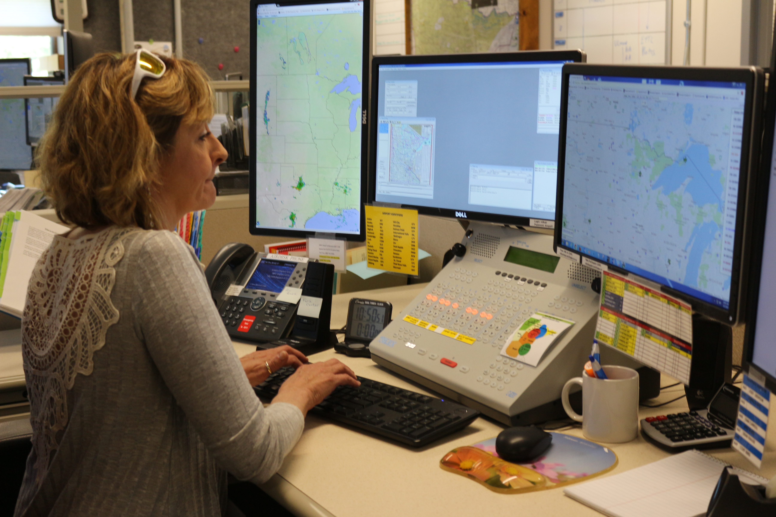

MNICS
Minnesota Coordination Center (MNCC) Updates
Tasha Woodwick – Assistant Center Manager – Logistics
  MNICS Type 3 Team Updates
  FireNet

Slide 5
Incident within and Incident
Lisa Radosevich-Craig – US Forest Service
  What is the Role of the PIO during an Incident Within an Incident?

Slide 6

InciWeb Update
Tim Engrav – US Forest Service
  What’s new with InciWeb the Incident Information System?
  Who are Minnesota’s InciWeb Super Users?
  Incident Assignments - obtaining admin access

Slide 7
Working for Success with Command and General Staff
  Liaison Officer – Tim Engrav, US Forest Service
  Safety Officer – Ben Roy, US Forest Service
  Plans – Paul Olson, MNIT/Minnesota DNR
  Operations – Tom Roach, US Forest Service
  Logistics – Jay Lauer, Minnesota DNR

Slide 8
Preparing for a Single Resource Assignment In/Out of State
  Facilitator – Tim Engrav, US Forest Service
    Small Group discussion
    Large Group discussion

Slide 9
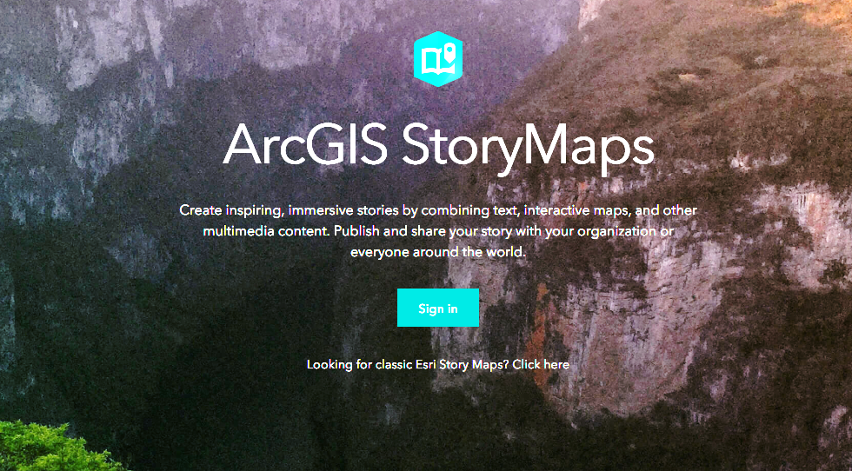
Public Information
Emerging Technologies
  Tim Engrav – US Forest Service
    ArcGIS Story Map and Collectors
    Other technologies

Slide 10
2018/2019 Fire Assignments
Lessons Learned
  Facilitator – Mary Nordeen – US Forest Service
    Large Group Round Robin

Slide 11
That’s A Wrap
  On-deck for Thursday
  Any Questions from the day?
  Dinner Plans…

