Slide 1
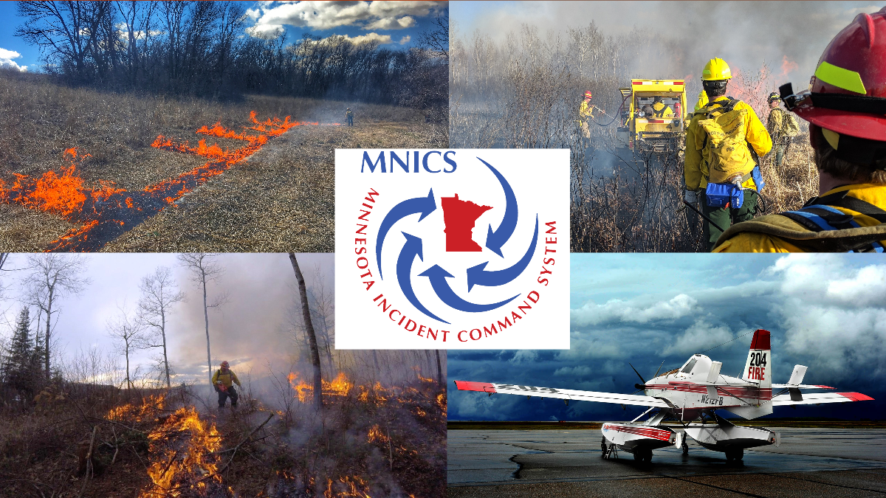
2020 MNICS PIO Workshop

Slide 2

Welcome
General Housekeeping
Plan for the days

Slide 3
2020 Fire Season Outlook
Travis Verdegan – Predictive Services, MN DNR

Slide 4
Incident Commander’s Perspective
Brian Pisarek, MN DNR – Type 2 IC Eastern Area Gold Team

Slide 5
Superior National Forest Update
Lily Palmer – US Forest Service

Slide 6
Best Practices for Community Meetings & Media Relations
Facilitated by Leanne Langeberg, MINCS/ MN DNR
  Small Group discussion

Slide 7
MN Interagency Fire Center and MN DNR Updates
Leanne Langeberg, MINCS/ MN DNR

Slide 8
MNICS Information Management Working Team Updates
  Leanne Langeberg, MNICS/MN DNR – Working Team Chair
  MNICS Working Team
    DNR – Leanne Langeberg – Chair
    USFS – Tim Engrav

Slide 9
Chippewa National Forest Updates
  Michael Stearly – US Forest Service

Slide 10
MIFC Tour
  Facilitator – Leanne Langeberg – MNICS/MN DNR

Slide 11
That’s A Wrap
  Any questions from the day?
  Adjourn

