Slide 1
Aviation Communications
RT-130 2024
Safety
Effectiveness
Coordination

Slide 2
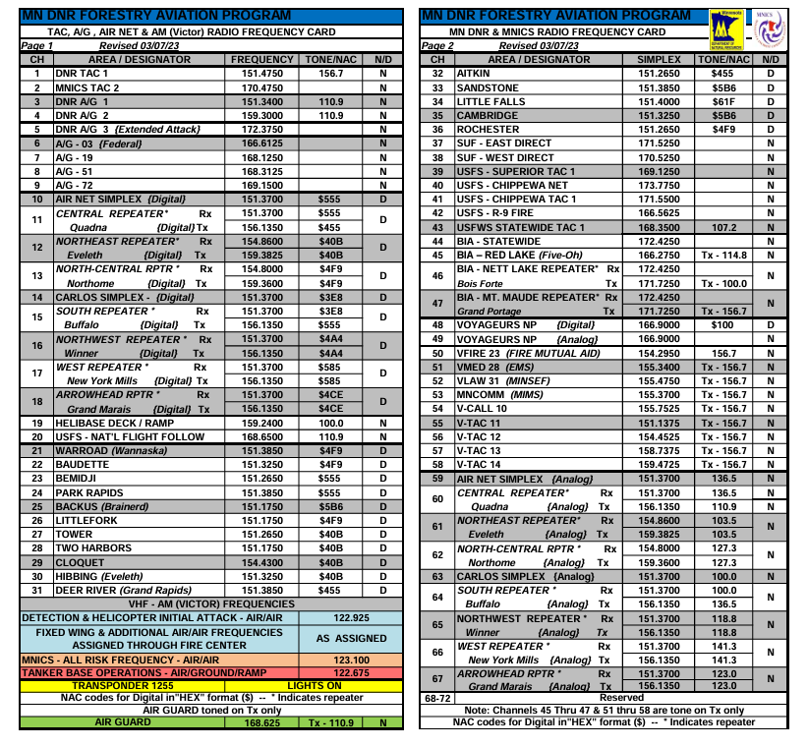
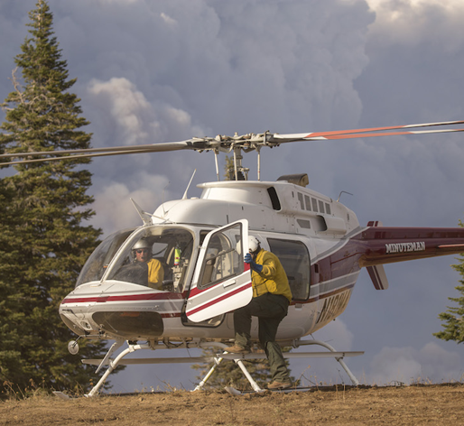
Radios & Capabilities
Ground
Aircraft
Frequencies
VHF-FM
A/G
Scan & Prioritize
1 – 3 FM Radios
2-3 AM Radios (aircraft to aircraft)
DO NOT Scan!
A/G
Command
Air Guard
Notes:
Prior to ordering aircraft, it is important to have a basic understanding of communication requirements, protocols and expectations. Communication is the same regardless of the aircraft, helicopter or fixed wing, or ATGS you are communicating with.
Majority of these radio requirements and frequency assignments are assigned prior to a fire and are set by jurisdictional boundaries and/or protocols of your agency.
Frequencies and assignments will be confirmed by dispatch when aircraft are ordered

Slide 3
Radios & Capabilities Ground Resources
VHF-FM radio required!
Scan and prioritize aviation traffic
3
Notes:
- The VHF-FM radio (BK your handheld or mobile) is the primary radio for aircraft to contact ground resources on the air to ground frequency and/or command frequency (area repeater).
- Ensure your radio has the air to ground (A/G) frequency on your scan list and it is made a priority channel. If you hear an aircraft hailing, answer! Or prompt the person they are calling to answer. ICs are busy, if aircraft are ordered consider designating a contact for aviation resources.
- All personnel working on the fire with aviation assets should be monitoring the A/G frequency to ensure they are clear of the line during water or retardant drops – this is a major safety issue that results in near misses &/or injuries or fatalities every season.

Slide 4
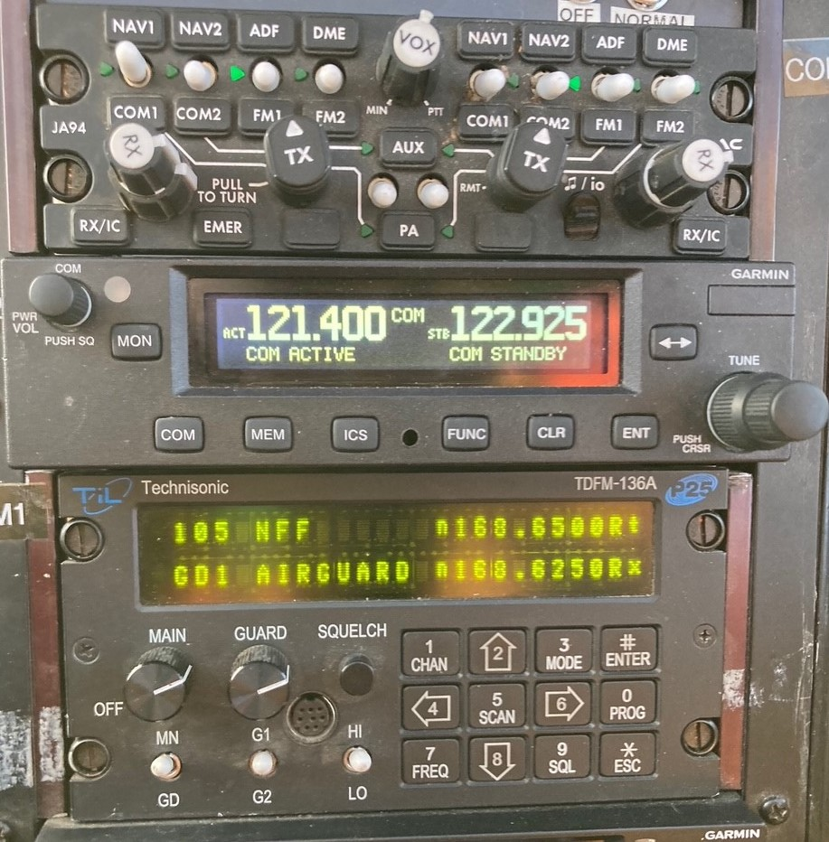
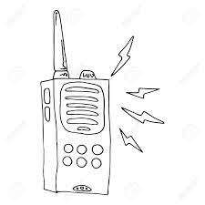
Radios & Capabilities Aviation Resources
Air Guard
Aircraft radios do NOT scan
4
Notes:
-There are multiple radios in each aircraft however, aircraft radios are not capable of scanning like your handheld or mobile radio.
-So, what does that mean? Each radio can only hear the transmissions on 1 channel at a time, with one exception we will cover in a bit. Although aircraft may have 1-3 VHF-FM radios, they need to flight follow with dispatch, communicate on A/G & possibly talk on command; in addition to listening to 1-3 other air-to-air frequencies..
-Aviation communication priorities are:
1) air-to-air (Victor or VHF-AM radio which is for aircraft-to-aircraft communications)
2) Air to ground communications
3) Dispatch.
Be patient if you do not get a response from an aircraft immediately.
- Aviation resources are prioritizing communications & maintaining the safety of the aircraft (ie: flying the plane). Pilots, ATGSs & HMGBs may have to frequently switch between channels to complete needed communications
If unable to contact an aircraft on A/G or the command frequency you may utilize the Air Guard freq. – this freq. will override other FM communications in the aircraft.
Instructor note: Air Guard is a fire only frequency, it is not utilized in any other operations outside of fire
*Instructor note: This is a picture of a partial aircraft radio set up – top part of the picture is the channel selectors & volumes (mixer panel) for all radios. The middle part of the picture is the VHF-AM or Victor radio for air-to-air communications, beneath that is 1 of the VHF-FM radios. You can see in the top display that the radio is set to the National Flight Following frequency & has the Air Guard frequency below it. If a transmission is made to the aircraft on Air Guard, it will override any transmissions the aircraft is receiving on National Flight Follow.

Slide 5
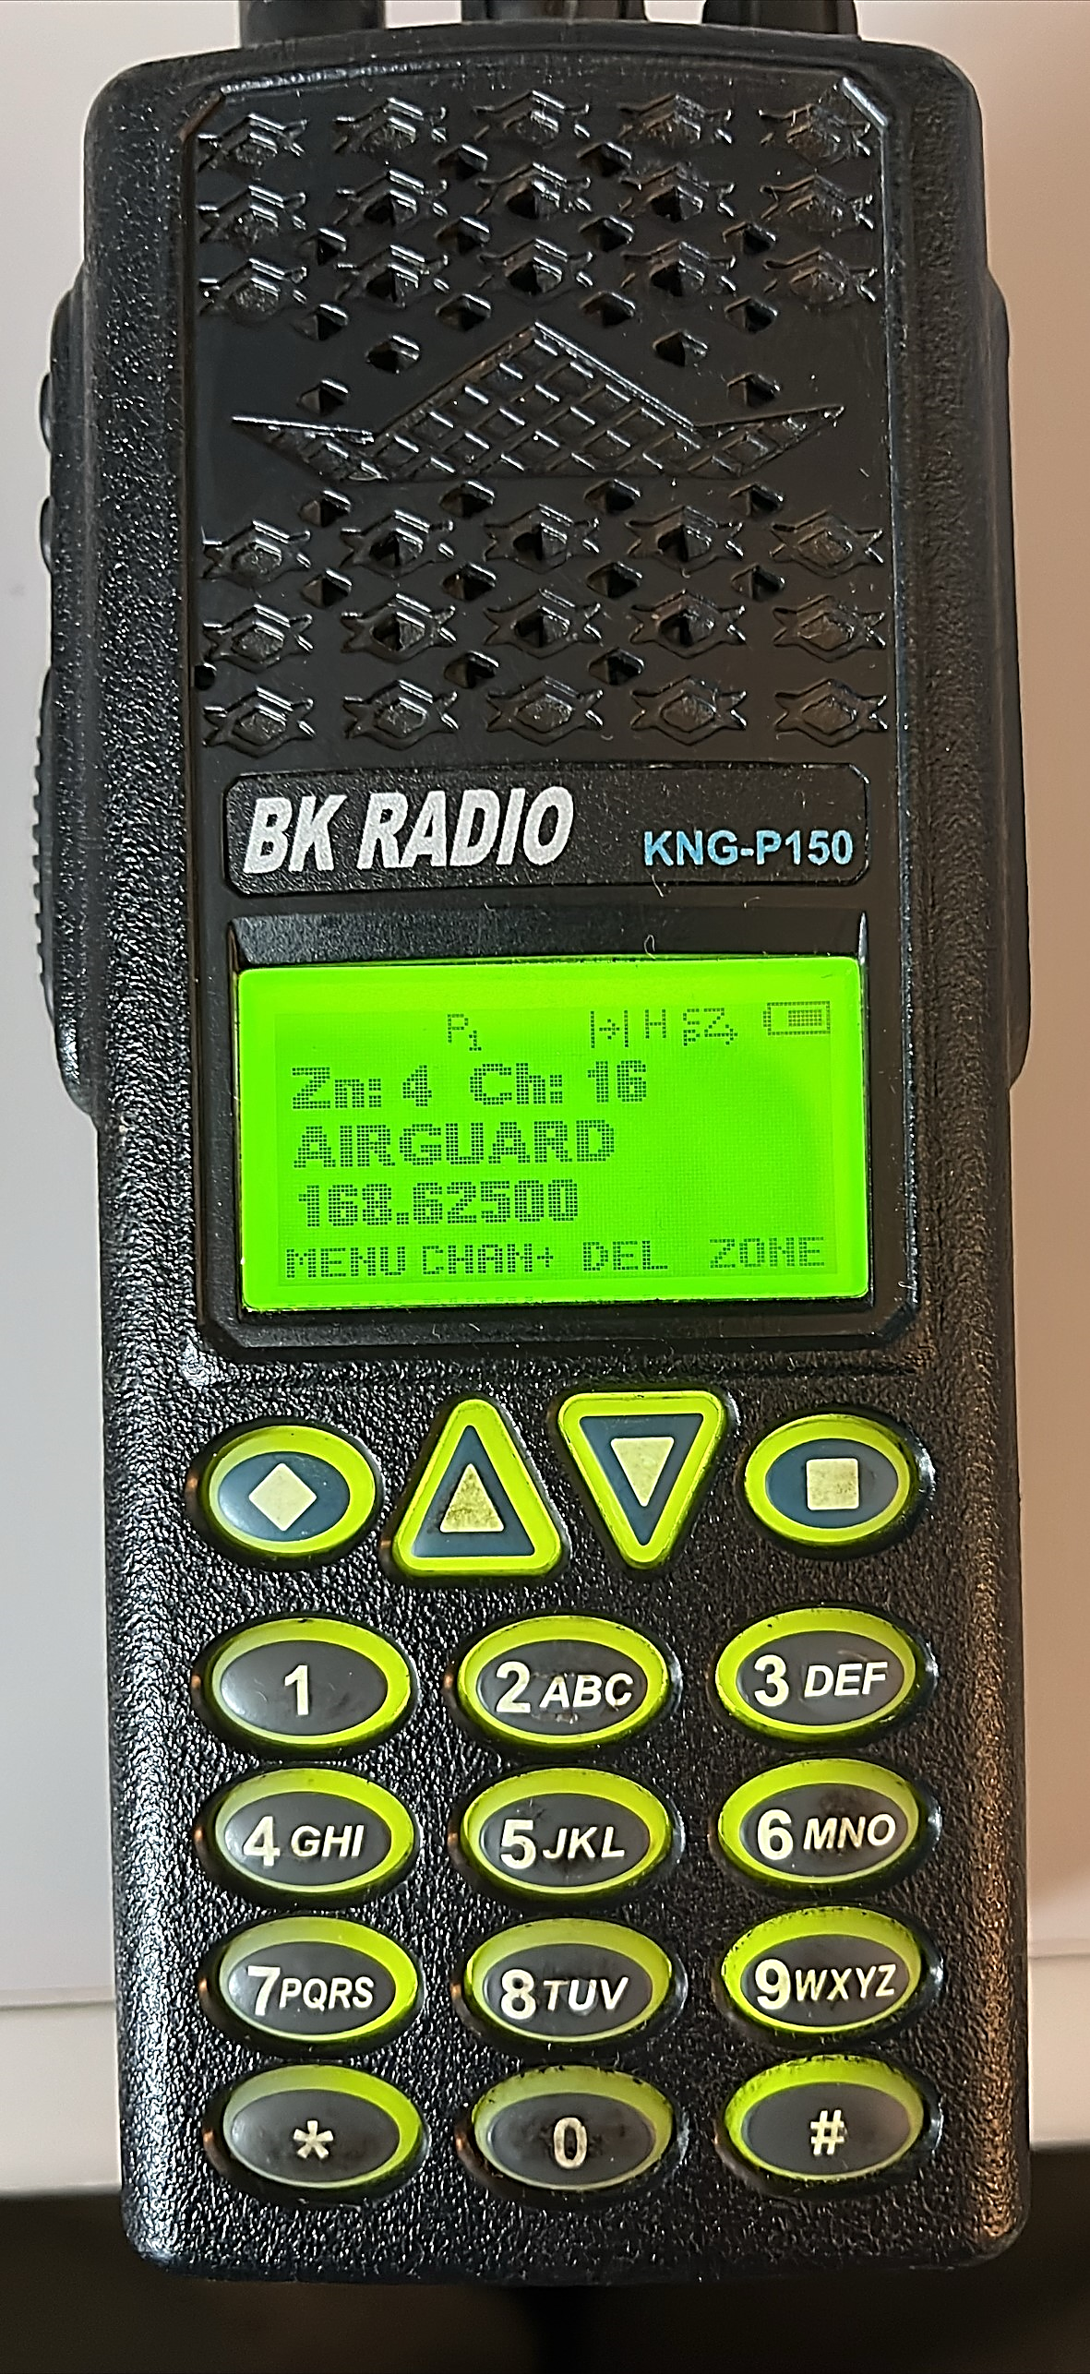
Radios & Capabilities Frequencies
?
Troubleshooting
Air Guard
Notes:
-A/G is the primary contact frequency, and most agencies have a primary & secondary A/G frequency for if the primary A/G frequency becomes too busy or there is bleed over from another fire. Ensure you know both your primary & secondary A/G freq.
Student Question: If you are unable to contact an aircraft on the A/G or command channel what can you do?
1. Ensure you are on the correct frequency & have the correct tones;
2. Contact dispatch to confirm frequencies
3. If you are on the correct frequencies, you’ve tried the A/Gs & the command channel, have tried hailing multiple times & are still unable to make contact hail the aircraft on the Air Guard frequency.
Student Question: What is the Air Guard frequency and when should it be used?
The Air Guard frequency is a national frequency & must not be used for any function other than its intended uses which include: air-to-air emergency contact and coordination, ground-to-air emergency contact, and initial call aircraft when no other contact frequency is available/working.
Hail the aircraft on Air Guard to confirm another frequency & then switch over, use it but don’t abuse it!
Student Question: If you need to use it, do you know where it is located in your radio?
-Most commonly on the last channel in your radio, but not always the case. Review your radio programming so you know where it is prior to ever having to use it.

Slide 6
ABC’s of Communication
Accurate
Brief
Clear
Notes:
Provide Accurate information utilizing basic fire anatomy & terminology. Accurate includes feedback – if they missed the target, for example the drop was too early, too late or drifted into the black, provide that honest feedback, don’t say “good drop, I’ll take another” – example: “1AW you started your drop 100’ too early & the wind carried it into the black; same target next drop, move over 50’ to the left & start the drop earlier”
Brief- Do your best to be brief and to the point (remember it’s push to talk, not push to think..) Take a second to gather & organize your thoughts prior to starting communications. Example: “1AW I want a trail drop on the left shoulder in front of the dozer.”
Clear – Do not use code/CB or slang, communications should be in plain language & utilize ICS terminology & fire anatomy. Ensure transmissions are clear by shielding the radio from wind, background noise such as heavy equipment, etc.

Slide 7
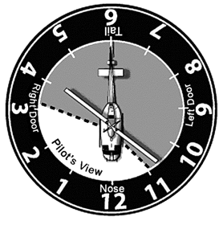
Communication Basics
Parts of the fire
Visible landmarks
Clock direction
High, low, even when in terrain
Signaling devices – mirror, panel, strobe
*IRPG – pages 74-75
Notes:
-Avoid using cardinal directions when possible, use fire anatomy (ie: left flank, heel, head, shoulder, etc.)
-Visible landmarks are useful – roads, rivers, structures, etc.
-When providing clock directions, provide direction from the pilot’s perspective.
- High, low, even – High you are above the aircraft (for example you are up on a ridge line and the helicopter is downslope), low - you are located below (helicopter is at the top of the ridge and you are at the bottom of the slope), even means you are at the same altitude; These directions are very helpful when working in terrain, especially when combined with clock directions.
- Use a signaling device to assist the pilot or ATGS in identifying your location. When using signaling devices to call in helicopter drops remember to CLEAR THE LINE once a pilot confirms they have your location.

Slide 8
The “Do’s & Do NOT’s”
Do:
Prioritize A/G traffic
Assign a contact for aviation assets
Scan the correct frequencies
Provide honest feedback
Report hazards
Do NOT:
Use A/G for non-aviation traffic or tie up a frequency
Contact helicopters while in the dip*
Contact aircraft on the drop*
During landing/takeoff*
*Unless an emergency
Notes:
Do’s:
-A/G communication is essential for safety and effectiveness, ATGS will not have an aircraft drop without confirming the line is clear of personnel – prioritize A/G traffic for the safety of your ground personnel and for the effective utilization of aircraft.
-If you are unable to prioritize or maintain good communications with aerial resources assign that duty to someone
- Feedback is important, if the pilot is off target or you need a drop in a different location let them know! (ie: Air Attack 5, that last seat drop was a 100 yards late and drifted into the black)
- Never assume aircraft can see a hazard –snags, wires, towers and fence lines can disappear depending upon the angle of the sun & back drop
Do Not’s:
- A/G frequencies are just that, for air to ground traffic. They are not approved for any other use. Follow the “ABCs” of communication when transmitting.
These are critical stages of flight, the pilots should be concentrated on flying the aircraft safely vs. communicating while in the dip, on the drop or landing/taking off.
The aircraft could be hearing you but waiting for a safer time to respond

Slide 9
UAS
Notify dispatch
NO fly zone
Dispatch to call the Air Desk
Notes:
There are more people & agencies with drones than ever before – hot shot crews, VFDs, news networks, law enforcement, etc.
As an IC it is okay to utilize a UAS on your fire, but the MNCC Air desk needs to know when a UAS is flying whether even if you do not currently have aircraft on your fire.
Prior to an aircraft arriving on an initial attack fire all UAS assets MUST be grounded!
UAS sightings on a fire with aircraft must be reported to all aircraft immediately! - location, altitude & heading if possible
Aircraft will disengage from the fire until the UAS is identified and grounded or no one has seen the UAS for some time – it is then up to each aircraft to decide if they will re-engage.

Slide 10
Initial Contact
Establishing radio contact
Informing IC of ETA
Confirm A/G freq.
Big picture – hazards, objectives
“Creek IC, helicopter 1AW on Lookout Repeater”
Notes:
Regardless of the aircraft (ATGS, helicopter, etc.) you will be contacted prior to the aircraft arriving on scene. This will often be on your command channel
- This contact is to establish radio communication, confirm the A/G freq., contact & provide big picture objectives
- Do you want a size up when the aircraft arrives? Do you have aircraft objectives & tactics identified? If not ensure you take a moment to consider those prior to the aircraft arriving on scene.
- Confirm the A/G freq. with the aircraft & provide a ground contact for when they are on scene
-This is also the time to inform aircraft of on scene hazards – wires, towers, other aircraft, etc.

Slide 11
Student Scenario
Creek Fire
Notes:
Student scenario setup – pick a student (a newer IC5 preferably), have them review the fire image & then the picture of the fire scene on the next slide. Ask the student to develop the initial communication they would deliver to a single helicopter that contacts them enroute to the incident.
- Students can use their home frequencies, or the instructor can provide frequency names for an A/G and command channel (ie: A/G 19 and Lookout Repeater)
- Helicopter’s call sign is 1AW & they contact the Creek Fire IC 5 miles out from the incident on the command channel (instructor will make “radio” call out as 1AW on next slide and have student respond
*The intent is NOT to get into tactics or aircraft ordering! Focus should be on the communication to the inbound aircraft & getting that person comfortable to communicate with an aircraft and relay necessary information.
- Remind the students of the ABCs

Slide 12
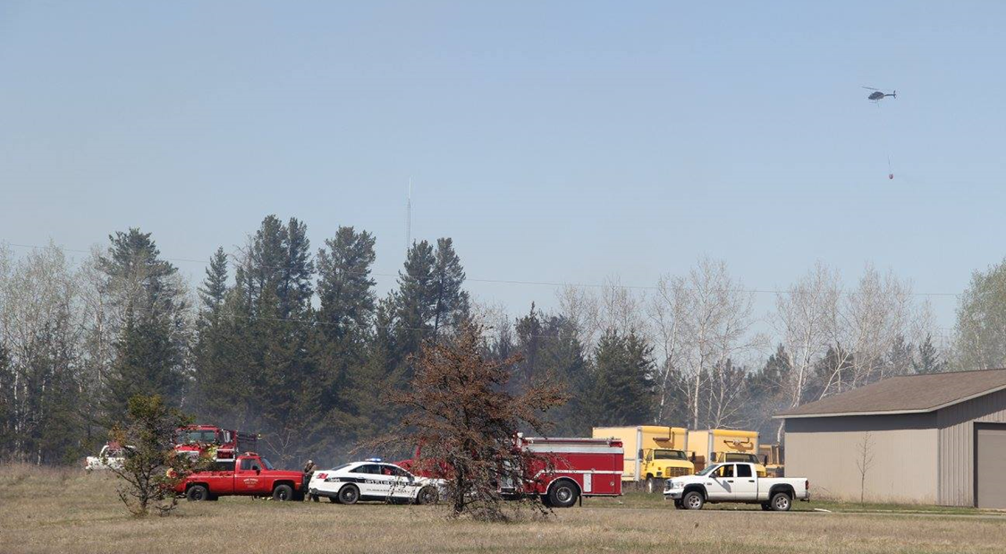
Communicating with Aircraft
Verify ground contact
Name, location & frequency
Communicate “the plan”
Objectives and tactics
Confirm on scene hazards
Wires, towers, fences, hazmat, etc.
Other aircraft – detection, etc.
Notes:
Instructor note: Give the student a moment to view the picture to identify hazards & then start the scenario, DO NOT bring up the communication information until after the scenario. It may be hard to see but hazards in the picture include a tower, power lines, and helicopter 8BH who is already on scene. If asked by the student the location of the hazards the tower is on the left flank, power lines on the right flank and 8BH is working from the heel of the fire up the left flank
Student scenario continuation –.
Instructor: “Creek IC, helicopter 1AW on Look Out”
Student: “Go ahead 1AW, Creek IC”
Instructor: “1AW is 5 miles out from your fire”
Student: Should provide initial communication information – objectives/tactics, confirm freq. & ground contact, & discuss hazards from the picture (power lines, tower and another helicopter 8BH on scene)
Bring the communication information up on the screen, ask the student to evaluate their transmission –
-Did they adhere to the ABCs and/or the aircraft communication basics?
- What information did they miss or add?
-Emphasis that this communication applies to all aviation operations and aircraft (helicopter, ATGS, detection, etc) and suppression &/or Rx

Slide 13
Wrap-Up
Scan & prioritize A/G
Assign a contact if necessary
Stick to fire terminology & anatomy
Air Guard freq.
See something, say something!
Questions?

