Slide 1
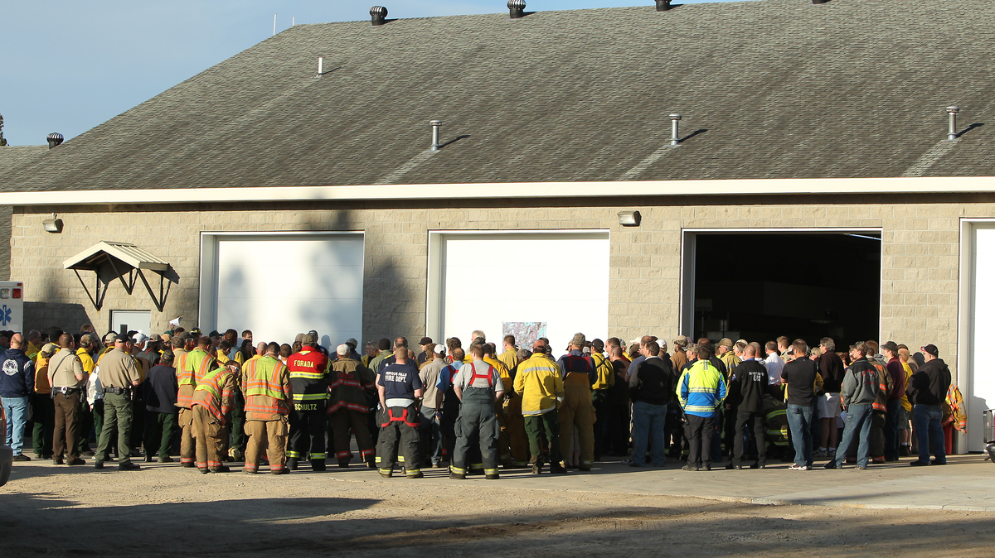
What is a MINCS Type 3 Team?

Slide 2
Objectives
Describe what a MINCS Type 3 Team?
Identify the purpose of a MINCS Type 3 Team?
Identify the positions within a MINCS Type 3 Team?
Identify the shortage positions with in the MINCS Type 3 Teams?
Identify what training is needed to get into a position on a MINCS Type 3 Team?
Identify steps needed to get involved?
Notes:
.

Slide 3
What is a MINCS Type 3 Teams?
Made up of all MINCS agencies through out the state of Minnesota.
MN DNR
US Fish and Wildlife Service (USFWS).
National Park Service (NPS).
Bureau of Indian Affairs (BIA).
US Forest Service (USFS).
Homeland Security and Emergency Management (HSEM).

Slide 4
What is a MINCS Type 3 Team?
Assume command of incidents that are above the local area’s capabilities to manage.
Team can be ordered and in place within 24 hours.
Team comes with all the positions needed for the specific incident.
Team Rosters are determined by the Agency Administrator (AA) and the Incident Commander (IC) according to incident needs.

Slide 5
What is a MINCS Type 3 Team?
Teams are rostered and available for instate response from April 1st thru June 15th and September 1st thru October 31st. Team availability can be altered for conditions.
Currently have three rostered teams on rotation within the state.
Placed on a national rotation to help outstate partners when needed.
Go to the MINCS website for more information. https://mnics.org/wpress/left-sidebar-menu/logistics-dispatch/overhead-teams/
Notes:
2024 had 2 instate call out and 1 outstate call out, 2023 had 1 outstate call out. 2021 was the last busy year for the type 3 teams in state, 14 instate call outs.

Slide 6
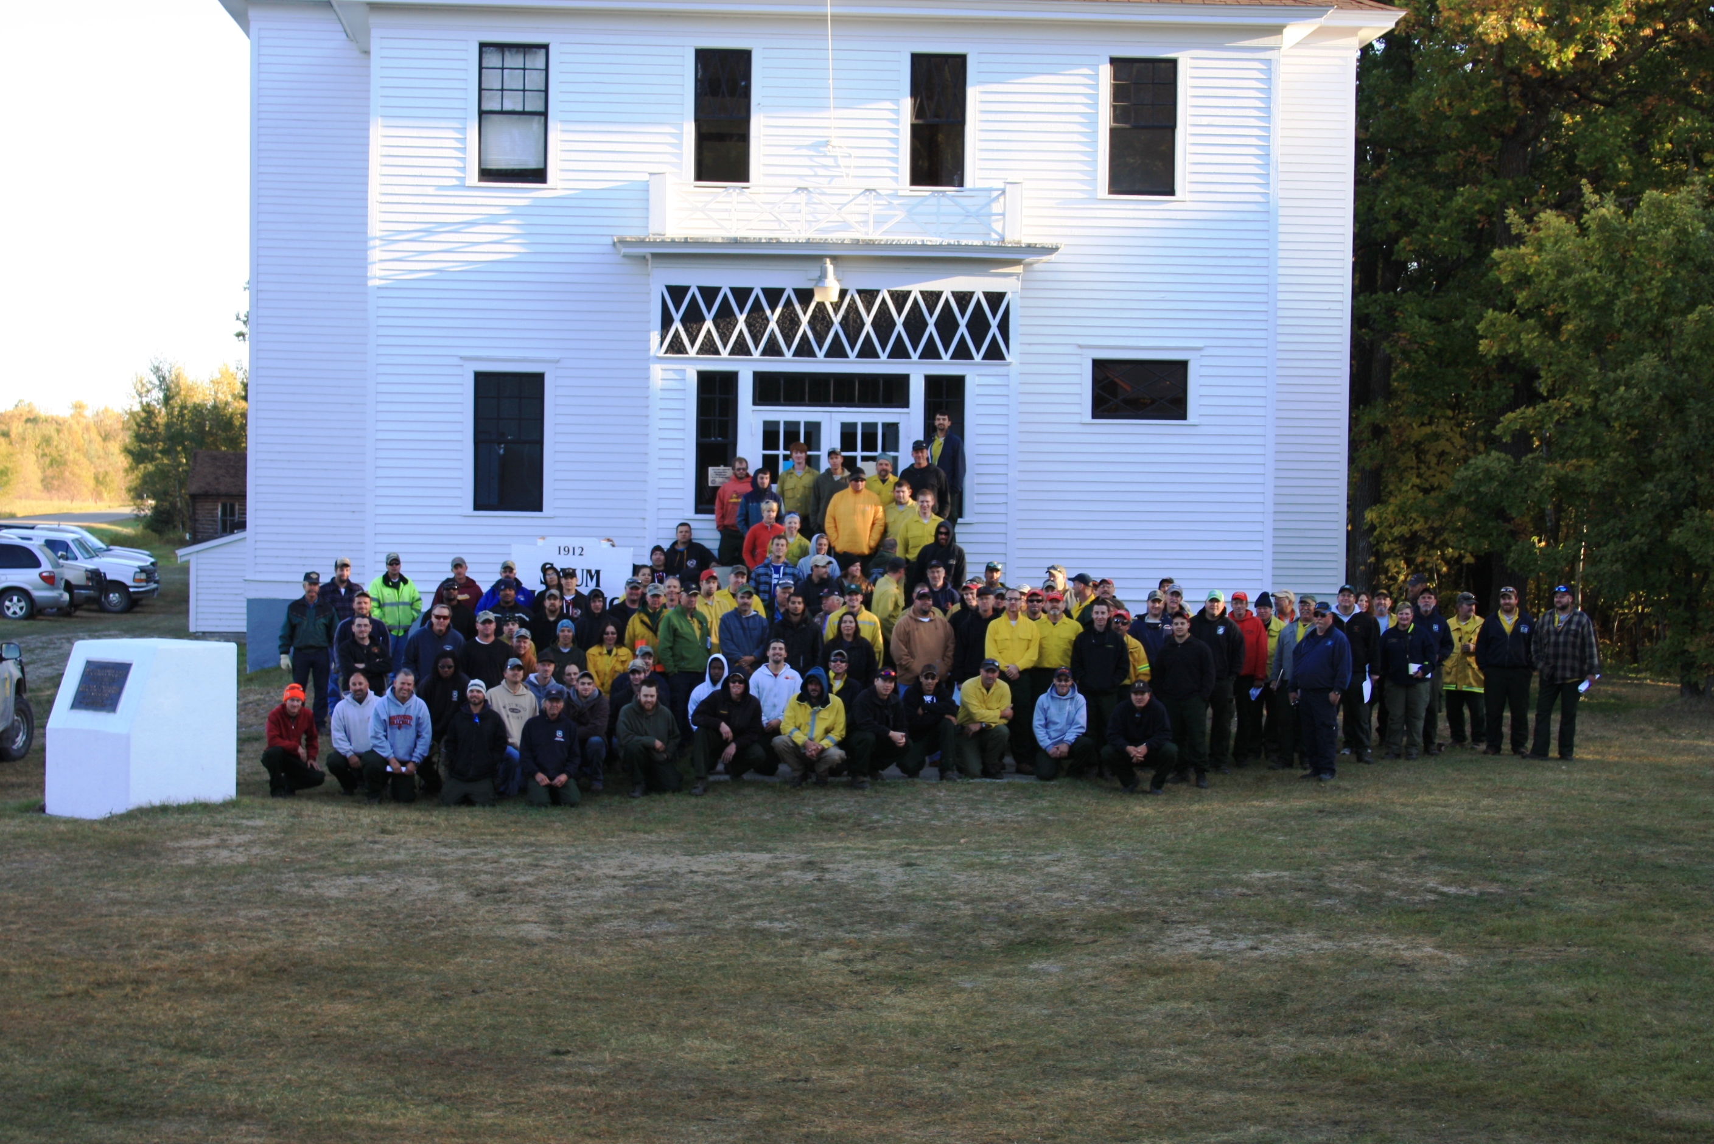
Type 3 Team Coming together in Shotley, MN

Slide 7
What is the Purpose of a MINCS Type 3 Team?
To provide MNICS agencies with a Type 3 Incident management team for the duration of a Type 3 Incident.
Flood
Wildfire
Search and Rescue/Recovery
Tornado
Public Event
Take the burden of a larger scale incident off the local area to free up area resources.
Utilize trainees to enhance the workforce when possible.
Notes:
Staff filling the team roster are able to work one level above their qualification.

Slide 8
What are the positions with in a MINCS Type 3 Team?
Notes:
Not all positions will be filled, it is going to be up to the Incident Commander and the Agency Administrator to determine the needs of the incident. Ask the crowd who is on a current or past team whether type 3 or even CIMT and get their input in some of these positions. They may be able to speak to more detail on each Job Position.

Slide 9
Incident Commander (IC)
Manages all aspects of the Incident.
Develop the Incident Objectives in accordance with the Agency Administrator (AA).
Reports Directly to the Agency Administrator (AA).
Ensures the team is right sized to meet incident needs.
Ensures protection of natural and cultural values designated by the Local Authority.

Slide 10
Public Information Officer (PIO)
Develop Public Information Strategy.
Coordinate transportation and activities for the media.
Coordinate public information news releases.
Maintains contact with appropriate stakeholders.

Slide 11
Safety Officer (SOFR).
Ensure all aspects of the incident are done safely.
Coordinate with all team units that Incident within an Incident (IWI) protocols are in place.
Identify hazardous and potentially unsafe situations on the incident.
Prepare safety message for Incident Attack Plan (IAP).
Exercises authority to stop and prevent unsafe acts.

Slide 12
Liaison Officer (LOFR)
Lead contact for cooperating agencies.
Maintains cooperator and stakeholder contact lists.
Assess the need for cooperator and stakeholder meetings.
Communicates incident objectives and concerns with cooperators and stakeholders.
Coordinates with local unit to preform effective cooperator relations.

Slide 13
What are the positions with in a MINCS Type 3 Team?
Operations
The ones that put the plan into play!
Notes:
Have some of the operation staff fill in the blanks if there are any.

Slide 14
Operation Section Chief (OPS 3).
Identify Divisional Boundaries.
Ensure host agency direction and policies are applied and followed.
Work with Agency Administrator (AA) and resource advisors to protect natural, cultural, and social resources.
Establish and maintain proper span of control.

Slide 15
Division Supervisor (DIVS)
Provide oversite to all assigned resources within his or her division.
Sign shift tickets and Crew Time Reports (CTR) for assigned fire staff on his or her division.
Conduct fireline briefings
Monitor suppression efforts for proper span on control.

Slide 16
Task Force Leader (TFLD).
Direct personnel, crews, and equipment performing tactical missions.
Identify tactical capabilities and limitations.
Identify and plan for logistical needs associated with mixed resources.

Slide 17
What are the positions with in a MINCS Type 3 Team?
Plans
The Folks that keep the plan moving!
Notes:
Make a comment for the group that this section is a shortage area within the teams.

Slide 18
Planning Section Chief (PSC).
Ensures emergency plan is complete.
Ensures incoming resources meet agency standards.
Tracks resources ordered and resources assigned.
Prepares transition documents and conducts closeout meetings.

Slide 19
Resource Unit Leader (RESL).
Establish all incident check-in activities.
Prepares and processes resource status information.
Maintains master list for resources assigned to the incident and their assignment on the incident.
Supervises status check in staff were applicable.

Slide 20
Situation Leader (SITL).
Oversees map production for fire behavior, weather, and incident status.
Supervisor Fire Behavior Analyst (FBAN), Field Observers (FOBS), and GIS Staff were applicable (GISS).
Completes and submits Incident Status Summary (ICS 209).
Presents infrared data to operations section.

Slide 21
What are the positions with in a MINCS Type 3 Team?
Finance
The folks that make sure we get paid!
Notes:
Make the comment to the group that this section is a shortage on the teams.

Slide 22
Finance Section Chief (FSC).
Maintain daily contact with Agency Administrator (AA) on financial matters.
Provide Incident Commander (IC) with daily cost Analysis.
Responsible for all financial, administrative and cost aspects of the incident.
Reports directly to the Incident Commander (IC).

Slide 23
Time Unit Leader (TIME).
Ensures personnel time is recorded to agency policy.
Supervises personnel time recorder.
Ensures auditing processes are established.
Ensures payment packages are complete and sent to the appropriate administrative agencies.

Slide 24
Cost Unit Leader (COST).
Collects all cost data for the incident.
Assists with cost sharing documents.
Perform cost effectiveness analyses.
Provide cost estimates and cost saving recommendations.

Slide 25
What are the positions with in a MINCS Type 3 Team?
Logistics
The folks that get you the stuff to get the job done!
Notes:
Make the comment to the group that this section is a shortage area within the teams.

Slide 26
Logistics Section Chief (LOGS)
Order supplies, personnel and equipment to support the incident needs.
Ensure food and drinking water are priorities.
Processes orders for supply and personnel.
Track accountable property.

Slide 27
Facilities Unit Leader (FACL)
Organizes and supervises the facilities unit.
Establishes ICP, Spike camps, incident facilities, and incident base facilities.
Supervises the base camp manager and camp crew were applicable.

Slide 28
Ground Support Leader (GSUL)
Supervise the Ground Support Unit, Equipment managers and Mechanics.
Inspect equipment coming onto and leaving an incident.
Develop the traffic plan, sign roads into and out of the incident.

Slide 29
Receiving and distribution manager (RCDM).
Works for the supply unit leader.
Maintains inventory of supplies and equipment.
Organizes physical layout of a secure and safe receiving and distribution area.
Establishes procedures for receiving supplies and equipment.

Slide 30
Medical Unit Leader (MEDL).
Plans for medical emergencies.
Determines Ambulance availability.
Ensures proper procedures for medical transport are in place.
Ensures medical care is in place of the incident needs.

Slide 31
Ordering Manager (ORDM)
Place resource orders through established and proper ordering channels.
Establish filing system to track resource orders.
Reconcile resource orders.
Keep Receiving and Distribution Manager (RCDM) informed of orders being placed.

Slide 32
Communication Unit Leader (COML)
Supervises Radio operators and incident communication technicians.
Order communication equipment from cache.
Prepare communication plan (ICS 205) for the Incident action plan (IAP).
Design radio system to meet incident needs.

Slide 33
Radio Operator (RADO)
Incident Dispatcher
Answer radio traffic for the incident
Respond to appropriate communications to emergency situations
Processing communication related documentation, Radio Dispatch Log, General Messages

Slide 34
What are some of the shortage positions with in the MINCS Type 3 Teams and what training do I need to complete to get into the position?
Almost all the positions within the Type 3 teams are at a shortage both statewide and nationally.
Logistics, Plans and Finance have the most shortages.
For training needs to get into these positions it varies.
Job Aids are available on the NWCG website. https://www.nwcg.gov/training/job-aids
Classroom courses to qualify staff to become a trainee in the position.
Some take a very large amount of training to get into the Job Function.
Notes:
Stress the need for staff to get involved with the MINCS teams as all positions are in a shortage of some kind.

Slide 35
What are some of the shortage positions with in the MINCS Type 3 Teams and what training do I need to complete to get into the position?
Look at the PMS 308 wildfire position flow chart for information that will help guide you through the process and what qualifies you for each position.
Talk with your fire team leader, FMO, or team members to find out the proper pathways to go to get involved with the MINCS Teams.

Slide 36
How do I get involved with the MINCS Type 3 team?
Talk to your local Fire Team Leader.
Identify a position that interests you.
With Supervisors approval submit a application to MINCS during the application period, usually September through the end of October.

